Slide 1
IBM University Engagement Project Submission
“Exploring the Power of Agentic AI with IBM Granite and LangFlow”

Slide 2

Project Tile – [ Research Agent ]
Domain of Project – [ Academic / Scientific Research (Agentic AI)]
Student Name | Recent Passport Photo | Email ID | Mobile number [WhatsApp]
Siddharth Patwal |  | sidpatwal26@gmail.com | 9389127290

Slide 3
Problem Statement -
Problem Statement : Research Agent
The Challenge
Researchers are overwhelmed by the volume of scientific literature published daily
Hours are spent manually searching ArXiv and reading lengthy abstracts
Organizing references across multiple tools is fragmented and error-prone
Formatting citations correctly (APA, MLA, BibTeX) is tedious and time-consuming
No single unified tool handles the full research workflow intelligently
.
The Objective
Build GraniteAgent — an autonomous AI-powered research assistant
Search and retrieve relevant academic papers from ArXiv in real-time
Generate instant AI-powered summaries using IBM Granite-3-8B-Instruct
Save and organize references with auto-formatted citations (APA, MLA, BibTeX)
Generate novel hypotheses based on observations and research gaps
Draft complete research paper sections (Introduction, Literature Review, Methodology) via IBM watsonx.ai

Slide 4
Technology Used
Tech Stack
I used:
IBM Watsonx AI,
IBM Granite-3-8B-Instruct (LLM),
React.js + Vite (Frontend),
Node.js + Express.js (Backend),
ArXiv Academic API (Live Paper Search),
IAM Token-based Authentication,
LocalStorage (Browser Persistence)

Slide 5
Proposed Solution -
Proposed Solution: Research Agent
GraniteAgent is an end-to-end autonomous research assistant built with React + Vite (frontend), Node.js + Express (backend), and Watsonx to streamline the entire academic research workflow in one unified platform.
.
Literature Search Engine: Queries ArXiv API in real-time to retrieve relevant papers by keyword, parsing live XML responses.
Reference Library Manager: Save papers into collections; auto-generate citations in APA, MLA, Chicago, and BibTeX.
Hypothesis Lab: Input domain, observations & gaps — IBM Granite returns a structured hypothesis.
Report Workspace: Select saved references — IBM Granite drafts Introduction, Literature Review, or Methodology.
Smart Summarization: Instant AI-generated summaries of any retrieved paper powered by IBM Granite-3-8B-Instruct model.
Credential Manager: Store IBM Cloud API Key & Project ID in-browser for secure live Granite authentication.

Slide 6
Langflow component Used -
1) USER INPUT– Researcher types query/topic via React + Vite Chat Interface
2) EXPRESS.JS BACKEND--REST endpoints: /api/search /api/llm/generate → Orchestrates all services
3) IBM WATSONX AI + GRANITE--meta-llama/llama-3-3-70b via Watsonx Runtime (us-south) — Generates intelligent research answers (summarize / hypothesize / draft)
4) AGENTIC PIPELINE--Prompt Template Node → IBM Granite LLM Node → Output Parser Node (Summarize / Hypothesize / Draft Paper Sections)
5) DATA SOURCES -- ArXiv Academic API (live XML papers) | IBM IAM Token Auth (IBM Cloud) | LocalStorage (references)

Slide 7
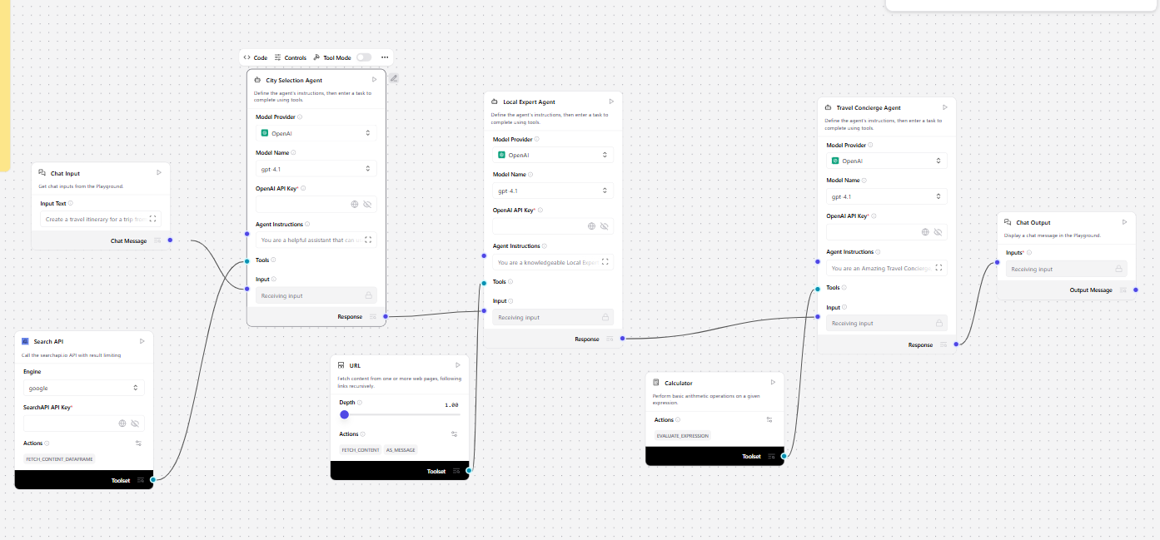
GraniteAgent Agentic Workflow -

Slide 8
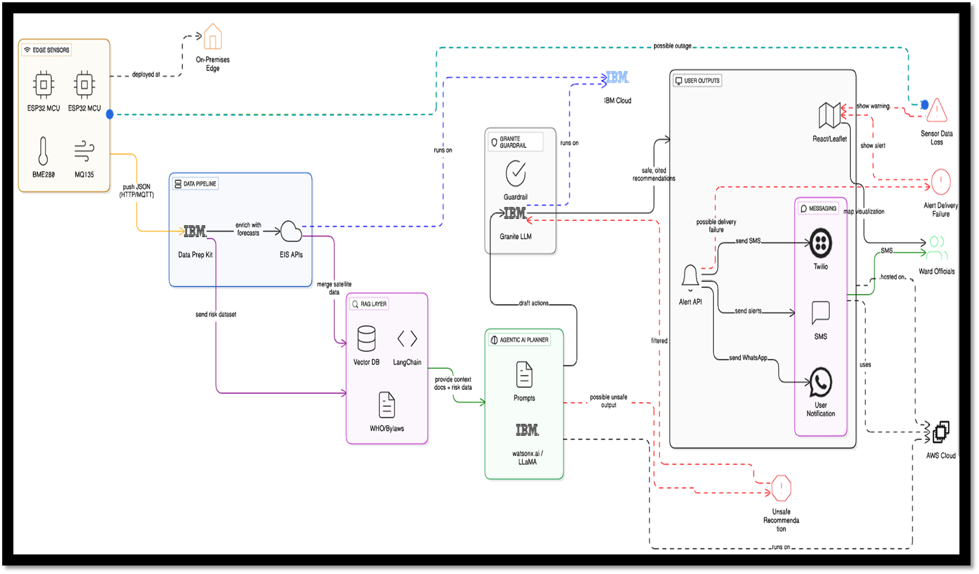
GraniteAgent — System Architecture

Slide 9

Role of Agentic AI in Research Agent
Role of Agentic AI in Research Agent
Agentic AI enables GraniteAgent to function as a fully autonomous research assistant rather than a simple chatbot. Using IBM watsonx.ai and IBM Granite models, it orchestrates the entire academic research pipeline to deliver intelligent, structured research support.
Each agent performs a specific role—such as retrieving nutritional data, generating diet plans, providing health advice, and analyzing food logs—while working collaboratively. This multi-agent approach ensures efficient task execution and accurate results.
GraniteAgent also brings context awareness, understanding the researcher’s query context, domain, and observations to generate targeted outputs. It supports real-time adaptation, dynamically responding to each research query with structured and grounded AI outputs.
Additionally, the pipeline routes between ArXiv search, IBM Granite LLM calls, and the output parser, enabling accurate and trustworthy academic outputs.
Overall, Agentic AI makes GraniteAgent proactive, context-driven, and research-ready — acting like a smart digital research assistant that helps researchers accelerate discovery and produce high-quality academic work.

Slide 10
Technology Used
React.js + Vite (Frontend) - Modern React frontend with Vite build tool for the chat and research interface
IBM (Backend Server) - REST API endpoints: /api/search, /api/llm/generate
IBM Granite-3-8B-Instruct – Core AI model via watsonx.ai REST API. Supports IAM token-based authentication for secure IBM Cloud access.
ArXiv API – Live academic paper retrieval. Real-time XML parsing of scholarly papers by keyword from ArXiv.org.
IBM Watsonx.ai - Model deployment platform. Provides REST API access to Granite LLM with temperature and token controls
LocalStorage (Browser) – Client-side persistence for references, credentials & notes. No database needed.

Slide 11
Novelty and Uniqueness
GraniteAgent stands out by combining Agentic AI, live academic APIs, and IBM Granite into a single unified research intelligence platform.
End-to-End Research Workflow – Covers the full research cycle: search, summarize, organize references, generate hypotheses, and draft paper sections — all in one tool.
Live ArXiv Integration – Fetches real academic papers live from ArXiv API, grounding AI outputs in actual peer-reviewed literature.
Multi-Format Citation Engine – Auto-generates citations in APA, MLA, Chicago, and BibTeX — saving hours of manual formatting.
AI Hypothesis Generator – IBM Granite formulates structured, scientifically grounded hypotheses from user-provided domain, observations, and knowledge gaps.
Intelligent Paper Drafting – IBM Granite drafts complete research sections (Introduction, Literature Review, Methodology) from user-selected references.
No Database Required – Uses browser LocalStorage for reference persistence — zero backend database setup needed.
Scalable & Enterprise-Ready – Built on IBM watsonx.ai with IBM Granite models, ensuring reliability, governance, and production-grade AI quality.
This makes GraniteAgent a smart, autonomous, and research-ready AI assistant, not just a simple academic search engine.

Slide 12
Git Hub Link
·
https://github.com/Siddharthpatwal26/Research-Agent-
·
·
·

Slide 13
Future Scope
1. Multi-Source Research Integration –
Expand beyond ArXiv to integrate PubMed, IEEE Xplore, Google Scholar, and Semantic Scholar APIs, enabling cross-domain academic discovery across medicine, engineering, and social sciences.
2.Collaborative Research Workspace –
Add multi-user collaboration features allowing research teams to share libraries, annotate papers, co-author hypotheses, and export structured reports in PDF or DOCX format directly from GraniteAgent.
·
·
·

Slide 14


