Slide 1

DEPARTMENT OF COMPUTER ENGINEERING
CCL MINI PROJECT
TOPIC : Codeginner (E-Learning Website)
Made By:
Student Name: Siddharth Poojary Roll No: 7 Division:C
Student Name: Rahul Pote Roll No: 8 Division:C
Student Name: Pratik Pawade Roll No: 5 Division:C
Under the guidance of : Prof. Arathi

Slide 2
Abstract:
E-learning website designed for students, teachers, and professionals
Easy-to-use interface for accessing learning content and course materials
Interactive features include discussion forums and exercises
Course creation, management, student registration, enrollment, materials, quizzes, assessments, progress tracking
Easily customizable to meet unique needs and requirements
Backend built using Django web framework
Frontend designed using HTML, CSS, and JavaScript
Hosting infrastructure built on AWS cloud for scalability, reliability, and security

Slide 3
Problem Statement
Lack of interactivity and engagement in e-learning experiences
Many e-learning websites rely on static content, leading to low motivation and interest
Lack of hands-on learning opportunities in e-learning, limiting effectiveness
Coding requires practical experience, but many e-learning websites don't provide integrated code editors or tools
The main challenge facing e-learning is the lack of interactivity, personalization, and hands-on learning
These issues can limit the effectiveness of e-learning websites
It is essential to address these issues for learners to achieve their objectives and reach their full potential.

Slide 4
Objective
To provide an engaging and interactive e-learning platform for learners to learn Python programming language effectively
To offer high-quality learning materials that are easy to access and understand
To provide practical hands-on learning opportunities with an integrated code editor
To track learners' progress and provide personalized learning experiences
To enable learners to apply their knowledge effectively in real-world scenarios

Slide 5
Scope
E-learning website teaching Python programming
Animation-based videos for visually engaging concepts
Integrated code editor for practical hands-on learning
Admin panel for up-to-date learning materials
Quizzes with feedback for improvement
Suitable for learners of all levels
Wide range of Python topics covered
Personalized learning with progress tracking and recommendations
Real-world scenarios through practical examples/projects

Slide 6
Services used
Amazon Elastic Compute Cloud (EC2): is a web service provided by Amazon Web Services (AWS) that enables users to launch and manage virtual servers in the cloud.
We used Amazon Web Services (AWS) Elastic Compute Cloud (EC2) to host our application servers in the cloud. EC2 provides us with a scalable and flexible way to run our application.
Amazon Relational Database Service (Amazon RDS): We have used the RDS instance of MySQL Engine in order to store the data such as orders and user data.
We used Relational Database Service (RDS) to manage our application's database infrastructure. RDS provides us with a fully managed, highly available, and scalable database infrastructure.

Slide 7
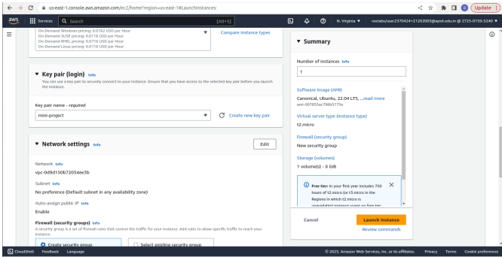
Screenshots:
creating instance in ec2 panel and adding required values and rules

Slide 8
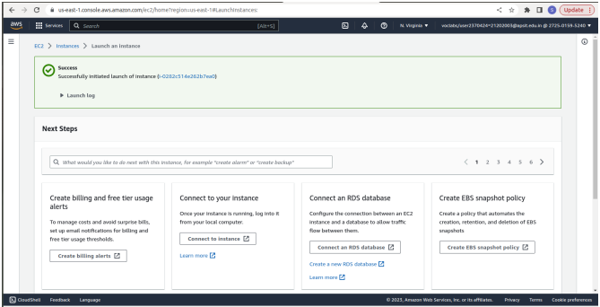
successfully initializing and launching the instance

Slide 9
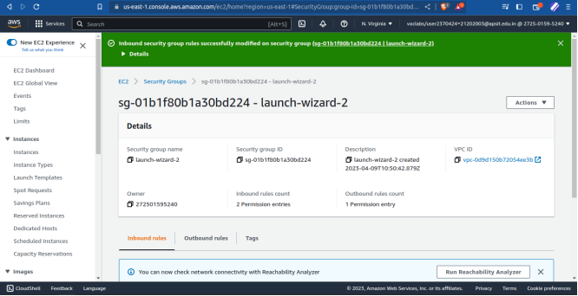
Changing Inbound rules for the instance

Slide 10
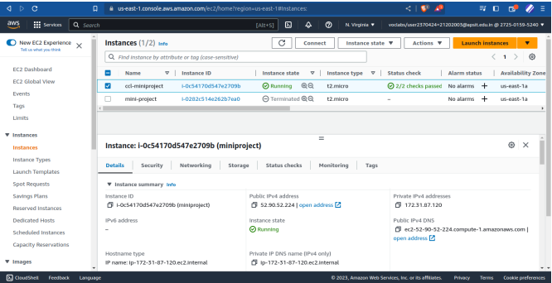
selecting the instance and checking the details

Slide 11
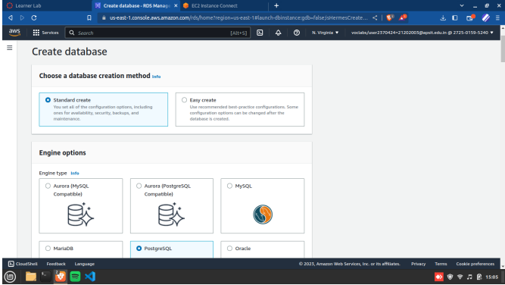
Creating the database and adding requires values

Slide 12
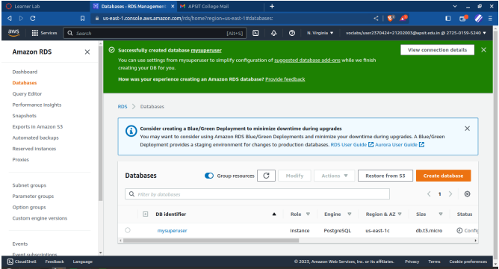
successfully creating the database in rds

Slide 13
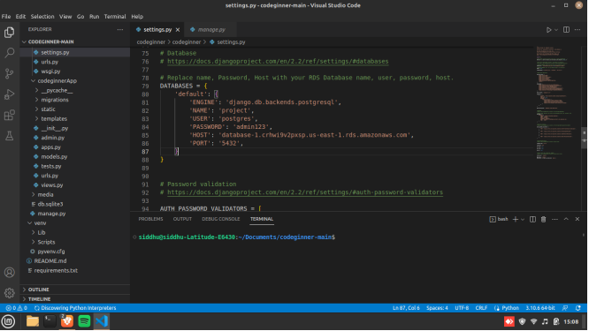
making changes in the django web app according to the rds

Slide 14
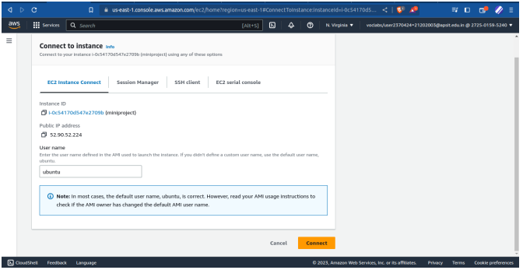
connecting to the selected instance

Slide 15
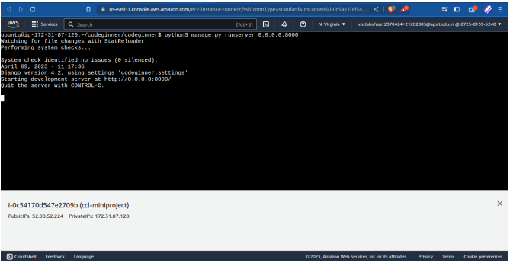
running the django web app on ec2 instance

Slide 16
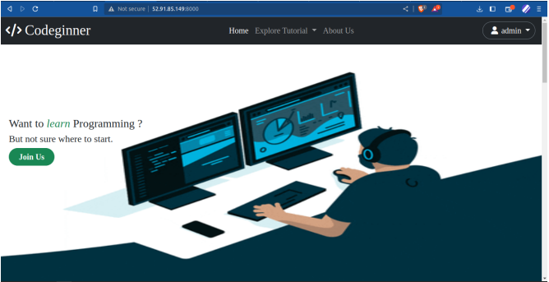
Successfully running website on AWS

Slide 17
Learning Outcome:
Codeginner is an e-learning website for teaching Python programming language
Amazon Web Services (AWS) Elastic Compute Cloud (EC2) and Relational Database Service (RDS) were used
EC2 provided a scalable and reliable environment for hosting application servers
AWS's built-in monitoring and management tools helped optimize application performance
RDS managed the application's database infrastructure in a fully managed, highly available, and scalable environment
Codeginner provided a reliable, scalable, and cost-effective learning platform for users
Integrated code editor and admin panel made it easy to manage content and keep users engaged
Quizzes enabled users to test their knowledge and track their progress
Use of AWS services delivered a comprehensive and effective learning experience.

Slide 18

THANKYOU

