Slide 1
AGENDA
Why
What
How
Who
Project Objective
Project Scope
Project Approach
Project Timeline
Project Roles & Organization
When
Project Management
Control

Slide 2
AGENDA
Project
Objective
Project
Scope
Project
Approach
Project
Timeline
Project Roles
& Organization
Project
Management
WHY?
WHAT?
HOW?
WHEN?
WHO?
CONTROL?
Project Objective
WHY
Project Scope
WHAT
Project Approach
HOW
Project Timeline
WHEN
Project Roles & Organization
WHO
Project Management
CONTROL

Slide 3
INTRODUCTIONS
Department of Health (MSDH) Team
XXX UUUU – DOH Deputy Director of Programs
Craig Oregeron – ITS Executive Sponsor – CIO
Acro Team
Vishwas Tare– Acro Project Manager
Kshiteej Bhosale – Acro Single Point of Contact
RV Rao – Acro Executive Sponsor

Slide 4


INTRODUCTIONS
Department of Health (MSDH) Team
XXX UUUU – DOH Deputy Director of Programs
Craig Oregeron – ITS Executive Sponsor – CIO
Acro Team
Vishwas Tare– Acro Project Manager
Kshiteej Bhosale – Acro Single Point of Contact
RV Rao – Acro Executive Sponsor

Slide 5
PROJECT OBJECTIVES
Establish, configure and deploy a consolidated, state-of-the-art tracking and case management information system to be used in its statewide programs involving
One, and
Two
which will monitor ADAP Application processing for over 15000 clients across the State of Mississippi every year
Migrate existing data from legacy systems –
The Mississippi Department of Health – ACAMS (MSDH-ACAMS) Case Management System will help to integrate data systems, increase automation, and reduce duplication of data.

Slide 6
Project
Objective
Project
Scope
Project
Approach
Project
Timeline
Project Roles
& Organization
Project
Management
WHY?
WHAT?
HOW?
WHEN?
WHO?
CONTROL?
Establish, configure and deploy a consolidated, state-of-the-art tracking and case management information system to be used in its statewide programs involving
One, and
Two
which will monitor ADAP Application processing for over 15000 clients across the State of Mississippi every year
Migrate existing data from legacy systems –
The Mississippi Department of Health – ACAMS (MSDH-ACAMS) Case Management System will help to integrate data systems, increase automation, and reduce duplication of data.

Slide 7
PROJECT OBJECTIVES – THE SOLUTION
Please create an editable version of this IMAGE.

Slide 8
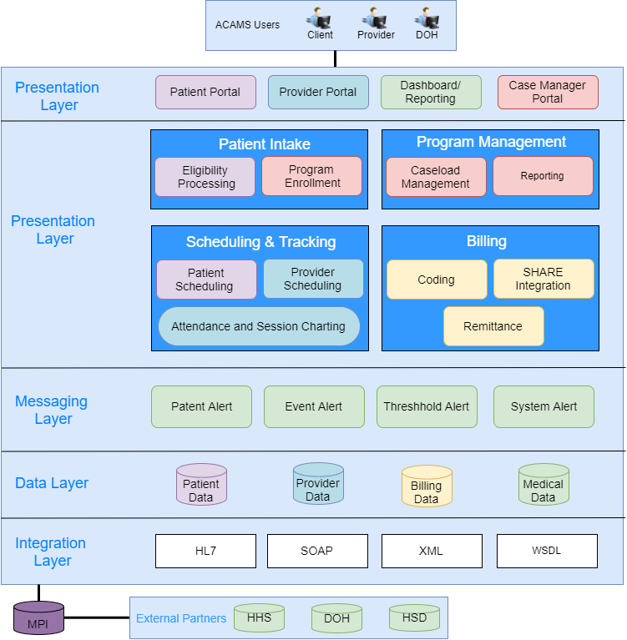
Project
Objective
Project
Scope
Project
Approach
Project
Timeline
Project Roles
& Organization
Project
Management
WHY?
WHAT?
HOW?
WHEN?
WHO?
CONTROL?

Slide 9
PROJECT SCOPE – KEY ACTIVITIES
Conduct Project Kick-off Session
Facilitate Requirement Gathering Workshops
Business Workflow Design
Document – Business and Technical Requirements
Define Reporting Requirements
Configure, Customize and Deploy Case Management System
Conduct User Acceptance Testing
Develop and Deliver Training and Support Materials
Data Migration – INPHORM and ChallengerSoftTM
Manage Project – Communication, Quality, Issues, Risk and Change
Share Lessons Learned

Slide 10
Project
Objective
Project
Scope
Project
Approach
Project
Timeline
Project Roles
& Organization
Project
Management
WHY?
WHAT?
HOW?
WHEN?
WHO?
CONTROL?
01
Conduct Project Kick-off Session
05
Define Reporting Requirements
09
Data Migration – INPHORM and ChallengerSoftTM
02
06
Configure, Customize and Deploy Case Management System
10
Manage Project – Communication, Quality, Issues, Risk and Change
Facilitate Requirement Gathering Workshops
03
Business Workflow Design
07
Conduct User Acceptance Testing
11
Share Lessons Learned
04
Document – Business and Technical Requirements
08
Develop and Deliver Training and Support Materials

Slide 11

PROJECT APPROACH – OUR PHILOSOPHY
Integrate people, processes, and technology to provide a balanced service level
Create a collaborative environment to enhance flexibility, data definition, data stewardship, reporting & monitoring and increasing security
Leverage resources, institutional knowledge, skill sets, and technology to continuously improve service and productivity throughput for DoH
Increase the ability to be more responsive to family demands
Promote the creation of a faster, more accurate, and proactive technological environment
Mitigate Risk by focusing on compliance requirements and understanding the impact these requirements have on productivity and customer service
Develop an integrated structure that will promote the consistent enforcement of policies, procedures and regulations throughout the State
Design an environment that eliminates redundant technological solutions and encourages solutions that maximize the goals and objectives of State – accomplished through the use of creative design, timely issue resolution, thoughtful decision making, and consistent project management.
Integrate Process
Leverage
resources
Mitigate Risk

Slide 12
Project
Objective
Project
Scope
Project
Approach
Project
Timeline
Project Roles
& Organization
Project
Management
WHY?
WHAT?
HOW?
WHEN?
WHO?
CONTROL?
Integrate people, processes, and technology to provide a balanced service level
Create a collaborative environment to enhance flexibility, data definition, data stewardship, reporting & monitoring and increasing security
Leverage resources, institutional knowledge, skill sets, and technology to continuously improve service and productivity throughput for DoH
Increase the ability to be more responsive to family demands
Promote the creation of a faster, more accurate, and proactive technological environment
Mitigate Risk by focusing on compliance requirements and understanding the impact these requirements have on productivity and customer service
Develop an integrated structure that will promote the consistent enforcement of policies, procedures and regulations throughout the State
Design an environment that eliminates redundant technological solutions and encourages solutions that maximize the goals and objectives of State – accomplished through the use of creative design, timely issue resolution, thoughtful decision making, and consistent project management.
Integrate Process
Leverage
resources
Mitigate Risk

Slide 13
PROJECT APPROACH – DELIVERY MODEL
Acro will deliver this solution using an Onsite and Offsite team delivery model.
Key members of the team will be Onsite (in Jackson, MS) collocated with the Department of Health’s Subject Matter Experts (SMEs) – during the key phases of Requirements Gathering, and Review, Training and UAT, and Deployment.
Development team will work Offsite from Acro’s Application Delivery Center located in Livonia, MI – during the Design, Development and Unit Testing phases.
Onsite Team
Acro Team working with Department of Health’s SMEs
Benefit of face to face interaction with DoH SMEs
Offsite Team
Located at Acro Application Development Center in Livonia, MI.
Leverage the synergies of working with skilled teams

Slide 14
Project
Objective
Project
Scope
Project
Approach
Project
Timeline
Project Roles
& Organization
Project
Management
WHY?
WHAT?
HOW?
WHEN?
WHO?
CONTROL?
Acro will deliver this solution using an Onsite and Offsite team delivery model.
Key members of the team will be Onsite (in Jackson, MS) collocated with the Department of Health’s Subject Matter Experts (SMEs) – during the key phases of Requirements Gathering, and Review, Training and UAT, and Deployment.
Development team will work Offsite from Acro’s Application Delivery Center located in Livonia, MI – during the Design, Development and Unit Testing phases.
Onsite Team
Acro Team working with Department of Health’s SMEs
Benefit of face to face interaction with DoH SMEs
Offsite Team
Located at Acro Application Development Center in Livonia, MI.
Leverage the synergies of working with skilled teams

Slide 15
PROJECT TIMELINE
Place holder for the timeline.

Slide 16
Project
Objective
Project
Scope
Project
Approach
Project
Timeline
Project Roles
& Organization
Project
Management
WHY?
WHAT?
HOW?
WHEN?
WHO?
CONTROL?
Place holder for the timeline.

Slide 17
PROJECT ROLES – ORGANIZATION CHART
Please insert the Project Org.

Slide 18
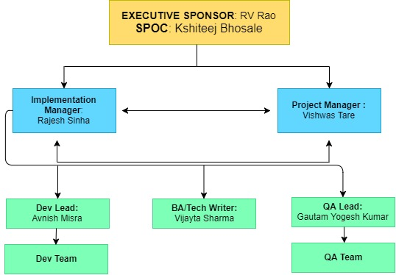
Project
Objective
Project
Scope
Project
Approach
Project
Timeline
Project Roles
& Organization
Project
Management
WHY?
WHAT?
HOW?
WHEN?
WHO?
CONTROL?

Slide 19
PROJECT MANAGEMENT
Acro’s methodology is flexible and can adopt the development processes to comply with the client’s defined project management standards
We will use State of Mississippu – Department of IT (ITS)) standard templates
We will augment these templates based on the learnings from Acro’s past project experiences to capture relevant project/delivery details
Communication Management
Issue Management
Risk Management
Change Management

Slide 20
Project
Objective
Project
Scope
Project
Approach
Project
Timeline
Project Roles
& Organization
Project
Management
WHY?
WHAT?
HOW?
WHEN?
WHO?
CONTROL?
Acro’s methodology is flexible and can adopt the development processes to comply with the client’s defined project management standards
We will use State of Mississippu – Department of IT (ITS)) standard templates
We will augment these templates based on the learnings from Acro’s past project experiences to capture relevant project/delivery details
Communication Management
Issue Management
Risk Management
Change Management

Slide 21
Status review meetings / conference calls
Weekly Management status review with State’s project teams
Issue, Risks and Action items will be reviewed in the weekly meetings
Monthly status review with stakeholders including Executive Management teams
Phase exit meetings
Scheduled as per pre-identified milestone dates in the project plan
Conduct lessons learned sessions for continuous improvement
Phase exit checklists to ensure completion of all the steps
Status Reporting
Weekly Status Report will be sent to all stakeholders
Project status dashboards will be used to maintain the visibility
Minutes of all the review meetings will be circulated
SharePoint site will be setup to archive all status reports
Escalation
Issues and Risks will be escalated to State and Acro Executive Management if they are not mutually addressed by the project teams within seven days
PROJECT MANAGEMENT – COMMUNICATION PLAN

Slide 22




Project
Objective
Project
Scope
Project
Approach
Project
Timeline
Project Roles
& Organization
Project
Management
WHY?
WHAT?
HOW?
WHEN?
WHO?
CONTROL?
Status review meetings / conference calls
Phase exit
meetings
Status
Reporting
Escalation
Weekly Management status review with State’s project teams
Issue, Risks and Action items will be reviewed in the weekly meetings
Monthly status review with stakeholders including Executive Management teams
Scheduled as per pre-identified milestone dates in the project plan
Conduct lessons learned sessions for continuous improvement
Phase exit checklists to ensure completion of all the steps
Weekly Status Report will be sent to all stakeholders
Project status dashboards will be used to maintain the visibility
Minutes of all the review meetings will be circulated
SharePoint site will be setup to archive all status reports
Issues and Risks will be escalated to State and Acro Executive Management if they are not mutually addressed by the project teams within seven days.

Slide 23
PROJECT MANAGEMENT – ISSUE MANAGEMENT
Identification
Issue number, Issue identification date, Description of issue
Resources assigned responsibility for resolution, Resolution date, Resolution description
Prioritization
Monitoring
Escalation
Step 1: Acro Project Manager
Step 2: Acro Single Point of Contact
Step 3: Acro Executive Sponsor
Acro will log and monitor issues during contract period. Information captured is :
Issues are assigned priority levels in mutual agreement by the State and Acro.
Critical and high priority issues will be brought to the attention of the State’s project manager within 24 hours of discovery.
Any unresolved issues will be escalated for resolution as defined below.
Issues with other priorities will be reviewed in the next project status meeting at the latest.
Critical,
High,
Medium or Low -

Slide 24
Project
Objective
Project
Scope
Project
Approach
Project
Timeline
Project Roles
& Organization
Project
Management
WHY?
WHAT?
HOW?
WHEN?
WHO?
CONTROL?
Identification
Acro will log and monitor issues during contract period. Information captured is :
Issue number, Issue identification date, Description of issue
Resources assigned responsibility for resolution, Resolution date, Resolution description
Prioritization
Issues are assigned priority levels in mutual agreement by the State and Acro.
Critical,
High,
Medium or Low -
Monitoring
Critical and high priority issues will be brought to the attention of the State’s project manager within 24 hours of discovery.
Issues with other priorities will be reviewed in the next project status meeting at the latest.
Escalation
Any unresolved issues will be escalated for resolution as defined below.
Step 1: Acro Project Manager
Step 2: Acro Single Point of Contact
Step 3: Acro Executive Sponsor

Slide 25
Identification
Identify and document the Risk and assign resource(s) for mitigation analysis
Risk Analysis
Involves assigning a level of priority based on the probability of occurrence and impact to the project. This results in preparation of probability and impact matrix
Risk Response
Review the risk and its impact on cost, schedule, and quality with State’s project manager and work out a prevention/ mitigation strategy with the project stakeholders.
Planning involves the definition of prevention and mitigation strategies
Risk Monitoring and Control
Continuous review of risks and revision of mitigation strategies
During regular monthly project status reviews with the State, Acro will review the risks, reassign the levels and revise the probability and impact matrix
PROJECT MANAGEMENT– RISK MANAGEMENT

Slide 26
Project
Objective
Project
Scope
Project
Approach
Project
Timeline
Project Roles
& Organization
Project
Management
WHY?
WHAT?
HOW?
WHEN?
WHO?
CONTROL?
Identification
Identify and document the Risk and assign resource(s) for mitigation analysis
Risk Analysis
Involves assigning a level of priority based on the probability of occurrence and impact to the project. This results in preparation of probability and impact matrix
Risk Response
Review the risk and its impact on cost, schedule, and quality with State’s project manager and work out a prevention/ mitigation strategy with the project stakeholders.
Planning involves the definition of prevention and mitigation strategies
Risk Monitoring and Control
Continuous review of risks and revision of mitigation strategies
During regular monthly project status reviews with the State, Acro will review the risks, reassign the levels and revise the probability and impact matrix

Slide 27
PROJECT MANAGEMENT – CHANGE MANAGEMENT
Acro’s Change Management ensures:
Precise scope and impact of each Change Request is presented to and reviewed with the Project Stakeholders
Appropriate Stakeholder approvals are obtained prior to undertaking a Project Change request
Change requests are analyzed for impact, tracked, monitored and impact to all the deliverables such as training plans, user documentation and other deliverables are updated accordingly

Slide 28
Project
Objective
Project
Scope
Project
Approach
Project
Timeline
Project Roles
& Organization
Project
Management
Acro’s Change Management ensures:
Precise scope and impact of each Change Request is presented to and reviewed with the Project Stakeholders
Appropriate Stakeholder approvals are obtained prior to undertaking a Project Change request
Change requests are analyzed for impact, tracked, monitored and impact to all the deliverables such as training plans, user documentation and other deliverables are updated accordingly
WHY?
WHAT?
HOW?
WHEN?
WHO?
CONTROL?

Slide 29

PROJECT – NEXT STEPS
Logistics
Access to legacy systems
Access to the facility
Office space
Requirements Gathering
Template Walkthroughs
Workshops in June and July
Requirements sign-off by November 30th, 2018

Slide 30
REQUIREMENTS GATHERING – WORKSHOP SCHEDULE

Slide 31
Q&A

Slide 32
Thank you ! www.AcroCorp.com

Slide 33
JAD SESSIONS – DEFINITION
The Joint Application Design (JAD) process is a used method to elicit/document business requirements and create solution design documentation for new or updates to existing systems.
How should a JAD session be used?
Inputs
Process
Output
Business Requirements:
User driven
Technology driven
WHAT: Series of sessions to review & refine requirements
WHO: Business and IT
personnel
WHEN: Inception /Elaboration Phase
Deliverables:
Refined Requirements / Design
Stakeholder Agreement
Sign-off
When to use JAD:
Project involves many groups of stakeholders that cross traditional boundaries
Project involves willing users
When Not to Use JADs:
Stakeholders and users are not willing or
available for JAD sessions
Traditional methods are preferred by the
client

Slide 34
JAD SESSIONS – ORGANIZATION
For each JAD phase, divide process areas into logical threads such as:
By functional area
By user group
By use case
Process Threads have the following:
Dedicated Client Lead
Business Process SMEs
Power Users
Work Threads
Key Process Client Lead
Business Process SMEs
Extended JAD Team
Application Configurator, Integration Analyst, Security Analyst
LEGEND
Client Resources
Client Resources

Slide 35
JAD SESSIONS – PROCESS / SCHEDULE
JAD Prep
Pre-JAD
JAD Review
JAD
Post-JAD
JAD Prep / Pre JAD / JAD
focused on gathering the available information for the specific business process
organizing it into visual process flows
refining the requirements, and designing artifacts through a series of review sessions.
Post-JAD and JAD Review
focus on reviewing and refining the requirements
design artifacts generated with information elicited during the previously conducted JAD sessions
The JAD process provides general guidelines on how to conduct JAD sessions both to elicit requirements and also develop solution design

