Slide 1
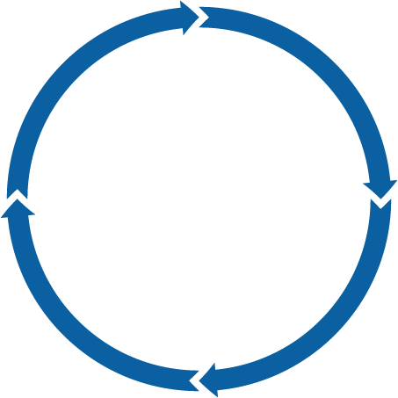
Execution & Delivery
Strategic Alignment
Fully Integrated with the Strategic Planning process
Portfolio Management
Program & Project Reviews
Project Scorecards
Benefit Realization
Post Completion Audits
Established Blueprint to achieve the Vision
A focus on maximizing the value of investment decisions
Project
Portfolio
Management
Governance
Methods & Tools
Steering Committee providing oversight and guidance
Demand Management
Capacity Management
Business Cases & CBAs
Prioritization Criteria
Financial Management
Change Management
Centralized Oversight of Strategic Portfolio Management Process
Portfolio Owners / Managers

