Slide 1


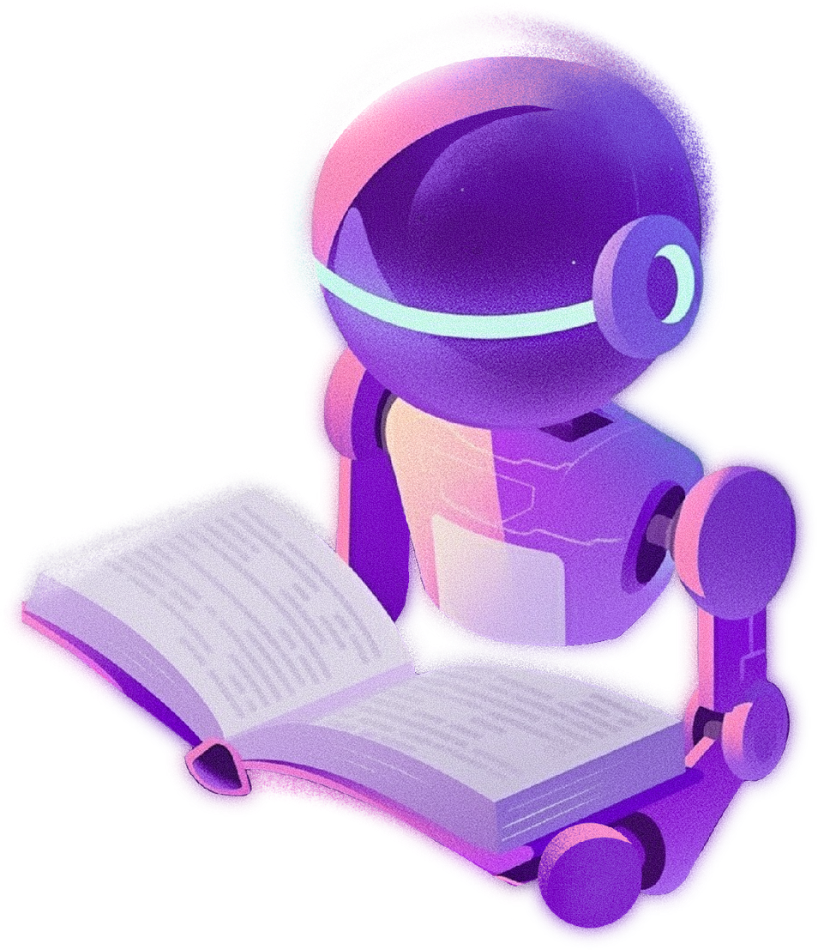



SaralAI
VOICE-FIRST AI ASSISTANT FOR GOVERNMENT SCHEMES
Simplifying access to government schemes
April 23, 2026
Presented by Siddharth Sadhu

Slide 2

PROBLEM
• Government scheme information is complex and scattered
• Many citizens do not know which schemes they qualify for
• Language barriers make official portals difficult to understand
• People struggle to find eligibility, documents, and application steps

Slide 3
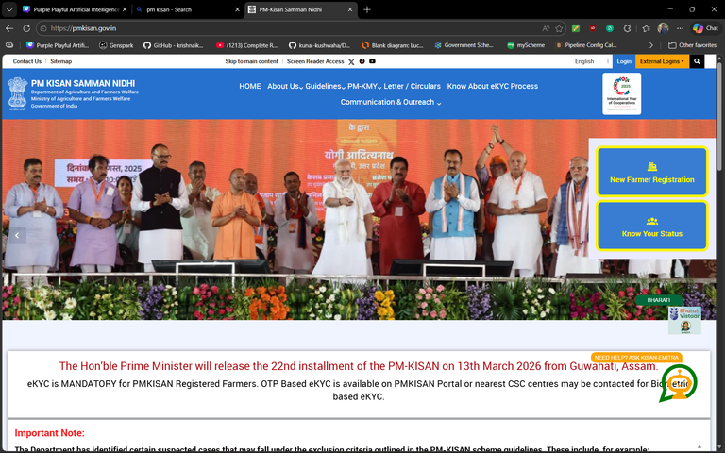

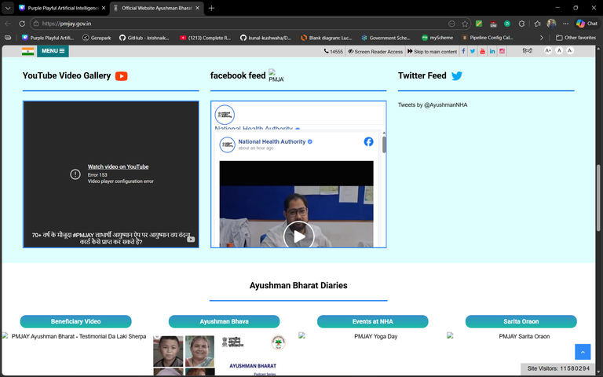
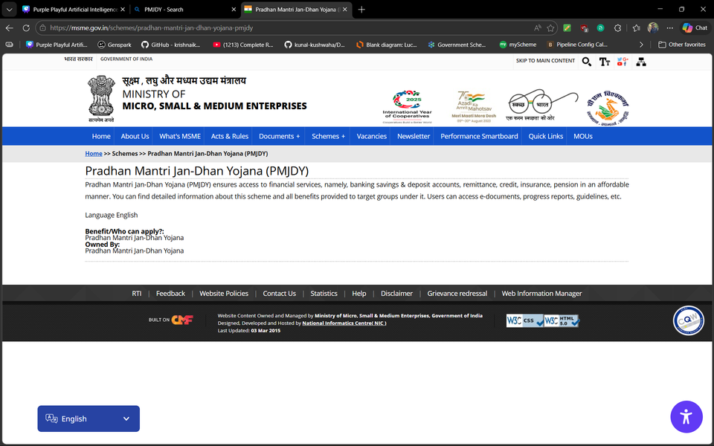
PROBLEM
PM KISAN
PM Aayushman Bharat
PM JDY

Slide 4

SARAL AI: THE SOLUTION
SaralAI is a voice-first AI assistant designed to help citizens easily understand government schemes.
• Users can ask questions using voice or text
• AI understands the query and identifies the relevant scheme
• The system retrieves verified scheme information
• SaralAI generates a simple explanation with eligibility, documents, and steps

Slide 5



SYSTEM OVERVIEW
AI Processing
• AI detects the user’s intent
• System retrieves verified scheme information
• SaralAI generates simple guidance for the user
WORKING
User Interaction
• User asks a question using voice or text
• SaralAI captures and processes the user query

Slide 6
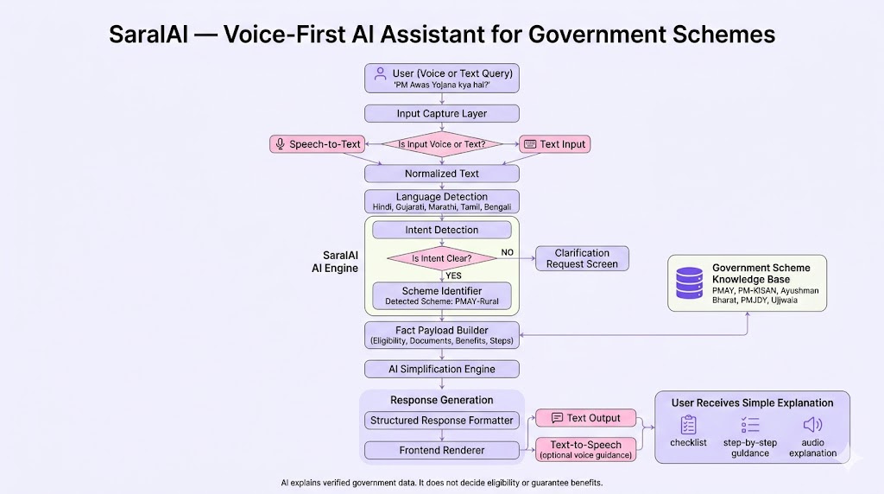

SYSTEM ARCHITECTURE

Slide 7
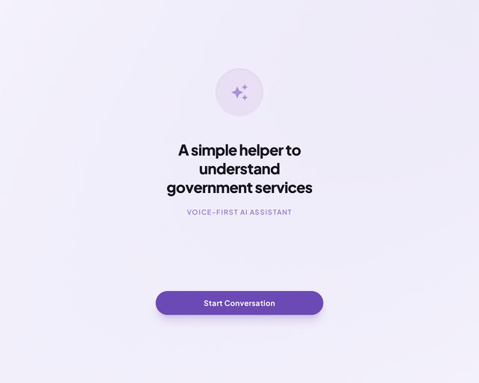
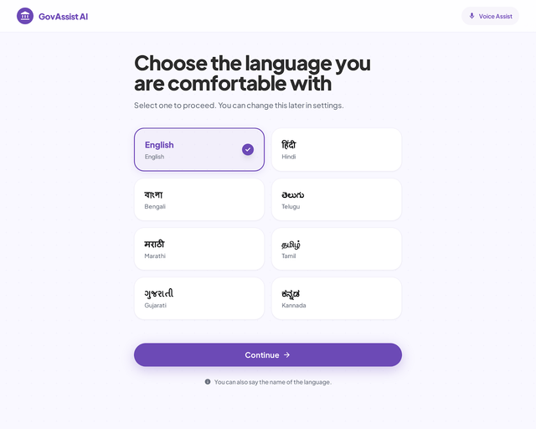
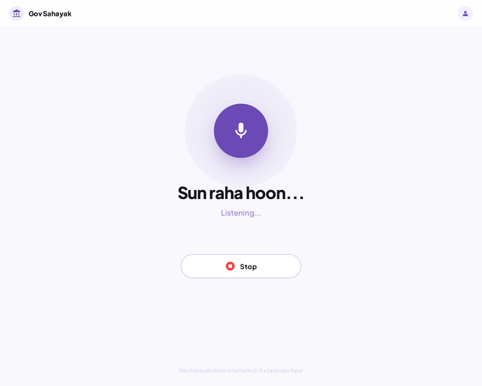
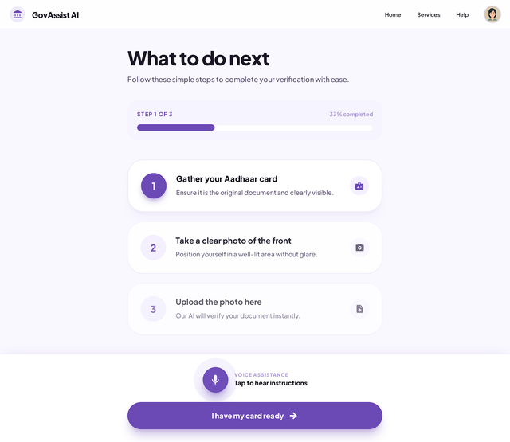
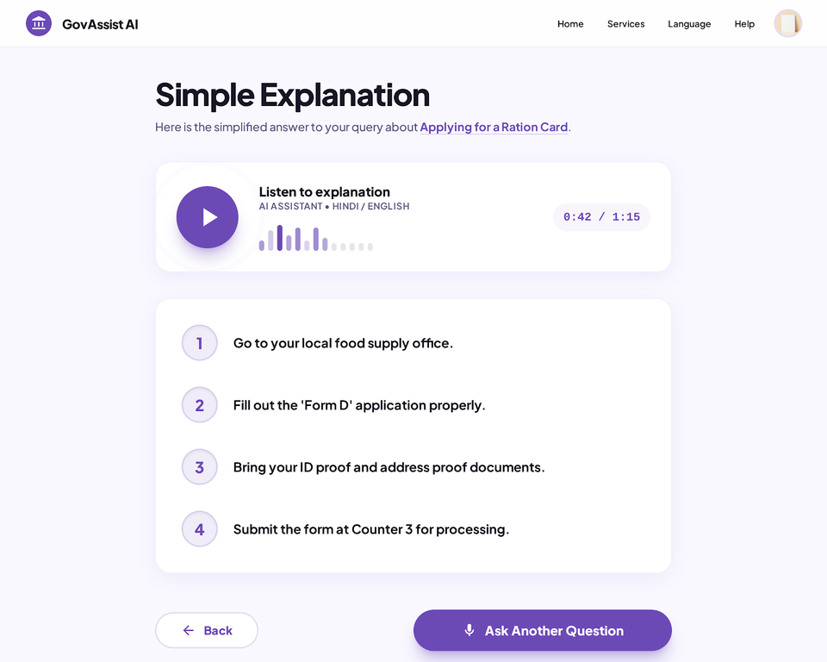
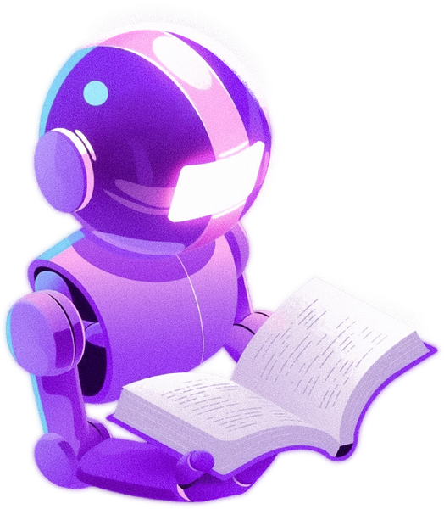

PROTOTYPE

Slide 8
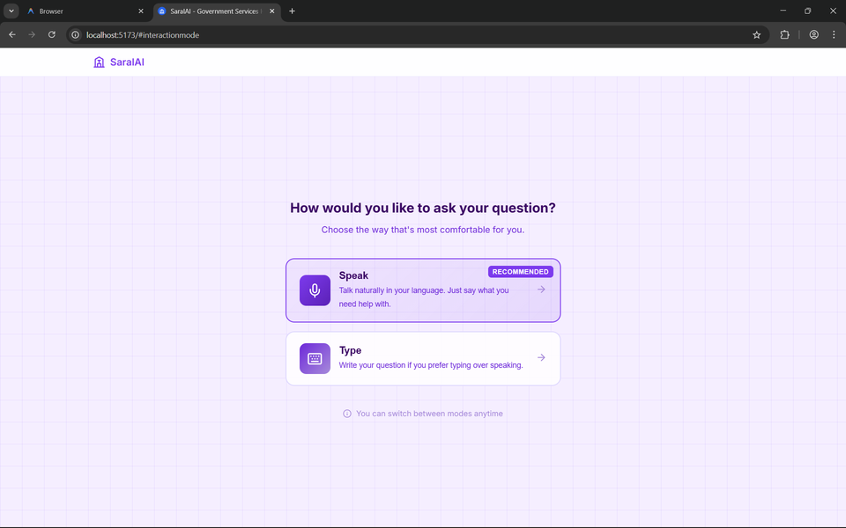
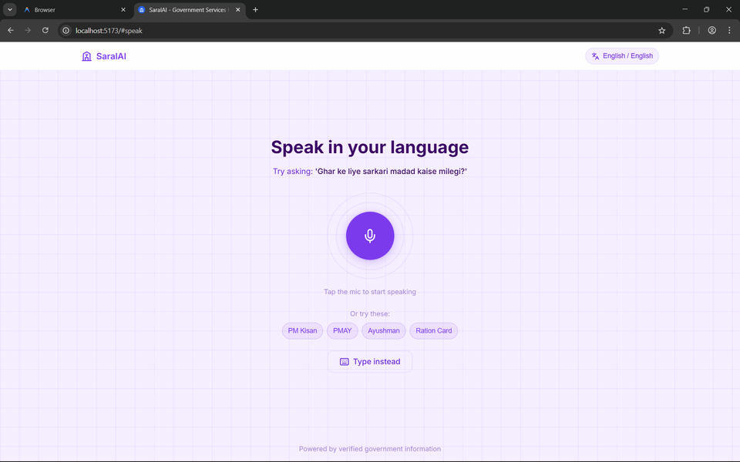
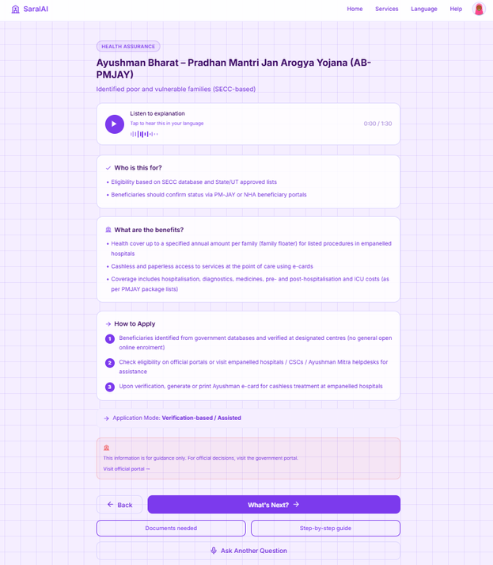
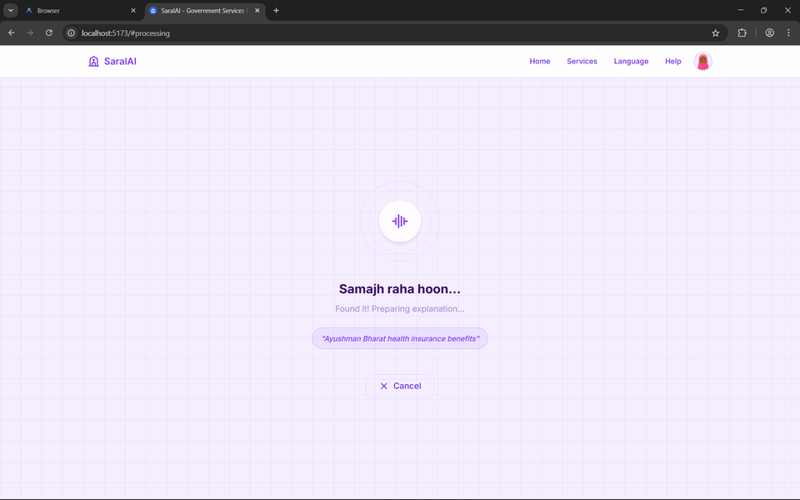
SARAL AI SYSTEM INTERFACE

Slide 9
CURRENTLY SARAL AI
Completed Components
• User interface design and navigation flow
• Client-side AI query processing engine
• Government scheme dataset integration
PROJECT PROGRESS
Future Improvements
• More government schemes in the database ..

Slide 10
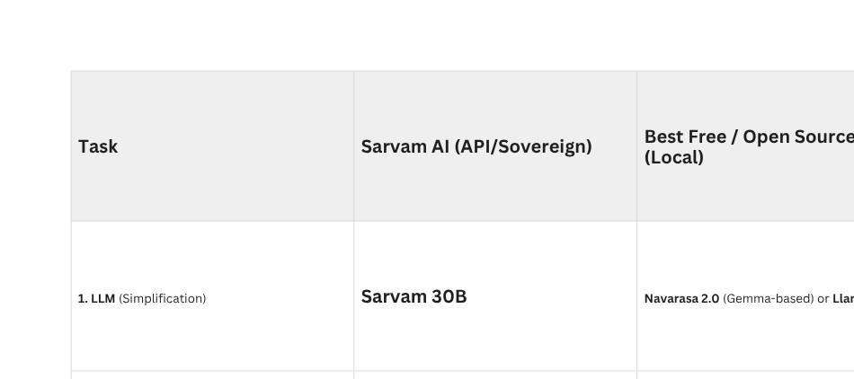
BACKEND PLAN

Slide 11

KEY TAKEAWAYS
• SaralAI simplifies access to government scheme
• Voice-first interaction makes the system accessible to more citizens
• AI helps generate clear explanations of eligibility, documents, and application steps

Slide 12

YOUR THOUGHTS

Slide 13

THANK YOU
FOR YOUR ATTENTION!
siddharthsadhu28@gmail.com

