Slide 1
Trump Tweets
Siddharth Sah
09/05/2018

Slide 2
Objective
1. Classify the sentiment of tweet
2. Report the source of the tweet

Slide 3
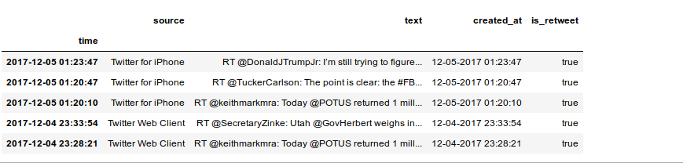
Data Sample

Slide 4
Restrictions
1. The polarity do not have ground truth to compare with.
2. Top three sources were chosen to analyze.

Slide 5
Our Model
1. we use CountVectorizer which converts our texts input into numeric features based on the set of words and their counts.
2. Converts the word in our corpus into a vector which betters fits for our machine learning purpose.

Slide 6
Null model (Baseline)
1. With iphone being the source generating the highest number of truth, Null accuracy falls to 46%.
2. Our model gives around 76% of accuracy predicting the source of the tweet.

Slide 7
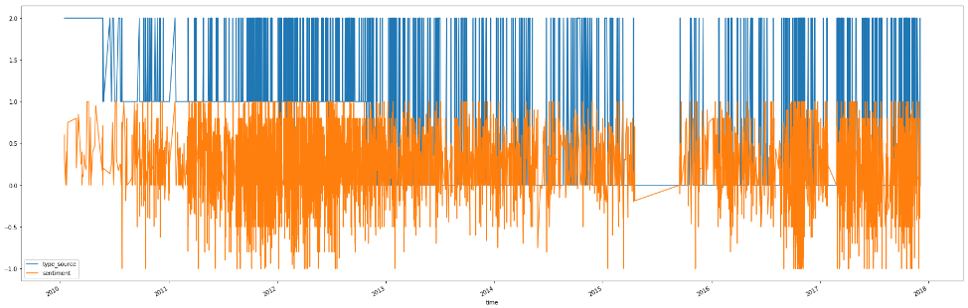
Sentiments
1. The number of negative sentiments see a surge during 2011-2013 and 2017 afterwards.
2. you also see correlation with the source of tweet as mostly blackberry/web client when the sentiment is negative.

Slide 8
Restrictions/Assumption
1. Trying to bring context into play with N-grams do not help much to increase our model accuracy.
2. Same was the case with other techniques like stemming and lemmatization.
3. Since the tweets are limited to 140 characters, n-grams could not have given a context to classify better and other vector optimization technique did not help significantly.

Slide 9
Questions
                Thank You

