Slide 1
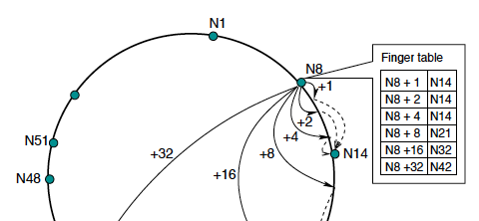
P2P Systems and Distributed Hash Tables
Section 9.4.2
COS 461: Computer Networks
Spring 2011
Mike Freedman
http://www.cs.princeton.edu/courses/archive/spring11/cos461/

Slide 2
P2P as Overlay Networking
P2P applications need to:
  Track identities & IP addresses of peers
    May be many and may have significant churn
  Route messages among peers
    If you don’t keep track of all peers, this is “multi-hop”
Overlay network
  Peers doing both naming and routing
  IP becomes “just” the low-level transport

Slide 3
Early P2P

Slide 4
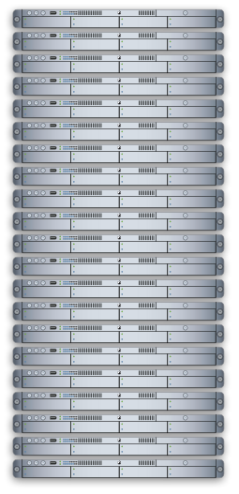

Early P2P I: Client-Server
Napster
  Client-server search
  “P2P” file xfer
1. insert
xyz.mp3
2. search
xyz.mp3 ?
3. transfer

Slide 5
Early P2P II: Flooding on Overlays
search
xyz.mp3
xyz.mp3 ?
Flooding

Slide 6
Early P2P II: Flooding on Overlays
xyz.mp3
xyz.mp3 ?
Flooding
search

Slide 7
Early P2P II: Flooding on Overlays
transfer

Slide 8
Early P2P II: “Ultra/super peers”
Ultra-peers can be installed (KaZaA) or self-promoted (Gnutella)
  Also useful for NAT circumvention, e.g., in Skype

Slide 9
Lessons and Limitations
Client-Server performs well
  But not always feasible: Performance not often key issue!
Things that flood-based systems do well
  Organic scaling
  Decentralization of visibility and liability
  Finding popular stuff
  Fancy local queries
Things that flood-based systems do poorly
  Finding unpopular stuff
  Fancy distributed queries
  Vulnerabilities: data poisoning, tracking, etc.
  Guarantees about anything (answer quality, privacy, etc.)

Slide 10
Structured Overlays:
Distributed Hash Tables

Slide 11
Basic Hashing for Partitioning?
Consider problem of data partition:
  Given document X, choose one of k servers to use
Suppose we use modulo hashing
  Number servers 1..k
  Place X on server i = (X mod k)
    Problem? Data may not be uniformly distributed
  Place X on server i = hash (X) mod k
    Problem?
      What happens if a server fails or joins (k → k±1)?
      What is different clients has different estimate of k?
      Answer: All entries get remapped to new nodes!

Slide 12
Consistent Hashing
  insert(key₁,value)
  lookup(key₁)
key₁=value
key₁
key₂
key₃
Consistent hashing partitions key-space among nodes
Contact appropriate node to lookup/store key
  Blue node determines red node is responsible for key₁
  Blue node sends lookup or insert to red node

Slide 13
Consistent Hashing
0000
0010
0110
1010
1100
1110
1111
URL₁
URL₂
URL₃
0001
0100
1011
Partitioning key-space among nodes
  Nodes choose random identifiers: e.g., hash(IP)
  Keys randomly distributed in ID-space: e.g., hash(URL)
  Keys assigned to node “nearest” in ID-space
  Spreads ownership of keys evenly across nodes

Slide 14
Consistent Hashing
Construction
  Assign n hash buckets to random points on mod 2^{k} circle; hash key size = k
  Map object to random position on circle
  Hash of object = closest clockwise bucket
    successor (key) → bucket
0
14
12
Bucket
4
8
Desired features
  Balanced: No bucket has disproportionate number of objects
  Smoothness: Addition/removal of bucket does not cause movement among existing buckets (only immediate buckets)
  Spread and load: Small set of buckets that lie near object

Slide 15
Consistent hashing and failures
0
Consider network of n nodes
If each node has 1 bucket
  Owns 1/n^{th} of keyspace in expectation
  Says nothing of request load per bucket
If a node fails:
  Its successor takes over bucket
  Achieves smoothness goal: Only localized shift, not O(n)
  But now successor owns 2 buckets: keyspace of size 2/n
Instead, if each node maintains v random nodeIDs, not 1
  “Virtual” nodes spread over ID space, each of size 1 / vn
  Upon failure, v successors take over, each now stores (v+1) / vn
14
12
Bucket
4
8

Slide 16
Consistent hashing vs. DHTs
 | Consistent Hashing | Distributed Hash Tables
Routing table size | O(n) | O(log n)
Lookup / Routing | O(1) | O(log n)
Join/leave: Routing updates | O(n) | O(log n)
Join/leave: Key Movement | O(1) | O(1)

Slide 17
Distributed Hash Table
0000
0010
0110
1010
1100
1110
1111
0001
0100
1011
Nodes’ neighbors selected from particular distribution
  Visual keyspace as a tree in distance from a node

Slide 18
Distributed Hash Table
0000
0010
0110
1010
1100
1110
1111
Nodes’ neighbors selected from particular distribution
  Visual keyspace as a tree in distance from a node
  At least one neighbor known per subtree of increasing size /distance from node

Slide 19
Distributed Hash Table
0000
0010
0110
1010
1100
1110
1111
Nodes’ neighbors selected from particular distribution
  Visual keyspace as a tree in distance from a node
  At least one neighbor known per subtree of increasing size /distance from node
Route greedily towards desired key via overlay hops

Slide 20
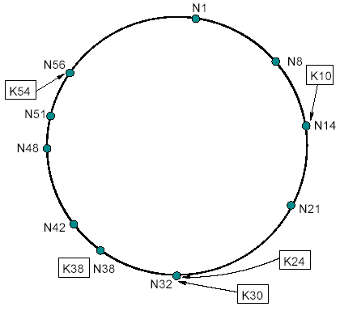
The Chord DHT
Chord ring: ID space mod 2¹⁶⁰
  nodeid = SHA1 (IP address, i)
  for i=1..v virtual IDs
  keyid = SHA1 (name)
Routing correctness:
  Each node knows successor and predecessor on ring
Routing efficiency:
  Each node knows O(log n) well-distributed neighbors

Slide 21
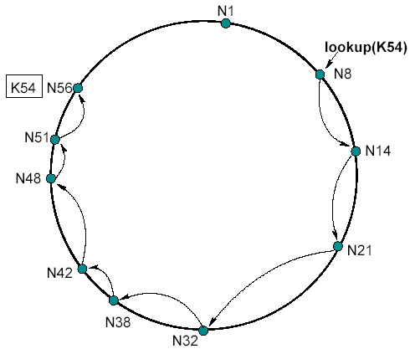
Basic lookup in Chord
lookup (id):
if ( id > pred.id &&
id <= my.id )
return my.id;
else
return succ.lookup(id);
Route hop by hop via successors
  O(n) hops to find destination id
Routing

Slide 22
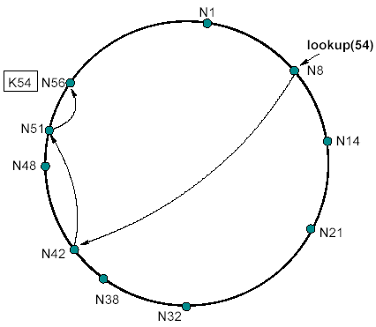
Efficient lookup in Chord
lookup (id):
if ( id > pred.id &&
id <= my.id )
return my.id;
else
// fingers() by decreasing distance
for finger in fingers():
if id <= finger.id
return finger.lookup(id);
return succ.lookup(id);
Route greedily via distant “finger” nodes
  O(log n) hops to find destination id
Routing

Slide 23
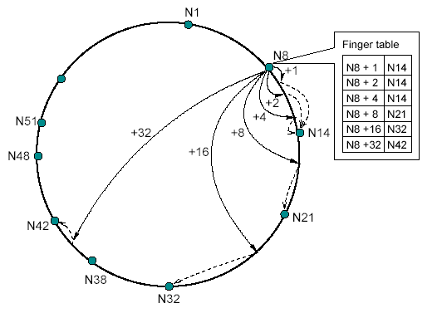
Building routing tables
Routing Tables
Routing
For i in 1...log n:
finger[i] = successor ( (my.id + 2^{i} ) mod 2¹⁶⁰ )

Slide 24
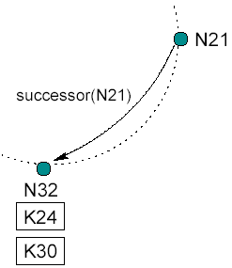
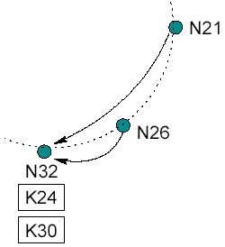
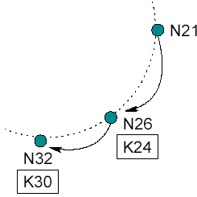
Joining and managing routing
Join:
  Choose nodeid
  Lookup (my.id) to find place on ring
  During lookup, discover future successor
  Learn predecessor from successor
  Update succ and pred that you joined
  Find fingers by lookup ((my.id + 2^{i} ) mod 2¹⁶⁰ )
Monitor:
  If doesn’t respond for some time, find new
Leave: Just go, already!
  (Warn your neighbors if you feel like it)

Slide 25
DHT Design Goals
An “overlay” network with:
  Flexible mapping of keys to physical nodes
  Small network diameter
  Small degree (fanout)
  Local routing decisions
  Robustness to churn
  Routing flexibility
  Decent locality (low “stretch”)
Different “storage” mechanisms considered:
  Persistence w/ additional mechanisms for fault recovery
  Best effort caching and maintenance via soft state

Slide 26
Storage models
Store only on key’s immediate successor
  Churn, routing issues, packet loss make lookup failure more likely
Store on k successors
  When nodes detect succ/pred fail, re-replicate
Cache along reverse lookup path
  Provided data is immutable
  …and performing recursive responses

Slide 27
Summary
Peer-to-peer systems
  Unstructured systems
    Finding hay, performing keyword search
  Structured systems (DHTs)
    Finding needles, exact match
Distributed hash tables
  Based around consistent hashing with views of O(log n)
  Chord, Pastry, CAN, Koorde, Kademlia, Tapestry, Viceroy, …
Lots of systems issues
  Heterogeneity, storage models, locality, churn management, underlay issues, …
  DHTs deployed in wild: Vuze (Kademlia) has 1M+ active users

