Slide 1

Smart Accident Detection And Alert System Using Iot.
Presented by
1. Shekhar Jadhav.
2. Siddhartha Lolge.
3. Aditya More.
4. Darshan Pawar.
Guided by
Prof.
Department of Computer Engineering
LGNSCOE, Nashik
LGNSCOE, Nashik

Slide 2
OUTLINE…
Introduction
Literature Survey
Problem Definition
System Architecture
Algorithm
Advantages & Dis-advantages
Software & Hardware Requirements
Future Scope
2
LGNSCOE, Nashik

Slide 3
Conclusion
References

Slide 4
Introduction
Road accidents are a major global concern resulting in thousands of deaths and injuries every year. One of the leading causes of high fatality rates is the delay in providing medical assistance due to unreported accidents, lack of eyewitnesses, and the inability of victims to communicate. Manual reporting systems are unreliable in critical conditions. To address these challenges, IoT-based accident detection systems can be deployed to automatically sense collisions, determine the vehicle’s GPS location, and instantly alert emergency contacts or authorities. This approach ensures faster response time and increases the chance of survival.
4
LGNSCOE, Nashik

Slide 5
Literature Survey
Sr. No. | Author / Source | Year | Method / Technology Used | Advantages | Limitations / Gaps Identified
1 | IEEE – GSM Accident Alert System | 2019 | Accelerometer sensor + GSM module | Simple implementation, SMS alerts | High false positives due to bumps; no cloud dashboard
2 | IJERT – IoT Accident Monitoring | 2020 | GSM + GPS + Microcontroller | Sends location coordinates; low cost | Poor network reliability; lacks real-time visualization
3 | Elsevier – Smartphone Sensor Detection | 2020 | Smartphone accelerometer + Gyroscope | No additional hardware required | Dependent on battery, user presence; phone damage risk
4 | Springer – ML-based Crash Detection | 2021 | Machine Learning (SVM/CNN) crash data classification | Higher accuracy, learns from patterns | Requires complex processing; not suitable for low-power MCUs
5 | IEEE – IoT Vehicle Safety Integration | 2021 | GPS + IoT Cloud dashboard | Enables remote monitoring | Latency issues in remote areas
6 | Elsevier – IoT Emergency Routing System | 2022 | Cloud routing + hospital integration | Improves medical dispatch response | Requires high-speed internet and server infrastructure

Slide 6
7 | Springer – Intelligent Transport System | 2022 | Cloud + Transportation Network | City-wide monitoring | High installation cost; complexity
8 | IEEE Xplore – GPS Integrated Crash Response | 2023 | Microcontroller + GPS tracking | Accurate emergency location | No historical accident logging
9 | Scopus – IoT-Based Vehicle Safety Framework | 2023 | IoT cloud backend, REST API | Real-time analytics | Requires stable network connectivity
LGNSCOE, Nashik

Slide 7
PROBLEM Definition
Road accidents are increasing day by day and many victims do not receive immediate help.
Delay in accident detection and emergency response leads to loss of lives.
In many cases, no one is available to inform family members or emergency services.
Existing systems lack real-time monitoring and automatic alert mechanisms.
Problem Statement: There is a need for a system that can automatically detect accidents and instantly send alerts with location details to reduce response time and save lives.

Slide 8
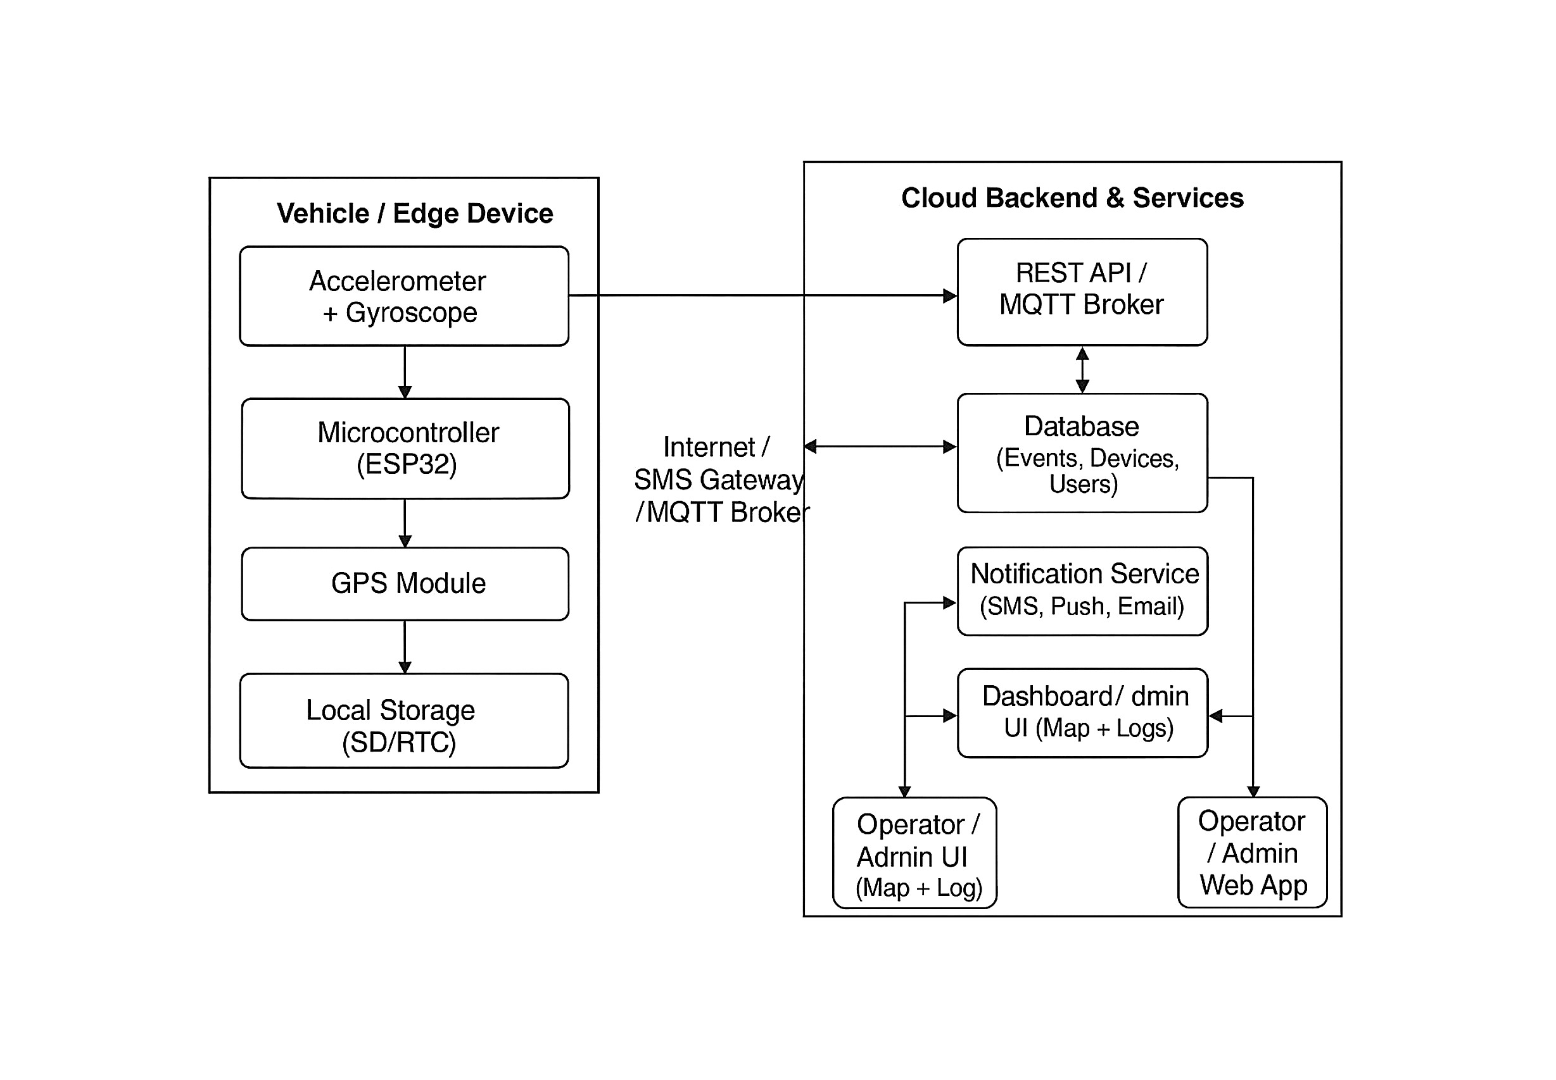
System Architecture :-
8
LGNSCOE, Nashik

Slide 9
Algorithm
Step 1: Start
Step 2: Initialize all modules
Initialize Accelerometer, Gyroscope, GPS, and
Communication module (ESP32 Wi-Fi/SMS).
Step 3: Continuously read sensor data
Read acceleration and gyroscope values from the sensors at regular intervals.
Step 4: Check for abnormal conditions
If sudden change in acceleration or angle exceeds the predefined threshold: → Possible accident detected.
Else, go back to Step 3 (continue monitoring).
Step 5: Confirm accident
Optionally, check for multiple readings to confirm accident (to reduce false alarms).
If confirmed → proceed to Step 6.
Step 6: Fetch GPS location
Get current latitude and longitude from the GPS module.
9

Slide 10
Step 7: Send alert message
Prepare an alert message containing:
Accident detection info
GPS coordinates
Vehicle ID / Device ID
Timestamp
Send the message to:
Cloud server (via Internet/MQTT)
Emergency contacts (via SMS or Email)
Step 8: Cloud processing
Cloud receives alert → stores in database.
Cloud triggers notification service → sends alerts to admin, operator, and emergency contacts.
Step 9: Display on dashboard
The Admin Dashboard updates the map with the vehicle’s live accident location and logs the event.
Step 10: End

Slide 11
Advantages
Instant Alert:- Sends immediate alert to contacts.
GPS Tracking:- Tracks real-time accident location.
Saves Lives:- Helps provide quick medical help.
Automatic System:- Reduces human error.
Low Cost:- Simple and affordable IoT solution.
Data Storage:- Stores data for future use.
Smart City Use:- Can be used in smart city systems.
11
LGNSCOE, Nashik

Slide 12
Dis-Advantages
Internet Needed:- Works only with internet connection.
False Alerts:- May send wrong alerts sometimes.
Power Use:- Needs continuous power supply.
Maintenance:- Sensors need regular check-up.
Poor Network:- Alerts may fail in weak network areas.
Privacy Issue:- Location tracking may affect privacy.

Slide 13
Application
Used on highways to detect accidents automatically.
Helps hospitals and ambulances respond faster.
Assists police and traffic control in managing accidents.
Supports smart city traffic and safety systems.
Can be installed in modern vehicles for safety.
Useful for research, study, and IoT development projects.
13
LGNSCOE, Nashik

Slide 14
Software & Hardware Requirements
Hardware:-
ESP32/Arduino microcontroller
MPU6050 accelerometer & gyroscope
NEO-6M GPS module
SIM800L GSM module
Rechargeable battery
Voltage regulator
Casing & connectors
Software:-
Arduino IDE
Embedded C/C++
MQTT/HTTP communication protocols
Firebase/Thingspeak cloud platform
Google Maps API for location visualization

Slide 15
Future Scope :-
This system can be improved using AI and Machine Learning for better accuracy.
It can be connected with hospitals, police, and ambulance services.
A mobile app can be developed for real-time alerts and tracking .
Cloud storage can be used to save and analyze accident data .
It can be integrated with smart city systems and traffic signals.
Advanced features like driver health monitoring and voice alerts can be added .
The system can help in improving road safety and saving lives in the future .

Slide 16
Conclusion
The Smart Accident Detection and Alert System using IoT is an innovative project designed to improve road safety and reduce the number of fatalities caused by delayed medical help. This system uses IoT-based sensors, GPS, and communication modules to detect accidents in real time and send instant alerts to emergency services and registered contacts.
By providing quick information about the accident location, the system helps in faster rescue operations and timely medical assistance.
It minimizes human involvement and errors by working automatically and ensures that help reaches the victim as soon as possible.
Overall, this IoT-based system is a cost-effective, reliable, and efficient solution for modern transportation networks.
It can be further enhanced and integrated with smart city infrastructure to create a safer and more connected environment for all road users.
16
LGNSCOE, Nashik

Slide 17
References
IEEE Transactions on Intelligent Transportation Systems (2019)
IJERT – Accident Detection and Alerting System using GSM (2020)
Springer – Real-Time Crash Detection Using ML (2021)
WHO Global Road Safety Report (Latest Edition)
Elsevier – Smartphone-Based Accident Monitoring (2020)
IoT-Based Remote Monitoring Research Journals (Multiple Sources
17
Seminar Name LGNSCOE, Nashik

Slide 18
Thank you
Questions…..
18
LGNSCOE, Nashik

