Slide 1
A RESTful Approach
to the
Management of a Cloud Infrastructure
Team Cirrus:
Siddharth Sujir Mohan
Suraj Rao
Vageesh Bhasin

Slide 2
Project Description
The project aims at allowing users to manage and monitor various cloud services provided by the cloud platform.
The project integrates the ability to manage and monitor cloud services with a user-friendly web portal allowing the user to perform the management and monitoring tasks on any DevStack/OpenStack cloud platform.
A user will be able to login to a cloud infrastructure built on DevStack/OpenStack platform via the web.
Once user authentication is successful, the user can then deploy and withdraw cloud services like Computing (Nova), Identity Service(Keystone), Image Service(Glance), Object Storage(Swift) and Block Storage(Cinder).
The user will also be able to monitor the resource usage of the services as well as generate reports of resource utilization.

Slide 3
Project Description (cont.)
Task | Sub-Task | Team Member | Work Percentage
Cloud | Environment Setup | Siddharth/Suraj | 7.5
 | DevStack Configuration | Suraj/Vageesh | 10
 | DevStack Deployment | Suraj/Vageesh | 10
 | Services Testing | Vageesh/Siddharth | 7.5
Web Application | Environment Setup | Suraj/Vageesh | 5
 | Server-Side Development | Vageesh/Siddharth | 10
 | Client-Side Development | Siddharth/Suraj | 10
 | Smoke Testing | Suraj/Vageesh | 5
 | Application Deployment | Vageesh/Siddharth | 5
API Integration | Network Setup | Suraj/Siddharth | 5
 | Server-Side Methods Development | Vageesh/Siddharth | 10
 | Integration Testing | Siddharth/Suraj | 5
Documentation | Reports | All | 2.5
 | Power-point Presentation | All | 2.5
 | Demo | All | 5

Slide 4
Technical Details
Hardware used
  Laptop Configuration:
    Intel 64-bit i7 Processor
    8GB RAM
  Virtual Machines Configuration:
    Intel 64-bit Processor
    4GB RAM
Software Used
  Applications/Platform: Oracle VM VirtualBox, DevStack/OpenStack Cloud Platform, Ubuntu Server OS 14.04, Node.js
  Framework: Express.js
  API: DevStack/OpenStack API
  IDEs: Text Editor (Sublime Text)

Slide 5
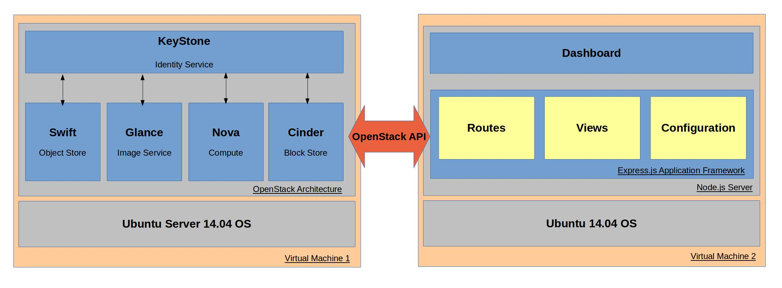
Technical Details (cont.)
System Model and Architecture

Slide 6
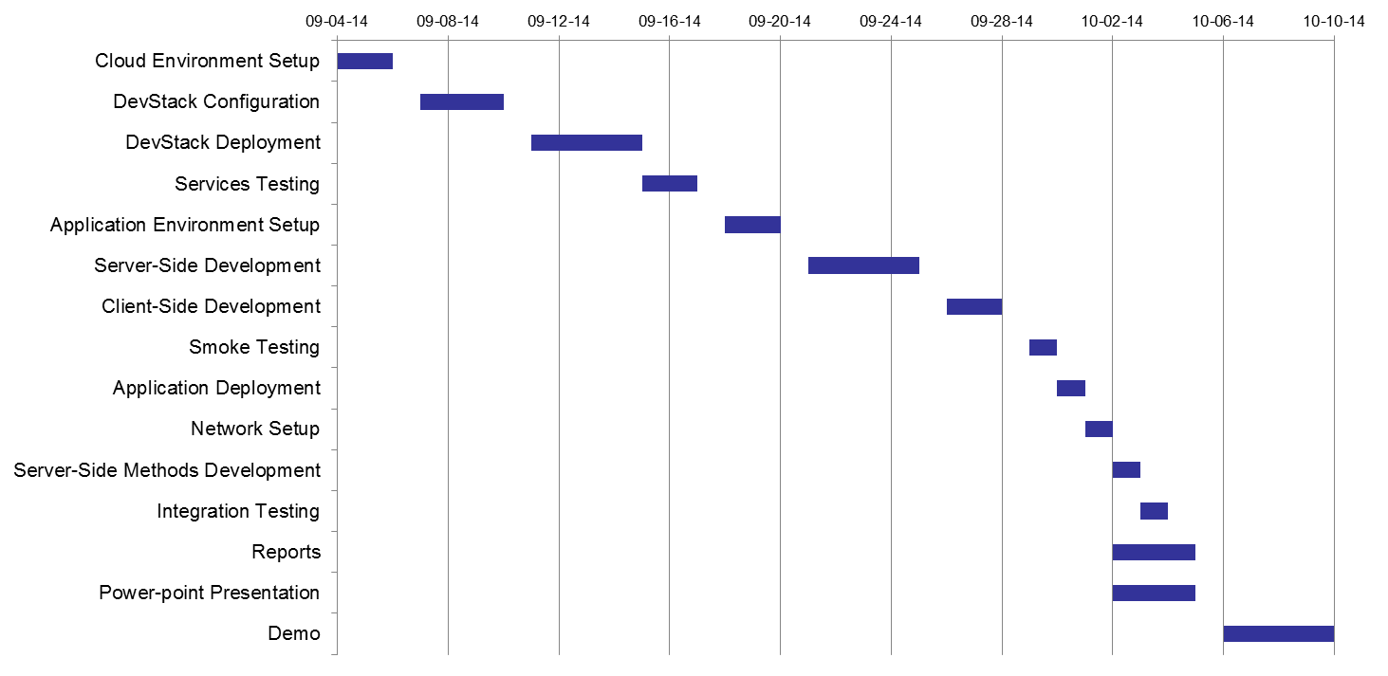
Technical Details (cont.)
Project Roadmap

Slide 7
Technical Details (cont.)
OpenStack:
A Cloud operating system that manages large pools of compute, storage and networking resource throughout a data center
Released under the term of Apache License that provides Infrastructure as a Service (IaaS)
Has a modular architecture and has several shared services that span the three pillars of compute, storage and networking
The other Services include identity, and image management
DevStack is a developer flavor of OpenStack, and is not meant to be production-ready

Slide 8
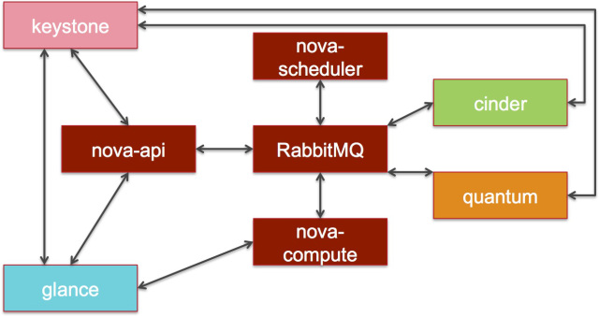
Technical Details (cont.)
Compute (Nova):
Manages and automates computer resources
Works with wide range of virtualization techniques, bare metals and High Computing(HPC) configurations
Shared-nothing, message-based architecture
Uses RabbitMQ for messaging
Figure 1: Nova Architecture

Slide 9
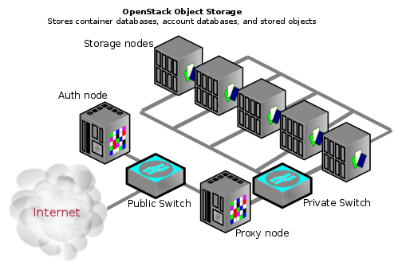
Technical Details (cont.)
Object Storage (Swift):
Highly available, distributed, eventually consistent object/blob store
Enables users to store, retrieve, and delete objects (with their associated metadata) in containers via a RESTful HTTP API
Provides replication feature to protect from disk failure etc.
Figure 2: Swift Architecture

Slide 10
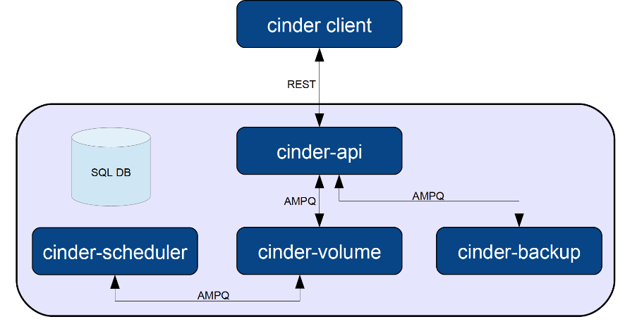
Technical Details (cont.)
Block Storage (Cinder):
Provides block level storage service to be used with compute instances.
Manages attaching, detaching and creation of the block storage devices to servers
Virtualizes pools of block storage devices
Snapshot management allows backup of data stored in block devices.
Figure 3: Cinder Architecture

Slide 11
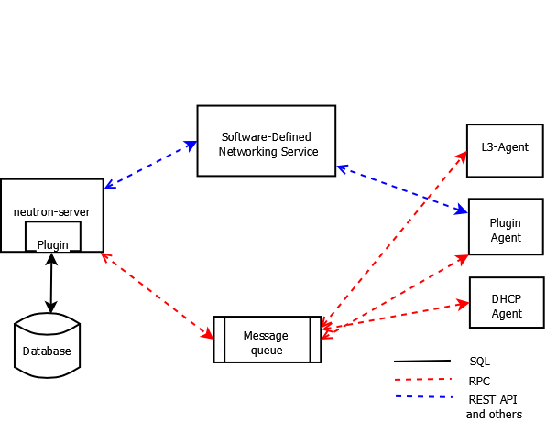
Technical Details (cont.)
Networking (Neutron):
Handles networking features of OpenStack
Pluggable, scalable API driven service
Management of networking modes for different user groups
Management of networking devices and data center assets
Allows multi tenancy and scalability through Software Defined Networking(SDN)
Figure 4: Neutron Architecture

Slide 12
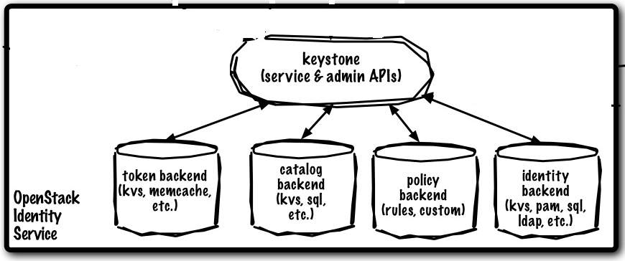
Technical Details (cont.)
Identity (Keystone):
Identity management service for OpenStack
Provides a common authentication system for all services
Can be integrated with LDAP
Authentication mechanisms allowed are username/password, token-based, Amazon web service login.
Figure 5: Keystone Architecture

Slide 13
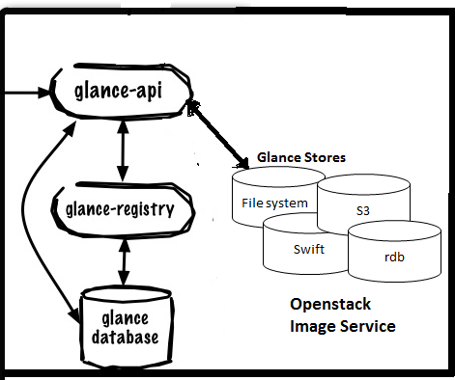
Technical Details (cont.)
Image Service (Glance):
Image management service
Provides discovery, registration, delivery services for server images
Provides RESTFul API to manage server images and querying information about images
Can use Swift or Cinder service to store disk/server images
Figure 6: Glance Architecture

Slide 14
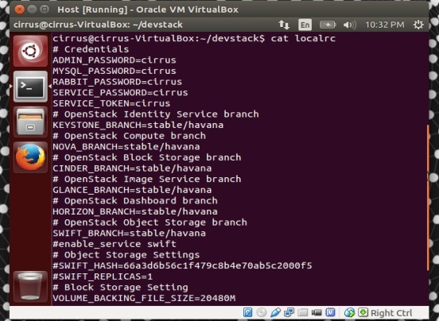
Technical Details (cont.)
OpenStack Configuration File (Localrc):
Used to provide configuration details, passwords and enabling/disabling flags for OpenStack Services
Sample localrc file:
DATABASE_PASSWORD=password
RABBIT_PASSWORD=password
SERVICE_TOKEN=password
SERVICE_PASSWORD=password
ADMIN_PASSWORD=password
FLAT_INTERFACE=eth0
LOGFILE=/home/stack/stack.sh.log
Figure 7a: Sample localrc file
Figure 7b: Details localrc file

Slide 15
Technical Details (cont.)
Web Application Architecture Overview:
Client UI developed using HTML and CSS
Server side code written in JavaScript framework (Express.js) running on Node.js server
Host OS
Figure 8: Web Application Architecture

Slide 16
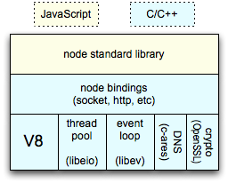
Technical Details (cont.)
Server (Node.js):
A platform for building fast, scalable network applications
Built on Google Chrome's JavaScript runtime
Uses asynchronous, event driven, non blocking I/O model
Built-in package management (NPM) for installing, updating and removal of reusable packages. The packages are available through online repositories
Useful for creating data intensive real time applications dealing with distributed devices.
Figure 9: Node.js Architecture

Slide 17
Technical Details (cont.)
Application Framework (Express.js):
A minimal node.js web application framework
Helps build single and multi-page, and hybrid web applications
Three layers
  Server layer (Node.js)
  Middleware (Request and response handlers)
  Routing (Routes mapping to handlers)

Slide 18
Technical Details (cont.)
RESTful Services:
An architectural style that specifies constraints, like:
  Client/Server architecture
  Stateless communication protocol (typically HTTP)
  Data and functionality are considered as resources and are accessed using Uniform Resource Identifiers(URIs)
A concrete implementation of REST web service should follow:
  Use HTTP methods explicitly
  Be stateless
  Expose directory like structure
  Transfer XML, JSON, or both

Slide 19
Implementation
The following services have been implemented on our Cloud management portal
  Authentication
  User Management
  Domain Management
  Project Management
  Role Management
  Compute Services
  Imaging Services
  Block Storage Services

Slide 20
Configuration
Port Forwarding
Each of the OpenStack services operate on a different port number.
In order to manage the OpenStack services from the host machine, we need to map the guest machine port numbers used by these services to the host machine
For each service, we map the default port of the service to the corresponding port on the host machine.

Slide 21
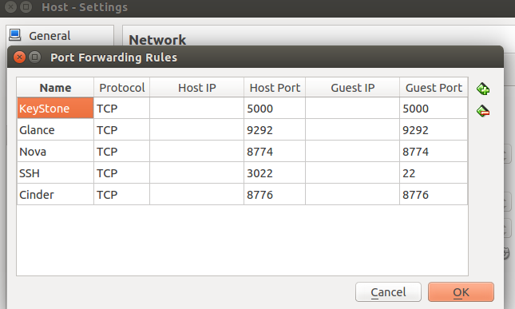
Configuration (Contd.)
Port Forwarding:
Figure 10: Port Forwarding Entries

Slide 22
Configuration (Contd.)
Before making API calls to the services, we have to make sure that Auth-Token middleware is part of their authentication pipeline
Configuring Nova:
  The ‘nova-paste-config.ini’ is modified to include keystone in its authentication pipeline. Below is an example:
        [filter:authtoken]
        paste.filter_factory
        keystoneclient.middleware.auth_token:filter_factory
        auth_port = 35357
        auth_host = 127.0.0.1
        auth_token = 012345SECRET99TOKEN012345
        admin_user = admin
        admin_password = keystone123

Slide 23
Configuration (Contd.)
Configuring Glance:
  The ‘glance-api-paste.ini’ and ‘glance-registry-paste.ini’ are modified to include keystone in its authentication pipeline. Below is an example:
    [filter:authtoken]
    paste.filter_factory = keystonemiddleware.auth_token:filter_factory
    auth_host = 127.0.0.1
    auth_port = 35357
    auth_protocol = http
    admin_user = glance_admin
    admin_tenant_name = service_admins
    admin_password = password1234
    [pipeline:glance-registry-keystone]
    pipeline = authtoken context registryapp

Slide 24
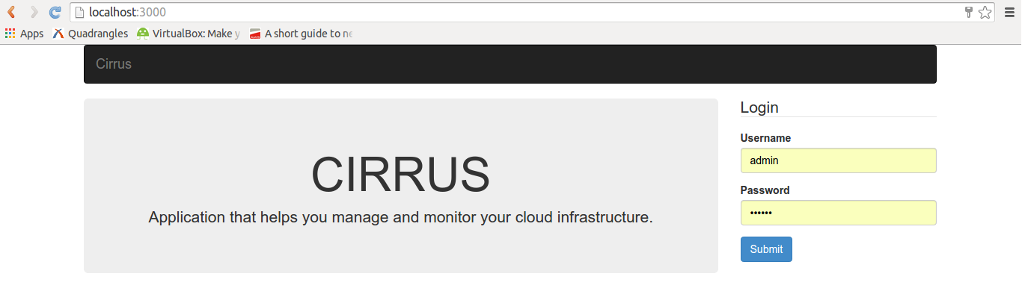
Service Functions
Authentication:
  OpenStack services are authenticated using a token based system, which is generated when a user provides valid credentials.
  Application takes the user’s credentials and makes an API call to Identity to generate a token.
  Token is stored in the applications session management. When the tokens are need in future, it is extracted from the session.
Figure 11: Login Screen

Slide 25
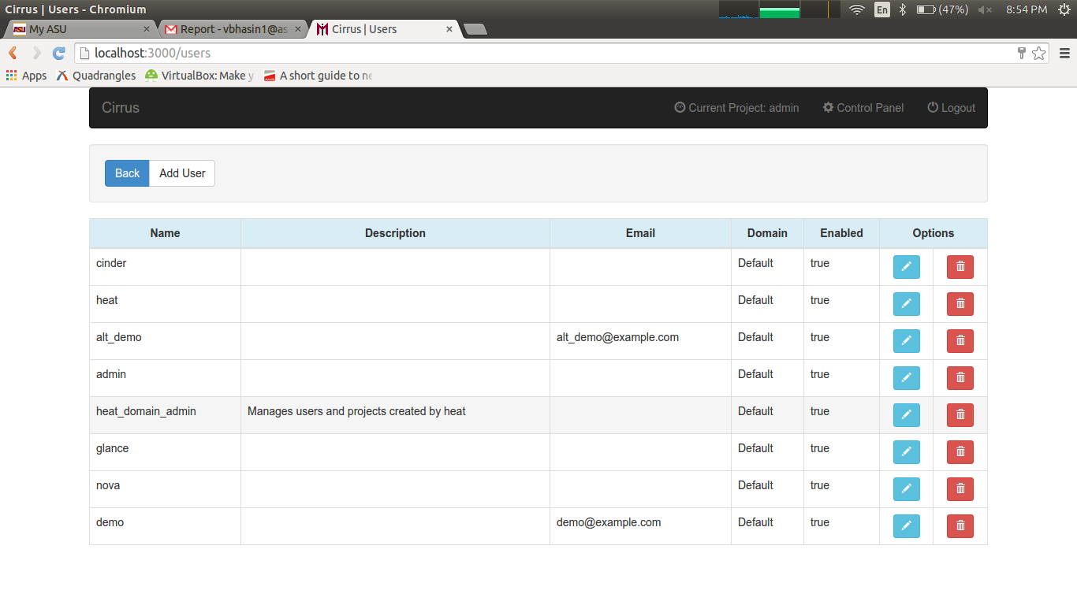
Service Functions (Contd.)
User Management:
  The application provides interface for user management functions such as creating a new user, viewing the existing users and deleting a user.
Figure 12: User Management

Slide 26
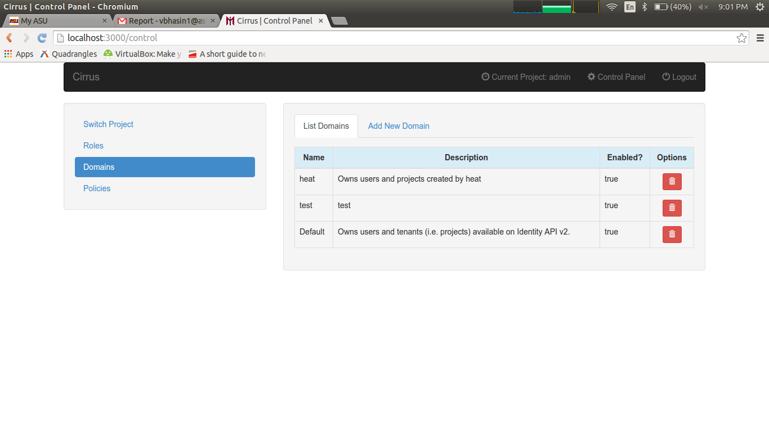
Service Functions (Contd.)
Domain Management:
  Domains represent collections of users, projects and groups.
  The application provides interface to map user actions for viewing, creating and deleting domains to API calls
Figure 13: Control Panel and Domain Management

Slide 27
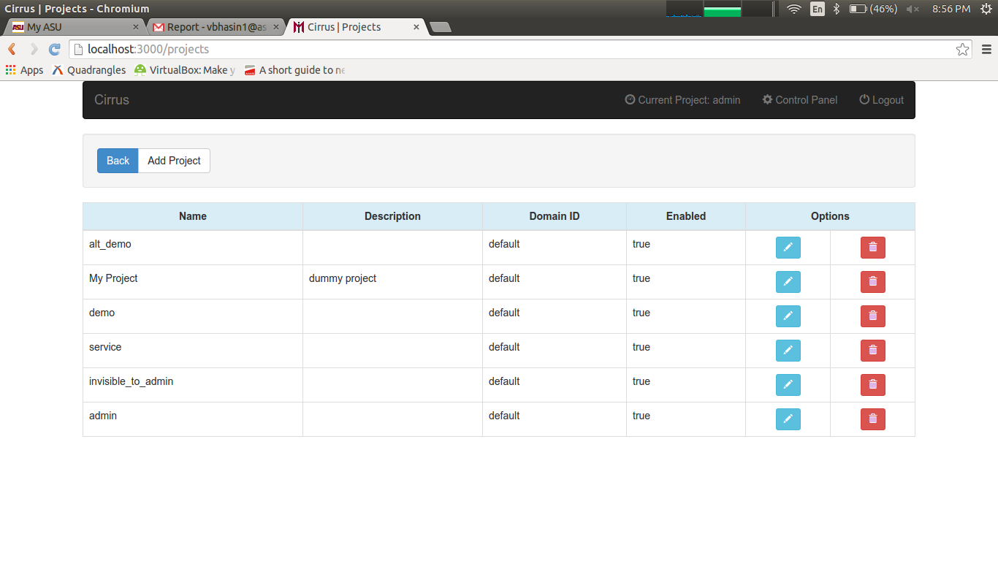
Service Functions (Contd.)
Project Management:
  Projects (also called tenants) are isolated resource containers forming the principal organizational structure within the Compute service.
  The application provides a user to view, create, delete and switch projects.
Figure 14: Project Management

Slide 28
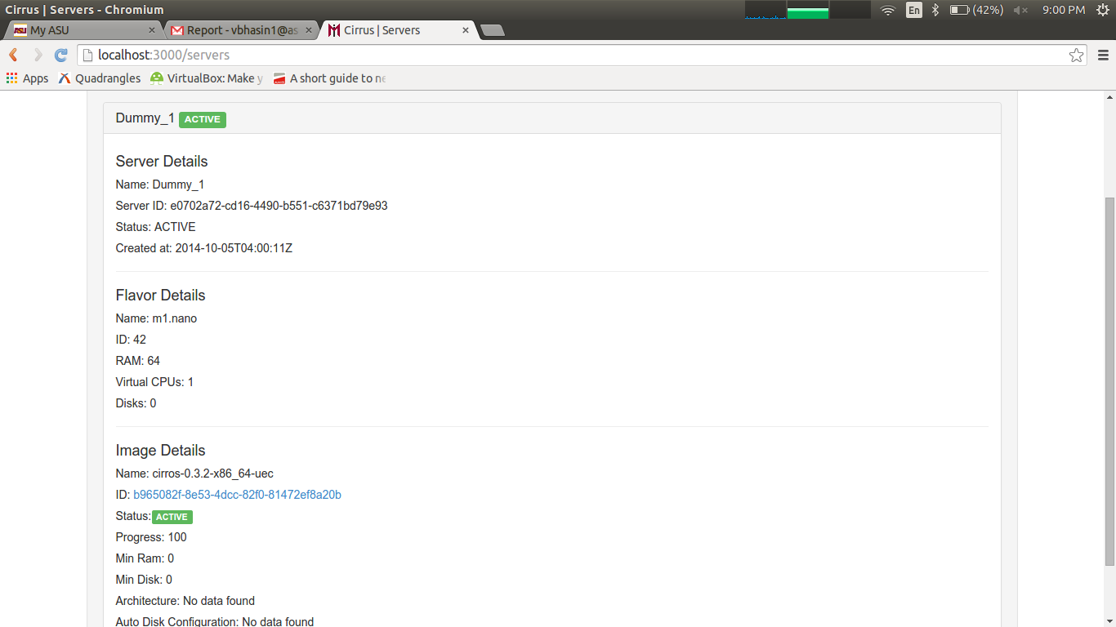
Service Functions (Contd.)
Compute Services:
  Nova provides the software that can control an Infrastructure as a Service (IaaS) cloud computing platform
  The application provides an interface to map the user actions of viewing, creating, updating (rebooting, resizing and properties modification) and deleting of server instances.
Figure 15: Server Management

Slide 29
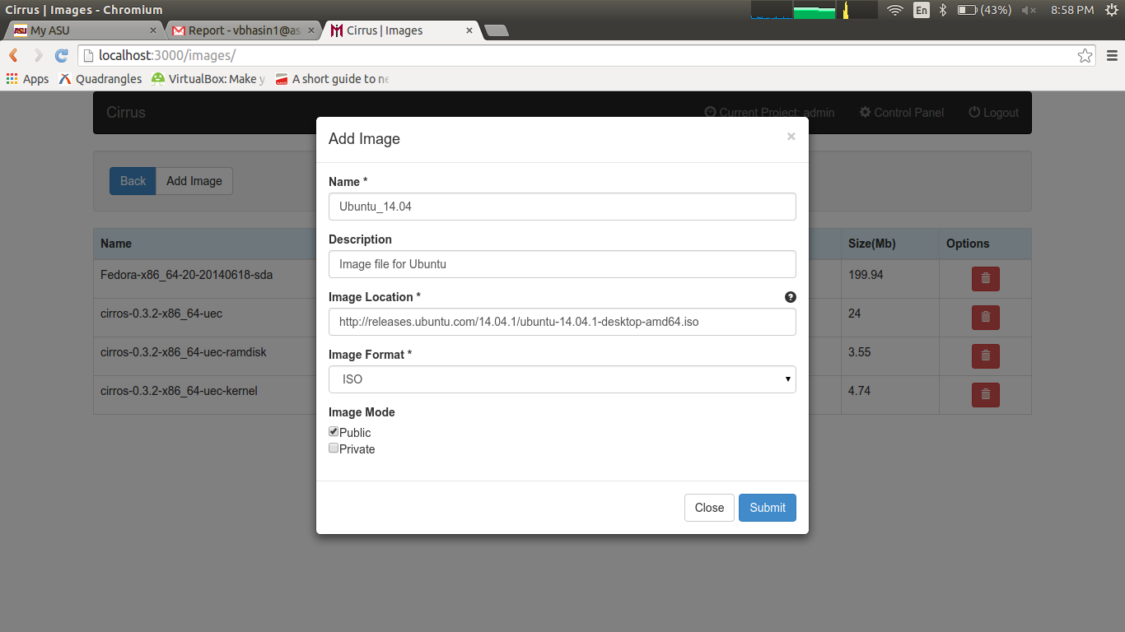
Service Functions (Contd.)
Imaging Services:
  The OpenStack Image Service enables users to discover, register, and retrieve virtual machine images.
  The application provides an interface to map the user actions of viewing, updating(metadata properties), uploading(image files) and deleting the images.
Figure 16: Image Management

Slide 30
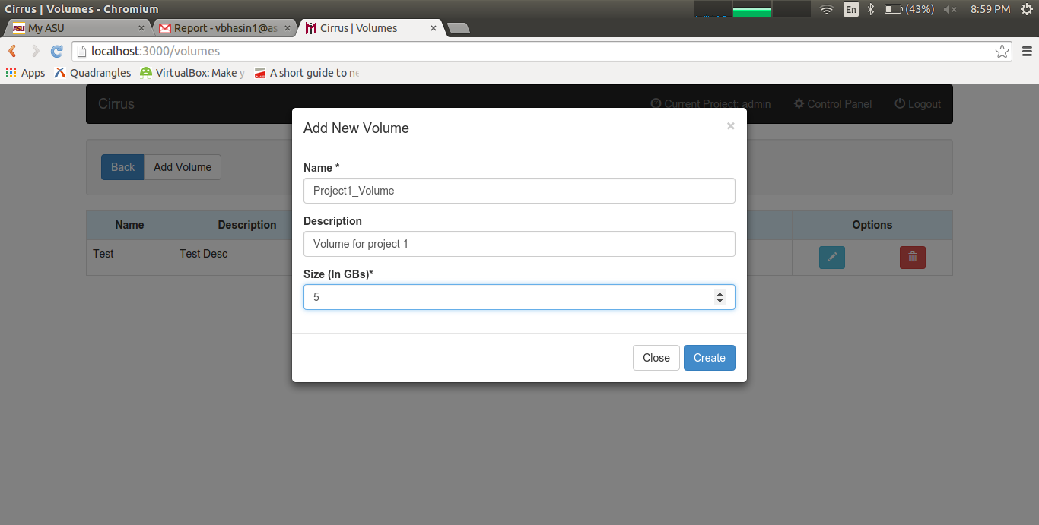
Service Functions (Contd.)
Block Storage Services:
  The Block Storage Service enables management of volumes, volume snapshots, and volume types.
  The application provides an interface to map user actions of viewing, creating and deleting the volumes.
Figure 17: Storage Management

Slide 31
Risks and Benefits
Novel aspects of this project:
  Deployment of a cloud service is a very time-consuming problem that expects a high level of understanding of the cloud environment.
  It involves setting up configuration files and executing setup scripts on the host machine.
  Monitoring of available resources is another area that requires addressing due to the fact that the service instances have a limited resource pool.
Risks and Challenges:
Risk Description | Likelihood | Impact | Priority | Mitigation Strategy
Network Connectivity | Medium | High | High | Virtual machines to use same network adapter
DevStack feature not supported by API | Low | Medium | Medium | Extend the API to integrate the required feature
Physical Machine Overload | High | High | High | Use a higher configuration machine or vLab

Slide 32
Benefits
Potential applications & benefits:
  Provides a user friendly and intuitive web application to perform administrative tasks in a DevStack cloud platform
  Users can remotely connect to the cloud platform and deploy and withdraw services. They can also monitor resource utilization and generate statistic reports of the utilization.
  The project can be extended to allow the application to connect to a multi-node environment.
  The project can be enhanced to allow the application to provide the management and monitoring tasks for other cloud platform solutions as well, like XenServer, XCP, etc.

Slide 33
Tasks Accomplished by Now
Cloud Infrastructure:
  VM running Host OS has been setup
  DevStack (Havana build) has been downloaded, installed and set-up on the machine
  DevStack is in running state with Nova, Glance, Cinder, Swift, Identity services enabled
  VM has been assigned a static IP to allow communication with application server for API usage
  VM ports have been forwarded to allow host machine to communicate with the VM
Web Application:
  Server-side code structure has been setup
  Application for the specified functions is created and is running smoothly

Slide 34
Tasks Not Implemented
New Services:
  Object Storage Services:
    Swift has been configured and is enabled
    API calls from application is missing
  Networking Services:
    Neutron services to be setup
Known Issues with Existing Services:
  Image service takes a lot of time to download image file and upload it to Glance
    Solution: Create a separate process to download the image to application server and then upload it to Glance via API

Slide 35
Conclusion
We are attempting to provide a user friendly and intuitive web application to perform administrative tasks in a DevStack cloud platform. This will also provide the administrator with a remote access to the system.
The future scope for this project would be to extend this application to
  include a heterogeneous cloud infrastructure which can include different cloud environments like XenServer and XCP
  allow the application to connect to a multi-node environment.
  port the application to run on hand-held devices like smartphones and tablets.

