Slide 1
Diagrams for GAPS
Siddharth Sule

Slide 2
GAPS v1 Diagrams

Slide 3
Generate
Trial Emission
Accept / Veto
Make Parton
t = t_{Max}
n_{Em} = 0
t = t₁
n_{Em} = 0
t = t₁
n_{Em} = 0
t = t₁
n_{Em} = 1
End
Generate
Trial Emission
Accept / Veto
t = t_{Max}
n_{Em} = 0
t = t₁
n_{Em} = 0
Generate
Trial Emission
Accept / Veto
Make Parton
t = t₁
n_{Em} = 0
t = t₂
n_{Em} = 0
t = t₂
n_{Em} = 0
t = t₂
n_{Em} = 1
End

Slide 4
Generate Trial Emission
Accept / Veto
Make Parton
t_{Max}
0
t₁
0
t₁
0
t₁
1
t₁
1
t₁
1
t₁
1
End
t_{Max}
0
t₁
0
t₁
0
t₁
1
t₁
1
t₁
1
t₁
1
End
Generate Trial Emission
Accept / Veto
Make Parton
t_{Max}
0
t₁
0
t₁
0
t₁
0
t₂
0
t₂
0
t₂
1
End
t_{Max}
0
t₁
0
t₁
0
t₁
0
t₂
0
t₂
0
t₂
0
End
More Vetoing

Slide 5
Generate Trial Emission
Accept / Veto
Make Parton
Generate Trial Emission
Accept / Veto
Make Parton
t_{Max}
0
t₁
0
t₁
0
t₁
1
t₂
1
t₂
1
t₂
2
…
t_{Max}
0
t₁
0
t₁
0
t₁
1
t₂
1
t₂
1
t₂
1
…
t_{Max}
0
t₁
0
t₁
0
t₁
0
t₂
0
t₂
0
t₂
1
…
t_{Max}
0
t₁
0
t₁
0
t₁
0
t₂
0
t₂
0
t₂
0
…
Cycle 1
Cycle 2

Slide 6
Different n_{Em} = Divergence?
Generate Trial Emission
Accept / Veto
Make Parton
Generate Trial Emission
Accept / Veto
Make Parton
t_{Max}
0
t₁
0
t₁
0
t₁
1
t₂
1
t₂
1
t₂
2
…
t_{Max}
0
t₁
0
t₁
0
t₁
1
t₂
1
t₂
1
t₂
1
…
t_{Max}
0
t₁
0
t₁
0
t₁
0
t₂
0
t₂
0
t₂
1
…
t_{Max}
0
t₁
0
t₁
0
t₁
0
t₂
0
t₂
0
t₂
0
…
Empty/Waiting Threads?
Cycle 1
Cycle 2

Slide 7
Different n_{Em} = Divergence?
GPU handles it!
Generate Trial Emission
Accept / Veto
Make Parton
Generate Trial Emission
Accept / Veto
Make Parton
t_{Max}
0
t₁
0
t₁
0
t₁
1
t₂
1
t₂
1
t₂
2
…
t_{Max}
0
t₁
0
t₁
0
t₁
1
t₂
1
t₂
1
t₂
1
…
t_{Max}
0
t₁
0
t₁
0
t₁
0
t₂
0
t₂
0
t₂
1
…
t_{Max}
0
t₁
0
t₁
0
t₁
0
t₂
0
t₂
0
t₂
0
…
Not efficient, but OK!
Empty/Waiting Threads?
Cycle 1
Cycle 2

Slide 8
Generate Trial Emission
Check
t > t_{c}
Generate Trial Emission
Check
t > t_{c}
m-1 cycles
t_{m}
…
Conti.
m-1 cycles
t_{m}
…
Conti.
m-1 cycles
t_{m}
…
Conti.
Generate Trial Emission
Check
t > t_{c}
m-1 cycles
t_{m}
…
Conti.
m-1 cycles
t_{m}
…
End
m-1 cycles
t_{m}
…
End

Slide 9
CPU
GPU

Slide 10
16
16
4
8

Slide 11
Calculate Acceptance Probability
Generate Trial Emission
Check t > t_{c}
Evaluate PDFs w. LHAPDF
Accept / Veto
Make Parton
t_{Max}
0
t₁
0
t₁
0
t₁
0
t₁
0
t₁
0
t₁
1
…
t_{Max}
0
t₁
0
t₁
0
t₁
0
t₁
0
t₁
0
t₁
0
…
t_{Max}
0
t₁
0
t₁
0
t₁
0
t₁
0
t₁
0
t₁
1
…
t_{Max}
0
t₁
0
t₁
0
t₁
0
t₁
0
t₁
0
t₁
0
…
Cycle 1

Slide 12
Base
Vec4
Histogram
Parton + Event
Matrix
Alpha S
Observables
Shower

Slide 13
= Unfinished Event
= Finished Event
Start Showering
50% of Events Finished
Sort by Unfinished/Finished
Continue with Smaller Kernels

Slide 14


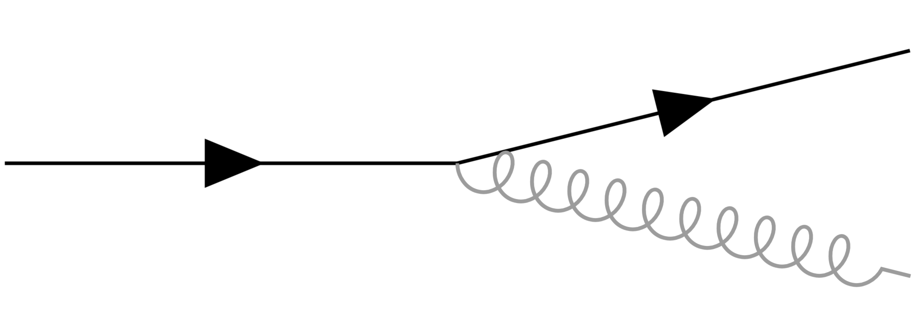

Shape
Image

Slide 15
GAPS
a GPU-Amplified Parton Shower

