Slide 1


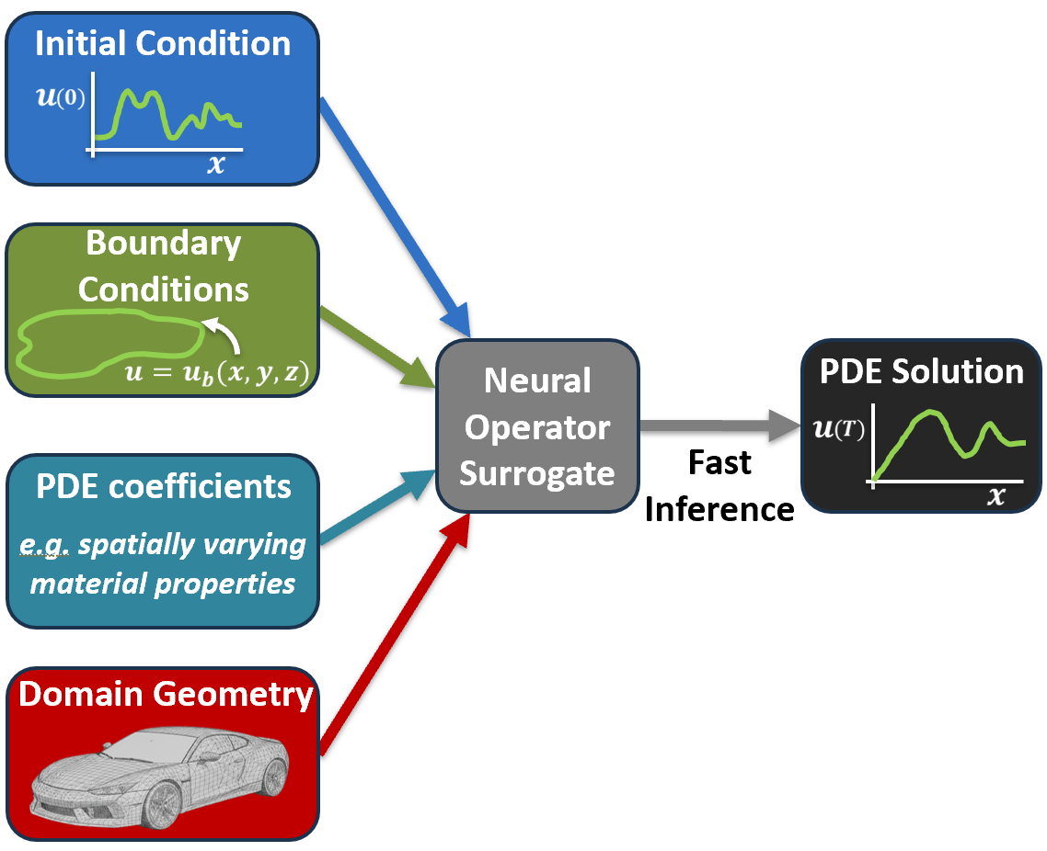
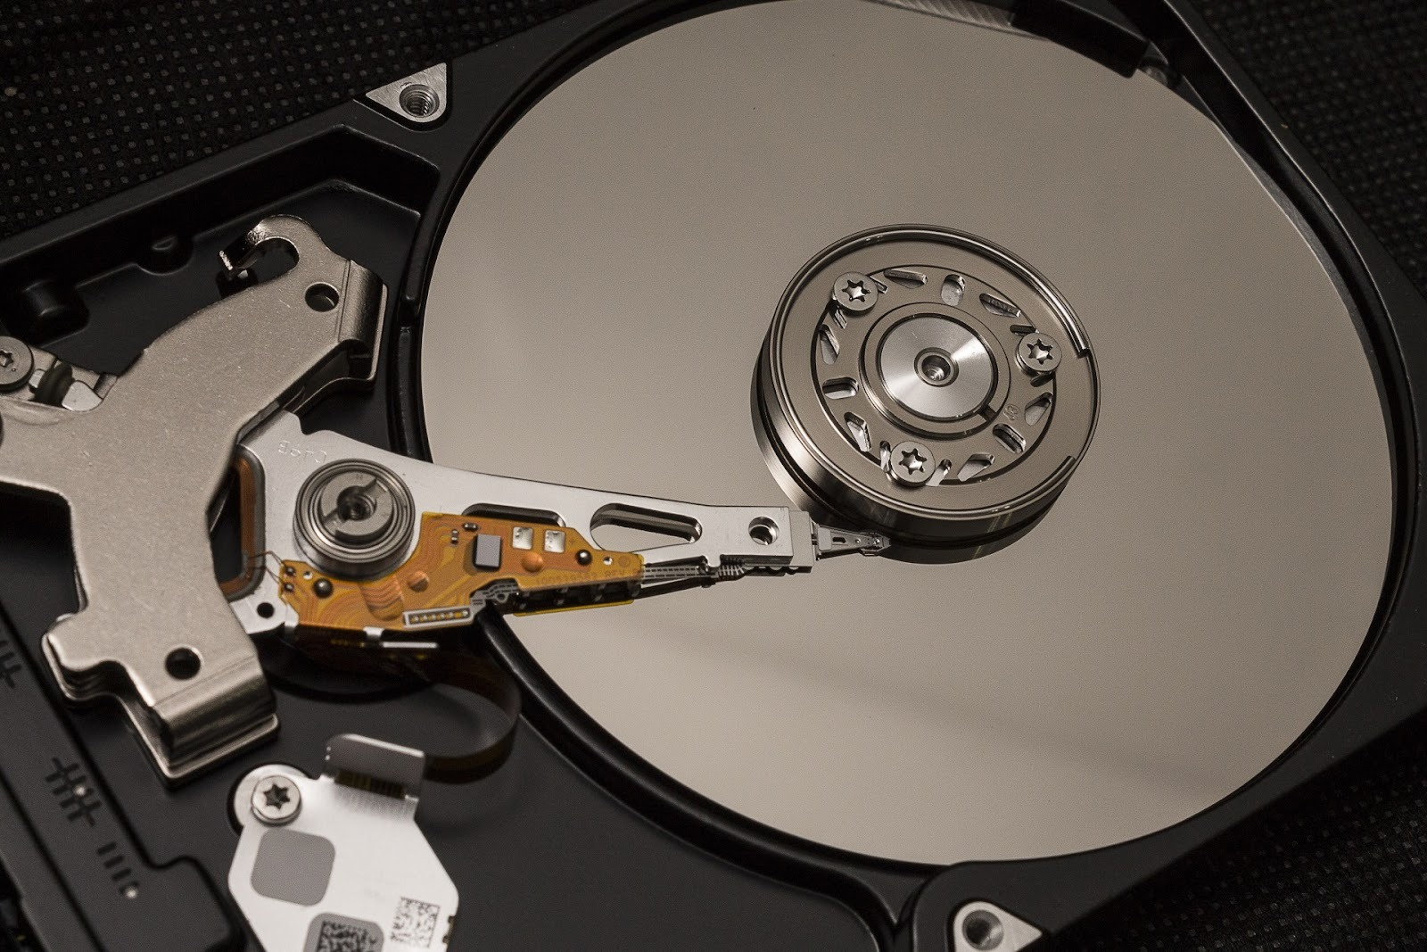
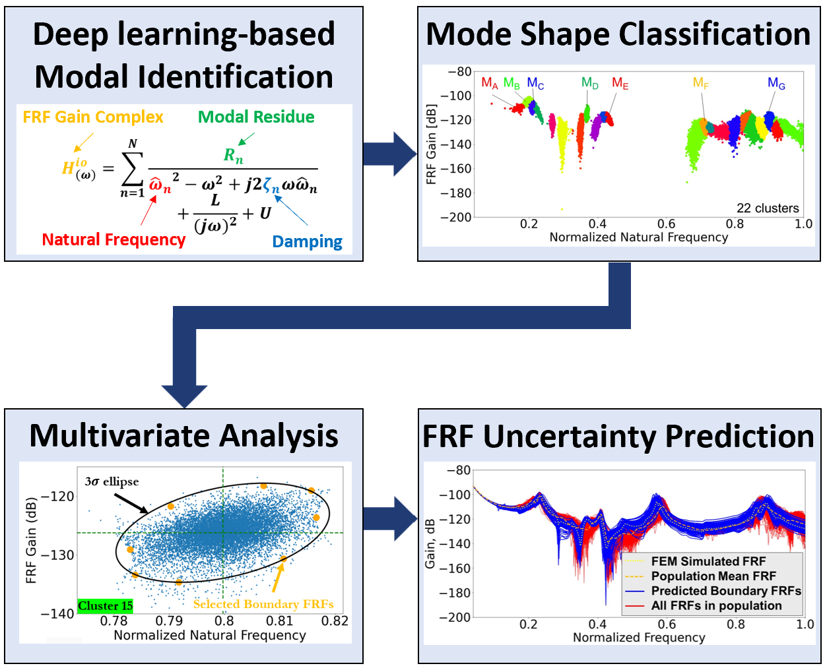
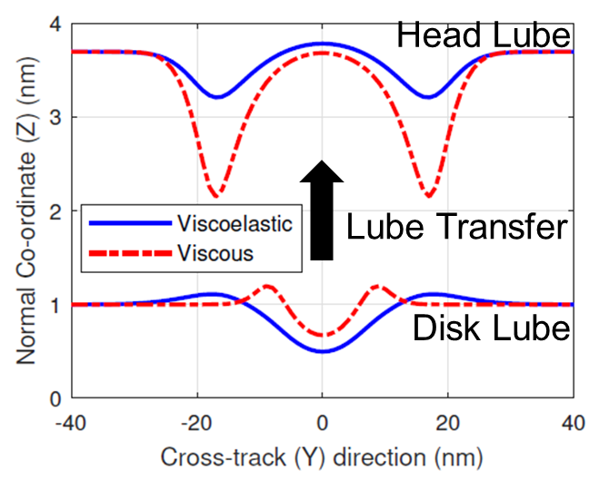
Dr. Siddhesh Sakhalkar
PhD, University of California, Berkeley, USA
Assistant Professor, Department of Mechanical Engineering
044-2257-4599; ssakhalkar@iitm.ac.in
https://mcubedlab.com/
Scientific Machine Learning (SciML) for Computational Engineering
Structural Dynamics, System Identification, Uncertainty Quantification
Micro- and Nanoscale Fluid Mechanics
Neural Operators & Foundation Models for accelerating
Engineering Simulations
System Identification and Uncertainty Quantification for Multi-Input Multi-Output Devices
Modeling Fluid Flow and Fluid-Structure Interactions in Micro- and Nanoscale Devices
Rotating Storage Disk
Recording Head
Hard Disk Drive (HDD)
Nanoscale Lubricant Flow at the HDD Head-Disk Interface
Applications:
Structural Analysis
Thermal Analysis
Fluid Mechanics
Tribology

