Slide 1

Detecting Pneumonia From Chest X-rays
An AI-driven Approach
Siddhesh Chavan

Slide 2
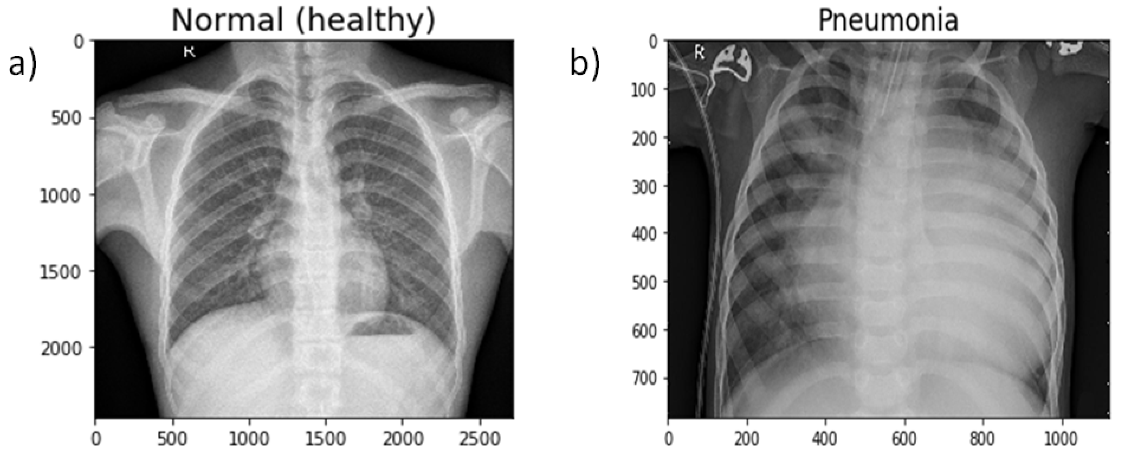

Introduction
Pneumonia is a common and serious lung infection that can be life-threatening if not treated promptly.
Early diagnosis is crucial for timely treatment and improving patient outcomes.
Utilizing AI and deep learning techniques to automate pneumonia detection from chest X-ray images.

Slide 3
Dataset Overview
The dataset is organized into 3 folders (train, test, val) and contains subfolders for each image category (Pneumonia/Normal).
There are 5,863 X-Ray images (JPEG) and 2 categories (Pneumonia/Normal).

Slide 4
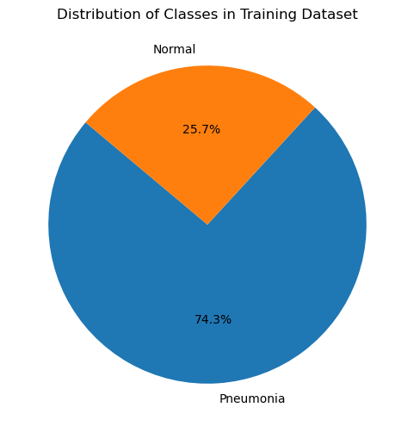
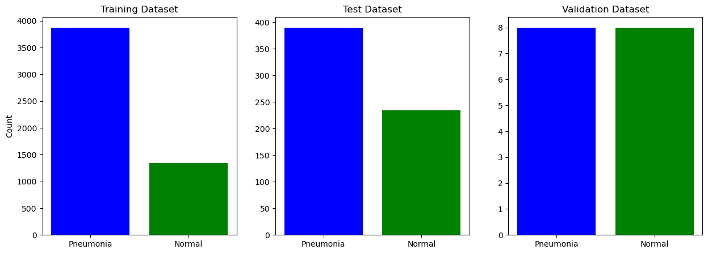
Exploratory Data Analysis
Total dataset size: 5863
Training Dataset:
Pneumonia: 3875
Normal: 1341
Test Dataset:
Pneumonia: 390
Normal: 234
Validation Dataset:
Pneumonia: 8
Normal: 8

Slide 5

Model Architecture
Convolutional Layers: In my model, we use multiple convolutional layers with increasing filter depths to capture complex patterns in the input images.
Batch Normalization: Batch normalization is employed to improve the stability and performance of the neural network.
MaxPooling Layers: MaxPooling layers downsample the feature maps obtained from convolutional layers, reducing their spatial dimensions while retaining the most important information.
Flatten Layer: The Flatten layer converts the 2D feature maps into a 1D vector, preparing the data for input into the fully connected layers.
Dense Layers: Fully connected (Dense) layers are used to perform classification based on the features extracted by the convolutional layers. The first dense layer contains 256 neurons with ReLU activation function
Output Layer: The output layer consists of a single neuron with a sigmoid activation function, producing a binary classification output indicating the presence or absence of pneumonia.

Slide 6
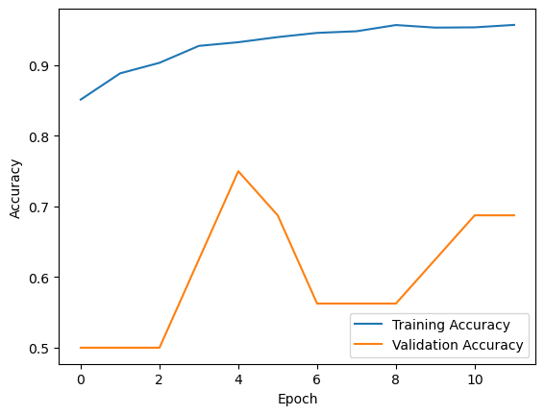
Overview of the training process
The model was trained using the training dataset, augmented using data augmentation techniques, that involves applying random transformations to the training images, such as rotation, zooming, shifting, and flipping, to increase the diversity of the training data and improve the model's ability to generalize to unseen images.
Data generators were utilized to generate batches of augmented images and corresponding labels during training. These generators facilitate efficient memory usage by generating data on-the-fly and feeding it directly to the model during training.
Training parameters:
Number of epochs: The model was trained for 12 epochs, with an epoch representing one complete pass through the entire training dataset.
Batch size: Each training batch consisted of 32 augmented images and their corresponding labels.
Callbacks: A learning rate reduction callback was employed to dynamically adjust the learning rate during training based on the validation accuracy.

Slide 7
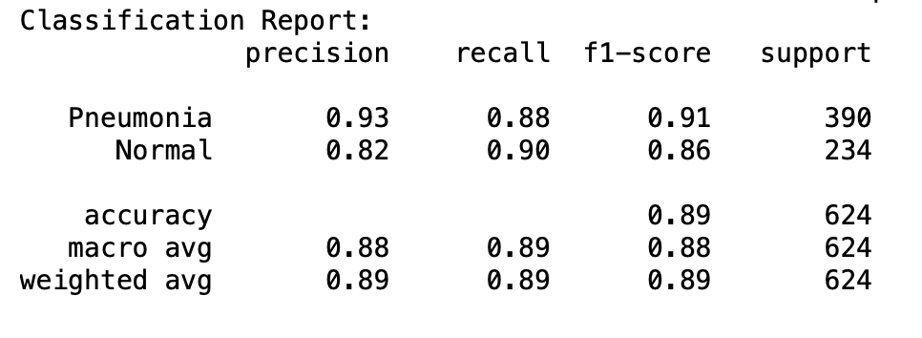
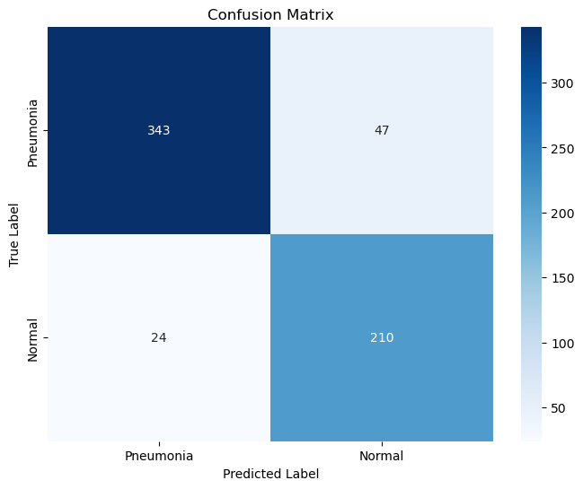
Evaluation Results

Slide 8
Conclusion
In brief, this project demonstrates the successful application of deep learning techniques for pneumonia detection from chest X-ray images. By leveraging convolutional neural networks and data augmentation, we've built an accurate and efficient diagnostic tool.
The model's high accuracy underscores its potential for real-world clinical applications, where early detection is crucial for patient outcomes. My work highlights the transformative impact of AI in healthcare, paving the way for more efficient and accessible diagnostic solutions.

Slide 9

THANK YOU!

