Slide 1
STATE MANAGEMENT IN REACT
By-Siddhesh Jadhav

Slide 2



useState() Yields An Array With Two Elements
And it will always be exactly two elements
const stateArray = useState(‘Please click a button’);
Array produced and returned by React’s useState() function
Contains exactly two elements

Slide 3









Manage State
Manage data & “tell” React to re-execute a component
function via React’s useState() Hook
State updates lead to new state values
(as the component function executes again)
const [counter, setCounter] = useState(0);
Current state value
Provided by React
State updating function
Initial state value
Stored by React
function in which useState() was called
May change if the
component function is
Executed again

Slide 4
State vs Refs
State
Refs
Causes component re-evaluation (re- execution) when changed
Do not cause component re-evaluation
when changed
Should be used for values that are directly
Can be used to gain direct DOM element
accessing certain browser APIs)
reﬂected in the UI
Should not be used for “behind the
scenes” values that have no direct UI
Can be used to expose API functions from
impact
your components
Should not be used for managing values
that have a direct UI impact

Slide 5
Introducing useReducer() for State Management
Sometimes, you have more complex state – for example if it got multiple states, multiple ways of changing it or dependencies to other states
useState() then often becomes hard or error-prone to use – it’s easy to write bad, inefficient or buggy code in such scenarios
useReducer() can be used as a replacement for useState() if you need “more powerful state management”

Slide 6
Understanding useReducer()
const [state, dispatchFn] = useReducer(reducerFn, initialState, initFn);
The state snapshot used in the component re-
render/ re- evaluation cycle
A function that can be used to
dispatch a new
action (i.e. trigger an update of the state)
The initial state
A function to set the initial state
programmatically
(prevState, action) => newState
A function that is triggered automatically once an action is dispatched (via dispatchFn()) – it receives the latest state snapshot and should return the new, updated state.

Slide 7
useState() vs useReducer()
Generally, you’ll know when you need useReducer() (➔ when using useState() becomes cumbersome or you’re getting a lot of bugs/ unintended behaviors)
useState()
useReducer()
The main state management “tool”
Great if you need “more power”
Great for independent pieces of state/ data
Should be considered if you have related pieces of state/ data
Can be helpful if you have more complex state updates
Great if state updates are easy and limited to a few kinds of updates

Slide 8
Advanced State Management
The Problem Of Shared State: Prop Drilling
Sharing State with Context Managing
Complex State with Reducers

Slide 9
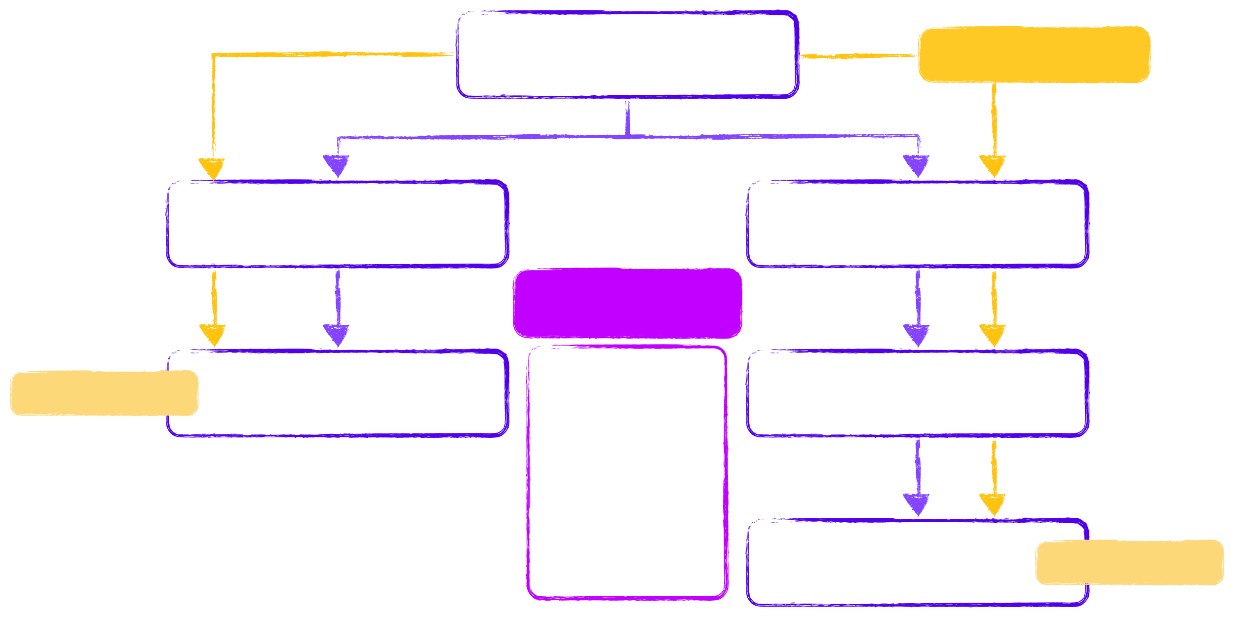
Most React Apps Consist Of Multiple Components
App
Cart State
onUpdateCart Prop
cart Prop
Shop
Header
onUpdateCart Prop
Prop Drilling
cart Prop
Update Cart
Product
Passing shared data through multiple components layers
CartModal
cart Prop
Cart
Display Cart

Slide 10
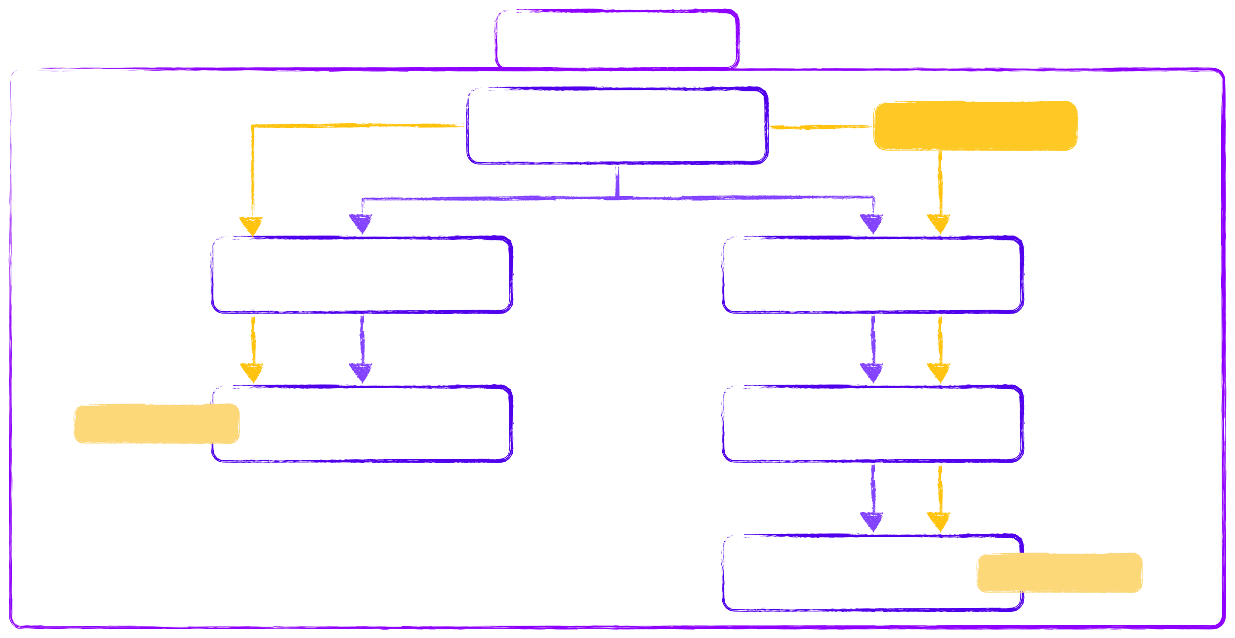
Most React Apps Consist Of Multiple Components
Cart Context
App
Cart State
onUpdateCart Prop
cart Prop
Shop
Header
onUpdateCart Prop
cart Prop
Update Cart
Product
CartModal
cart Prop
Cart
Display Cart

Slide 11
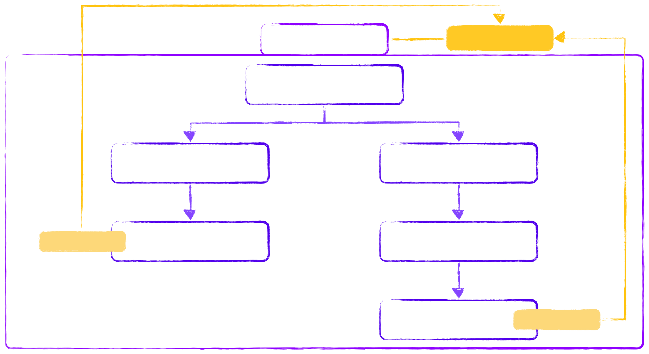
Most React Apps Consist Of Multiple Components
Cart Context
Cart State
App
Shop
Header
Update Cart
Product
CartModal
Cart
Display Cart

Slide 12


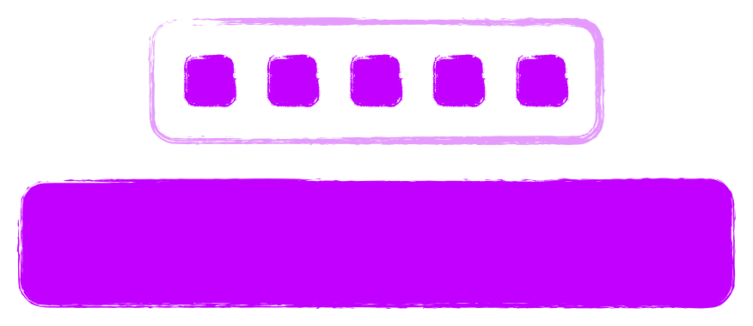




What Is Cross-Component & App-Wide State?
Local State
Cross-component State
App-wide State
State belongs to a single component
State affecting multiple components
State affecting the entire app
E.g., listening to user input on an
input ﬁeld or toggling a “show
E.g., open / closed state of a
E.g., user authentication status or
more details” ﬁeld
modal overlay
chosen theme
Should be managed inside the /
Requires “prop drilling”
Requires “prop drilling”
component via
useState()
useReducer()
Or: React Context or Redux

Slide 13
Redux
A state management system for cross-component
or app-wide state
Don’t we have React Context already?

Slide 14


React Context Has Some Potential Disadvantages
Complex Setup & Management
Performance
In more complex apps, using React Context can lead to deeply nested or “fat”
React Context is not optimized for high- frequency state changes
“Context Provider” components

Slide 15
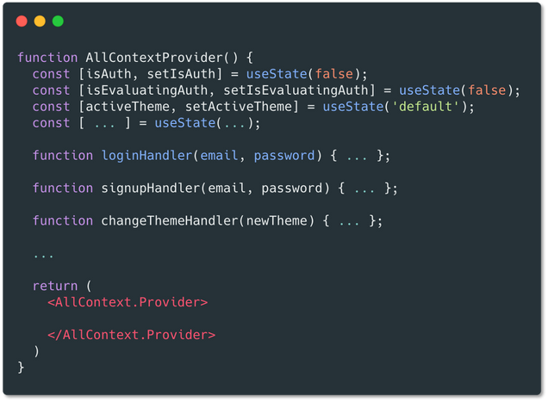
Potential Problem: Complex Providers

Slide 16
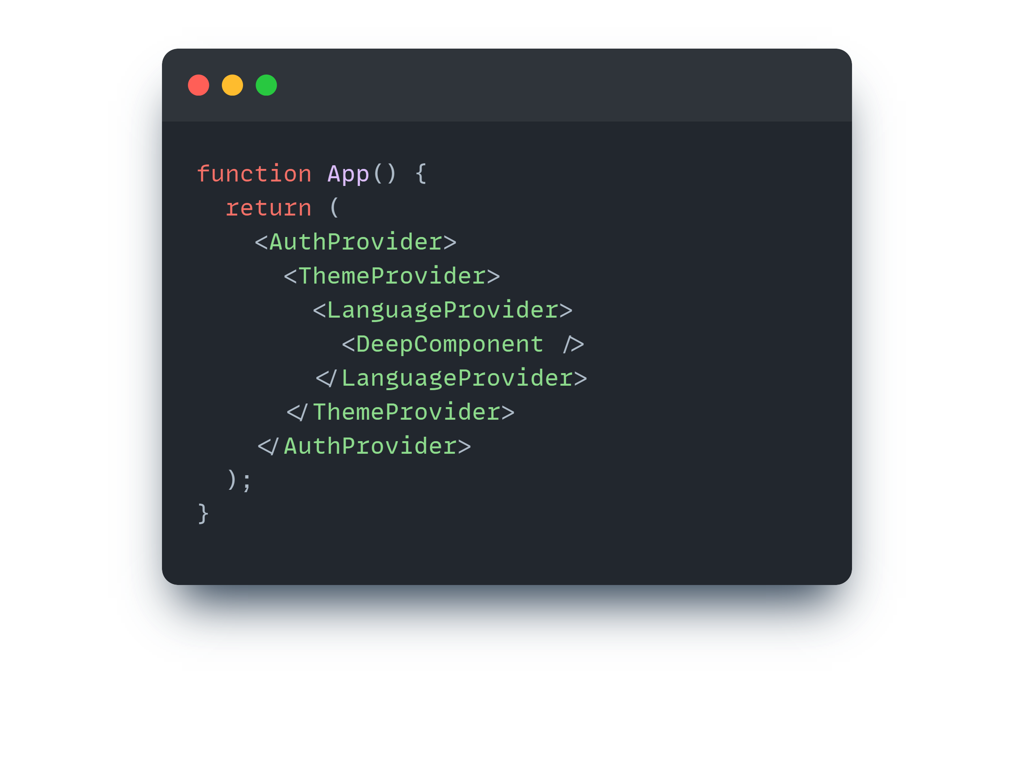
Potential Problem: Deeply Nested Providers

Slide 17
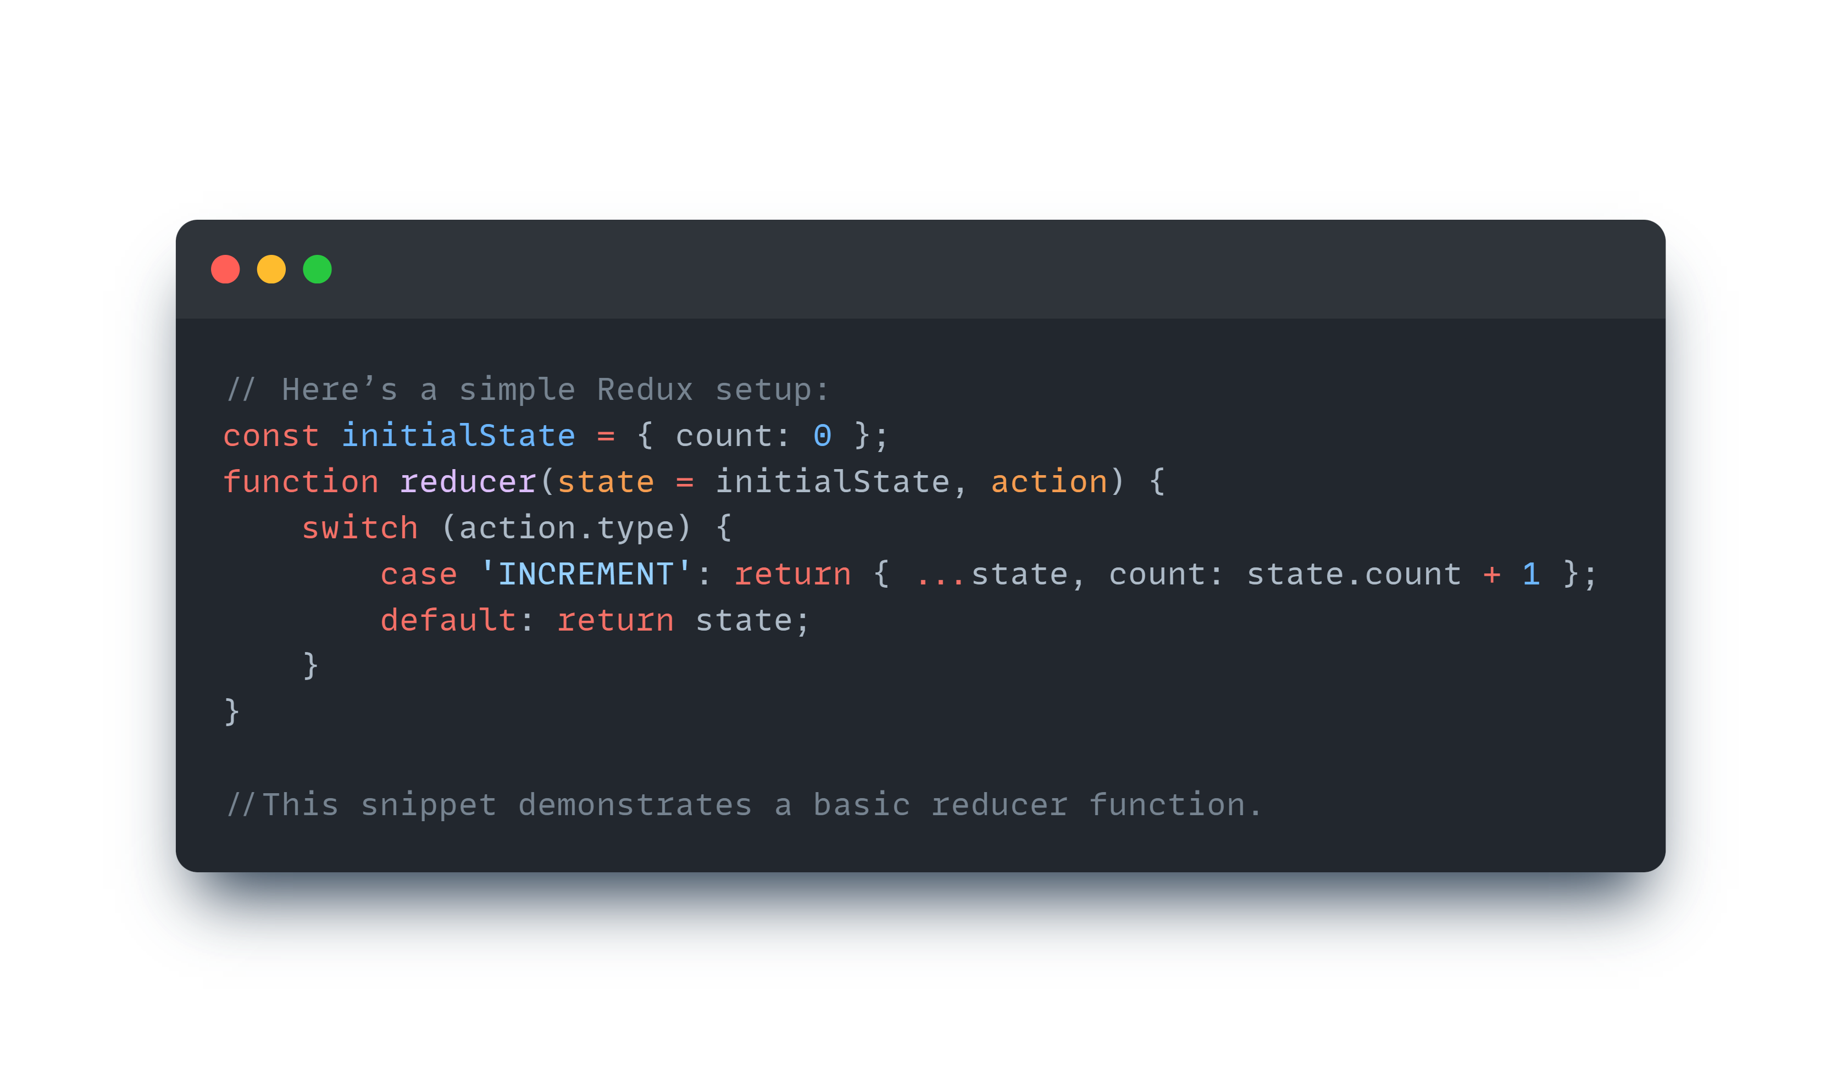
What is Redux?
A predictable state container for JavaScript apps.
Centralized store that holds the entire state of the app.
Unidirectional data flow with actions, reducers, and state.
Suitable for complex applications.

Slide 18




Pros of Redux
The advantages of Redux include a centralized store, easier debugging with time travel, and the ability to use middleware for side effects. It also has a strong community and extensive ecosystem, providing many tools and libraries.
Predictable
Centralized
Debuggable
Flexible
Redux helps you write applications that behave consistently, run in different environments (client, server, and native), and are easy to test.
Centralizing your application's state and logic enables powerful capabilities like undo/redo, state persistence, and much more.
The Redux DevTools make it easy to trace when, where, why, and how your application's state changed. Redux's architecture lets you log changes, use "time-travel debugging", and even send complete error reports to a server.
Redux works with any UI layer, and has a large ecosystem of addons to fit your needs.

