Slide 1
New 3W process – System implementation

Slide 2
Pages
Landing page
BCD initiation page
PR initiation page
BCD status page

Slide 3


Landing page
Download BCD Template.
Please use the BCD template, this is the latest one
New BCD
New PR
Requestor | Date of request | Amount | Status | Document | Comment
Animesh | 4/2/2019 | 10000 | Pending with IT Finance
Notes:
On clicking new BCD page, navigate to BCD page
On clicking new PR page, navigate to PR Page
On click of icon, download the word file (BCD template)

Slide 4

BCD Initiation Page
BCD No. | <Auto generated>
Requestor Name | <Text field>
Amount | <Number field>
Brief Overview | <Free text field>
Upload BCD
1st approver | CIO 1 down <Dropdown field>
^{2nd} approver | IT Finance
3rd approver | CIO
4th approver (If Amount > 50 L) | Gurumurthy sir
Notes:
BCD no. will be auto generate by the system, rest will be filled in by the user.
User can upload the filled in BCD
1st approver will be selected by the user
2nd approver will be IT Finance group (Ashwini Y, Sarvesh lad and Jignesh Parekh), this will go to their bucket
3rd approver will be CIO
And IF the amount exceeds 50 lakhs, approval from Guru sir will be required

Slide 5
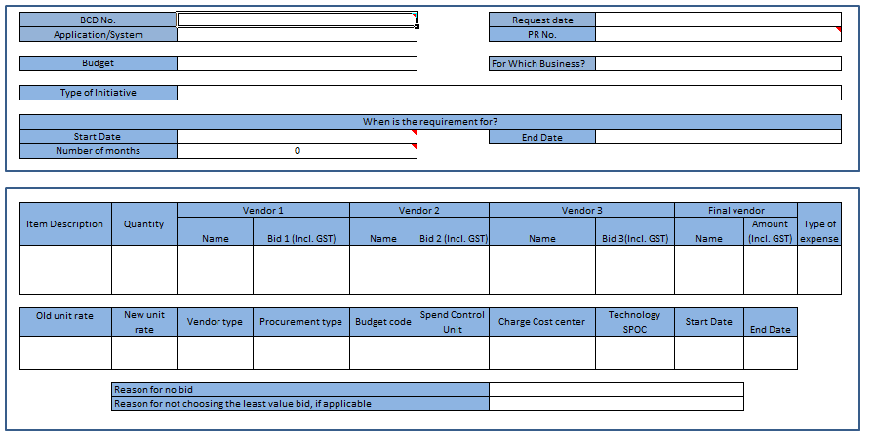

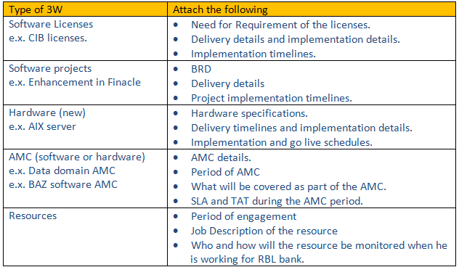
PR Initiation Page
This is a grid
Placeholder for checklist
1st approver | IT Finance | <Signature>
^{2nd} approver | CIO 1 down <Dropdown field> | <Signature>
3rd approver | CIO | <Signature>
Save
Print

Slide 6
Field description – PR page
BCD no -> will be filled in by the user
Request date -> will be the current date
PR No. -> will be auto generated
Application/system -> dropdown
Budget -> dropdown
For which business -> dropdown
Start Date -> Calendar widget
End Date -> Calendar widget
Number of months -> auto calculated basis the start date and end date selected
On click of plus icon a new grid will be available, user can add multiple items in the Purchase request form

Slide 7
Field description – PR page
Grid Fields
Item description -> text field
Quantity -> text field
Vendor Name -> free text field
Bid 1/2/3 -> Numeric
Type of expense -> dropdown
Old unit rate -> numeric
New unit rate -> numeric
Vendor type -> dropdown
Procurement type -> dropdown
Budget code -> dropdown
Spend control unit -> dropdown
Charge cost center -> dropdown
Type of Initiative -> dropdown
Technology SPOC -> auto populate (requestor)
Start date -> calendar widget
End date -> calendar widget
Reason for no bid -> text (500 char)
Reason for not accepting the least value bid, if applicable -> text (500 char)

Slide 8

BCD Status Page
Requestor | Date of request | Amount | Status | Document | Action | Comment
Animesh | 4/2/2019 | 10000 | Pending with IT Finance |  | Accept/Reject
Action will be available at approver level
Comment will be visible to requestor but he can’t add a comment
Notes:
on clicking the word icon the BCD will be downloaded, the approver can accept/reject with a reason.
Status can be following:
-accepted
-pending with IT Finance/CIO 1 down/CIO/Guru
-rejected

Slide 9
Logic
1 BCD can have n number of PR’s
PR can be raised, only if the total BCD amount is not being breached
BCD amounting greater than 50 lakh will go to Guru sir for approval
PR greater than 10 lakh will require CIO approval
Approver can take action on the BCD’s
Approver can reject/accept with a comment, this comment will be sent to the requestor
Requestor can only view the status but can’t take any action
On reject, the process has to be initiated from scratch

Slide 10
Annexure 1- checklist for PR

