Slide 1
ELECTRICITY

Slide 2
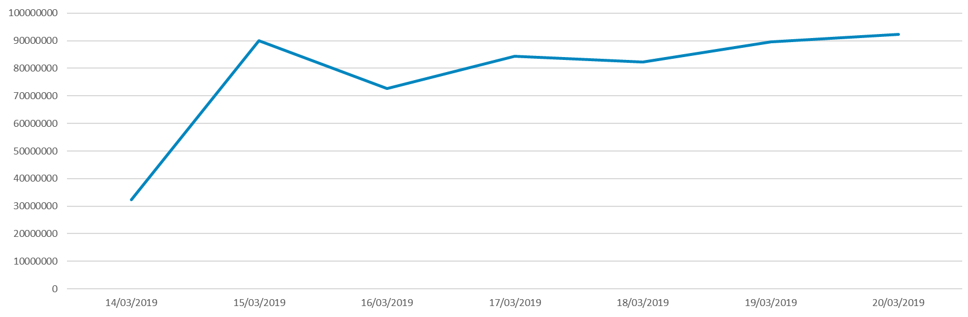
Total Average Energy Usage per day
Energy Wh
The y,x axis need to be labelled as I don’t know what they stand for
I am assuming total means electricity consumption?
Overall can these be labelled so the reader knows what they are looking at
Day of the week

Slide 3
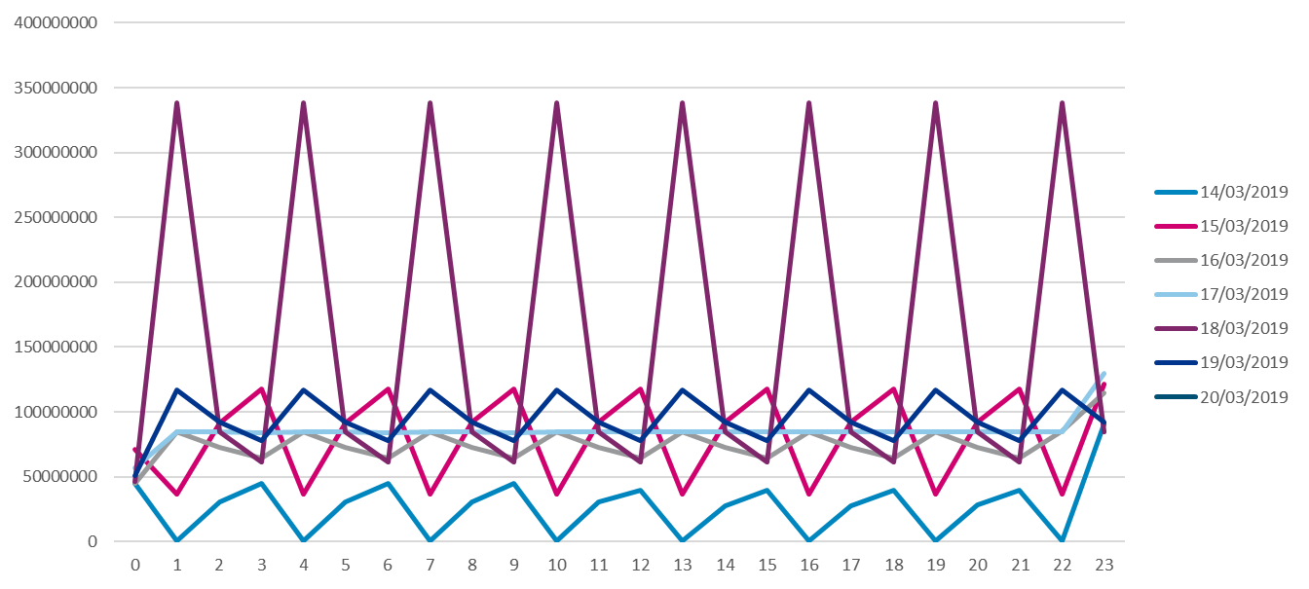
We discussed this slide is not useful for the report

Slide 4
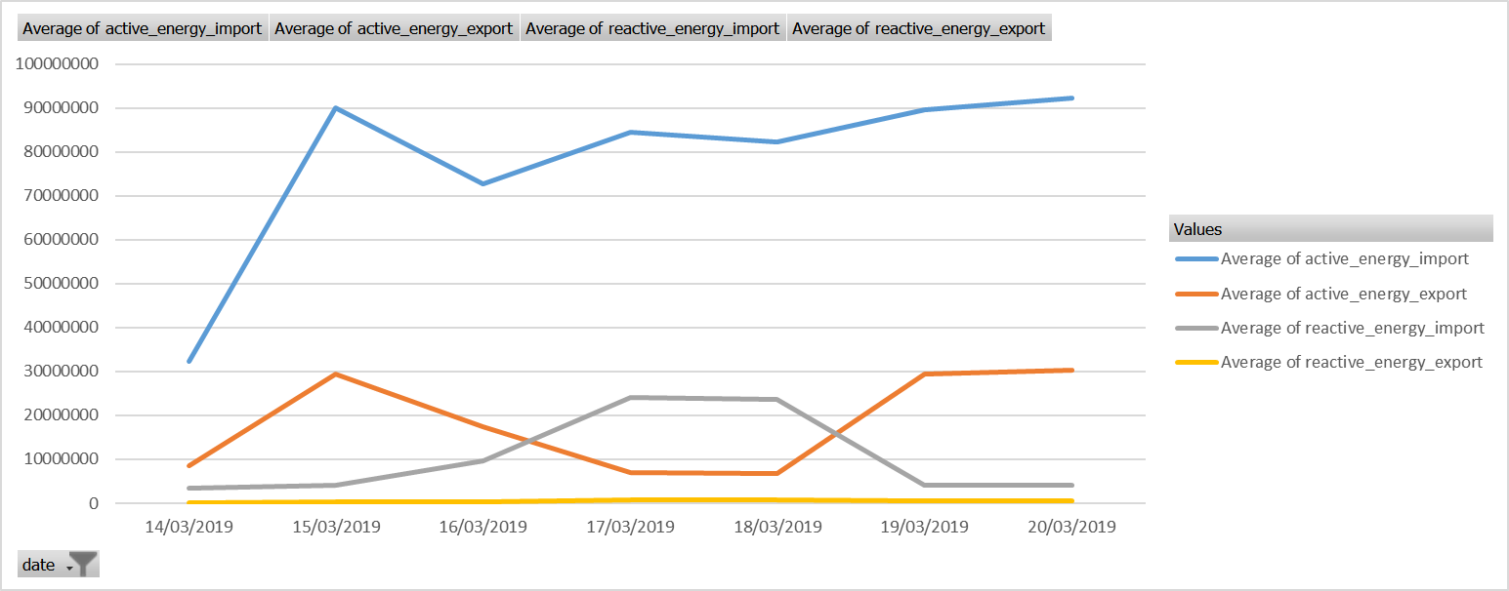
Again not too sure if this is useful

Slide 5


I have used this in the report but at the moment it looks quite basic

Slide 6
WATER

Slide 7


Slide 8


Slide 9


Slide 10
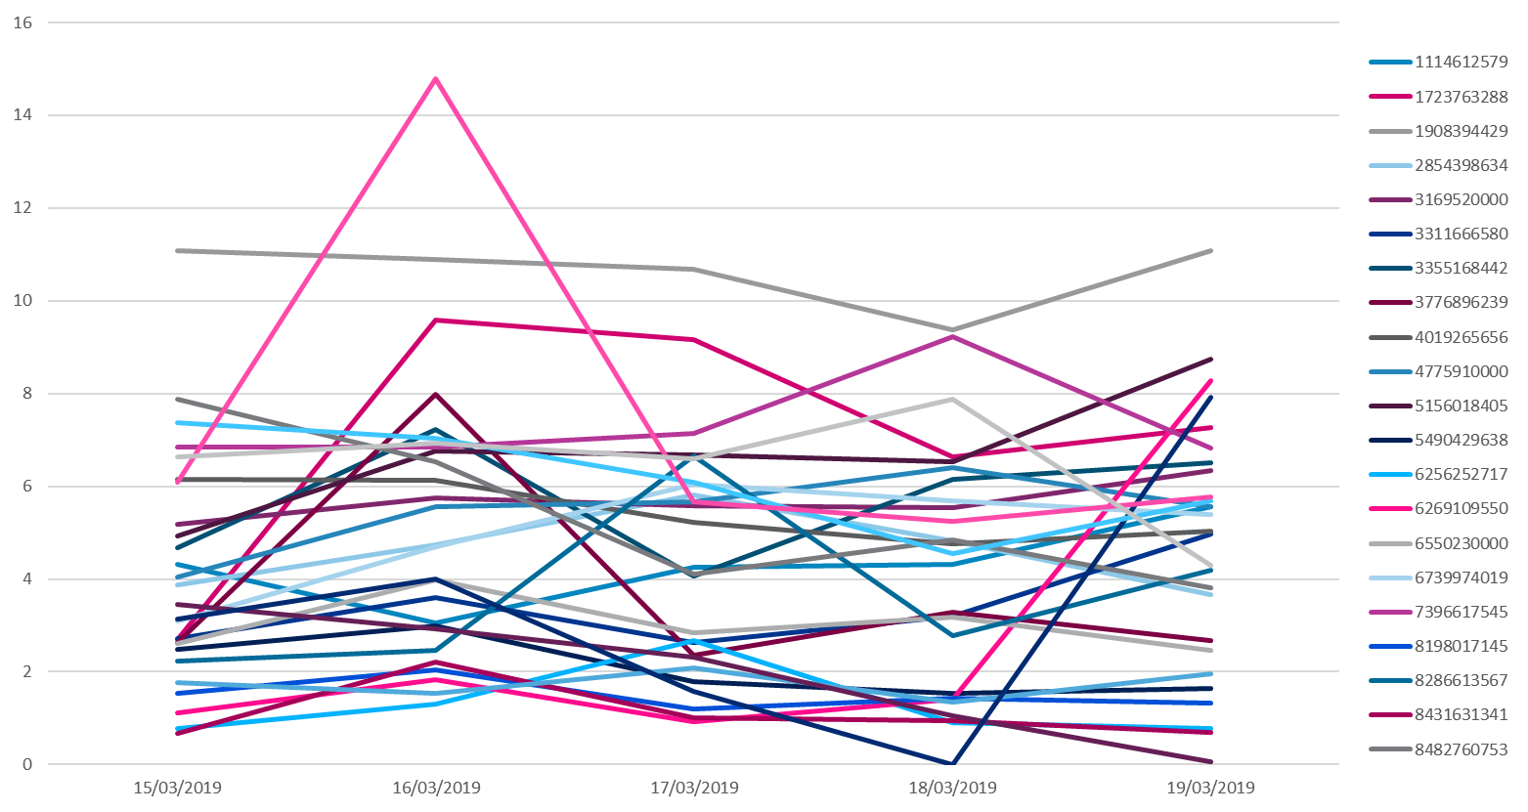

Slide 11
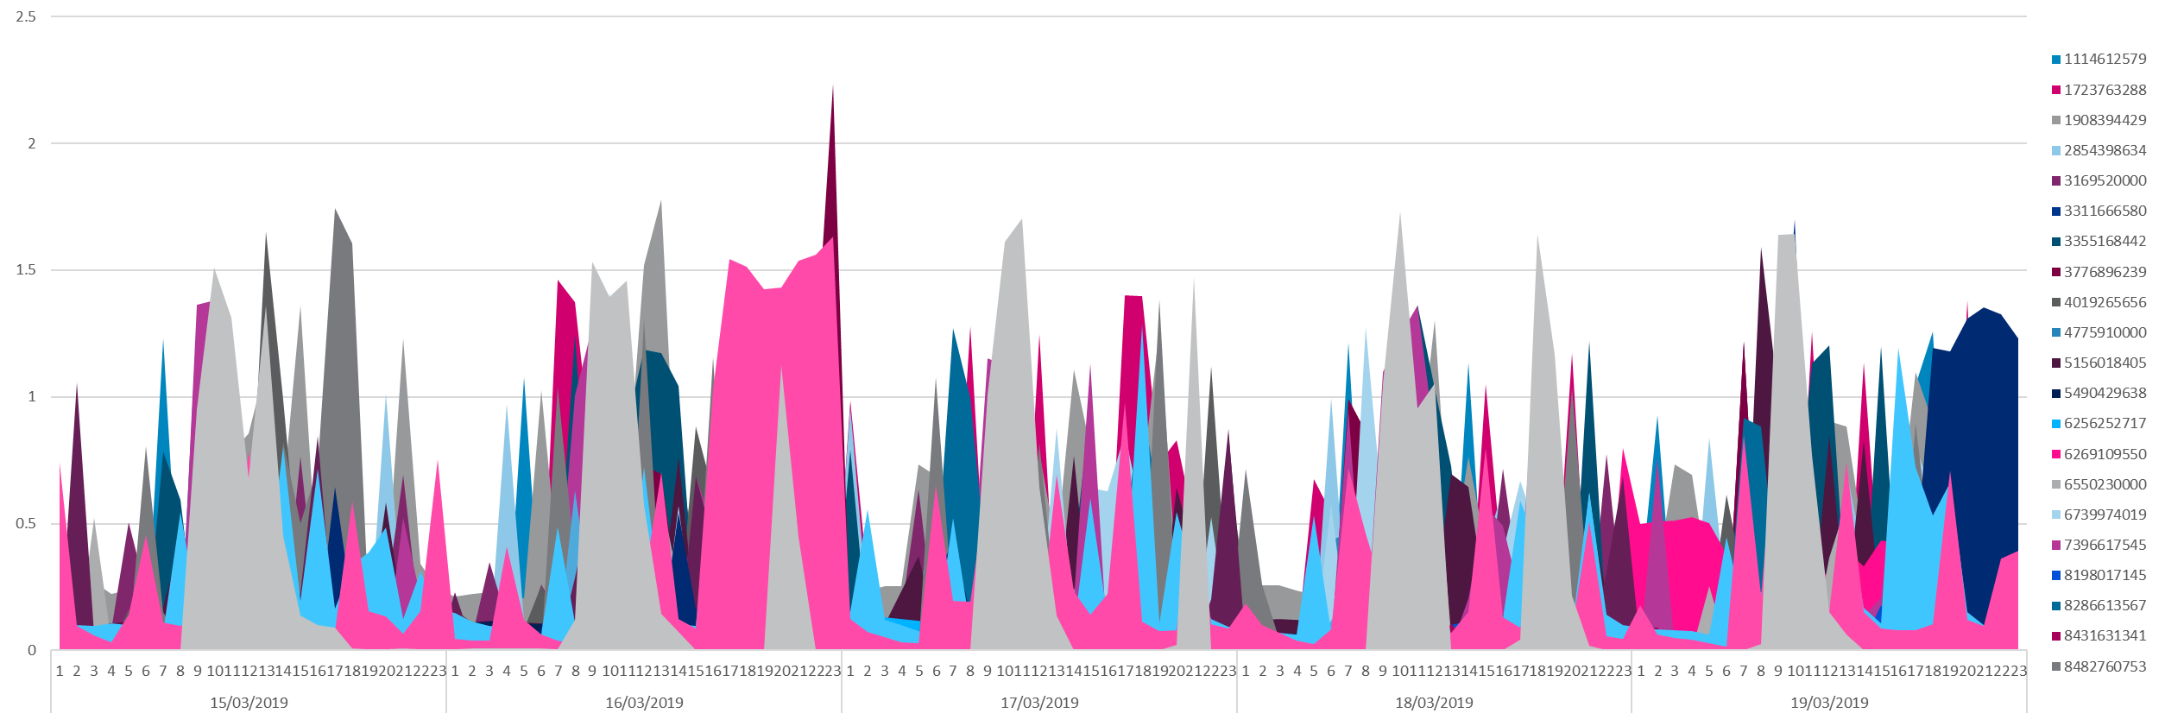

Slide 12
CARS

Slide 13
This is a GIF image it will animate when you publish

Slide 14
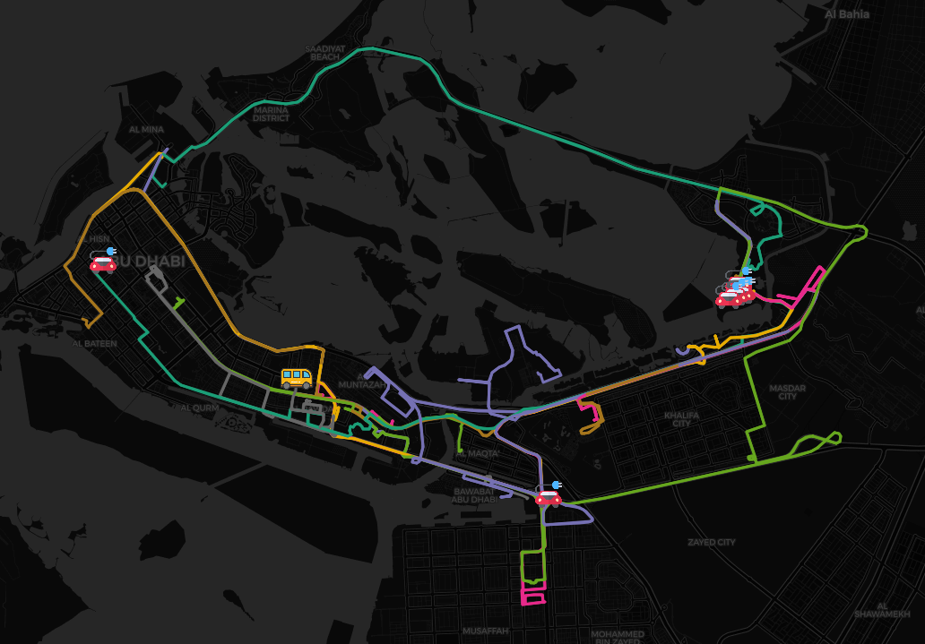
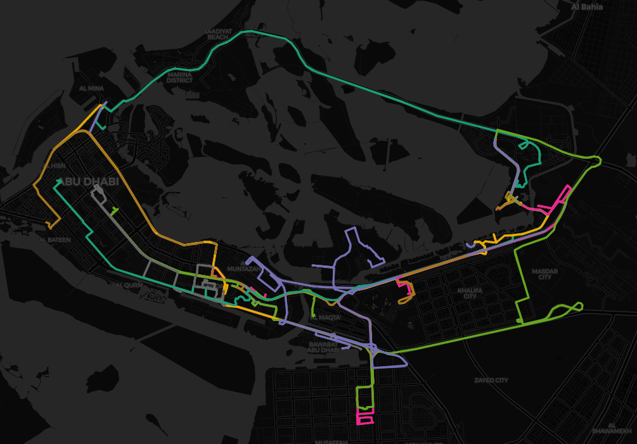

Slide 15



Our fleet have travelled over
7817 Km
equivalent to circumnavigating Pluto

Slide 16
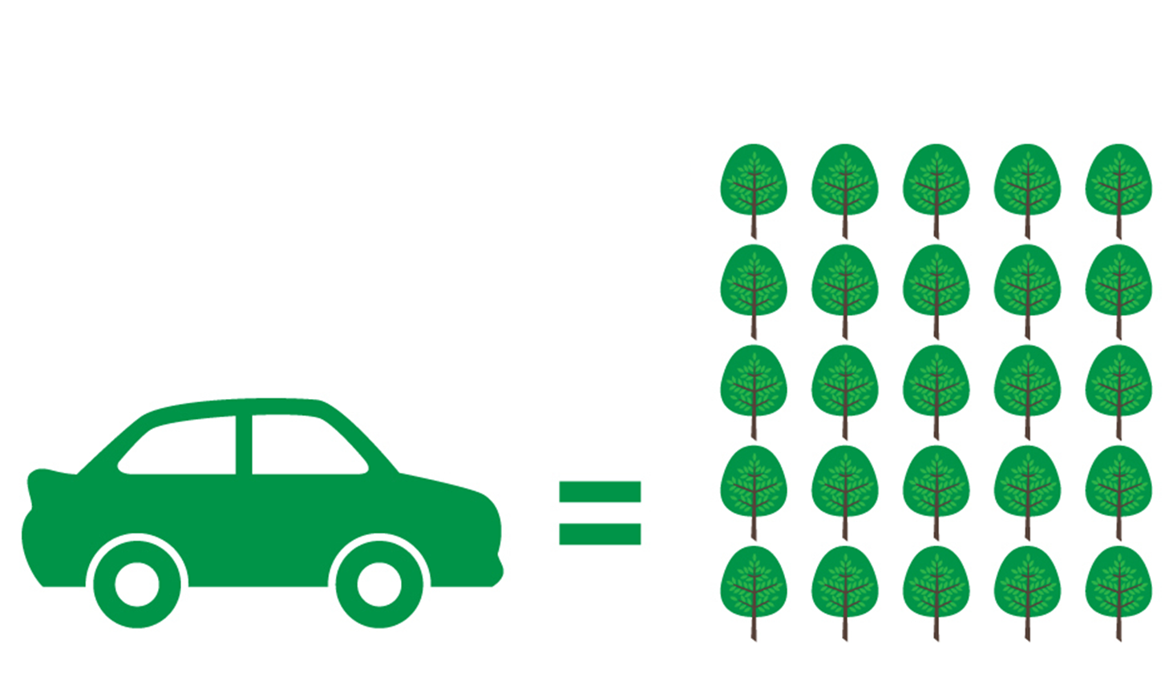
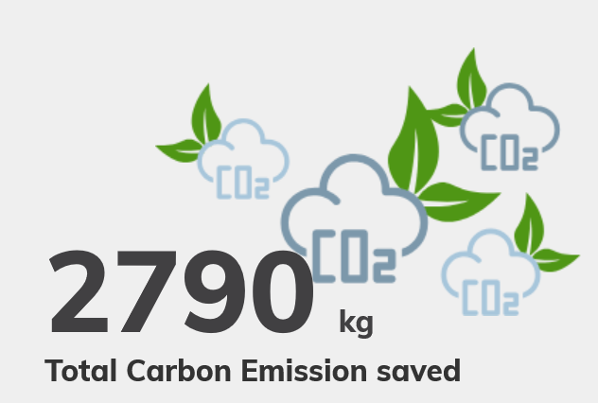


55 Trees grown for 10 years
421,046 smartphones charged

Slide 17
AC ID | 01:00 | 02:00 | 03:00 | 04:00 | 05:00 | 06:00 | 07:00 | 08:00 | 09:00 | 10:00 | 11:00 | 12:00 | 13:00 | 14:00 | 15:00 | 16:00 | 17:00 | 18:00 | 19:00 | 20:00 | 21:00 | 22:00 | 23:00
1114612579 | 0.4 | 1.0 | 0.1 | 0.1 | 1.1 | 0.2 | 6.1 | 1.1 | 3.2 | 1.5 | 0.2 | 0.2 | 0.1 | 1.2 | 0.2 | 0.4 | 1.1 | 6.2 | 1.5 | 0.3 | 0.2 | 0.1 | 0.4
1723763288 | 1.0 | 0.3 | 0.0 | 0.0 | 1.6 | 0.9 | 2.9 | 2.7 | 1.8 | 0.6 | 3.3 | 3.0 | 0.7 | 1.9 | 3.3 | 1.1 | 2.3 | 3.9 | 1.1 | 4.7 | 0.6 | 0.1 | 1.3
1908394429 | 1.4 | 1.4 | 1.7 | 1.6 | 1.7 | 2.5 | 1.4 | 1.2 | 1.1 | 1.9 | 3.0 | 5.4 | 4.5 | 3.3 | 3.5 | 1.7 | 3.4 | 2.9 | 2.8 | 1.3 | 2.3 | 1.4 | 1.7
2854398634 | 1.2 | 0.3 | 0.2 | 1.1 | 1.0 | 1.2 | 0.1 | 0.1 | 0.3 | 2.7 | 1.4 | 0.2 | 1.9 | 1.9 | 1.3 | 0.8 | 0.2 | 1.0 | 1.5 | 3.1 | 0.4 | 0.2 | 0.8
3169520000 | 1.3 | 0.8 | 1.2 | 0.8 | 1.8 | 0.9 | 1.1 | 1.0 | 2.0 | 1.7 | 0.9 | 1.3 | 1.8 | 1.9 | 2.6 | 1.5 | 1.3 | 2.0 | 1.5 | 1.9 | 2.6 | 1.9 | 1.0
3311666580 | 0.8 | 0.2 | 0.2 | 0.2 | 0.2 | 0.2 | 1.0 | 1.5 | 1.3 | 2.5 | 0.7 | 2.1 | 0.6 | 0.4 | 1.0 | 0.3 | 2.0 | 1.5 | 1.1 | 1.1 | 0.4 | 0.2 | 1.0
3355168442 | 0.9 | 0.3 | 1.2 | 0.5 | 0.1 | 0.1 | 1.3 | 2.3 | 1.8 | 3.2 | 3.9 | 3.6 | 2.2 | 1.7 | 2.4 | 1.2 | 1.7 | 0.6 | 0.3 | 0.3 | 2.4 | 1.4 | 0.3
3776896239 | 0.1 | 0.1 | 0.1 | 0.0 | 0.1 | 1.2 | 2.2 | 1.0 | 1.9 | 0.9 | 0.3 | 1.8 | 0.7 | 0.6 | 0.8 | 0.7 | 0.8 | 0.4 | 3.2 | 0.5 | 0.3 | 1.2 | 2.3
4019265656 | 0.2 | 0.2 | 0.1 | 0.1 | 0.8 | 2.2 | 1.4 | 1.5 | 1.1 | 2.3 | 2.5 | 1.3 | 2.3 | 2.0 | 2.3 | 1.9 | 1.3 | 1.2 | 1.5 | 0.9 | 1.1 | 2.3 | 1.1
4775910000 | 0.5 | 0.5 | 0.5 | 0.4 | 0.7 | 1.5 | 1.9 | 2.1 | 2.5 | 2.0 | 1.8 | 1.6 | 1.4 | 2.0 | 2.3 | 1.9 | 1.5 | 2.1 | 1.4 | 1.3 | 1.1 | 1.3 | 0.7
5156018405 | 0.7 | 0.8 | 0.9 | 1.2 | 1.0 | 0.6 | 0.6 | 3.6 | 2.0 | 2.5 | 2.0 | 2.8 | 1.8 | 3.8 | 1.0 | 2.4 | 2.5 | 1.0 | 1.9 | 2.1 | 1.5 | 1.1 | 1.8
5490429638 | 0.4 | 0.4 | 0.4 | 0.4 | 0.4 | 0.3 | 0.2 | 0.2 | 0.3 | 0.2 | 0.4 | 0.5 | 0.5 | 0.4 | 0.4 | 0.9 | 0.5 | 0.7 | 0.8 | 0.8 | 0.6 | 0.4 | 0.4
6256252717 | 0.2 | 0.2 | 0.2 | 0.2 | 0.2 | 0.1 | 0.1 | 0.2 | 0.9 | 0.5 | 0.4 | 0.3 | 0.4 | 0.2 | 0.2 | 0.4 | 0.2 | 0.3 | 0.2 | 0.1 | 0.2 | 0.3 | 0.4
6269109550 | 0.6 | 0.6 | 0.6 | 0.6 | 0.5 | 0.4 | 0.3 | 0.3 | 0.2 | 0.3 | 0.3 | 0.5 | 0.7 | 0.9 | 1.1 | 0.8 | 0.8 | 0.3 | 0.1 | 0.2 | 0.3 | 0.9 | 2.3
6550230000 | 0.0 | 0.0 | 0.5 | 0.0 | 0.3 | 0.1 | 1.2 | 0.6 | 1.8 | 0.7 | 0.1 | 1.5 | 2.3 | 1.2 | 0.6 | 1.0 | 0.5 | 1.3 | 1.3 | 0.7 | 0.3 | 0.6 | 0.7
6739974019 | 0.1 | 0.1 | 0.1 | 0.1 | 0.1 | 1.0 | 2.1 | 3.3 | 2.4 | 0.8 | 1.3 | 0.7 | 1.8 | 0.9 | 1.9 | 1.9 | 4.5 | 2.8 | 0.9 | 1.5 | 0.8 | 0.7 | 0.2
7396617545 | 0.3 | 0.8 | 0.0 | 0.0 | 0.0 | 1.6 | 3.0 | 1.9 | 6.4 | 5.2 | 3.5 | 3.0 | 1.0 | 1.2 | 3.0 | 2.7 | 1.8 | 2.0 | 2.2 | 2.0 | 1.0 | 0.2 | 0.8
8198017145 | 0.2 | 0.1 | 0.1 | 0.1 | 0.1 | 0.2 | 0.6 | 0.3 | 0.4 | 0.3 | 0.4 | 0.5 | 0.4 | 0.4 | 0.5 | 0.4 | 0.5 | 0.3 | 0.4 | 0.5 | 0.5 | 0.3 | 0.2
8286613567 | 0.4 | 0.3 | 0.3 | 0.2 | 0.2 | 0.4 | 2.6 | 2.1 | 0.8 | 0.6 | 0.7 | 0.7 | 0.6 | 0.5 | 0.5 | 0.8 | 1.3 | 1.6 | 1.1 | 0.6 | 0.7 | 0.6 | 0.6
8431631341 | 0.3 | 0.2 | 0.1 | 0.1 | 0.0 | 0.0 | 0.0 | 0.0 | 0.9 | 1.1 | 0.5 | 0.2 | 0.3 | 0.3 | 0.3 | 0.5 | 0.3 | 0.4 | 0.3 | 0.2 | 0.0 | 0.0 | 0.2
8482760753 | 0.8 | 0.3 | 0.1 | 0.1 | 0.1 | 1.9 | 1.4 | 1.3 | 1.2 | 1.1 | 1.1 | 2.4 | 0.4 | 1.8 | 0.8 | 2.1 | 3.9 | 4.1 | 2.9 | 1.3 | 0.5 | 1.0 | 0.2
8603465968 | 0.2 | 0.1 | 0.1 | 0.1 | 0.1 | 0.4 | 0.9 | 1.2 | 0.9 | 0.6 | 0.3 | 0.3 | 0.3 | 0.3 | 0.5 | 0.3 | 0.3 | 0.3 | 0.2 | 0.3 | 0.3 | 0.4 | 0.2
8682035806 | 0.4 | 1.1 | 0.1 | 0.1 | 0.0 | 0.0 | 0.0 | 0.3 | 1.5 | 1.6 | 0.1 | 0.1 | 0.0 | 0.0 | 0.9 | 1.3 | 0.1 | 0.0 | 0.0 | 0.0 | 0.0 | 0.5 | 1.6
8701397052 | 0.1 | 0.1 | 0.1 | 0.1 | 0.1 | 0.4 | 0.5 | 0.2 | 0.8 | 0.5 | 0.3 | 0.3 | 1.1 | 1.0 | 0.4 | 0.2 | 1.1 | 1.5 | 2.5 | 2.3 | 1.6 | 1.5 | 1.4
8721630000 | 0.7 | 1.1 | 0.6 | 0.5 | 0.9 | 0.8 | 2.4 | 1.4 | 0.7 | 2.7 | 0.8 | 2.5 | 1.3 | 1.3 | 1.5 | 3.2 | 1.8 | 3.0 | 2.5 | 2.3 | 1.5 | 0.9 | 1.1
9909698487 | 1.5 | 0.4 | 0.3 | 0.6 | 0.4 | 1.3 | 2.7 | 1.2 | 2.5 | 2.6 | 2.0 | 2.4 | 2.7 | 0.9 | 1.4 | 2.4 | 2.9 | 2.7 | 3.1 | 2.0 | 3.0 | 2.3 | 3.0
9976411424 | 0.0 | 0.0 | 0.0 | 0.0 | 0.0 | 0.4 | 1.7 | 1.8 | 6.6 | 8.0 | 6.3 | 3.6 | 1.7 | 0.5 | 0.1 | 0.1 | 0.1 | 1.7 | 2.9 | 1.7 | 1.9 | 0.0 | 0.0
Total Avg | 0.5 | 0.4 | 0.4 | 0.3 | 0.5 | 0.8 | 1.5 | 1.3 | 1.7 | 1.8 | 1.4 | 1.6 | 1.3 | 1.2 | 1.3 | 1.2 | 1.4 | 1.7 | 1.4 | 1.3 | 1.0 | 0.8 | 0.9
 | Low Usage |  |  |  |  |  | High Usage |  |  |  |  |  | Medium Usage |  |  |  | High Usage |  |  |  | Low Usage
Keys don’t match colours of heat mpa and can we show hours as time of day

Slide 19
Water Usage in cubic meters
Can you add in the metrics for water usage?
Cubic meters
Hour of the day

