Slide 1
TE – Mini Project
Maze Solving using
Deep-Reinforcement Learning
By,
L. Aniruth Naraayanan
Siddhesh Kokane

Slide 2
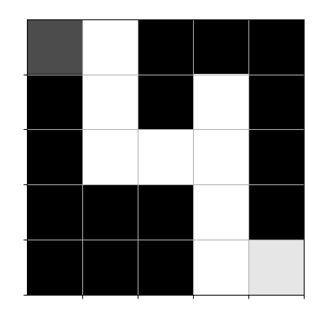
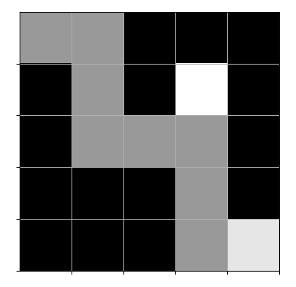

Introduction
Objective: To create a project to solve any MXN randomly generated maze using deep-leraning.
Implementation: using a python environment, tenserflow/keras backend and tkinter/matplotlib for plotting maze

Slide 3

Reinforced Learning
Reinforcement learning is a Machine learning technique using feedback system applied on an agent operating in an environment
With every action the agent transits to another state until a pre-defined final state is reached.
Classical algorithms such as Djithskra’s algorithm are still the most practical and efficient methods of solving maze solving problems, but these puzzles are quite good for demonstrating and testing reinforcement learning techniques

Slide 4
Maze Generation: Algorithm
Create an MXN numpy array with all cells/elements blocked i.e. set to 0.
Randomly traverse the array
Mark every visited block as a free cell i.e. 1
If current cell is target cell then exit
Go back to starting step 1

Slide 5
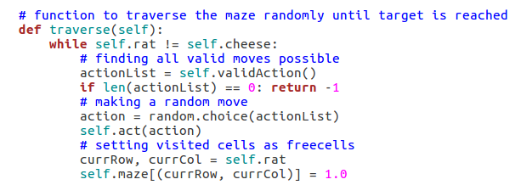
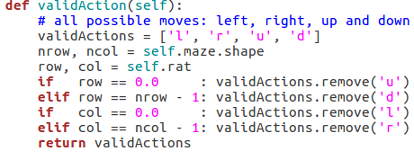

Maze Generation: Code Snippet

Slide 6
Feeding maze to the main program
(qmaze class)
Qmaze is a class that initialises and defines the behaviour of our agent.
It takes the maze as an input which is generated from the maze generator as an numpy array
Functions:
reset() – to reset the position of agent
update_state()– to change state based on the action
get_reward() – function to set reward or feedback for every action
valid_action() – to find out all possible valid actions
act() - to make an action and transit to a new state

Slide 7
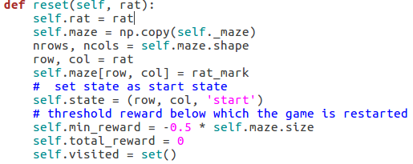
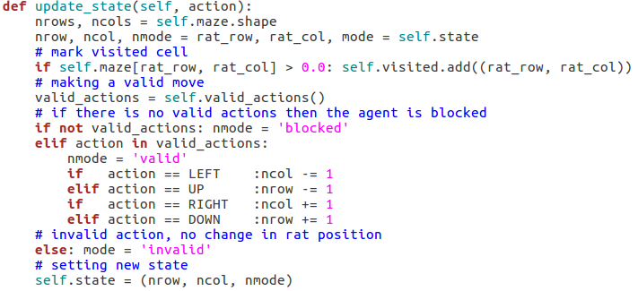
Qmaze: Code Snippet

Slide 8
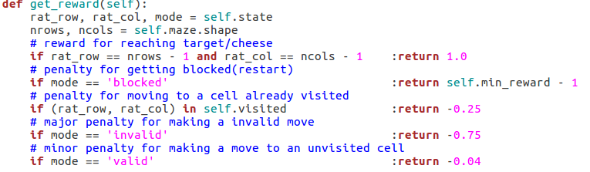
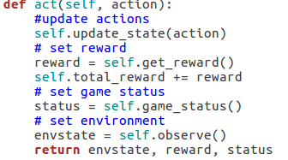
Qmaze: Code Snippet

Slide 9

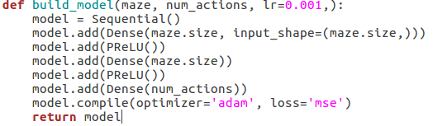
Building a Neural Network Model
Backend used: tenserflow/keras
Activation function used : PrelU
Loss fuinction : MeanSquare Error, Optimiser : Adam(adaptive moment estimation)
Two hidden layers, each of size equals to the maze size.
The input layer has also the same size as the maze since it accepts the maze stae as input.
The output layer size is the same as the number of actions (4 in our case – up,down,left,right), since its outputs the estimated q-value for each action.
We need to take the action with the maximal q-value for playing in the game.
Code Snippet:

Slide 12
Conclusion
It took less than a minutes to train the model. We can now simulate a few games with this model and visualize them with matplotlib
There are plenty of variations on the above type of games. We can for example add a cheese to the maze and then we have a double chase scene: the cat chases the mouse, and the mouse chases the moving cheese.
There are also a 3-dimensionl versions of these maze problems, which are hard to visualize, and probably much harder to solve, but sooner or later they must be used for testing, validating, and enhancing deep reinforcement learning techniques.
This is the type of problems in which classical algorithms are starting to get rough and deep learning techniques could provide better answers.
Current Reinforcement Learning techniques are still in their infancy and there's a vast room for further reseach and development.

