Slide 1
RFID based Access Control Systems
Seminar On
Presented By
B-72 Siddhesh Mahendra Mengade (TE Comp)

Slide 2
Table of contents
01
02
03
Introduction
Radio Frequency Identification (RFID)
RFID based Access Control System
04
Challenges Faced in Reusing RFID tags
05
Demonstration Details & Conclusion

Slide 3
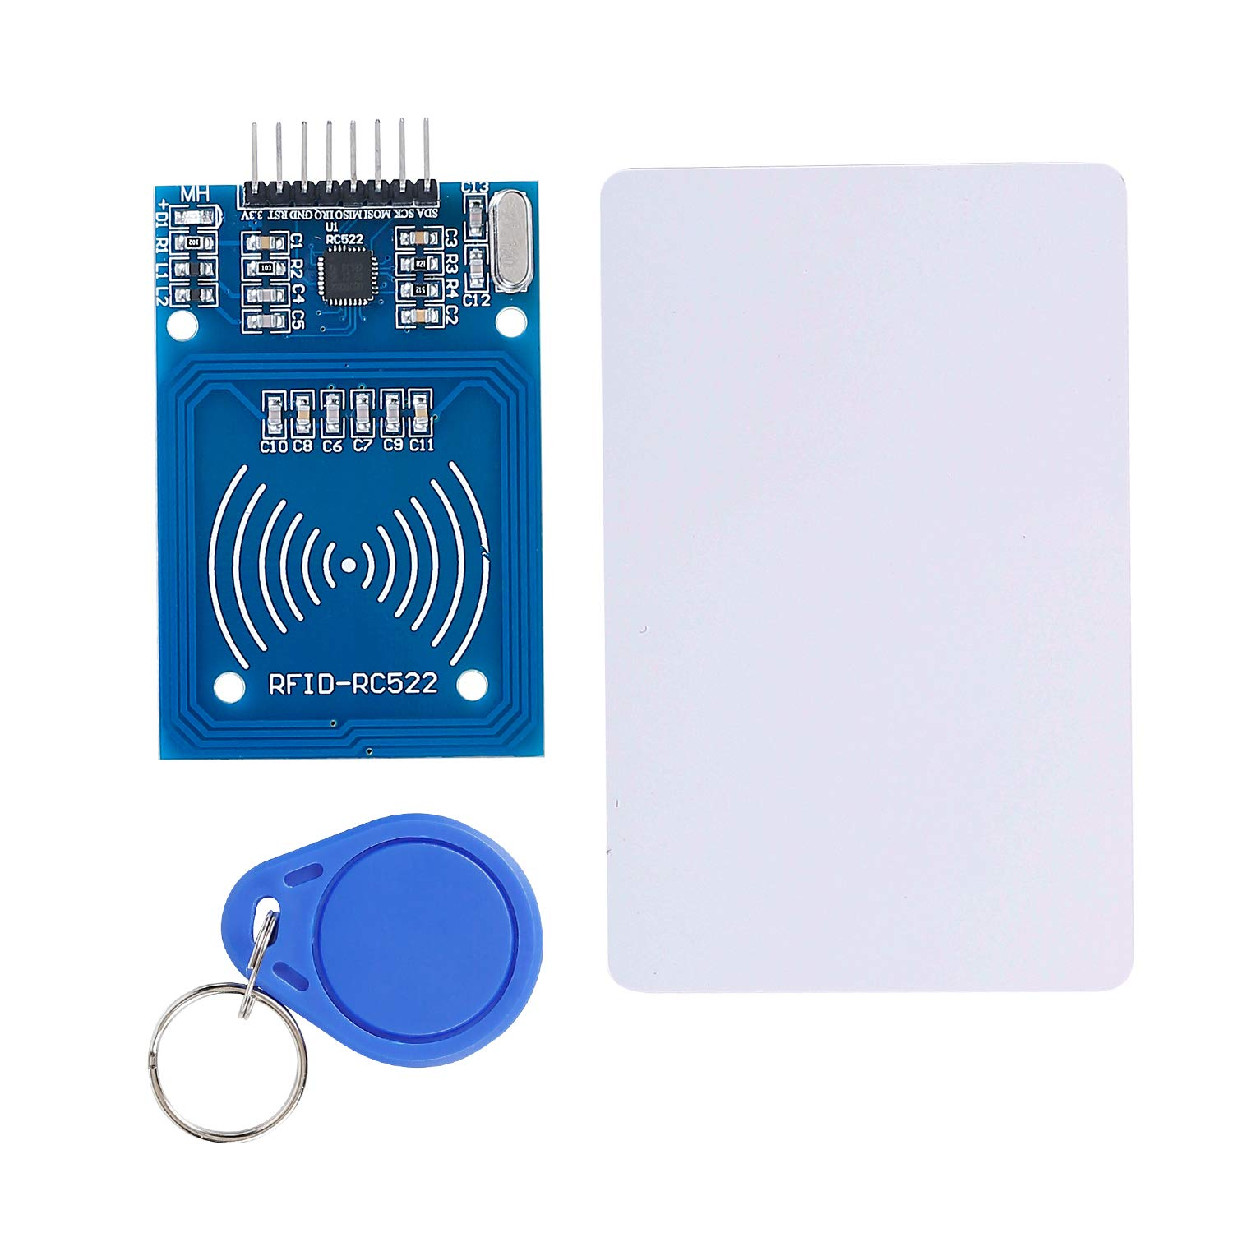
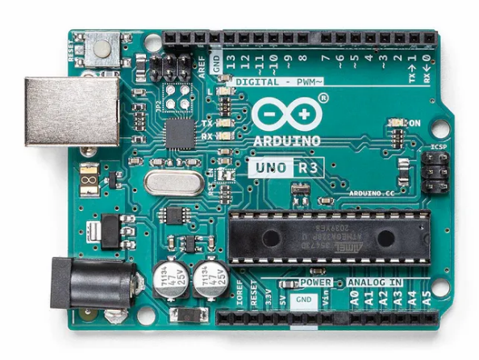
Demonstrating RFID module using Arduino
RFID Reader & Tags
Programmable Arduino UNO Board

Slide 4
Introduction
Welcome to this Seminar!
I’m Siddhesh Mengade, from Third Year of Computer Engineering, with a passion for Internet of things & Embedded Systems. This seminar is about RFID based Access Control Systems.
From business owners to security managers to artists who own portfolio studios, it is known how managing a physical space is far more complex than just setting up a password for an app on your phone. Big offices that span from many rooms to several floors can be hectic to manage if they use a lock and key for access into every room or to every floor. RFID access control systems are one of the best ways to ensure the safety of property in an age where there are always new ways to do so.
This technology offers convenience and security due to their excellence in adaptability and ability to track and monitor who is granted access to various places and the time of their entries and exits.
Therefore, the implementation of RFID-based access control systems addresses critical security concerns, improve operational efficiency and provide businesses and organizations with tools required to adapt to evolving security challenges.

Slide 5
IoT M2M RFID
IoT
M2M
RFID
RFID tags can be integrated into various IoT applications. For instance, in a smart retail environment, RFID tags on products enable inventory tracking and provide real-time data to the IoT system, allowing businesses to monitor stock levels, prevent theft, and optimize supply chains.
In M2M communication, RFID technology can be used as a method for machines or devices to communicate with each other without human intervention. For example, RFID tags on products in a warehouse can communicate with RFID readers, allowing machines to track inventory levels automatically.
RFID technology is not exclusive to either M2M or IoT; it is a versatile technology that can be applied in various contexts within both domains. It serves as a tool for identification, tracking, and data acquisition, contributing to the seamless communication and automation of processes in both M2M and IoT systems.

Slide 6
Radio Frequency Identification (RFID)
RFID, which stands for Radio Frequency Identification, is a simple and cost-effective way of item identification. It is a type of wireless communication that uses electromagnetic or electrostatic coupling in the radio frequency spectrum to uniquely identify an object, animal or human. These are recognized or identified via a small, readable microchip tag connected onto these objects.
This tag, the RFID tag, has a built-in antenna which can be read by a scanning device usually called the RFID reader. This scanning device scans the tag when it comes in range which then sends the scanned data to an application program. The application program then helps the user store and use it wherever desired.
Components of RFID
A basic RFID system consists of three main components:
The RFID tag: It consists of an integrated circuit(IC), a substrate and an antenna.
The RFID reader: It is a device that reads RFID tags and gathers data about the connected object. It can be both wired and wireless. It can use many technologies to communicate with the software, including USBs and Bluetooth connections.
The RFID software: The software monitors and tracks the object connected to the RFID tags and can be called data exchange and management software.

Slide 7
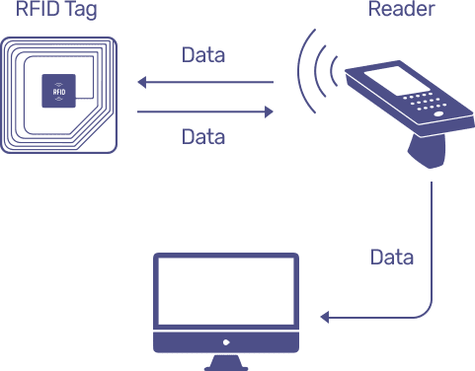
Radio Frequency Identification (RFID)
Working of RFID Components:

Slide 8
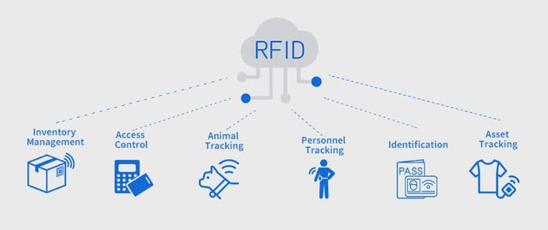
Radio Frequency Identification (RFID)
Advantages of using RFID Technology:
RFID technology is not exclusive to either M2M or IoT, in fact it is a versatile technology that can be applied in various contexts within both domains. It serves as a tool for identification, tracking, and data acquisition, contributing to the seamless communication and automation of processes in both M2M and IoT systems. So, while RFID is not part of M2M or IoT in itself, it can be an integral component within these interconnected communication frameworks. Some advantages of using RFID technology in general are:
Since more than one tag can be read at a time, RFID technology can allow multiple entries/tags to be scanned in little to no time.
The system contains accurate data stored in or facilitated by the RFID tags.
Any unauthorized exit of the documents can be detected easily, so it reduces theft and security in the library is improved.
It improves the Efficiency, traceability of production.

Slide 9
RFID based Access Control System
RFID & Access Control
RFID, which stands for Radio Frequency Identification, is a simple and cost-effective way of item identification. RFID systems can be seen as the next generation technology for bar-codes.
And RFID access control system comprises of several components, but the major ones are: RFID tag & reader, Arduino, Triggers or Indicators.
RFID based access control systems provides easy and efficient solutions. It grants authorized access via a RFID tag which is embedded in the users ID card or badge into areas and equipment.
Triggers or Indicators that various RFID based systems employ can help build different systems while the foundation or framework remains the same. Access Control Systems can grant or revoke access using various techniques:
Door lock opens for authorized access
False Alarm rings for unauthorized scanning
Opening of a safe/vault on scanning authorized access ID

Slide 10
RFID based Access Control System
Arduino
Arduino is an open-source platform that combines hardware and software to design and build electronic projects. The hardware part of Arduino comprises Arduino boards, input and output devices (including digital and analog pins, and sensors and actuators), shields, breadboards, jumper wires, and so on. These components can be combined together to create dynamic and interactive projects. Whereas the software is made up of the development tools used to write, debug, compile, and upload code to Arduino boards. Most 0f the software tools can be found in the Arduino IDE (Integrated Development Environment).

Slide 11
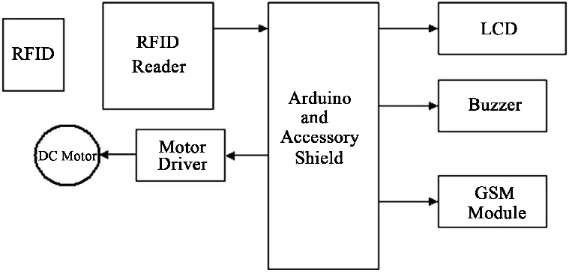
RFID based Access Control System
Structure and Working of RFID based Access Control System
An RFID-based access control system comprises three main components- RFID tags/cards, RFID readers, and a control system (often a microcontroller like Arduino or specialized access control software). RFID tags, containing unique identifiers, are attached to users' cards or badges. When a user presents their RFID card to an RFID reader, the reader captures the tag's ID. The control system (Arduino or dedicated software) processes this data, comparing it with authorized IDs. If a match occurs, access is granted, triggering actions like door unlocking or displaying colored lights or granting access to admin level machines..

Slide 12
RFID based Access Control System
What happens?
The authorized user holds their RFID access card up to the reader. This allows the reader and the RFID tag to communicate over a wireless connection.
The reader’s antenna establishes a connection to the RFID tag. The RFID tag uses this connection to send data to the reader. Then, the reader forwards that data to the control panel.
The control panel verifies the scanned credentials. When the control panel receives the number encoded into the signals sent by the RFID tag, it checks that number against a database stored either locally or in the cloud.
The control panel proceeds with programmed ;action’. After the control panel verifies the credentials, it sends signals to the RFID door opener, and the door’s electric strike unlocks. Hence allowing only that user inside the door whose RFID tag number has been authenticated and stored in the database as an ‘Allowed Access’ ID.

Slide 13
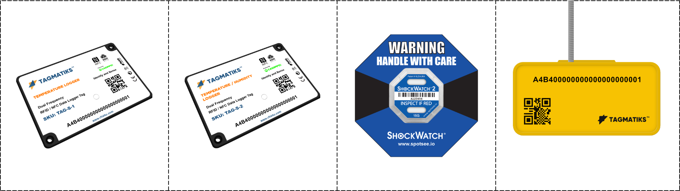
Challenges Faced in Reusing RFID Tags
Reusing RFID tags can pose several challenges due to the nature of RFID technology and the specific requirements of different applications that employ RFID technology. Some of the key challenges associated with reusing RFID tags include:
Compatibility Issues: Different RFID systems operate at various frequencies and operate at various protocols as seen in chapter 3.2, therefore reusing tags might lead to compatibility issues with the existing RFID infrastructure.
Wear and Tear: RFID tags can deteriorate over time affecting their performance and readability. Moreover, exposure to harsh environmental conditions can also damage tags and hence limit their lifespan.
Read/Write Limitations: Certain active RFID tags are not easily reusable as it is difficult and almost impossible to read and rewrite the data stored on them. Also, RFID tags have a limited number of write cycles and hit and trial write cycles might quickly exhaust these tags

Slide 14


Challenges faced in Reusing RFID Tags
In most cases, passive RFID tags, which do not have an internal power source and rely on the RFID reader's energy to transmit data, cannot be easily reused. Once a passive RFID tag is associated with a specific item or product and has been encoded with certain data, it's challenging to reset or rewrite the information on the tag without specialized equipment. Passive RFID tags are typically designed for one-time use and are permanently encoded during the manufacturing process. Attempting to modify the data on a passive RFID tag without proper equipment can damage the tag, rendering it unusable.
However, active RFID tags, which have their own power source and are more sophisticated, can often be reprogrammed and reused for different applications. Active RFID tags are commonly used in applications where the tag needs to transmit data over longer distances or where more complex information needs to be stored and transmitted. These tags can be reset and reconfigured with new data, allowing for reuse in different scenarios.

Slide 15
Demonstration Details & Conclusion
In conclusion, the implementation of RFID-based Access Control Systems using a miniature model, Arduino IDE, and Arduino UNO board has showcased the transformative potential of RFID technology in enhancing security and convenience. Through meticulous design and integration, we successfully demonstrated the seamless interaction between RFID tags, readers, and Arduino-based control systems. The mini model serves as a testament to the practical applicability of RFID technology, enabling precise access management and tracking capabilities.

Slide 16
Thank You.
Presented By
B-72 Siddhesh Mahendra Mengade (TE Comp)

