Slide 1
Investigators should open to a queue that is already triaged
The user · the job to be done · what I built and what I left out
The user
A fraud investigator and their supervisor, facing a daily queue of engine referrals that mostly turn out benign.
The job to be done
Decide fast, and defensibly, which referrals deserve human time — and on those, get the evidence and the next step without assembling it by hand.
WHAT THE 50-CASE SAMPLE SHOWED
8
extreme on every signal
9
genuinely ambiguous
33
clean
So: rules take the obvious 41. Agents and humans spend their time on the 9 — plus the links no single row reveals: 3 cases trip no flag yet carry five elevated signals, and one claim number sits on a clean case and a critical one.
BUILT IN THE PROTOTYPE
LEFT OUT ON PURPOSE
Morning briefing
Per-case assessment
Evidence + agent trace
Accept / reject / note
Bulk clear, guarded
Auth, multi-tenancy, deploy out of scope in the brief
Supervisor escalation
Rules + backtest
Blocklist
Outcome feedback
Audit log
A trained ML model no labels — accuracy would be invented
Provider / member graph no IDs in the CSV; code is ready
Junior AI Investigator · AI-first case review for fraud investigators
1 / 4
Notes:
THE USER is a fraud investigator and their supervisor. Every morning an engine hands them a queue of referrals, and most of those turn out benign. Today they paste a claim number into a legacy tool and read nine signals a case, one case at a time. The cost is not the fraud they find, it is the hours spent on the cases that were never fraud.
THE JOB TO BE DONE: decide quickly, and defensibly, which referrals deserve human time; and on the ones that do, get the evidence, the reasoning and a recommended next step without assembling it by hand.
THE DATA SHAPED THE BUILD. The 50-case sample splits three ways: 8 cases extreme on every signal, 9 genuinely ambiguous, 33 clean. That split is the whole product thesis: deterministic rules are enough for the 8 and the 33, so the expensive reasoning belongs to the 9. Two patterns no row-by-row engine can see: three cases trip no flag at all yet carry five elevated signals, and one claim number (LTC-2034786) sits on both a clean case and a critical one.
WHAT I CUT AND WHY: auth, multi-tenancy and deployment are explicitly out of scope in the brief. I did not train a model because the data has no fraud labels, so any accuracy number would be invented. A provider/member graph needs IDs the CSV does not contain; the code supports them the day a dataset does.

Slide 2
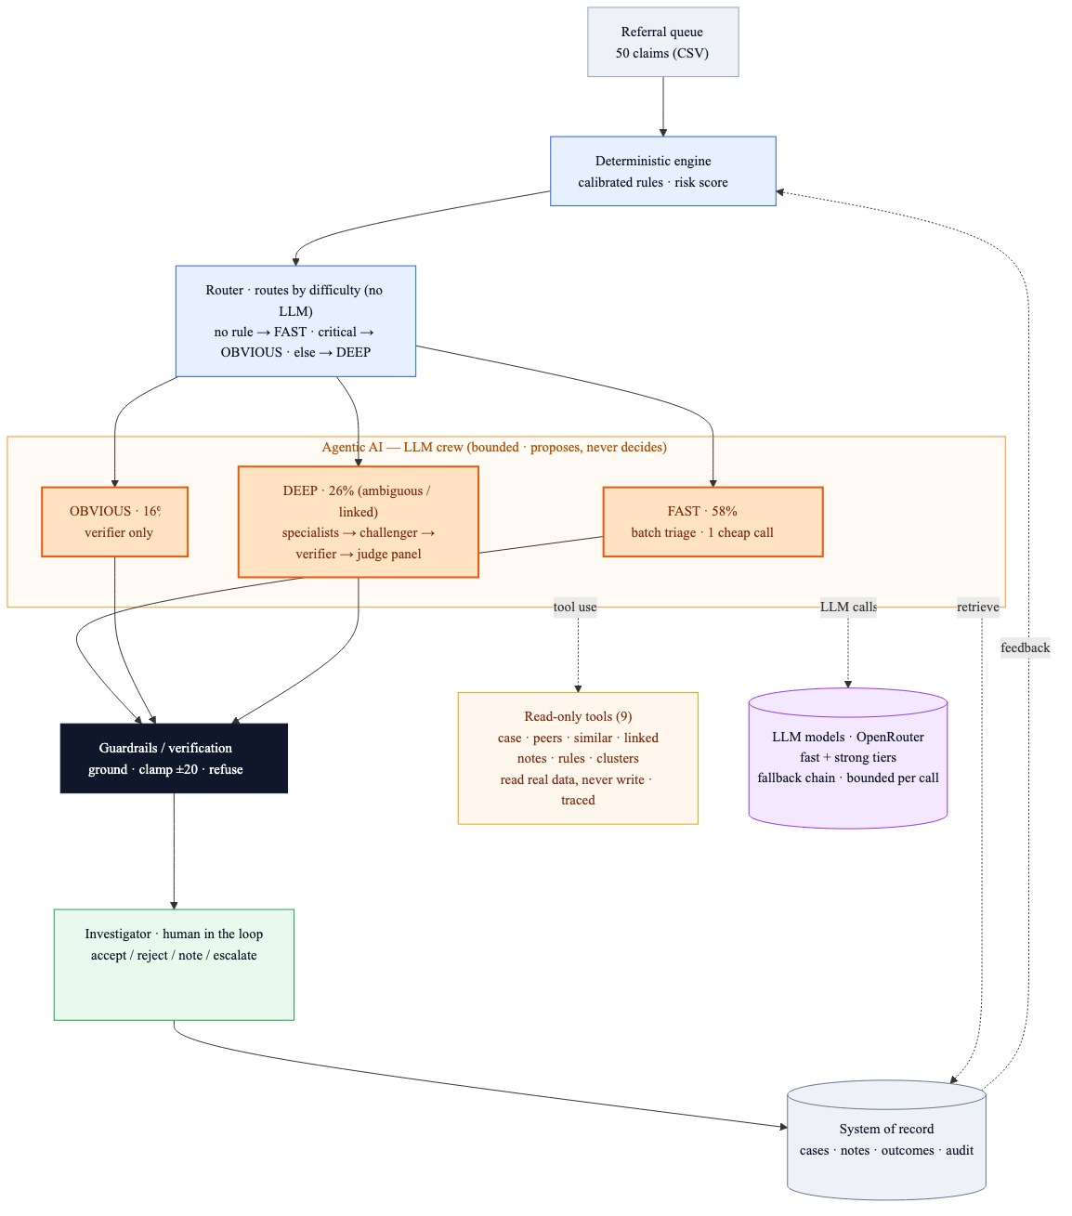
Rules set the depth; agents reason only where it pays
How the system reasons about a case, stays grounded, and scales
How it reasons
Not a single call, and not agents everywhere. Deterministic rules score and route every case; depth is bought only where the evidence is genuinely unclear.
58% one batched call · 16% verifier only · 26% specialists → challenger → verifier → panel if contested
Tool use, not retrieval
9 read-only tools query the live record — peers, similar cases, linked claims, notes, rules. No vector store, no RAG: 50 structured rows answer exactly in SQL.
Grounded by code, not by prompt
Every cited field = value re-verified against the record
Score moves ≤ ±20; the risk level is derived, not chosen
Cannot clear a HIGH/CRITICAL case or a confirmed-fraud lookalike
On failure it says “LLM unavailable” — never invented text
10/10 invariants 5/5 adversarial tests 277/277 indicators re-verified
Beyond 50 cases
Router is free and O(1) — spend lands on the hard tail. 100% band agreement with a single judge at 27% fewer tokens. Limits: SQLite, in-process workers, O(n) similarity.
Junior AI Investigator · AI-first case review for fraud investigators
2 / 4
Notes:
NOT ONE LLM CALL, AND NOT AGENTS EVERYWHERE. Deterministic rules score every case first — 17 rules whose thresholds come from natural breaks in the data, not from guesses — and a router with no LLM in it reads the fired rules and picks the depth. 58% of the queue fired nothing and is unlinked: those share one cheap batched call, five cases at a time. 16% are rule-CRITICAL, where the facts are not in doubt, so buying a debate would be waste: one verifier call. The remaining 26% are the ambiguous or linked cases, and only those get the full crew: specialists in parallel for the domains that actually fired (billing, collusion and linkage, geography and utilisation, one tool each), an adversarial challenger that argues the benign reading, a verifier on the strong model tier, and a three-persona panel that convenes only when the case is still contested.
TOOL USE, NOT RETRIEVAL. Nine read-only tools query the real record — peer statistics, similar cases, linked claim numbers, notes, the rule catalogue, cluster context. No vector store and no RAG: the corpus is 50 structured rows, so SQL answers exactly, and embeddings would only add a way to be wrong.
GROUNDING IS CODE, NOT PROMPTING. Every field=value the model cites is re-checked against the record before it is stored; the model may move the score by at most 20 points and the level is derived from the number, not chosen; it cannot recommend clearing a HIGH/CRITICAL case or a confirmed-fraud lookalike; and when the model fails, the case says LLM unavailable instead of showing invented text. Measured across the 50 cases: 10/10 behavioural invariants, 5/5 counterfactual and prompt-injection tests, 277/277 stored indicators re-verify.
SCALE. The router is free and O(1), so spend lands on the hard tail — and a real queue has a larger clean share than this sample. Against a single-judge baseline the crew agrees on the band 100% of the time with 27% fewer tokens, and a new note re-runs two calls instead of five because specialists are reused by evidence hash. The honest limits are SQLite, in-process workers and O(n) similarity.

Slide 3
What I cut, what I would do next, and the risks I can name
Trade-offs · deliberate omissions · where this could go wrong
RISKS I CAN NAME
DELIBERATELY CUT, AND WHY
Accuracy No labels in the data — so no accuracy claim. Backtests measure agreement, not fraud.
Auth, multi-tenancy, deployment — out of scope in the brief
A trained model — no labels, so any accuracy figure would be fiction
Provider / member graph — the CSV has no such IDs; the code is ready for them
External enrichment — compelling, but not the core of the AI experience
False negatives The asymmetric risk: only discovered misses can ever be measured.
Cost 27% fewer tokens than one judge, but 3.6× the reference dollars — the verifier runs strong-tier.
WITH MORE TIME, IN PRIORITY ORDER
Latency ~20s a call on free models. A morning batch, not a per-click interaction.
1 A false-negative safety net miss-rate from confirmed outcomes · look-back that reopens cleared lookalikes · an independent adversarial reviewer
Trust Cited fields are verified; the prose around them is not. It can still read wrong.
2 Learn from outcomes re-fit weights and thresholds on confirmed fraud instead of fixed calibration
Abuse Notes are untrusted input; bulk clear and broad blocklist entries are gated.
3 A labelled backtest the moment real outcomes exist, replace synthetic-label evaluation
Fairness Distance and weekend signals can proxy for rural or shift-work providers.
Prototyped, then deferred. A statistical anomaly detector for the silent cases: at 50 cases its flagged set moved with the random seed, so I would not ship it.
Junior AI Investigator · AI-first case review for fraud investigators
3 / 4
Notes:
THE HONEST HEADLINE: the data has no fraud labels, so nothing in this build claims accuracy. What I can evidence is behaviour — invariants that hold whatever the model says, grounding that survives an independent re-check, and adversarial tests that pass. Everything else on this slide is named risk, not solved risk.
FALSE NEGATIVES ARE THE ASYMMETRIC RISK. A false positive costs an investigator an hour; a false negative pays a fraudulent claim and never shows up in a metric. The guardrails stop the AI clearing anything risky, but they cannot find what the rules never flagged — which is exactly why the safety net is the first item on the roadmap rather than a nice-to-have.
COST AND LATENCY, MEASURED NOT GUESSED. The crew uses 27% fewer tokens than a single judge but costs more in reference dollars ($0.44 vs $0.12 across 50 cases) because the verifier runs on the strong tier — I would rather state that plainly than claim the architecture is cheaper on every axis. At roughly 20 seconds a call on free models, this is a morning batch job, not a per-click interaction, and the UI is built around that.
ABUSE AND FAIRNESS. Notes are untrusted input and injection tests pass. Bulk clear previews what it cannot touch. A blocklist entry covering more than a quarter of the queue demands explicit confirmation. On fairness, distance and weekend-billing signals can proxy for rural or shift-work providers — worth auditing before any real deployment.
MY OWN EVALS FOUND WEAKNESSES: the challenger rates nearly every case 'medium' plausibility, and confidence barely separates contested from uncontested cases. Both are reported rather than hidden.
DEFERRED ON PURPOSE: I prototyped a statistical anomaly detector and shelved it — at 50 cases its flagged set changed with the random seed, and a detector that unstable erodes trust faster than it finds fraud.

Slide 4
The AI advises. Only a human decides.
How investigators trust, validate and override the system
AI proposes
summary · indicators · risk · next step
Code verifies
re-ground · clamp ±20 · refuse
Human decides
clear · escalate · note · override
WHAT THE AI MAY DO — AND WHAT IT MAY NEVER DO
FOUR THINGS THAT MAKE IT CHECKABLE
The AI can
Rank and explain · recommend an action · draft an escalation · answer questions using read-only tools.
Only a human can
Clear · escalate · confirm fraud · delete a note. Supervisor only: override a decline, activate a hard rule.
Two scores, side by side
The deterministic rule score next to the AI score — the gap is always visible.
Citations you can reject
Every indicator names its field and value. Accept ✓ or reject ✗; a rejected finding is not re-asserted.
NOTES ARE THE STEERING WHEEL
A note changes the next assessment — the case is marked stale at once
Delete it and it is purged everywhere: assessment, chat, related cases
Notes are untrusted text: a hidden instruction is not obeyed (tested)
Investigators propose blocklist entries; supervisors enact them
The whole trace is open
Which specialists ran, what the challenger argued, what the guardrails removed — and what it cost.
A reason on every action
Clears, escalations and overrides all require a written reason and land in the audit log.
Junior AI Investigator · AI-first case review for fraud investigators
4 / 4
Notes:
THE HARD LINE: no agent in this system can change the state of a case. The AI ranks, explains, recommends and drafts; clearing, escalating, declining, confirming fraud and deleting a note are human actions, each one requiring a written reason and each one landing in an audit log. That is enforced in the service layer, not requested in a prompt.
TRUST IS BUILT FROM FOUR THINGS. First, both scores are shown side by side, so the investigator always sees where the model moved away from the deterministic rules and by how much. Second, every indicator cites the field and value it came from, and can be accepted or rejected with one click — a rejected finding is not re-asserted on the next run. Third, the full agent trace is visible: which specialists ran, what the challenger argued, what the guardrails removed and why, and what each step cost. Fourth, every action carries a reason into the audit log.
NOTES ARE THE STEERING WHEEL. An investigator's note changes the next assessment — the case is marked stale the moment its inputs change — and the chatbot can quote it. Deleting a note purges it everywhere: assessments, chat history, related-case context. Notes are also treated as untrusted text, so an instruction hidden inside one is not obeyed; that is covered by passing injection tests.
AUTHORITY IS SPLIT. Investigators propose blocklist entries; supervisors enact them. Only a supervisor can override an auto-decline, and only with a written reason that becomes a case note and counts against the entry that fired it as a false-positive signal. Escalations carry an AI-drafted handoff, and the supervisor approves or returns them.
DEMO PATH: add a note and watch the assessment go stale, ask the chatbot about it, then delete it; run a guarded bulk clear; decline a case from the blocklist and override it as the supervisor.

