Slide 1

Janasevakam: Web Framework for
NGO Outreach
Group No: 25
Yogesh Pendse : 18104041
Siddhesh Shinde : 17104043
Suraj Tetme : 19204004
Guide : Prof Ganesh Gourshete
Notes:
1

Slide 2
Contents
Introduction
Objectives
Problem Definition
Technological Stack
Review Suggestions
Proposed System Architecture/Working
Prototype Design Demonstration
Implementation Status
Status of Paper Draft & Targeted Conference
References
Notes:
2

Slide 3
Introduction
NGO’s are seen to have a central role in development practice, but the question that-remain unanswered, and probably never can be answered, is what role (or roles)-should this be?
This is not a new question; ever since NGO’s as institutional forms came to have a role in social development in the eighteenth and nineteenth centuries, governments have seen them as service providers, while the NGO’s supporters have seen them as advocates for social change.
For example, William Wilberforce and the anti-slavery movement, and the host of other social service organizations he was associated with, were devoted to both social service and social change. Two hundred years later, little has changed, with the same old debates continuing as to what roles NGO’s should have, and how they can be effective.
This project proposes to move the debate forward by looking at the factors that make NGOs’ work effective, and the issues that NGO’s face in meeting these requirements.
In this project we have studied about local NGO’s across India as a case study, as they are well established, have a strong social change focus mainly through society empowerment programs, and are undergoing rapid structural change as a result of India’s rapidly growing economy and the related change in their funding sources.

Slide 4
Introduction
Problems Identified :
Non-Existence of Common Platform for Communication between People, Non-Government Organizations and for Non-Government Organizations to Collaborate across the Country.
Notes:
4

Slide 5
Introduction
Solution Proposed :
Building a website cum installable progressive web app where society helping organization can collaborate with efficiency. .
Also make it easier for organization’s like APSIT-NSS,APSIT-Lakshya to collaborate with other social organization’s.
Notes:
5

Slide 6
Objectives
To implement backend using MongoDB.
To implement task recommendation using TensorFlow.
To implement frontend for our web-app using React.js and Bootstrap.
Notes:
6

Slide 7
Problem Definition
To design and develop progressive web-app which serves as a common platform of communication between NGO’s across country and connecting people to several social organization’s who are willing to make society a better place to live.
Notes:
7

Slide 8
Technology Stack
React – In our project we have used React to implement UI. It has also been used to develop SPA.
Bootstrap – In our project it gave us the ability to easily create responsive designs.
TensorFlow – It is used in our project to implement social work recommendation system.
MongoDB- In our project it has been used to store and retrieve data quickly and easily.

Slide 9
Review Suggestions
To make website responsive.
To implement recovery mechanism to recover forgotten password.

Slide 10
Proposed System Architecture

Slide 11
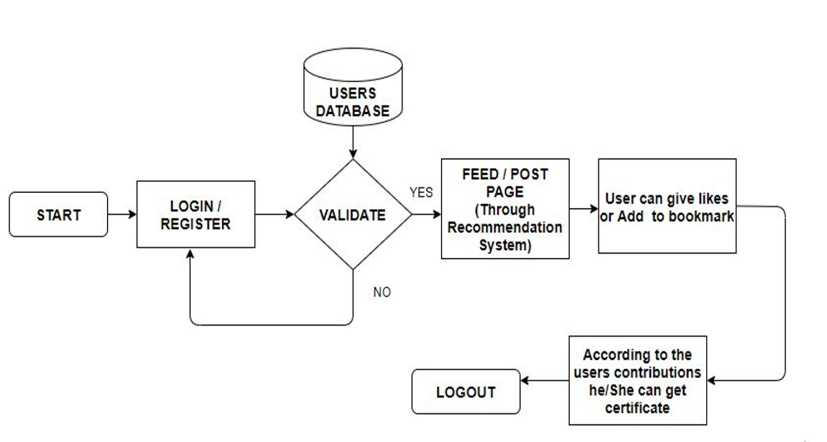
User End Block Diagram

Slide 12
Prototype Design Demonstration
https://jssocialmediapp.netlify.app.

Slide 13
Implementation Status
Designed rest API express backend.
Implemented authentication and other routes in express.
Implemented rest API in express.
Designed Frontend for the PWA.
Creating reactive and responsive Frontend.
Integrating frontend and backend.
Hosting express server on cloud(heroku).
Host react app on cloud(netlify).

Slide 14
Status of Paper Draft & Targeted Conference
Targeted Conferences:
3rd International Conference On Emerging Technologies In Data Mining And Information Security
More Details : http://iemschoolofit.in/iemis/#Reg
5th International Conference on Intelligent Sustainable Systems (ICISS 2022).
More Details : http://icoiss.com/2022/index.html
2nd International Conference on Ubiquitous Computing and Intelligent Information Systems.
More Details : http://icuis.in/2022/
IJSRD (International Journal for Scientific Research and Development)
More Details : http://ijsrd.com/

Slide 15
References
Kakumani Lavanya Latha and Kotte Prabhakar on the ‘NON-GOVERNMENT ORGANIZATIONS: PROBLEMS & REMEDIES IN INDIA’ (Received 14. September 2009; accepted 10 August 2010).
Roman Povzyk-Povzyk, Yoda Consult Strategist on Eight Problems that Regional NGOs Face.
Compiled by Ali Mostashari on the problem of An Introduction to Non-Governmental Organizations (NGO) Management in the Iranian Studies Group at MIT June 2005.

Slide 16
Thank You...!!
Notes:
16

