Slide 1

Department of Information Technology NBA Accredited
A.P. Shah Institute of Technology G.B.Road,Kasarvadavli, Thane(W), Mumbai-400615
UNIVERSITY OF MUMBAI
Academic Year 2021-2022

Slide 2
A Project Report on
Janasevakam: Web Framework For NGO’s Outreach
Submitted in partial fulfillment of the degree of Bachelor of Engineering(Sem-8)
in
INFORMATION TECHNOLOGY
By
Siddhesh Shinde(17104043) Yogesh Pendse(18104041) Suraj Tetme(19204004)
Under the Guidance of Prof.Ganesh Gourshete

Slide 3
1.Project Conception and Initiation

Slide 4
1.1 Abstract
In India, Non-Governmental Organizations are seen to have a significant role in community development practice. NGO’s are established with a vision by a group of like-minded people committed for community development, uplift of poor people.
Importance of NGO’s in various fields and the excellent work is done by NGO’s in specific fields is no doubt a good task that has helped to meet the changing needs of the today’s world full of crisis. But, now a days, many NGO’s in India is facing various problems and challenges which are creating barriers in the implementation of various developmental programs.
In this context efforts have been made through this study to focus on the major problems or challenges faced by Indian NGO’s. The result of the study shows that NGO’s are facing financial problems, HR related challenges, administrative and social problems in the implementation of various social developmental programs.

Slide 5
1.2 Objectives
To design and implement website cum installable progressive web app where society helping organization can collaborate with efficiency.
To design a common platform where all the NGO’s can collaborate with each other and can share their experience, knowledge by contacting each other.
To build a recommendation system using machine learning which will automatically suggest new NGO’s and new social activities based on user past social activities.

Slide 6
1.3 Literature Review
In literature [1] The author has discussed on the performance of development non-governmental organizations (NGO’s) has increased. The author has described an international structured literature review, and explored the salient characteristics of NGO performance research. We have demonstrated that understanding NGO performance is a multifaceted arena in which many issues are explored by academics, NGO practitioners, donors, governments and policymakers. Notwithstanding the modest number of studies (31) that fully met the inclusion criteria, emergent evidence supports three key conclusions and recommendations with research, practice and policy implications.
In literature [2] The author has discussed The Role of NGOs in Promoting Empowerment for Sustainable Community Development. NGOs are professionally-staffed organizations aiming at contributing to the reduction of human suffering and to the development of poor countries. They do thisin various ways, e.g. by funding projects, engaging in service provision and capacity building, contributing to awareness, and promoting the self-organization of various groups. These services help the people to achieve their ability, skill and knowledge, and take control over their own lives and finally become empowered. This paper demonstrated the importance of NGOs in achieving sustainable community development through micro-finance, capacity building and self-reliance.
●

Slide 7
1.4 Problem Definition
The problem that we have faced in now days that there are many NGO’s at small scale doing great work but they are facing problems like lack of funds, lack of public awareness about their NGO’s, people who are actually interested in donation they could not reach this small NGOs.
Also there is lack of communication gap between the small NGO’s and the NGO’s who are doing great job from last couple of years.
So we are Design and implementing website cum installable progressive web app wheresociety helping organization can collaborate with efficiency. And also the large NGO’s get the details about NGO’s who are at starting phase.

Slide 8
1.5 Scope
Can be used in the betterment of society.
Can be useful for small NGOs who need help.
Can be used by everyone across the country

Slide 9
1.6 Technology stack
React - In our project we have used React to implement UI. It has also been used to develop SPA.
Bootstrap - In our project it gave us the ability to easily create responsive designs.
TensorFlow - It is used in our project to implement social work recommendation system. ** Update **
MongoDB - In our project it has been used to store and retrieve data quickly and easily. **Update**

Slide 10
1.7 Benefits for environment & Society
Common platform where all the NGO’s can collaborate with each other and can share their experience.

Slide 11
2. Project Design

Slide 12
2.1 Proposed System
We are implementing front-end using ReactJS and back-end using MongoDB.
For the front end we are implementing a plethora of features like searching, tagsetc.
We are recommending posts using the TensorFlow library.
We are using CSS frameworks like bootstrap to make the website responsive.
We are making our website a progressive web app which is also known as PWA in short.
This makes our website work like a native app and can be installed on any platform like IOS, android, windows, Linux etc.
Using ReactJS we will be making our user interface more interactive and user friendly.

Slide 13
2.1 Proposed System
Volunteer
To be able to see social work.
To interact with posts.
NGO
To create posts on social work
To interact with posts.
Feed generation process
Feed generation will be done with ML based on past activity.

Slide 14
2.1 Proposed System
Authentication
To ensure the our service is personalized to each user.
Post Recommendation
Post recommendation will work on previous interactions
To integrate ml algorithm for this purpose.

Slide 15
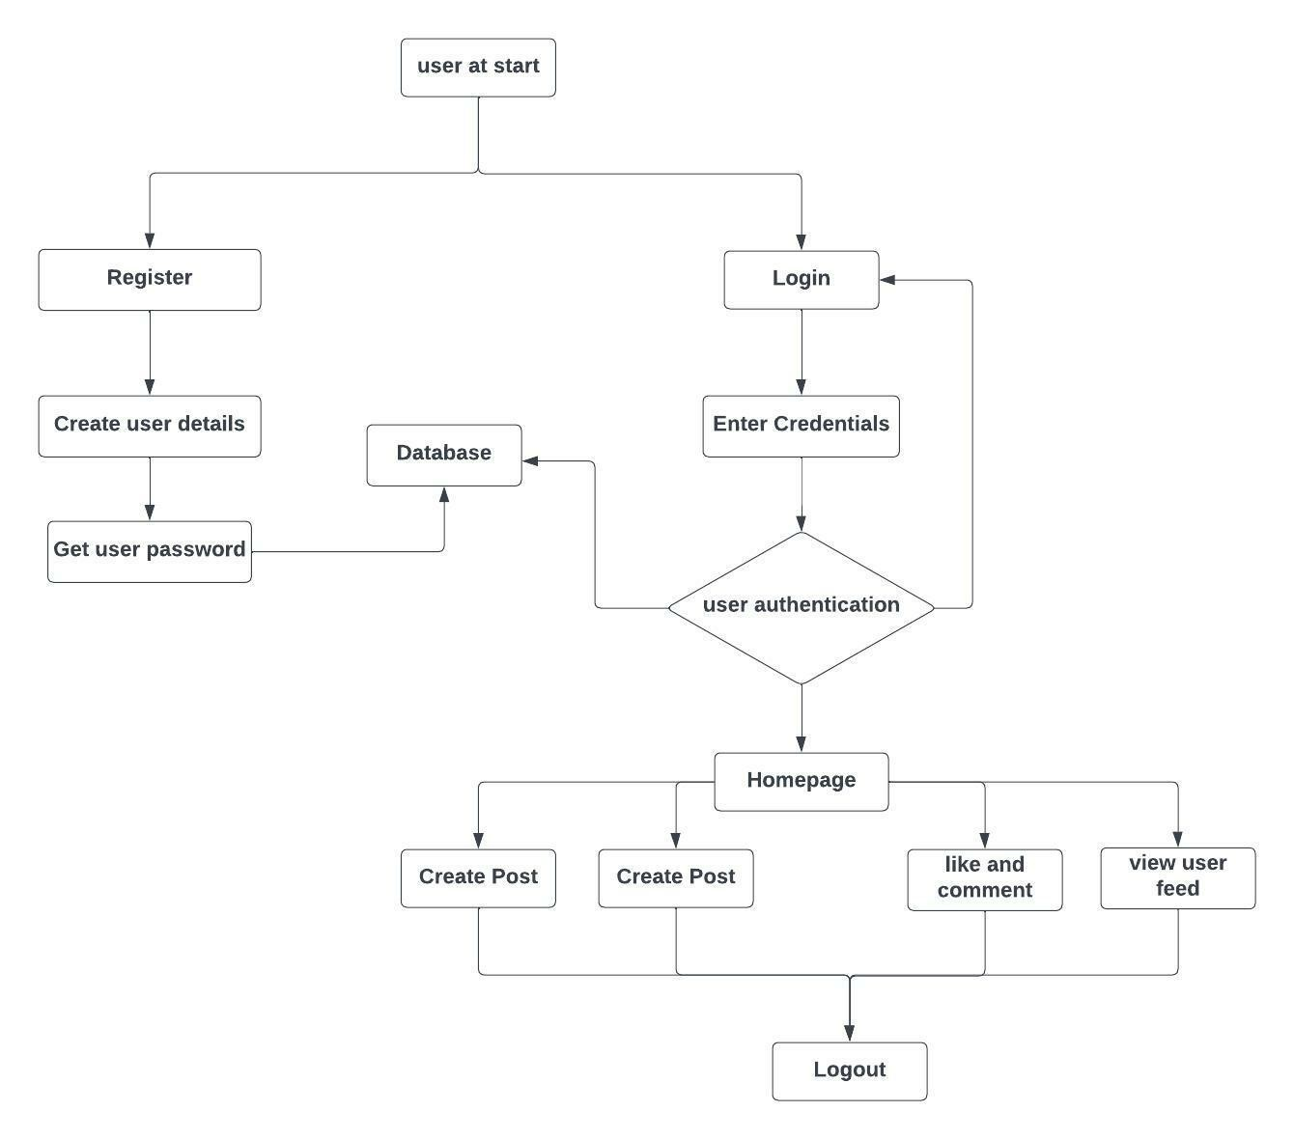
2.2 Design(Flow Of Modules)
1. User ﬂow

Slide 16
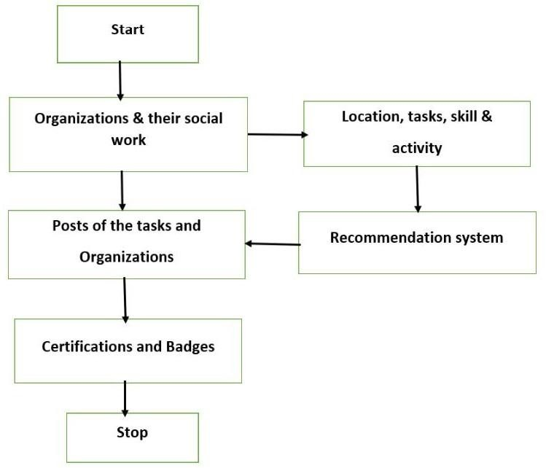
2.2 Design(Flow Of Modules)
2. website ﬂow

Slide 17
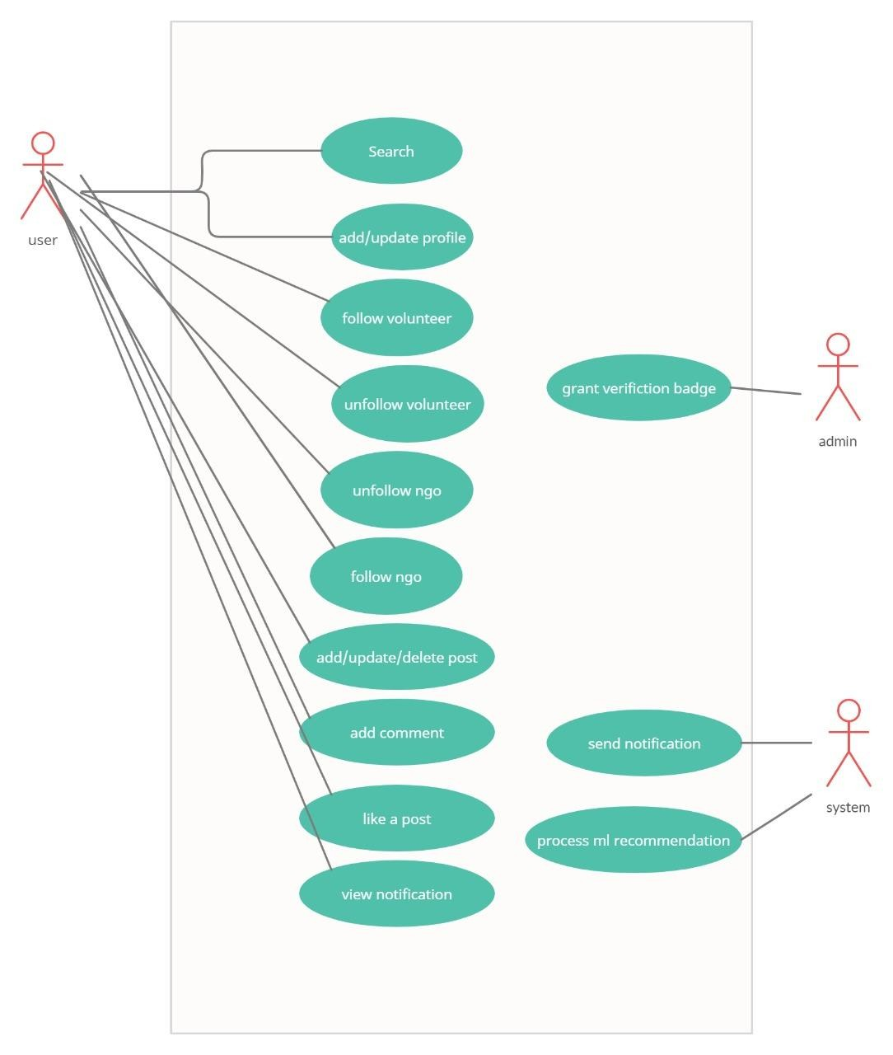
2.3 Description Of Use Case

Slide 18
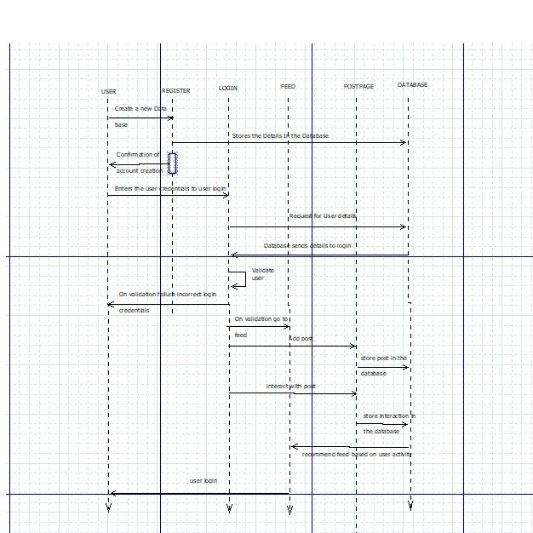
2.4 Activity diagram

Slide 19
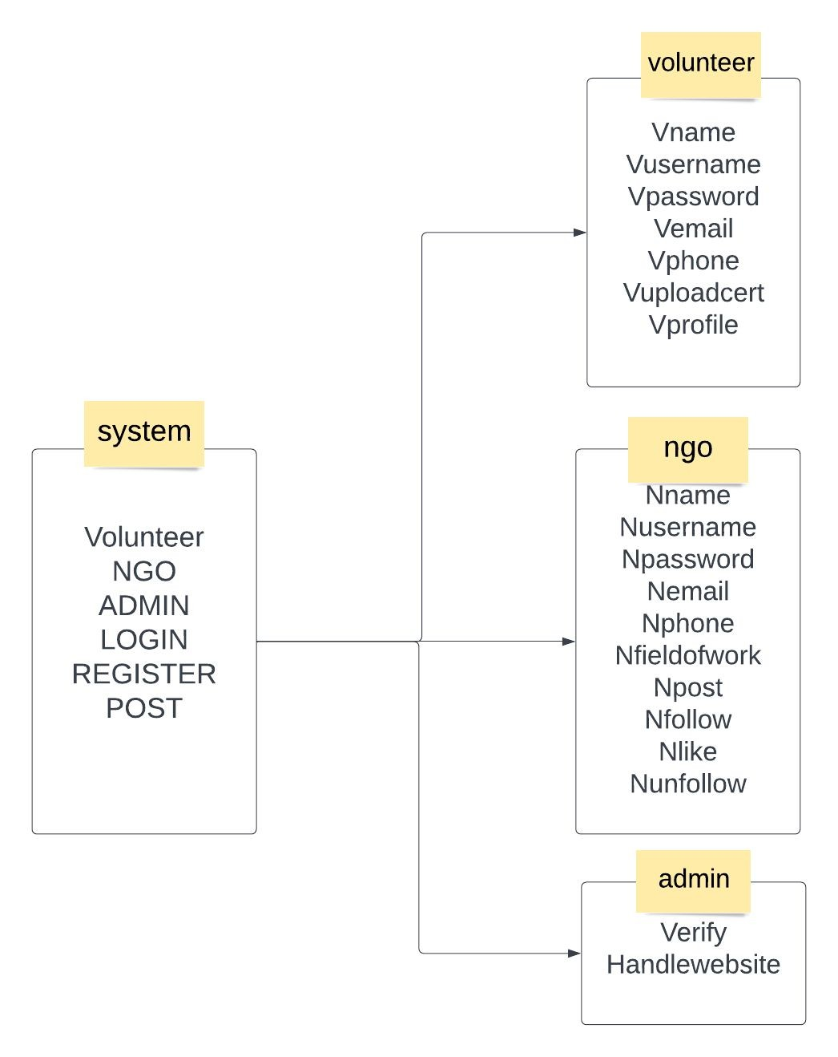
2.5 Class Diagram

Slide 20
3. Implementation

Slide 21
4. Testing

Slide 22
5. Result

Slide 23
6. Conclusion and Future Scope

Slide 24
References
Inamdar, N. R. (1987). Role of Voluntarism in Development, The Indian Journal of Public Administration, 333,Pp.420-432.
Lawani, B.T. (1999). NGO’s in Development (case study of Solapur-District), Rawat Publications, Jaipur.
Chowdhry, D.P. (1987). Critical appraisal of Voluntary Effect in Social Welfare and Development since Independence, The Indian Journal of Public Administration, 333,Pp.492-500.

Slide 25
Paper Publication

Slide 26
Thank You

