Slide 1

Janasevakam
Group No. 25
Siddhesh Shinde :17104043
Yogesh Pendse :18104041
Suraj Tetme :19204004
Project Guide and Co-guide
Prof. Ganesh Gourshete

Slide 2
Contents
Introduction
Objectives
Problem Definition
Technological Stack
Review Suggestions (Given in Last meeting)
Proposed System Architecture/Working
Prototype Design Demonstration
Implementation Status
Status of Paper Draft & Targeted Conference

Slide 3
Introduction
Problem Identified :
Lack of Awareness.
Lack of Dedicated Leadership.
Inadequate Trained Personnel.
Monopolization of Leadership.
Lack of Public Participation.
Lack of Coordination.
Lack of Volunteerism/Social Work among Youth.

Slide 4
Solution Proposed :
● Building a website cum installable progressive web app where society helping organization can collaborate with efficiency.
● Also make it easier for organization’s like APSITNSS,APSIT-Lakshya to collaborate with other organization’s.

Slide 5
OBJECTIVES
To implement backend using NoSQL.
Implementing task recommendation using TensorFlow.
Connecting people who can help to people who need help.
Streamlining the process of serving society.
Increase the outreach of NGO’s and help in making their work easier.
Create a more kind and aware society.
To implement frontend for our web-app using React.js and Bootstrap.

Slide 6
Problem Definition
To design and develop progressive web-app which serves as a common platform of communication between NGO’s across country and connecting people to several social organization’s who are willing to make society a better place to live.

Slide 7
Technology Stack
React – React is a JavaScript library for building user interfaces . In our project we are trying to used React to implement UI. React also allows us to create reusable UI components. It is used to develop SPA.
Bootstrap – Bootstrap is a free front-end CSS framework for faster and easier web development. In our project it give us the ability to easily create responsive designs.
NoSQL - A NoSQL database provides a mechanism for storage and retrieval of data that is modeled in means other than the tabular relations used in relational databases.
TensorFlow - To implement social work recommendation system in TensorFlow.

Slide 8
Review Suggestions
Implementing machine learning algorithm that will recommend
registered users about upcoming NGO task ,events etc.

Slide 9
Proposed System Architecture/Working
Login
Organizations & their social work.
location, task, skill & activity
Post’s of task and Organizations
Recommendation system.
Certifications and badges
Logout

Slide 10
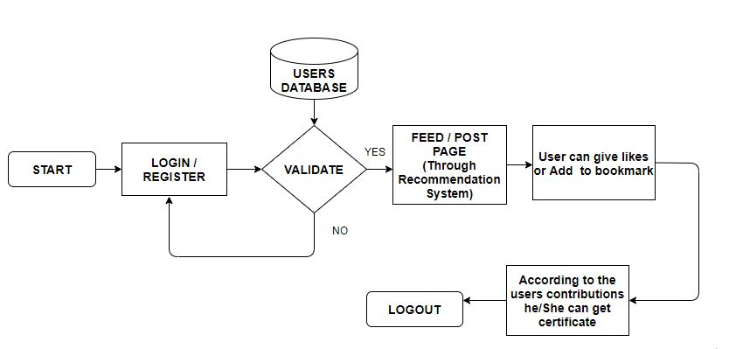
Users End Block Diagram

Slide 11
Prototype Design Demonstration
In progress….
https://jansevakam.netlify.app/

Slide 12
Implementation Status
Designing and Implementing Express Server(Objective 1)

Slide 13
Status of Paper Draft & Targeted Conference
Targeted Conferences :
    3rd International Conference On Emerging Technologies In Data Mining And Information Security
      More Details : http://iemschoolofit.in/iemis/#Reg
    5th International Conference on Intelligent Sustainable Systems (ICISS 2022).
    More Details : http://icoiss.com/2022/index.html
    2nd International Conference on Ubiquitous Computing and Intelligent Information Systems.
    More Details : http://icuis.in/2022/

Slide 14
Thank You...!!

