Slide 1

Janasevakam
Group No. 25
Siddhesh Shinde :17104043
Yogesh Pendse :18104041
Suraj Tetme :19204004
Project Guide and Co-guide
Prof. Ganesh Gourshete
Notes:
1

Slide 2
Contents
Introduction
Objectives
Problem Definition
Technological Stack
Review Suggestions (Given in Last meeting)
Proposed System Architecture/Working
Prototype Design Demonstration
Implementation Status
Status of Paper Draft & Targeted Conference
Notes:
2

Slide 3
Introduction
Problem Identified :
Lack of Awareness.
Lack of Dedicated Leadership.
Inadequate Trained Personnel.
Monopolization of Leadership.
Lack of Public Participation.
Lack of Coordination.
Lack of Volunteerism/Social Work among Youth.
Non-Existence of Common Platform for Communication between People, Non-Government Organizations and for Non-Government Organizations to Collaborate across the country.

Slide 4
Solution Proposed :
● Building a website cum installable progressive web app where society helping organization can collaborate with efficiency.
● Also make it easier for organization’s like APSIT-NSS,APSIT-Lakshya to collaborate with other social organization’s.

Slide 5
OBJECTIVES
To implement backend using NoSQL.
To implement task recommendation using TensorFlow.
To implement frontend for our web-app using React.js and Bootstrap.

Slide 6
Problem Definition
To design and develop progressive web-app which serves as a common platform of communication between NGO’s across country and connecting people to several social organization’s who are willing to make society a better place to live.

Slide 7
Technology Stack
React – In our project we have used React to implement UI. It has also been used to develop SPA.
Bootstrap – In our project it gave us the ability to easily create responsive designs.
TensorFlow – It is used in our project to implement social work recommendation system.
NoSQL- In our project it has been used to store and retrieve data quickly and easily.

Slide 8
Review Suggestions
Implementing machine learning algorithm that will recommend
registered users about upcoming NGO task ,events etc.
To Design Responsive and Dynamic User Interface.

Slide 9
Proposed System Architecture/Working
Login
Organizations & their social work.
location, task, skill & activity
Post’s of task and Organizations
Recommendation system.
Certifications and badges
Logout
Notes:
9
9

Slide 10
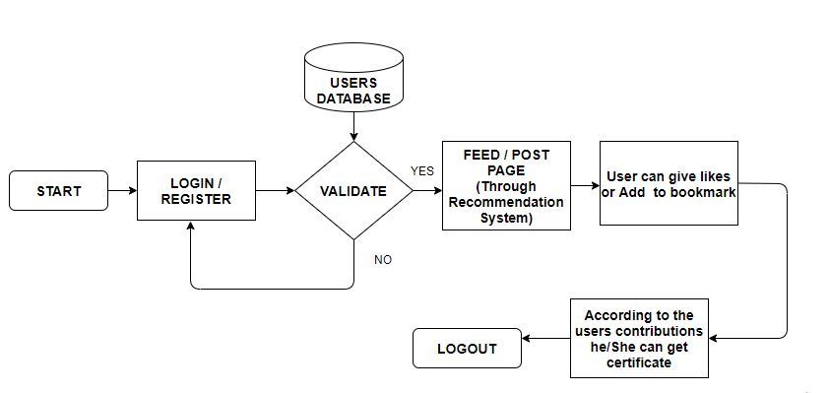
Users End Block Diagram

Slide 11
Prototype Design Demonstration
In progress….
https://jssocialmediapp.netlify.app

Slide 12
Implementation Status
Designed rest API express backend.
Implemented authentication and other routes in express.
Implemented rest API in express.
Designed Frontend for the PWA.
Creating reactive and responsive Frontend.
Integrating frontend and backend.
Hosting express server on cloud(heroku).
Host react app on cloud(netlify).

Slide 13
Status of Paper Draft & Targeted Conference
Targeted Conferences:
3rd International Conference On Emerging Technologies In Data Mining And Information Security
More Details : http://iemschoolofit.in/iemis/#Reg
5th International Conference on Intelligent Sustainable Systems (ICISS 2022).
More Details : http://icoiss.com/2022/index.html
2nd International Conference on Ubiquitous Computing and Intelligent Information Systems.
More Details : http://icuis.in/2022/

Slide 14
Thank You...!!
Notes:
14

