Slide 1

Hospital Emergency Room Data Analysis
Analysis of 9,216 ED records to understand demographics, admissions, wait times, satisfaction, and referrals. Tools: Python (cleaning & EDA), PostgreSQL (analysis), Power BI (dashboard & visualization).

Slide 2
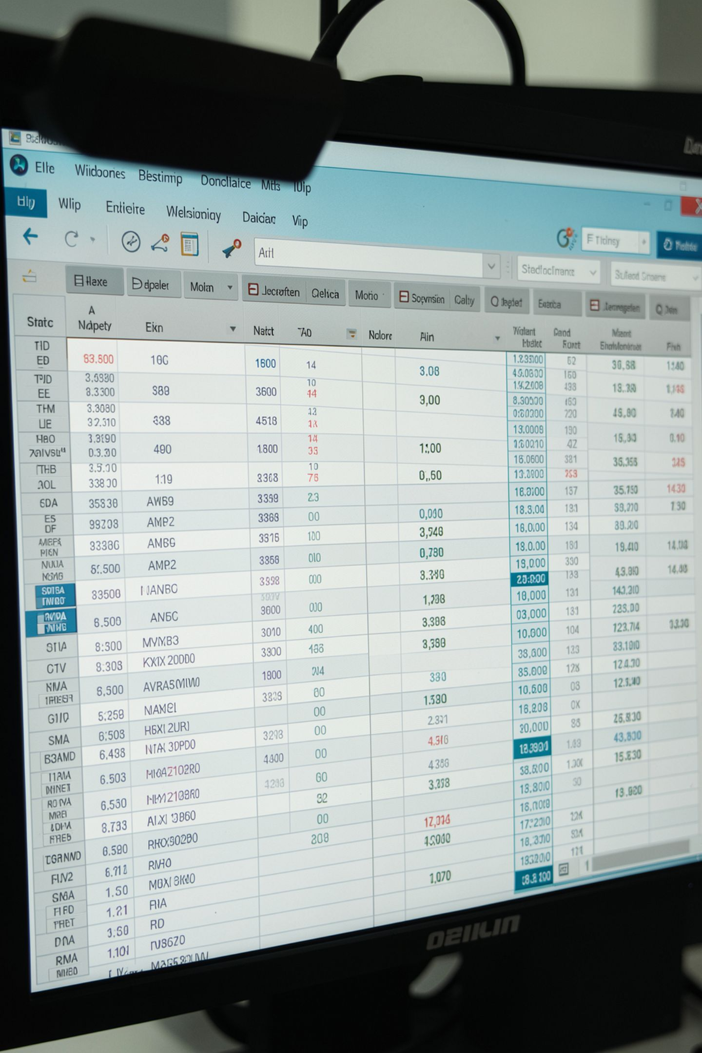
Dataset Snapshot
Rows & Columns
Key Features
9,216 rows • 12 original columns
Gender, Age, Race, Admission Date, Department Referral, Admission Flag, Satisfaction, Waittime
Missing Data
Department Referral and Satisfaction Score contain missing values

Slide 3
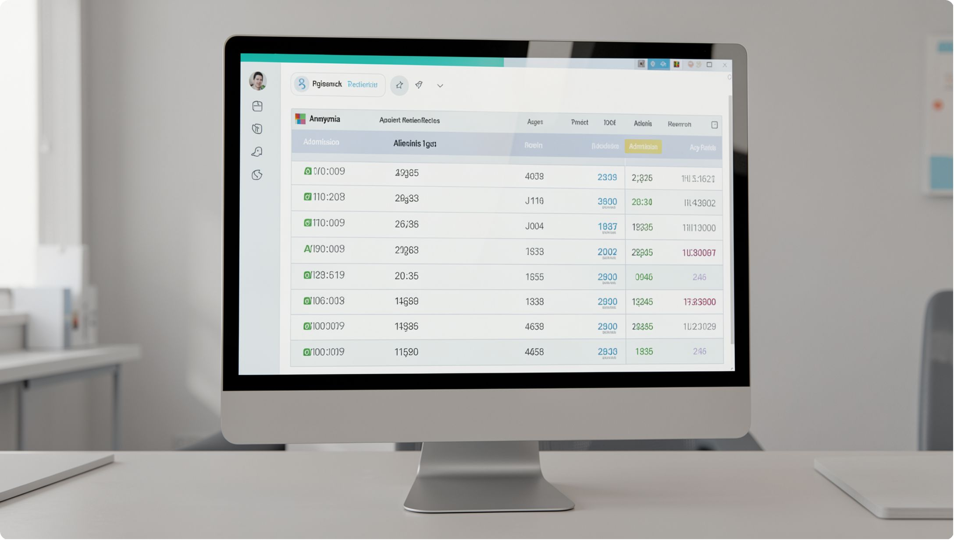
Sample Records (Illustrative)
Examples show varied ages (4–79), multiple races, mixed admission flags, and wait times like "39 min", "55 min". Names anonymized in cleaning. Date range spans 2023–2024 entries.

Slide 4

Data Preparation & Feature Engineering
01
Cleaning
Removed name columns, standardized genders, fixed column names (lowercase, underscores).
02
Missing Values
Filled department referrals with mode and satisfaction scores with median where appropriate.
03
Types & Features
Converted dates and wait times, created age_group (qcut), extracted month/quarter/day/hour.
04
DB Integration
Loaded cleaned data into PostgreSQL for structured querying.

Slide 5


Core SQL Analyses
Key queries run in PostgreSQL to answer operational questions: total visits by gender, admission rates, top departments by admission rate, waiting time outliers, and department satisfaction averages.
Total by Gender
Male: 4,729 • Female: 4,487
Admission Split
Admitted: 4,612 (50.04%) • Not admitted: 4,604 (49.96%)

Slide 6

Department Admission Rates
Top 5 departments by admission rate (from SQL):
Renal — 53.49% (86 patients)
Neurology — 50.26% (193 patients)
Orthopedics — 50.05% (995 patients)
General Practice — 50.04% (7,240 patients)
Gastroenterology — 50.00% (178 patients)

Slide 7

Waiting Time Insights
Flag Above-Average
Compute Average
List High-Wait Cases
Recommend Monitoring
Average waiting time ~35.20 minutes. Several patient records exceed average with waits of 39–59 minutes (examples listed in dataset). Use peak-hour analysis for staffing.

Slide 8
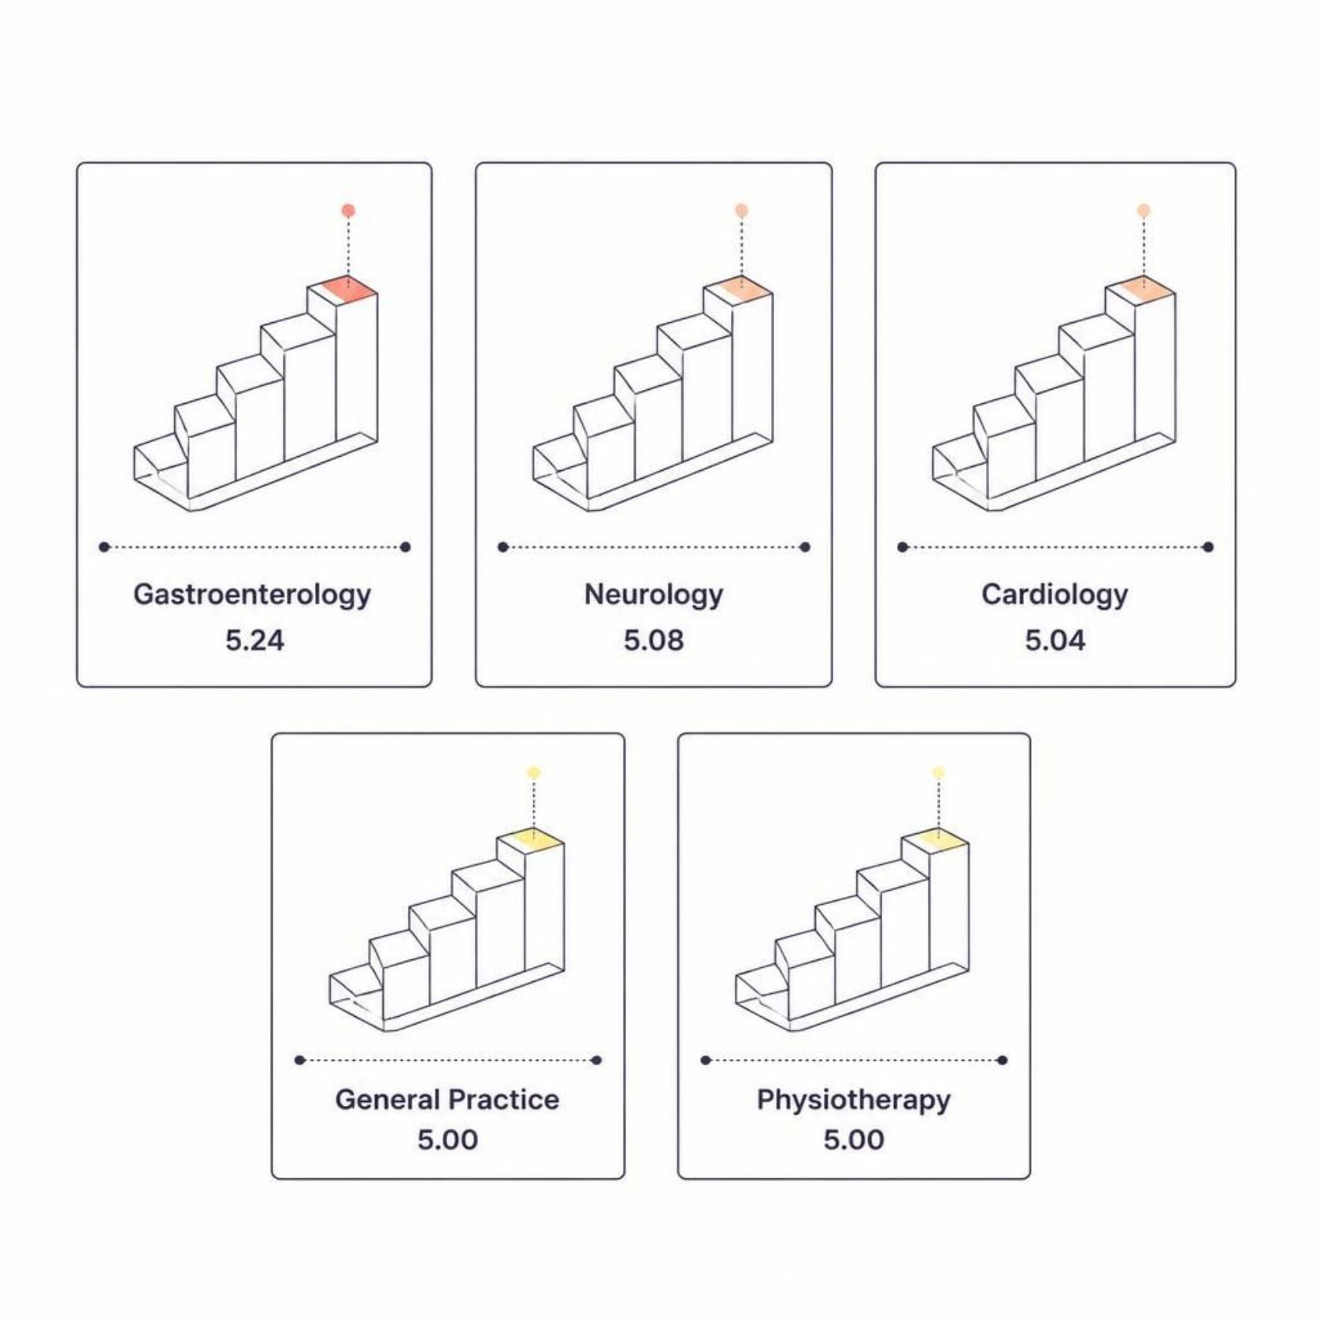

Satisfaction & Quality
Average satisfaction scores were computed where available. Missing satisfaction values were imputed with median to enable departmental comparisons.
Gastroenterology leads with avg 5.24 (top-ranked among departments with scores).

Slide 9
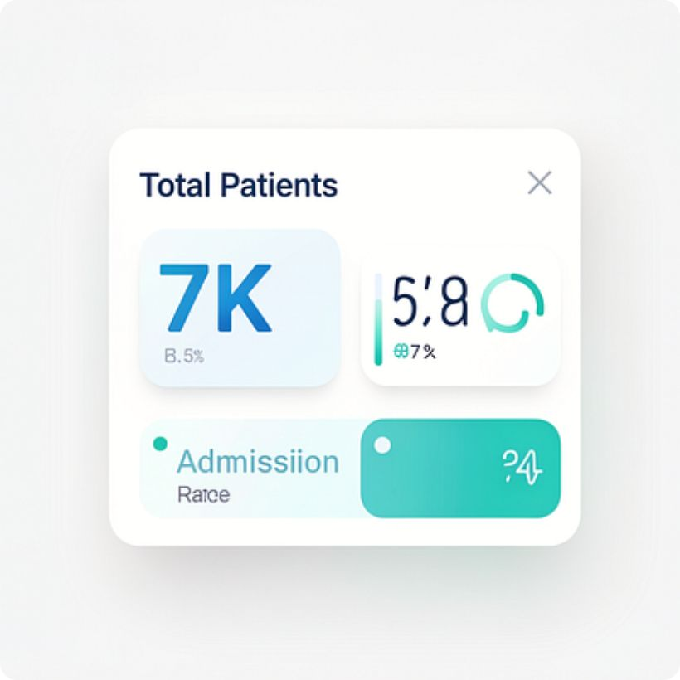
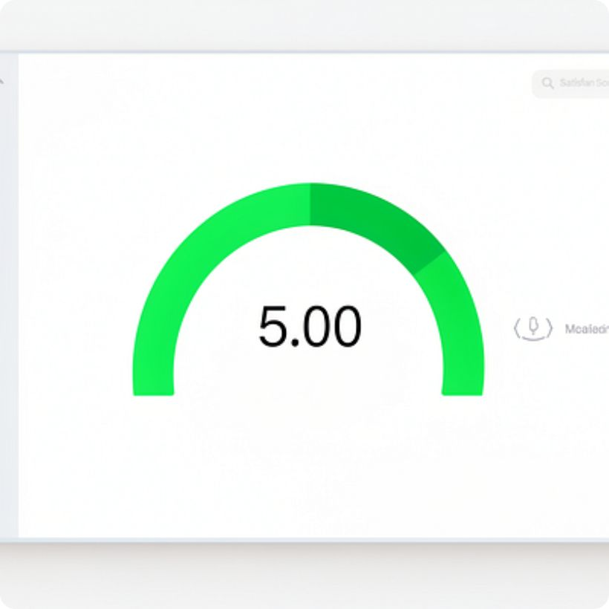
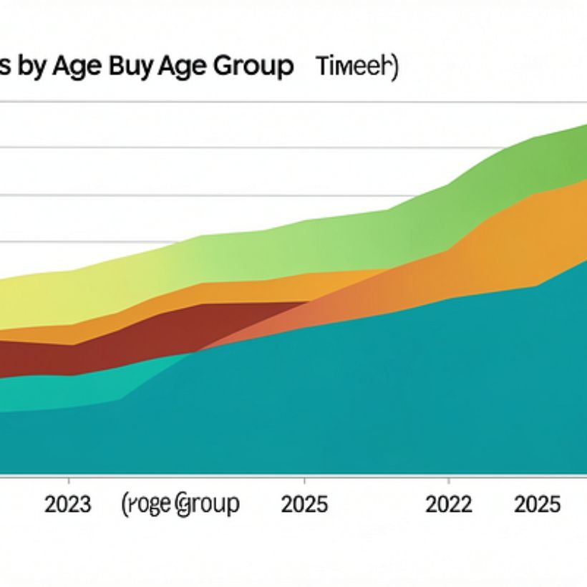
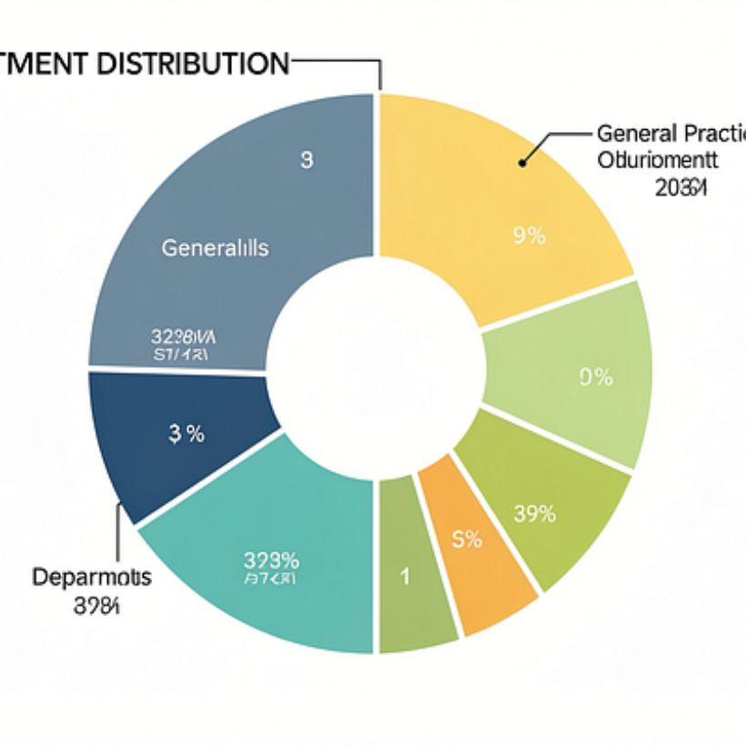
Power BI Dashboard Highlights
Dashboard features KPIs, age/gender/race charts, day-hour heatmap, slicers for department/gender/age/admission/date to explore trends interactively.

Slide 10
Business Recommendations
Improve Patient Flow
1
Monitor waiting-time peaks and reallocate staff during high-demand hours.
Plan Resources
2
Use day-hour volume patterns for staffing and supply planning.
Monitor Departments
3
Track referral counts to understand distribution of visits and capacity needs.
Improve Data Quality
4
Reduce missing department and satisfaction entries to strengthen reporting.
Track Experience
5
Continuously monitor satisfaction scores and waiting-time trends; use Power BI filters for cohort comparisons.

