Slide 1
NOESIS : VISION
Q & A

Slide 2
Q1
Write a program to print the first digit of given number .
Hint : Use str to convert a number to a string. One common use for this is to access individual digits of a number:

Slide 3
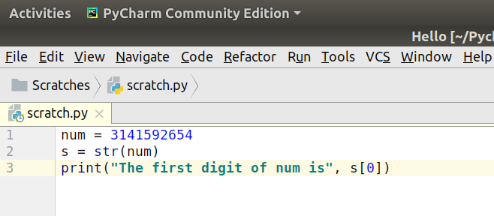
Answer 1

Slide 4
Q 2
Write a program that asks a user for their name and prints it in the following funny pattern:
E El Elv Elvi Elvis
Hint : Slice the name.

Slide 5
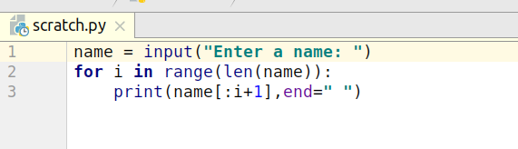
Answer 2

Slide 6
Q 3
Write a program that, given a string that contains a decimal number, prints out the decimal part of the number. For instance, if given 3.14159 , the program should print out .14159 .
Hint : By default input() takes a string.

Slide 7
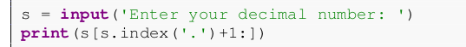
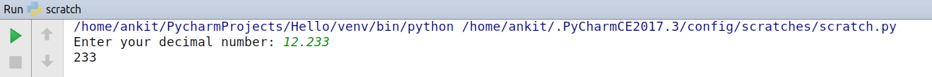
Answer 3
OUTPUT :

Slide 8
Q 4
Write a program that asks the user to enter a word and prints out whether that word contains
any vowels.

Slide 9
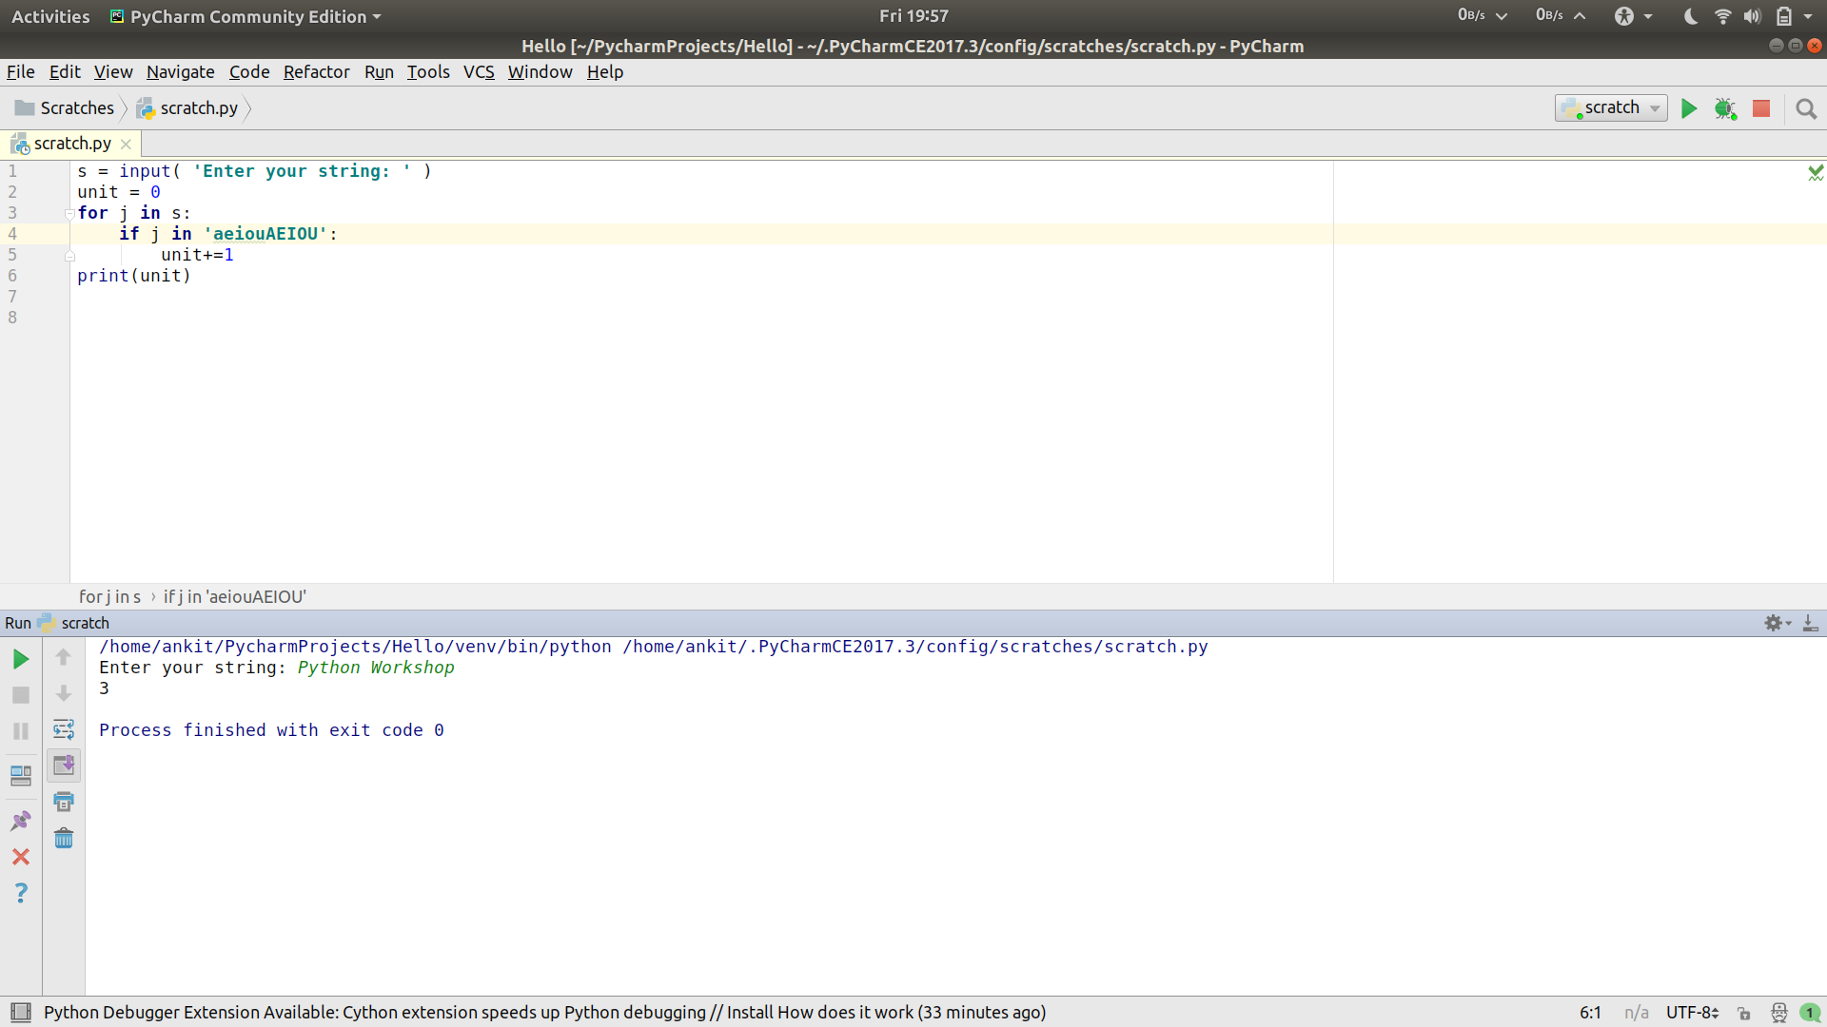
Answer 4
OUTOUT :

Slide 10
Q 5
Write a program to print REVERSE of a number.
Hint : Play with string of a number.

Slide 11
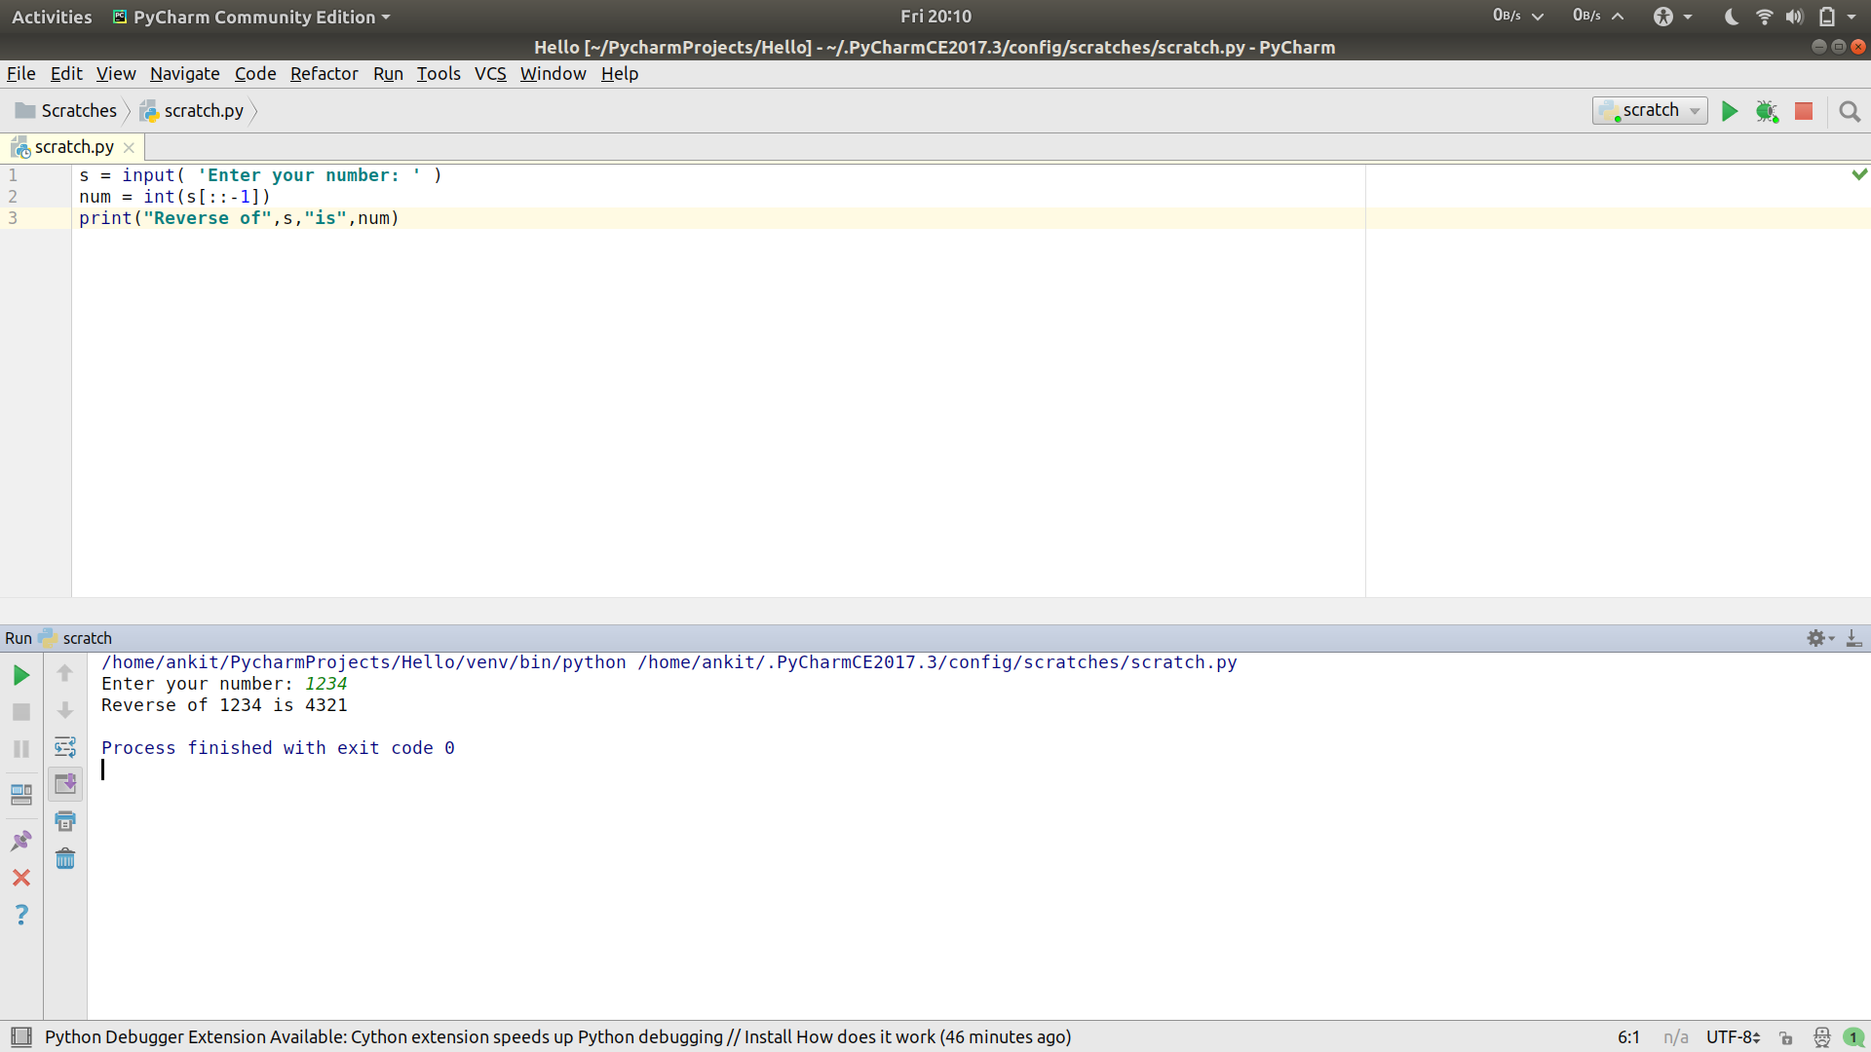
Answer 5
OUTPUT :

Slide 12
Q 6
Write a program that removes all capitalization and common punctuation from string s .

Slide 13
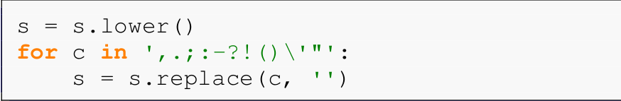
ANSWER 6

Slide 14
SOME MORE..
Q. Write a program that asks the user to enter a word and determines whether the word is a palindrome or not.
A palindrome is a word that reads the same backwards as forwards.

