Slide 1

BE Project
on
“Virtual Valet”
Presented By,
Siddhi Nirmale 71900442L
Jait Mahavarkar 71900287H
Pratiksha Kolte 71900343B
Guide By,
Prof. A.A.Prabhune
Department Of
Electronics and Telecommunication ENGINEERING
PUNE INSTITUTE OF COMPUTER TECHNOLOGY
PUNE – 43
Academic Year: 2021-22

Slide 2
Individual Contribution
Sr. No. | Student Name | Roll No. | Contribution
1 | Siddhi Nirmale | 42143 | Frontend & Integration
2 | Jait Mahavarkar | 42131 | Backend
3 | Pratiksha Kolte | 42435 | Frontend

Slide 3
Aim of the Project
The main purpose of this project is to create an app that leverages Python's Easy OCR and Tesseract to allow users' devices to automatically record license plates of cars, allowing them to learn more about the vehicle. The backend and frontend will be connected using Django.

Slide 4
Scope and Objective/s of the Project
In last few years, ANPR or license plate recognition (LPR) has been one of the useful approaches for vehicle surveillance. It is can be applied at number of public places for fulfilling some of the purposes like traffic safety enforcement, automatic toll text collection, car park system and Automatic vehicle parking system.
Although it appears to be a simple task, capturing an image of a moving car in real time in such a way that none of the vehicle's components, particularly the vehicle number plate, is missed, is a difficult task. We assessed and categorized based on the methodology in each approach because it is impossible to judge which strategy is best. When available, parameters such as speed, accuracy, performance, image size, and platform are presented for each approach. Our survey continues with a review of what is not implemented and what types of research in ANPR are conceivable.

Slide 5
Introduction
A vehicle registration plate is a metal or plastic plate attached to a motor vehicle for official identification purpose. These plates are placed on the front and back of the vehicle .
Number plate recognition is an image processing technology which is used to identify vehicles by their number plates using optical character recognition .
This technology is used in various security and traffic applications such as access control system , border control ,parking stations .

Slide 6
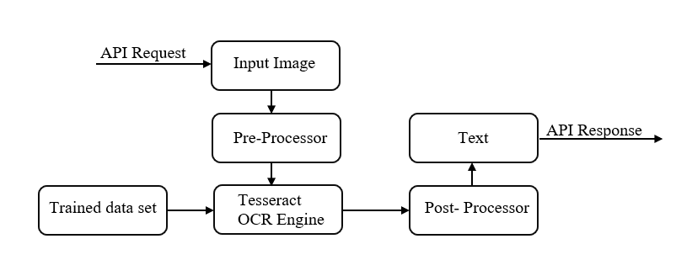
Block Diagram

Slide 7
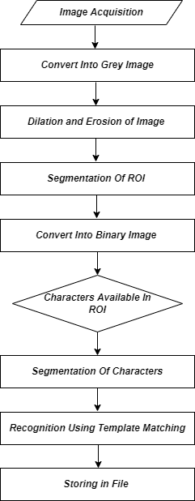
Flowchart/ Algorithm

Slide 8
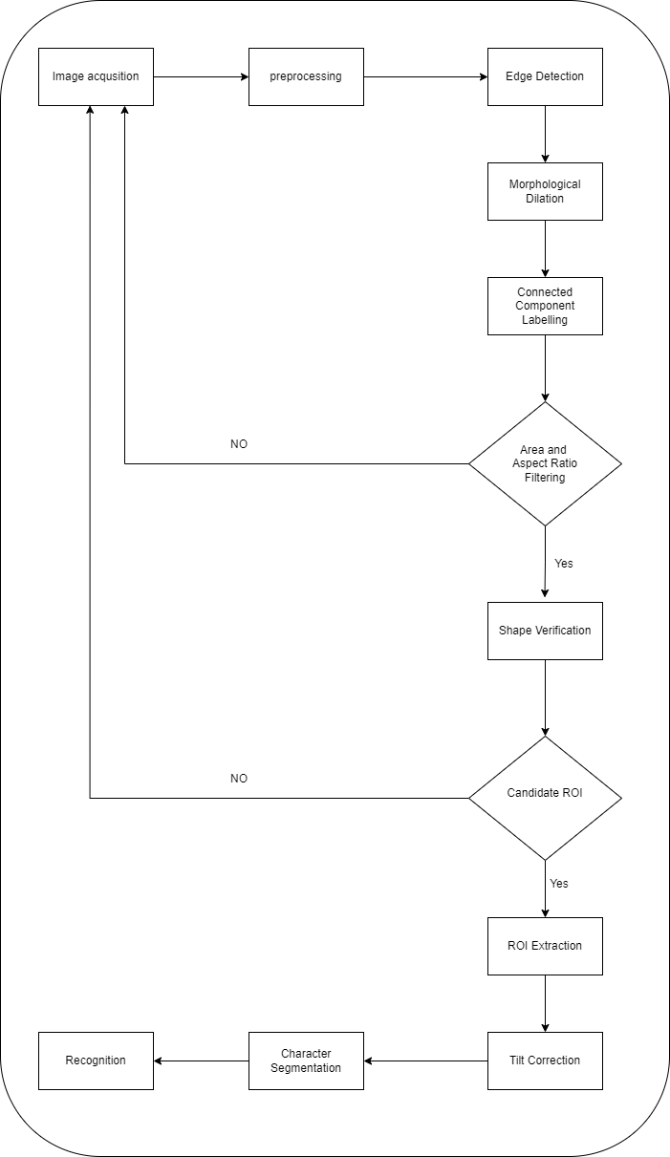
System Design

Slide 9
Virtual valet will help its user to get the information of the car’s owner with the help number plate. The first step for our user is to create an account in our application. After that he will be provided with two options like upload the image and click the image. Clicking an image is a real time function.
The photograph will be saved in our system for further processing once he submits it.
After that image preprocessing will takes place. Image preprocessing are the steps required to format images before sending it to our training model. This includes image resizing, color corrections, etc.
The user is going to enter the entire car image and not only the number plate. So, we need to crop it. For that purpose, we are using edge detection. Identifying object’s edges in an image with the help of image processing is known as edge detection.
The area of interest in an image is the portion of the image on which we want to execute additional operations. To get the required region of interest we first need to convert the RGB image to greyscale image.
Segmentation is the crucial stage in any image processing or recognition system. For subsequent processing, character segmentation extracts the objects of our interest.

Slide 10
System implementation and Testing Result
We began by conducting a thorough analysis of existing ANPR approaches and identifying the major components of ANPR systems by examining their performance summary, benefits, and drawbacks. We then investigated and sketched out a basic idea of how our app would look and function, as well as the specific type of app we were expected to create. We decided to construct a graphic prototype for the web app using Figma.
The project is carried out in Django. It's a Python framework that makes building web sites with Python a lot easier. The MVT design pattern is used by Django (Model View Template).
Model - The information you want to show, which is commonly data from a database.
View - A request handler that, based on the user's request, returns the appropriate template and content.
Template - A template is a text file (similar to an HTML file) that specifies the layout and logic for displaying data on a web page.

Slide 11
The project module was tested on a variety of images with varying backgrounds, lighting, and video quality and found to be successful with images that fit inside specific dimension frames. The image was effectively increasing image quality and transforming the image to binary and morphing image. The vehicle's license plate is removed and presented individually in the project. After using Pytesseract to conduct Optical Character Recognition, the project successfully prints the license number. The Tesseract engine has precision challenges which can be improved by fine-tuning the engine's design. All activities, including picture acquisition, number plate extraction, pre-processing, character segmentation, and character identification, as well as printing on the terminal, are completed in the final prototype. The project can be modified such that the number is collected and stored.

Slide 12
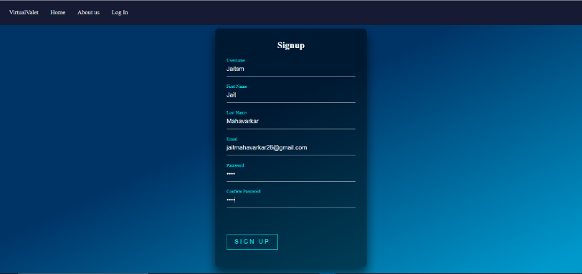
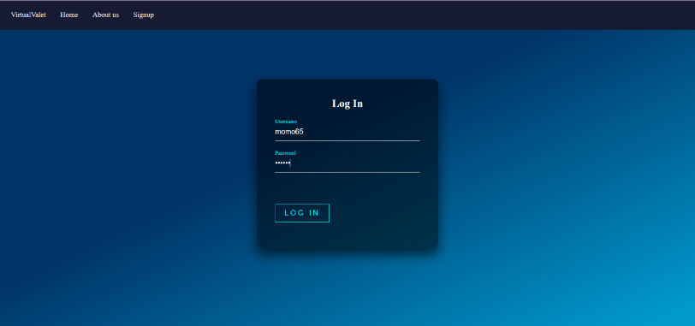

Slide 13
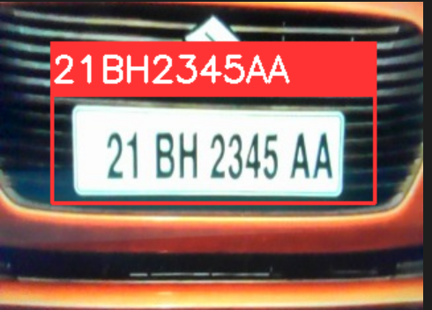
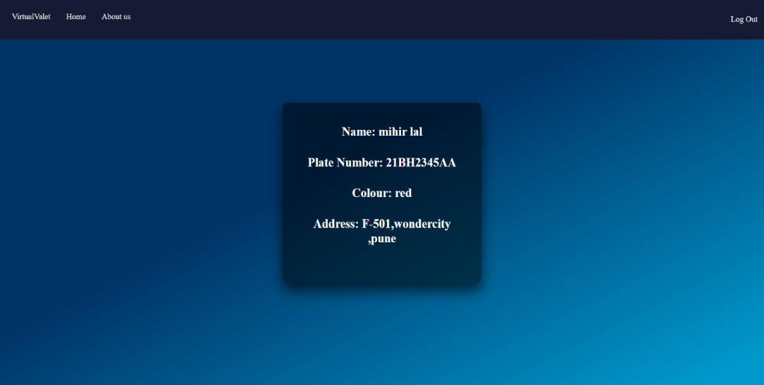
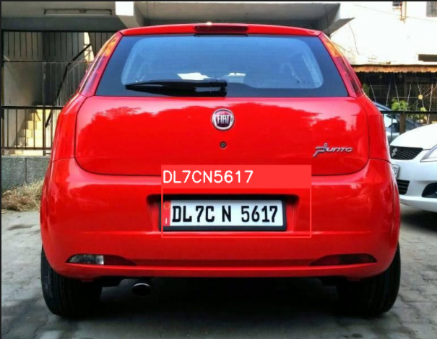
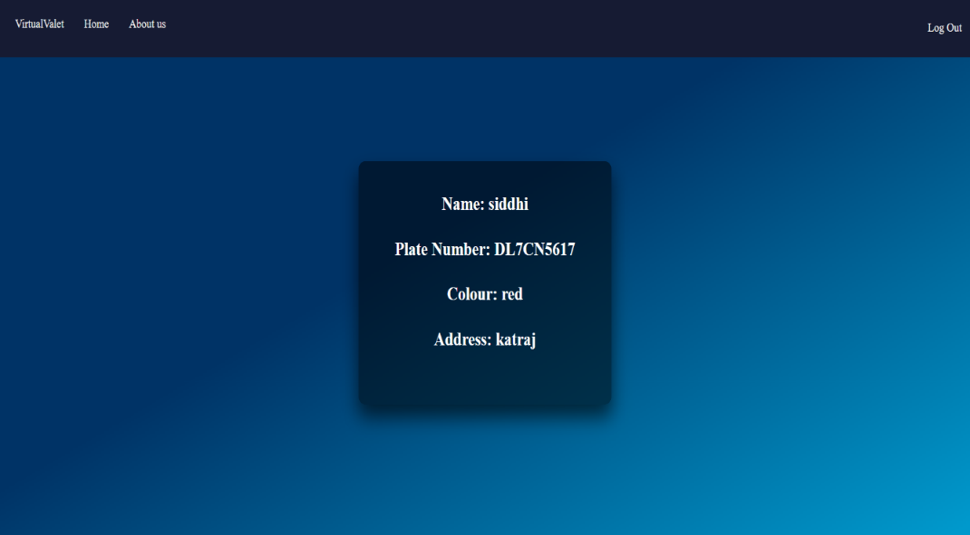

Slide 14
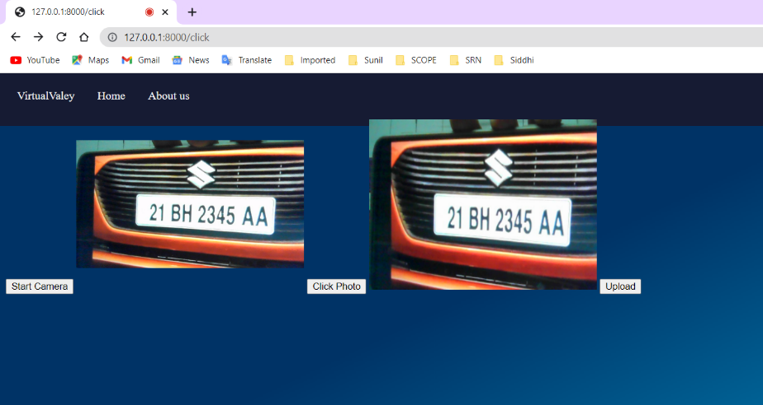

Slide 15
Limitations of the project:
Camera should be of good quality. Otherwise, correct text from image would not be extracted properly.
There should be proper lighting.
Under different lighting situations, this system does not respond well.
Although accuracy is high, mean squared error leads to low computational results.

Slide 16
Conclusion
This project shows an app that uses cameras to capture a vehicle plate image and then processes it to extract number plate information. A vehicle's back picture is taken and analyzed using a variety of algorithms. Number plate extraction, character segmentation, optical character recognition, and other techniques will be applied to the image. We also intend to research the characteristics of the automatic number plate system to improve its performance.
ANPR systems rely on complex optical, computational, and digitization capabilities, which might cause plate recognition to be delayed. The available ANPR solutions do not provide a consistent set of features for all nations; instead, each company must be provided with a well-optimized system for various parts/regions of the world, as the same system developed is insufficient and must be designed according to the region where it will be deployed, considering all influencing factors. OCR engines are frequently tailored to certain countries. It must be confirmed that the required countries are supported by the camera's installed library or engine. Each vendor's ANPR solution has its own set of strengths and disadvantages. The best of these is the one that addresses the region's demands in terms of identified system-effecting conditions.

Slide 17
Future Scope
The created system's future work will be focused on improving the accuracy of text localization and graphics removal in caption text images.
It can be assessed using a variety of other picture databases and classifiers.
The described approaches could be improved and used to sort mixed mail automatically.
Future ANPR research will confront several problems, including the need to focus on more robust algorithms for non-standardized formats across all regions. Furthermore, rather than pre-acquired photos, all proposed/designed algorithms must be tested for real-time scenarios. High-resolution cameras must also be used, enabling for powerful algorithms to minimize processing times and improve recognition capabilities. More research is needed to make the algorithms clever enough to work with non-standardized, heterogeneous number-plate datasets in a variety of contexts.

Slide 18
References
Chirag Patel, Atul Patel and D. Shah “Automatic Number Plate Recognition System (ANPR): A Survey,” International Journal of Computer Applications, DOI:10.5120/11871-7665
Nicole do Vale Dalarmelina, Marcio Andrey Teixeira and Rodolfo I. Meneguette "A Real-Time Automatic Plate Recognition System Based on Optical Character Recognition and Wireless Sensor Networks for ITS” Department of Informatics, Federal Institute of São Paulo, Catanduva 15808-305, Brazil
Lubna, Naveed Mufti and Syed Afaq Ali Shah ”Automatic Number Plate Recognition:A Detailed Survey of Relevant Algorithms” . Sensors 2021, 21, 3028. https://doi.org/ 10.3390/s21093028
Faizal Patel, Jaimini Solanki, Vivek Rajguru, Ankit Saxena “Recognition of Vehicle Number Plate Using Image Processing Technique” Medicaps Institute of Technology and Management Indore, MP
Aniruddh Puranic, Deepak K. T., Umadevi V., “Vehicle Number Plate Recognition System: A Literature Review and Implementation using Template Matching”, International Journal of Computer Applications (0975 – 8887)

Slide 19
Thank You …!!!

