Slide 1
ChatterBox
Real-Time WebSocket Chat Application
Siddhi Kumari
Infosys Springboard Internship – Batch 11
Mentor: Megha M
19 February 2026

Slide 2
Project Overview
ChatterBox is a full-stack real-time chat application developed using FastAPI and WebSockets.
The system provides:
• Secure user registration and login using JWT
• Real-time messaging using WebSocket protocol
• Admin dashboard for system monitoring
• ML-based bad word detection
• Automated warning and blocking system
• CSV data export functionality

Slide 3
Problem Statement
Modern chat applications often face:
• Lack of real-time efficiency
• Weak authentication mechanisms
• No proper moderation system
• Limited admin monitoring capabilities
This project solves these issues using a secure and scalable backend architecture.

Slide 4
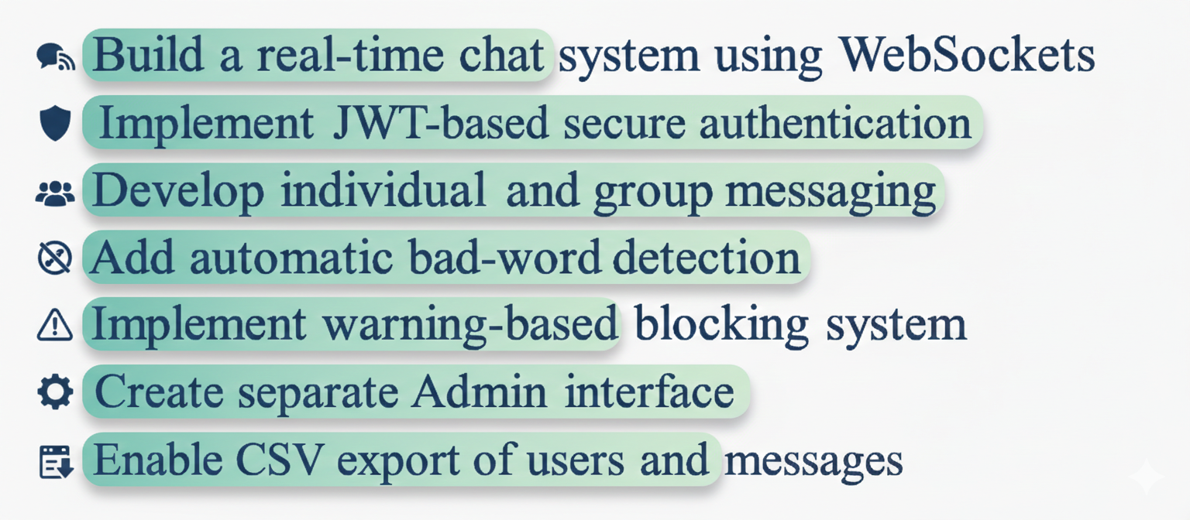
Project Objectives

Slide 5
Technology Stack
Backend:
• Python
• FastAPI
• WebSockets
• SQLAlchemy
• SQLite
Authentication:
• JWT (python-jose)
• Passlib + Bcrypt
Frontend:
• HTML
• CSS
• JavaScript
Machine Learning:
• Custom bad-word detection logic

Slide 6
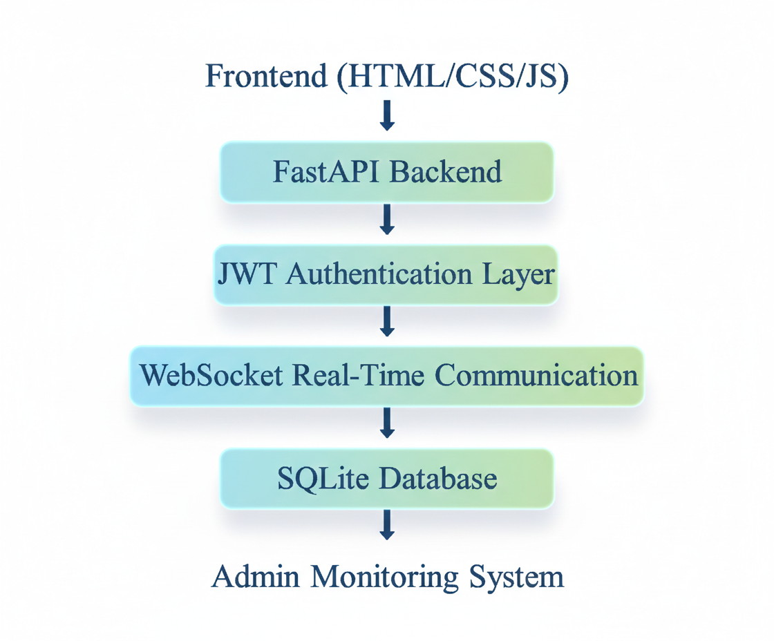
Project Architecture

Slide 7
Project Structure
Backend:
• Auth Module
• Admin Module
• Chat Module
• ML Moderation Module
• Utils & Security Module
• Database & Models
Frontend:
• User Login & Registration
• Real-Time Chat Interface
• Admin Login & Dashboard

Slide 8
Authentication Flow
User registers via /auth/register
Password is hashed using Bcrypt
JWT token is generated
Token stored in browser localStorage
Protected routes validate token
Admin access verified using role-based check

Slide 9
Real-Time WebSocket Flow
User connects using JWT token
Token is verified before connection
ConnectionManager stores active connections
Messages broadcasted to all users
Messages stored in database with UTC timestamp

Slide 10
Machine Learning Moderation System
• Custom bad-word detection module
• Tracks warning_count per user
• 1st violation → Warning
• 2nd violation → Warning
• 3rd violation → Auto Block
Blocked users cannot:
• Login
• Send messages

Slide 11
Admin Features
• Secure Admin Login
• Dashboard Summary
• Total Users Count
• Total Messages Count
• Blocked Users Count
• Recent Messages Monitoring
• Download Users CSV
• Download Messages CSV

Slide 12
Database Design
Users Table:
• id
• username
• email
• password_hash
• is_admin
• is_blocked
• warning_count
• created_at
Messages Table:
• id
• sender_id
• receiver_id
• room
• content
• timestamp

Slide 13
Key Features
• Real-time WebSocket communication
• JWT-based authentication
• Role-based admin control
• ML-based moderation
• Warning & Auto-block system
• CSV Export functionality
• Clean and responsive UI
• Date separator logic (Today / Yesterday)
• UTC timestamp handling

Slide 14
Challenges Faced
• Implementing secure JWT authentication
• Managing WebSocket token verification
• Handling Passlib & Bcrypt compatibility
• Designing auto-block logic
• Implementing CSV streaming response
• Timezone mismatch issues

Slide 15
Learning Outcomes
• Deep understanding of FastAPI architecture
• Real-time communication using WebSockets
• Secure authentication using JWT
• Database modeling using SQLAlchemy
• Role-based access control
• Backend + Frontend integration
• Admin monitoring systems

Slide 16
Conclusion
The ChatterBox project successfully demonstrates:
• A scalable real-time communication system
• Secure authentication and authorization
• Intelligent moderation mechanism
• Complete admin control system
• Professional full-stack development skills

Slide 17
Future Improvements
• Deploy on cloud server
• Add private chat rooms
• Implement proper ML model training
• Add file/image sharing
• Improve UI animations

Slide 18
Thank You
Questions?

