Slide 1
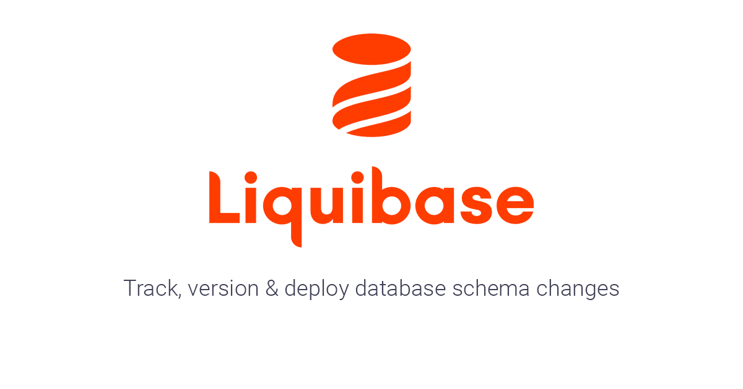
Liquibase
Track, version, and deploy database changes
Siddhi Kiran Bajracharya

Slide 2
Changes in Databases can be complex!

Slide 3
Tables
Stored procedure
Triggers
Views
And more…

Slide 4
How do we manage change?

Slide 5
CREATE TABLE `test` (
`id` int NOT NULL AUTO_INCREMENT,
`first_name` varchar(30) DEFAULT NULL,
PRIMARY KEY (`id`)
);

Slide 6
CREATE TABLE `test` (
`id` int NOT NULL AUTO_INCREMENT,
`first_name` varchar(30) DEFAULT NULL,
`last_name` varchar(30) DEFAULT NULL
PRIMARY KEY (`id`)
);

Slide 7
CREATE TABLE `test` (
`id` int NOT NULL AUTO_INCREMENT,
`first_name` varchar(150) DEFAULT NULL,
`last_name` varchar(150) DEFAULT NULL
PRIMARY KEY (`id`)
);

Slide 8
A Rather Simple Solution

Slide 9
Solution
First.sql: Create table test (id, first_name);

Slide 10
Solution
First.sql: Create table test (id, first_name);
Second.sql: alter table test add column last_name;

Slide 11
Solution
First.sql: Create table test (id, first_name);
Second.sql: alter table test add column last_name;
Third.sql: alter table test modify column …

Slide 12
Simple, right?

Slide 13
That is how flyway db works!

Slide 14
What we know till now?
FlywayDB
liquibase
Simple
Multiple files
SQL and Java
???
???
???

Slide 15
What we know till now?
FlywayDB
liquibase
Simple
Multiple files
SQL
Powerful
Single or multiple files called changelogs.
SQL, yaml, xml or json.
More differences here

Slide 16
Basic terminologies

Slide 17
Liquibase Terminologies
Changelog
A kind of ledger of changes and contains changesets.
Changeset
A unit of change that occurs to database.
Tracking Tables
Databasechangelog table
Tracks changes made in the database.
Databasechangelock table
Ensures only one instance of liquibase is running at a time.

Slide 18
Changelogs
Lists all changes sequentially.
Written in xml, sql, json or yaml file.

Slide 19
Changeset
A single unit of change
Denoted by <changeset> tag in xml file.
A single query separated by a semicolon (;) in SQL file.

Slide 20
ChangeType
Determines what kind of change is being made to the database.
For example
Adding column
Dropping columns
Full documentation here

Slide 21
Basic Commands

Slide 22
Basic commands
update - applies to all unrun changes.
rollback - reverts (rolls back) changes you have made to your database.
snapshot - used when you want to quickly compare changes in your database or keep a record of your current database state.
diff - allows you to compare two databases of the same type or different types to one another.
generateChangeLog - creates a changelog file that has a sequence of changesets which describes how to re-create the current state of the database.
rollbackOneUpdateSql - a helper command that allows you to inspect the SQL Liquibase will run to revert all changesets associated with the deploymentID specified in the rollbackOneUpdate command.
history - a helper command that lists out all your deploymentIds and all changesets associated with each deploymentId.

Slide 23
Workflow

Slide 24
Workflow
Step 1: Add your changesets to a/ changelog.
Edit your changelog file.
Step 2: Verify the SQL that you will execute.
Use command updateSQL.
Step 3: Save your changelog to your source control.
Use git or any version control tool.
Step 4: Run the database update command.
Use command update.
Step 5: Verify that the changeset or changesets were executed.
Use command history or status.
Check the databasechange log.

Slide 25
Demo

Slide 26
Installation
Download zip file from https://www.liquibase.org/download.
Extract files to directory.
Add the directory to path.
ALTERNATIVELY, JUST USE THE INSTALLER.
Verify installation.

Slide 27
Adding connector
Download the appropriate connector for the database.
Since we will be using mysql:
Download mysql-connector-java-<version>.jar.
Put the connector file inside ${liquibase_home}/lib/.

Slide 28
liquibase.properties file
changeLogFile:changelog.xml
# target database.
url:jdbc:mysql://localhost/liquibase_target
username: siddhi
password: siddhi@123
# reference database
referenceUrl: jdbc:mysql://localhost/source_schema
referenceUsername: siddhi
referencePassword: siddhi@123
liquibase.hub.mode=off

Slide 29
Commands in Demo
Update
updateSQL
Rollback
Tag
updateToTag
generateChangeLog
Status
history

