Slide 1





Bluestock Mutual Fund Capstone Project
Mutual Fund Performance Analysis and Dashboard Development
Submitted By: Siddhi Amare
Organization: Bluestock Fintech
Date: [22/06/2026]

Slide 2
Problem Statement
The mutual fund industry generates large volumes of financial data, including Net Asset Values (NAVs), returns, risk indicators, and fund performance metrics. Investors and financial analysts often face difficulties in efficiently analyzing this data to compare funds, identify high-performing investment options, and make informed decisions.
Manual analysis of mutual fund data is time-consuming, prone to errors, and lacks scalability when dealing with multiple fund categories and historical records. Additionally, the absence of a centralized and interactive analytical platform limits the ability to monitor performance trends, evaluate risk-return relationships, and derive actionable insights.
This project aims to address these challenges by developing an end-to-end Mutual Fund Analytics Solution that automates data extraction, transformation, and loading (ETL), performs comprehensive exploratory data analysis (EDA), evaluates fund performance using key financial metrics, and presents insights through an interactive dashboard. The solution enables efficient analysis of mutual fund data, supports data-driven investment decisions, and provides a scalable framework for future enhancements in financial analytics.

Slide 3
Data Sources
The Bluestock Mutual Fund Capstone Project utilizes mutual fund datasets collected from publicly available financial data sources and processed datasets generated through the ETL pipeline. These datasets provide information related to fund performance, returns, categories, and risk metrics, enabling comprehensive analysis and dashboard development.
1. Mutual Fund NAV Dataset
Description
The Net Asset Value (NAV) dataset contains historical daily NAV records for various mutual funds. NAV represents the per-unit value of a mutual fund and is used to evaluate fund performance over time.
Key Attributes
Fund Name
Scheme Code
NAV Value
Date
Fund Category

Slide 4
2. Mutual Fund Scheme Information Dataset
Description
This dataset contains descriptive information about mutual fund schemes and their classifications.
Key Attributes
Fund Name
Fund Category
Asset Management Company (AMC)
Scheme Type
Investment Objective
Risk Level
3. Returns and Performance Dataset
Description
This dataset is generated during the transformation stage of the ETL process and contains calculated performance indicators.
Key Attributes
Annual Return
CAGR (Compound Annual Growth Rate)
Rolling Returns
Benchmark Comparison
Performance Ranking

Slide 5
4. Risk Metrics Dataset
Description
A derived dataset containing financial risk indicators used to assess the risk-return profile of mutual funds.
Key Attributes
Volatility
Sharpe Ratio
Maximum Drawdown
Risk Category
Data Quality Assessment
Several data quality checks were performed before analysis:
Identification and removal of duplicate records
Handling of missing values
Date format standardization
Validation of numerical fields
Consistency checks across datasets
These preprocessing steps ensured reliable and accurate analytical results throughout the project.

Slide 6
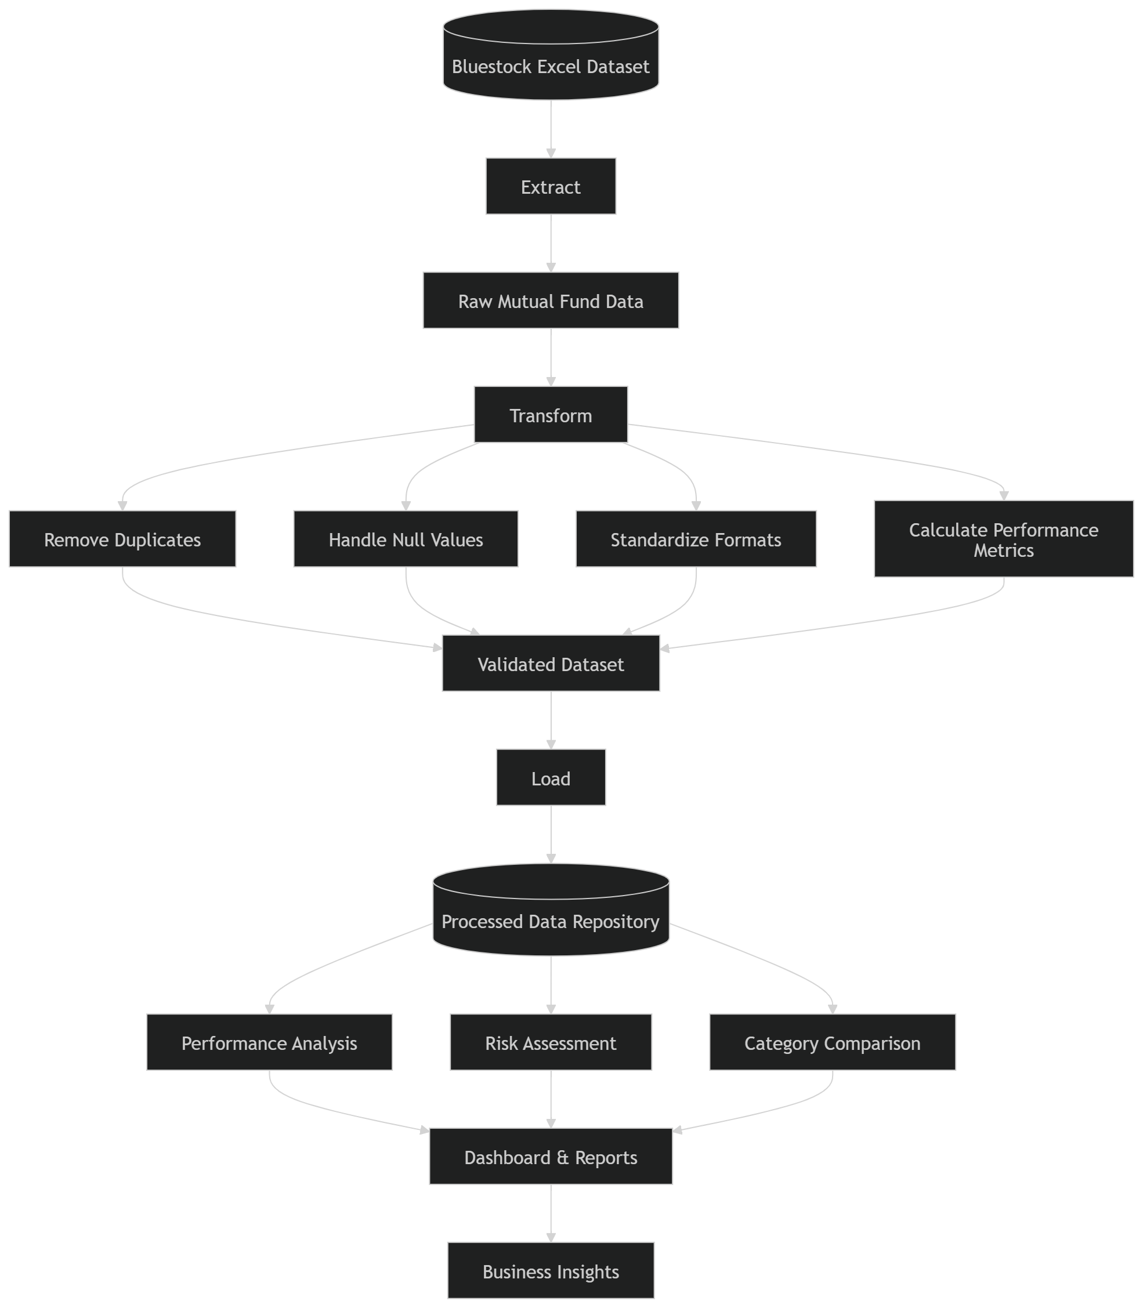
ETL Architecture

Slide 7
Exploratory Data Analysis (EDA) Highlights
Exploratory Data Analysis (EDA) was conducted to understand the structure, quality, and characteristics of the mutual fund dataset. The analysis focused on identifying trends, distributions, performance patterns, and risk-return relationships across different mutual fund categories.
1. Fund Category Distribution
The distribution of mutual funds across categories was analyzed to understand market representation.
Findings
Equity funds constituted the largest portion of the dataset.
Debt funds represented a significant share with lower-risk investment options.
Hybrid funds provided a balance between growth and stability.
Insight
The dominance of equity funds indicates a greater investor focus on long-term wealth creation and capital appreciation.

Slide 8
2. Return Distribution Analysis
The distribution of fund returns was examined to assess overall performance patterns.
Findings
Most mutual funds generated moderate returns within a defined range.
A small number of funds significantly outperformed the average.
Return variability differed across categories.
Insight
Higher-return funds often exhibited higher levels of risk and volatility.
3. Historical NAV Trend Analysis
Historical NAV trends were analyzed to identify growth patterns and performance consistency.
Findings
Several funds demonstrated steady long-term growth.
Equity-oriented funds experienced stronger growth trends.
Market corrections resulted in temporary declines in NAV values.
Insight
Long-term investments generally produced more stable and favorable outcomes despite short-term market fluctuations.

Slide 9
4.Risk and Volatility Analysis
Risk metrics were evaluated to understand the stability of fund performance.
Findings
Equity funds exhibited higher volatility.
Debt funds showed lower risk and stable returns.
Hybrid funds maintained moderate volatility levels.
Insight
A clear trade-off exists between risk and return, highlighting the importance of diversification.
5. Outlier Detection
Outlier analysis was performed to identify unusually high or low-performing funds.
Findings
Certain funds consistently delivered exceptional returns.
Some funds experienced significant performance declines during market downturns.
Insight
Outliers can represent both investment opportunities and potential risks, requiring careful evaluation.

Slide 10
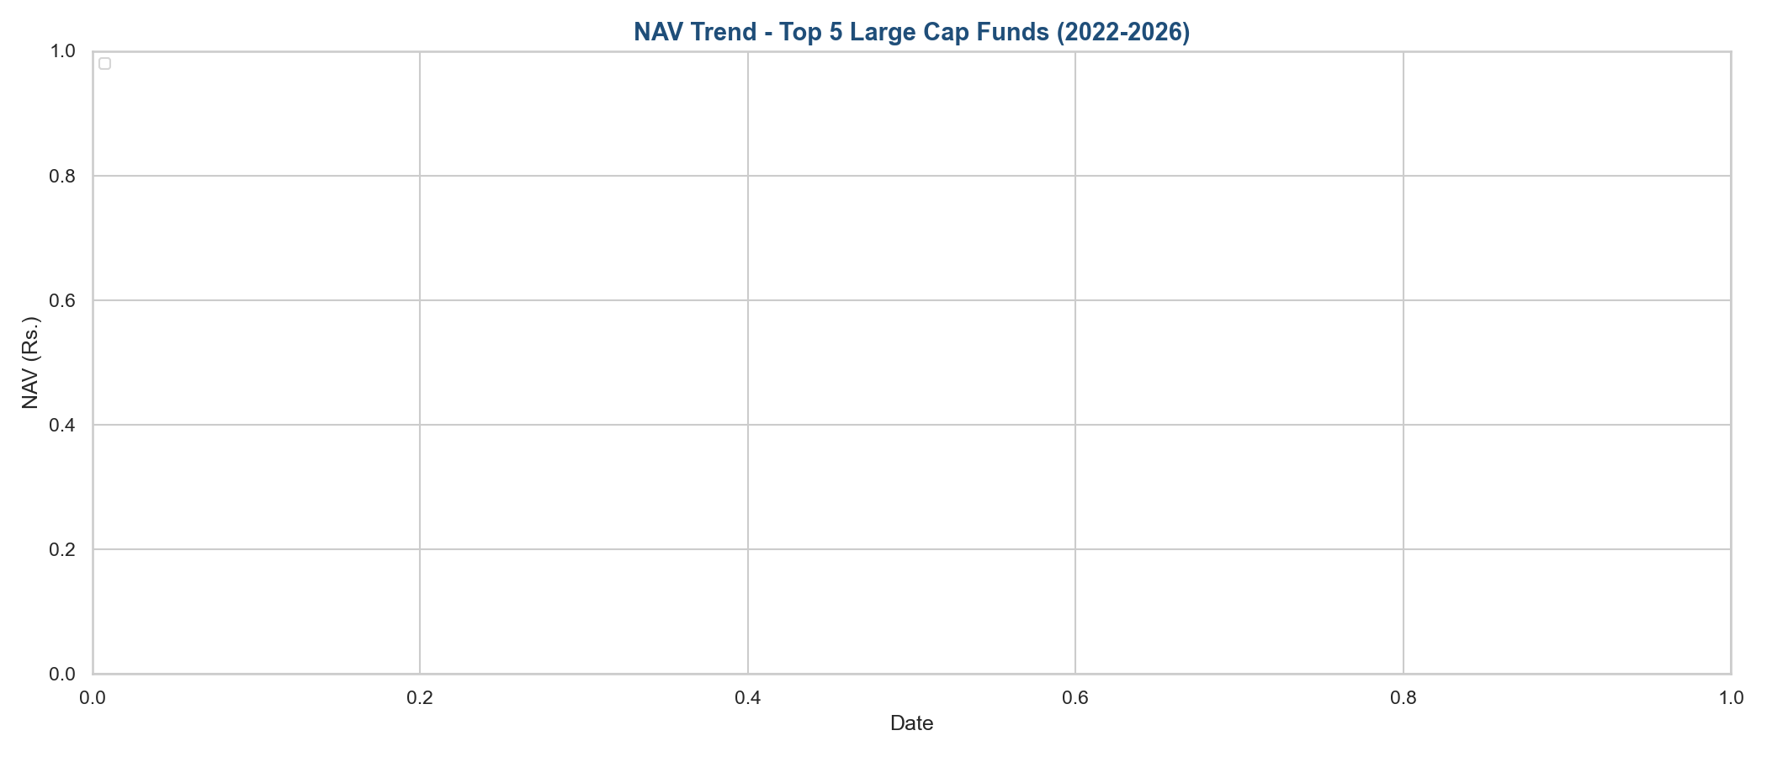
Charts

Slide 11

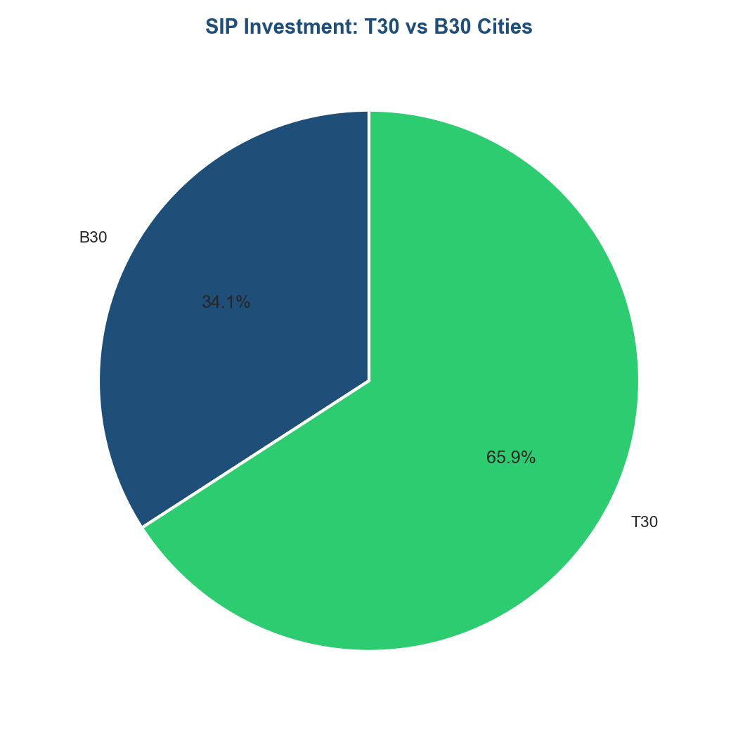

Slide 12
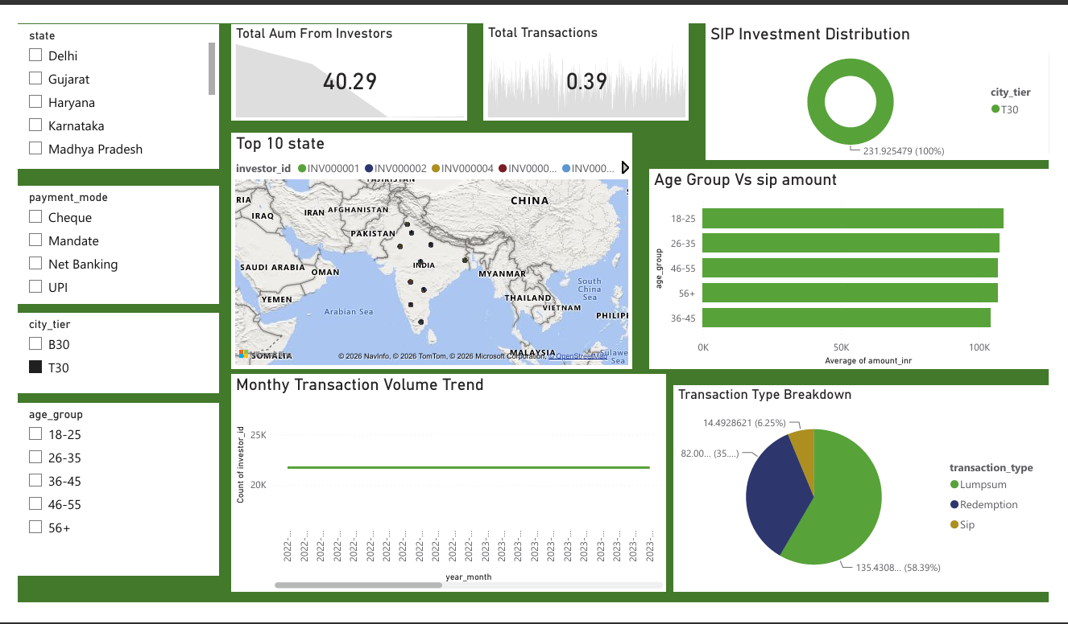
Investor Analytics

Slide 13
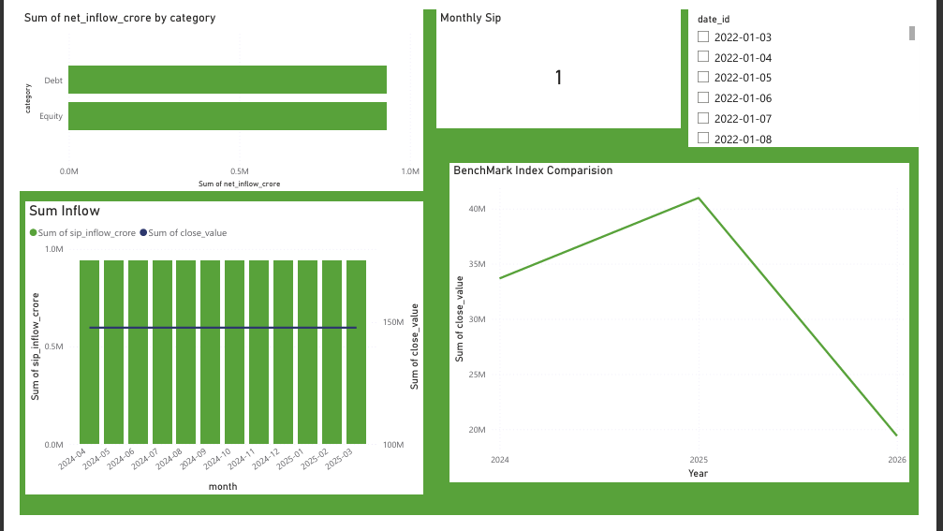
Dashboard
Sip & Market Trends

Slide 14
Thank YOU !

