Slide 1

Experiential Learning Project Assessment-I on “Simple Password Generator” under the course Python Programming Language (N-PCCCM304P)
Presented By :
Siddhi Bamnote
[CM25053]
Under the Guidance
of
Mrs. Suchita Meshkar
Session:2026-27 (ODD )
Department of CSE(AI&ML)
S. B. JAIN INSTITUTE OF TECHNOLOGY MANAGEMENT AND RESEARCH,NAGPUR
An Autonomous Institute, Affiliated to RTMNU, Nagpur

Slide 2
Problem statement
People often use weak passwords like their names or 123456.
Weak passwords are very easy for hackers to guess.
It is hard for users to create strong, random passwords by themselves.
We need a simple Python program to make safe passwords automatically.

Slide 3
Objectives
To build a simple tool that creates strong and random passwords.
To let the user choose how long the password should be.
To let the user pick capital letters, small letters, numbers, and symbols.
To make sure at least one character from each choice is included.
To show if the generated password is Weak, Medium, or Strong.

Slide 4
Algorithm
Start the program.
Ask the user for the password length.
Ask the user to choose uppercase, lowercase, numbers, and symbols
Mix all chosen character types together.
Pick random characters until the full length is ready.
Shuffle the characters so the order is random.
Show the password and its strength rating.
Stop the program.

Slide 5
Flowchart/pseudocode
Start
1. User Enters Password Length
2. User Selects Letter/Number/Symbol Types
3. Mix Chosen Character Groups Together
4. Pick Characters Randomly
5. Shuffle Everything
6. Show Password and Strength
End

Slide 6
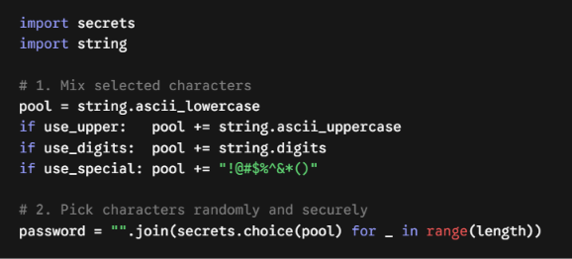
Understanding of Python logic

Slide 7
How it works & benefits
Simple Flow:
User Options → Combine Letters & Numbers → Pick Randomly → Safe Password
How it Works:
User Choice: User picks length and what characters to add.
Random Pick: Uses Python's secure secrets tool to pick random items.
Strength Check: Checks if password is long and has mixed characters.
Benefits:
Makes passwords impossible to guess.
Keeps online accounts safe from hackers.

Slide 8
GitHub Details & My Contribution
Repository Name : Python-simple-password-generator
My Contribution:
Understood the security needs and designed the simple algorithm.
Wrote the Python code using secrets and string.
Added safety checks and password strength test.
Created the GitHub repo and made this presentation.

Slide 9
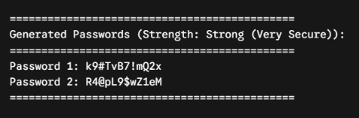
Result / Expected Output

Slide 10
Thank You
S. B. Jain Institute of Technology Management and research

