Slide 1

Authors : Siddhi Chechani, Akshata Joshi, Dr.Rekha Sharma

Slide 2

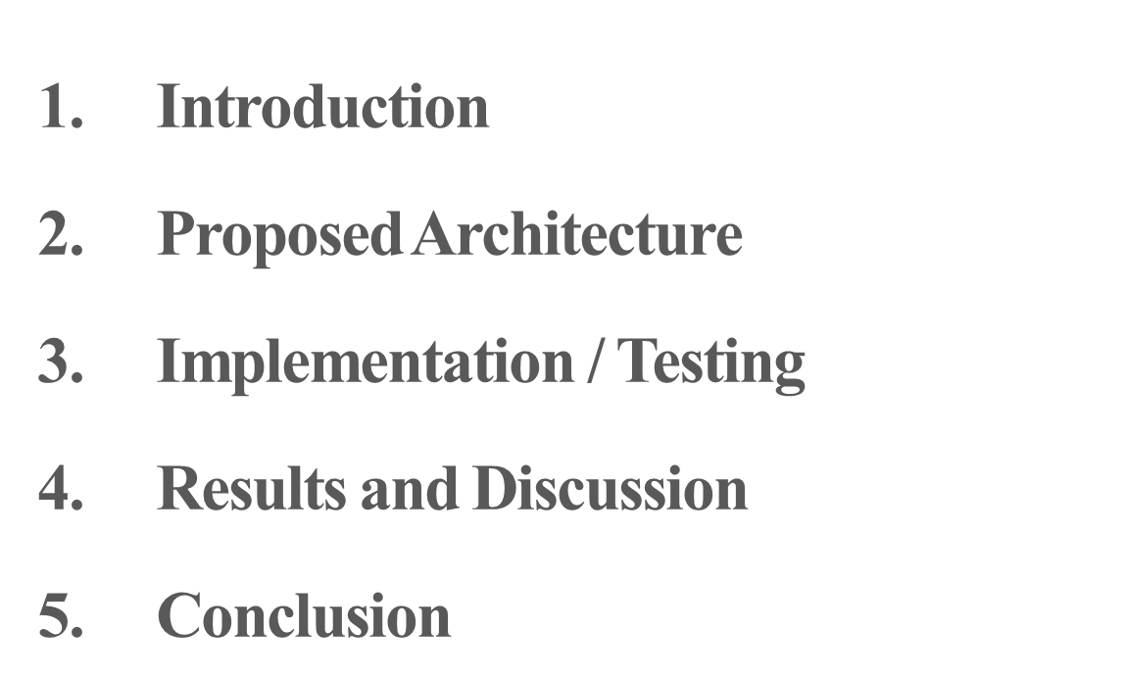

Slide 3
Introduction
A learning management system (LMS) is a software/ web-based application for the administration, documentation, tracking, reporting and delivery of educational technology courses or training programs.
Learning Management Systems are being extensively used in schools, colleges, universities and of course organizations.
It is a Web-based system for training programs and information sharing between individuals giving them the flexibility to access it from their workplace or home.
The LMS systems can be built using open source software like Moodle and all the educational as well as commercial institutions require customized systems as per their requirements.
This LMS will also provide assistance to the faculty members since the tedious manual tasks like maintenance of records, report generation and analysis will be automated.

Slide 4
Implementation
Term Test Result Analysis Module
1. Online marks entry
2. Analysis Report Generation
The report can be generated for each class (division wise) and for both the term tests individually.
Relational Database has been designed to implement the same.

Slide 5
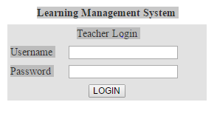
IMPLEMENTATION

Slide 6
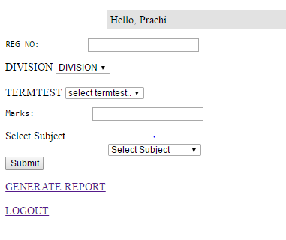
IMPLEMENTATION

Slide 7
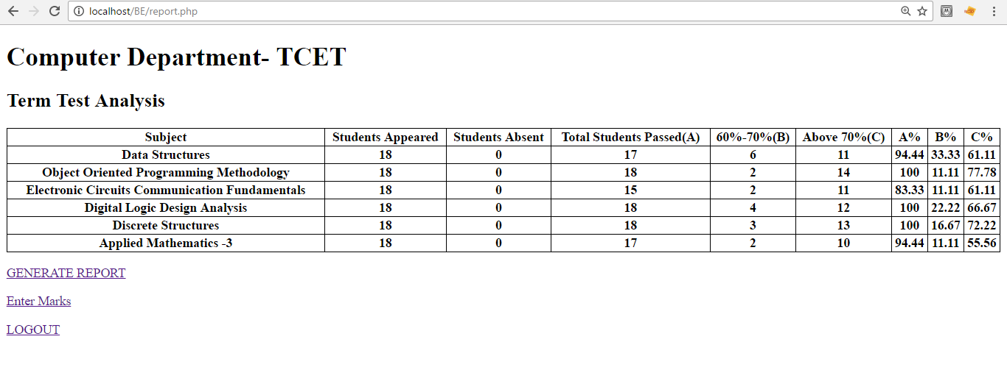
IMPLEMENTATION

Slide 8
Proposed Architecture
Information Sharing Portal:
An application will be designed where important notices of department as well as college, subject notes and presentations can be shared by teachers and viewed by students.
This will have two types of end users:
Teacher (Faculty members)
Student
Coursework completion can be updated by the teachers and viewed by the students so they can keep pace with the academics.

Slide 9
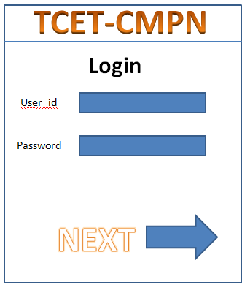
Proposed Architecture
Login Screen

Slide 10
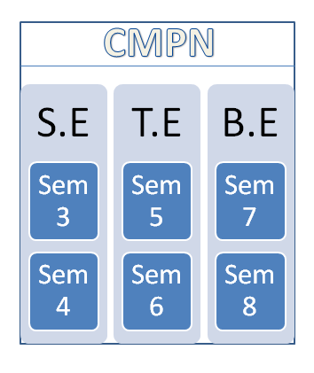
UI Design

Slide 11
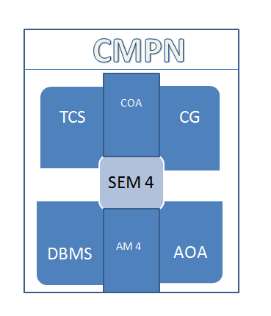
UI Design

Slide 12
Results and Discussions
The project as whole will prove to be of great use to both students as well as faculty members since it will promote two-way learning wherein the teachers share their knowledge and students will be able to use it whenever required.
The exam result analysis module will be of assistance to the teachers as it will be easy to generate reports and analyze the progress of the students.
Further, modules Online objective tests can be added to promote e-learning.

Slide 13
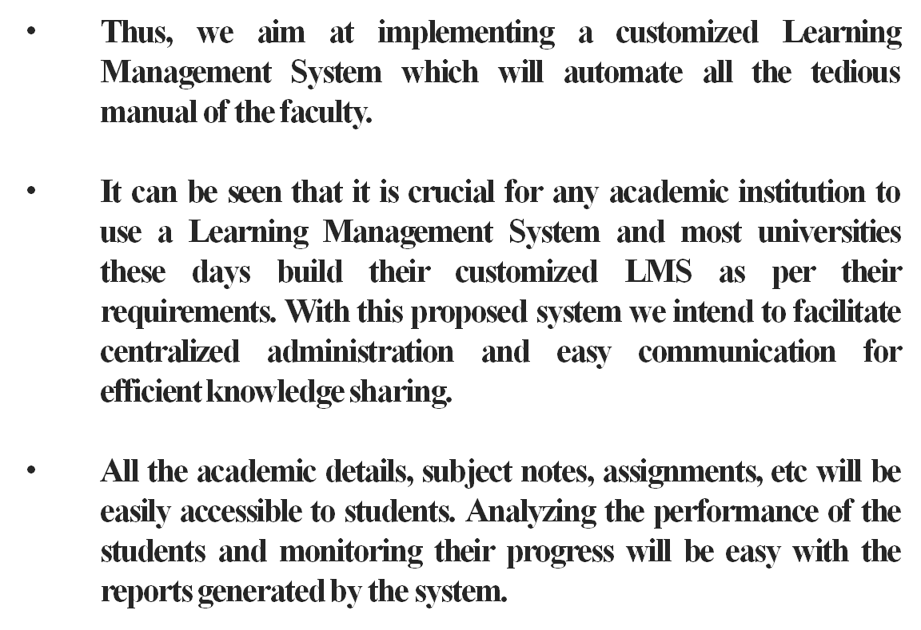
Conclusion

Slide 14


