Slide 1

Seasonal Agriculture Performance Analysis
VOIS AICTE Data Analytics Internship — Batch 2026-2027
Siddhi Santosh Jagtap
Army Institute of Technology, Pune
AICTE STU ID : STU6a5d1464e384b1784484964

Slide 2

PROBLEM STATEMENT
Agricultural activities are influenced by seasonal variations in environmental conditions, farming practices, resource availability and market conditions. As a result, agricultural performance may differ from one season to another. However, raw agricultural data does not clearly explain how agricultural performance changes across seasons or what patterns can be observed in different seasonal conditions. The problem is to analyze the given agricultural dataset and investigate seasonal differences in agricultural performance by identifying meaningful patterns, trends, relationships and variations within the available data.

Slide 3
Project Description
The project looks at 4,000 farm records that cover 8 crops, 8 states and three cropping seasons – Kharif, Rabi and Zaid. The project wants to see how agricultural performance changes from one season to another. The dataset holds conditions such as rainfall, temperature, humidity and sunlight. The dataset also holds resource usage such as fertilizer, NPK, irrigation and water. The dataset also holds outcomes such as cost, revenue and profit for each farm.
The project used Python with libraries such as Pandas, NumPy, Matplotlib, Seaborn and SciPy to clean the farm records. The project used Python to explore patterns in the farm records. The project used Python to run tests to see if the differences, between seasons are meaningful. The project did not aim to build a model. The project aimed to understand what the farm records show about how season affects yield, resource use and profitability. The project wanted to turn that understanding into evidence-based observations.

Slide 4

WHO ARE THE END USERS?
Farmers and farm managers deciding which crops to grow in which season
Agricultural extension officers and state agriculture departments
Agri-input and irrigation companies (fertilizer, seed, irrigation equipment)
Agricultural researchers, students and data analytics learners

Slide 5

Technology Used
Python 3
Pandas & NumPy — data cleaning and analysis
Matplotlib & Seaborn — visualization
SciPy — statistical testing (ANOVA, correlation, chi-square)
Jupyter Notebook — analysis environment
Microsoft PowerPoint — presentation

Slide 6
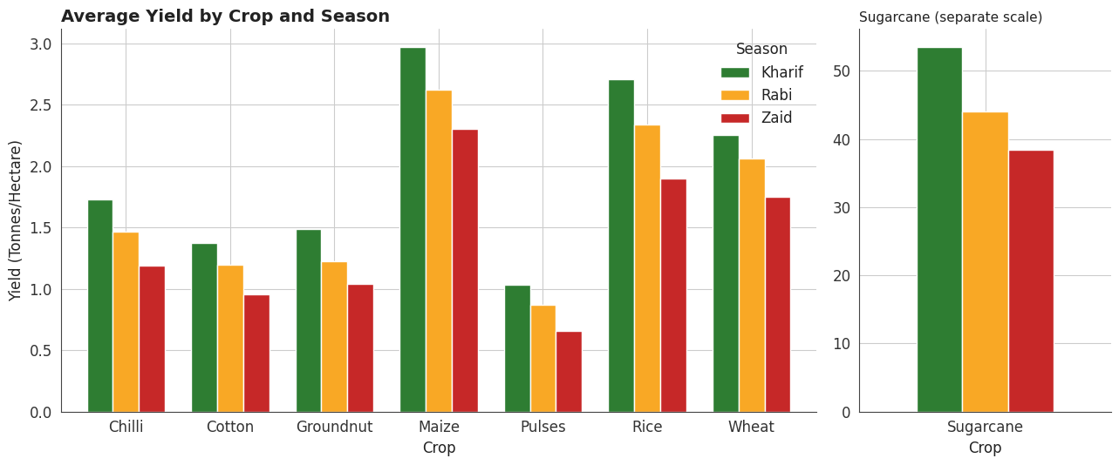
RESULTS
Yield by Crop and Season
Every crop yields highest in Kharif, lowest in Zaid

Slide 7
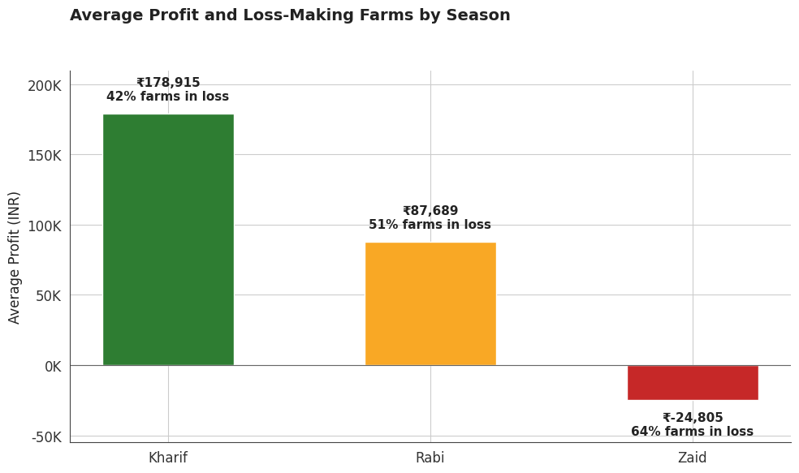
RESULTS
Economic Performance by Season
Zaid farms average a loss; 64% run below break-even

Slide 8
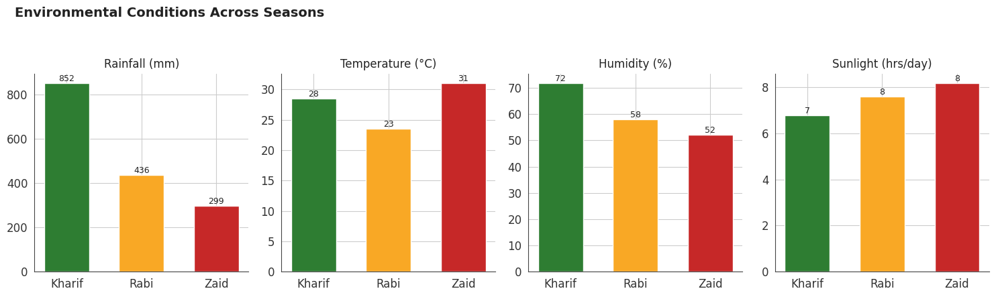
RESULTS
Environmental Conditions by Season
Kharif is wettest & most humid; Zaid is hottest & driest

Slide 9
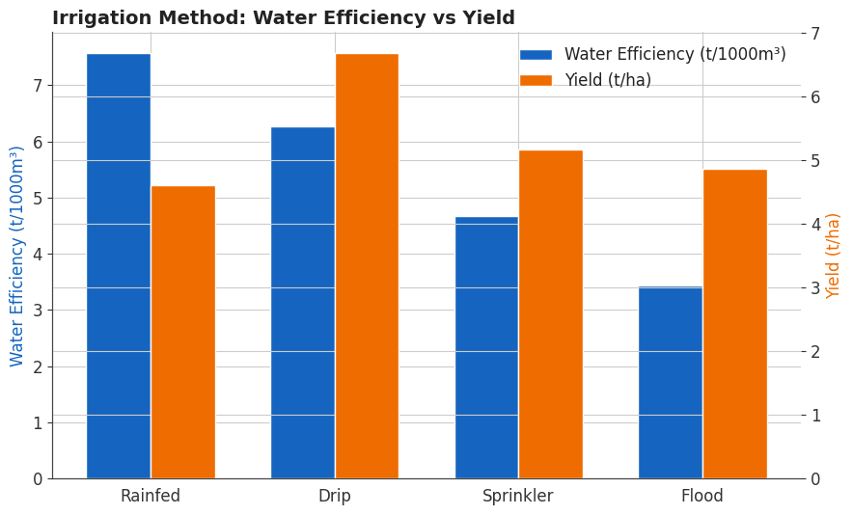
RESULTS
Irrigation Method vs Water Efficiency & Yield
Drip irrigation gives the best yield per unit of water used

Slide 10
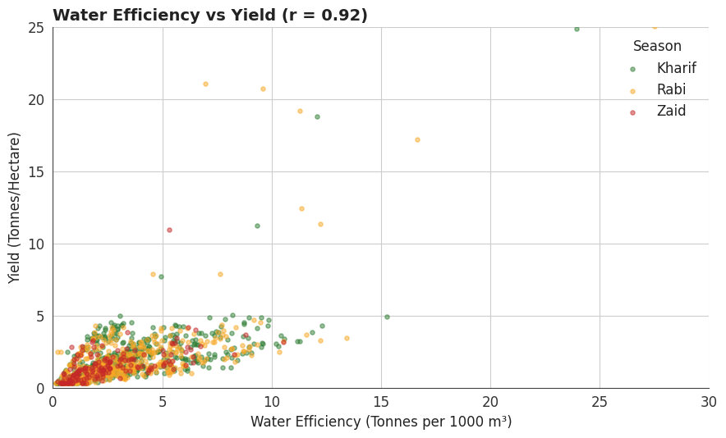
RESULTS
Water Efficiency Vs Yield
Water efficiency is by far the strongest correlate of yield (r ≈ 0.92) and a moderate correlate of profit

Slide 11
RESULTS
Key Findings
Season is the single strongest driver of outcomes
Finding | Supporting Analysis | Actual Value
Kharif is the most profitable season | Mean Profit_INR by Season | ₹178,915 (Kharif) vs ₹87,689 (Rabi) vs -₹24,805 (Zaid)
Yield differs significantly by season, even after accounting for crop type | One-way ANOVA on crop-normalised yield | F = 127.4, p < 0.001
Profit differs significantly across seasons | One-way ANOVA on Profit_INR | F = 34.3, p < 0.001
Water efficiency is the strongest correlate of yield — far more than fertiliser or NPK | Pearson correlation vs Yield_Tonnes_Ha | r = 0.92 (water eff.) vs r ≈ 0.00–0.05 (fertiliser, N, P, K)
Nearly half of all farms operate at a loss, worsening in Zaid | % of farms with Profit_INR < 0, by season | 49% overall — 42% (Kharif) → 51% (Rabi) → 64% (Zaid)
Drip irrigation is the most water-efficient method | Mean water efficiency & yield by Irrigation_Method | 6.27 t/1000m³ (Drip) vs 3.44 (Flood), highest yield among methods

Slide 12
Future scope
• Extend the analysis across multiple years to study year-over-year seasonal trends, not just a single-cycle cross-section
• Build a simple Power BI or Streamlit dashboard so farmers or planners can filter results by state, crop and season
• Investigate further why fertiliser and pesticide use show almost no correlation with yield in this dataset
• Combine with real market-price time series to separate yield-driven and price-driven profit swings

Slide 13
GitHub Link
https://github.com/siddhijagtap2028-tech/Seasonal_Agriculture_Performance_Analysis/tree/main

Slide 14
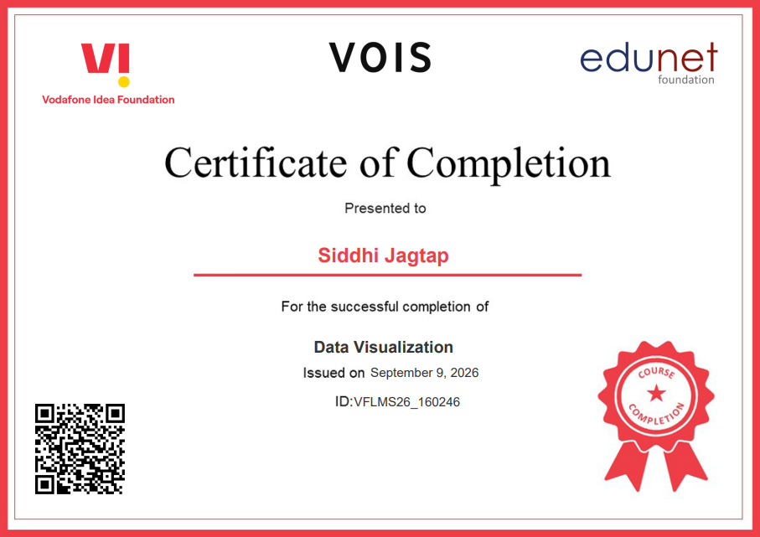
VOIS Course completion certificate - Course name- Data Visualization

Slide 15
Thank you
.
.

