Slide 1

Heart Disease
Risk Prediction
Using IBM SPSS Statistics and Python
Team Members
Yash Kaklij
Siddhika Kankubji
Sakshi Patvi
PBL Evaluation • B.Tech AI & Data Science
Sanjivani University • Academic Year 2026–2027
Project Guided By: Mr. Rohit Pawar

Slide 2
From patient records to useful patterns
01
Recorded health data
02
Analysis
03
Risk classification
Age, symptoms, blood pressure, cholesterol, ECG findings and exercise response provide structured evidence.
SPSS supports cleaning and exploration; Python supports reproducible machine-learning experiments.
Models learn patterns linked with the recorded heart-disease outcome.
Data → Analysis → Classification

Slide 3
The challenge
Can routine patient attributes help classify recorded heart-disease outcomes in a transparent, data-driven way?
HEALTH ATTRIBUTES
CLASS 0 / CLASS 1
Clinical and demographic variables are meaningful only after careful preparation and inspection.
Build and compare models that distinguish no recorded disease from recorded disease.

Slide 4
Four project objectives
01
Prepare
02
Explore
Import, label and recode the Cleveland dataset in SPSS.
Summarize distributions, missingness and class differences.
03
Model
04
Evaluate
Train Logistic Regression and Decision Tree classifiers in Python.
Compare clinically relevant metrics and confusion matrices.

Slide 5
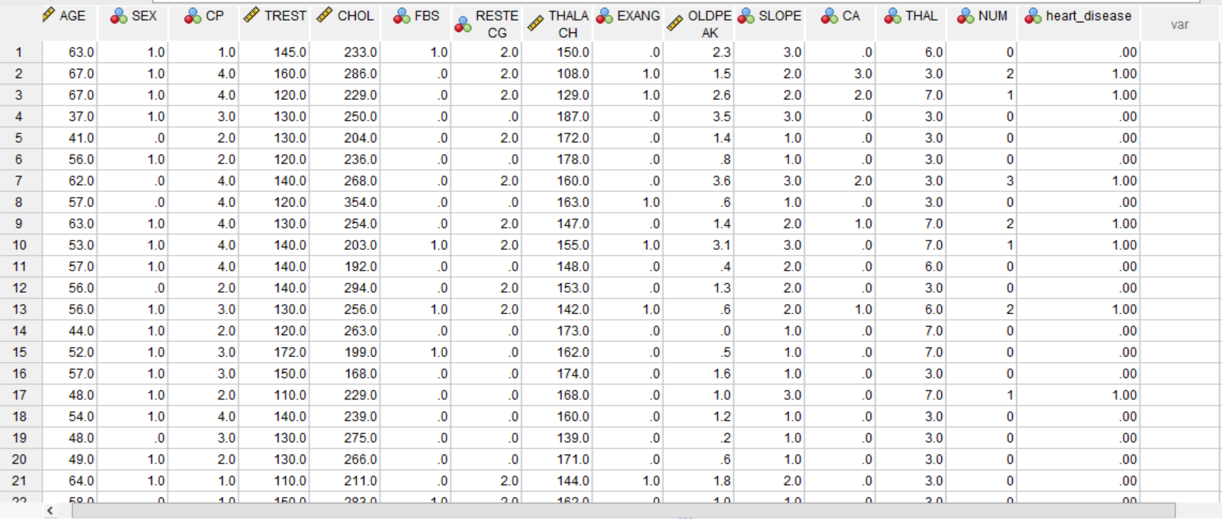
Dataset: UCI Cleveland processed subset
SPSS Data View: original NUM field and the derived heart_disease target.
Class 0 = NUM 0 (164 records)
Class 1 = NUM 1–4 (139 records)
303 records • 13 predictors • NUM target

Slide 6
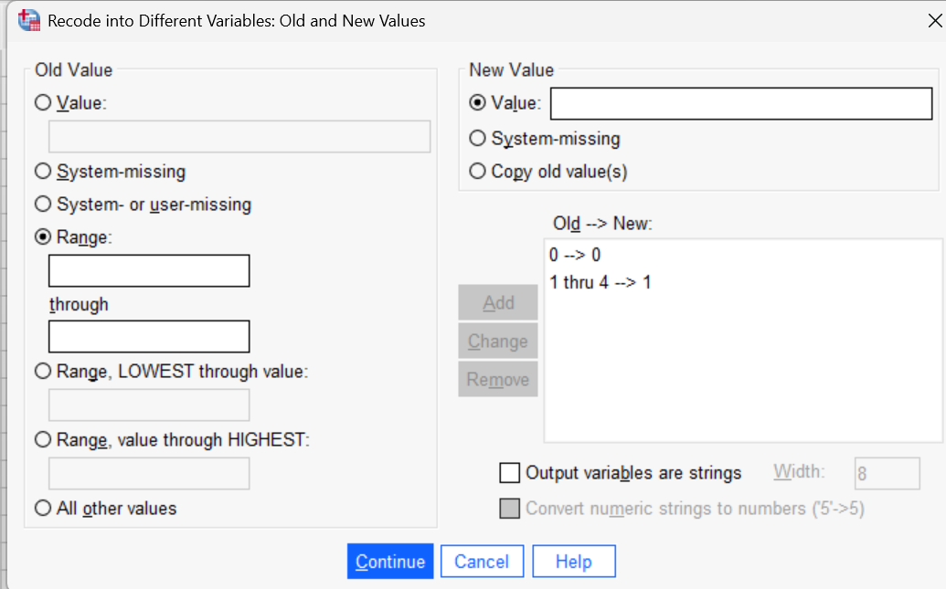
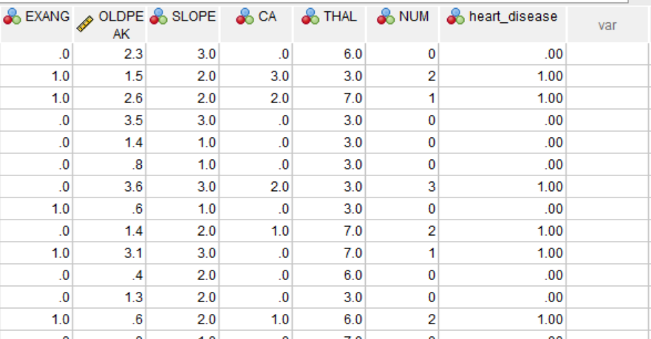
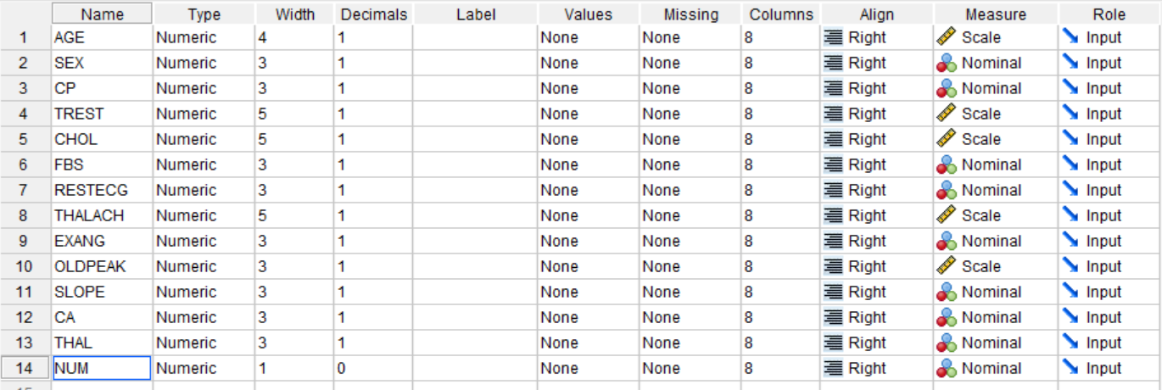
Data preprocessing using SPSS
Import → rename and inspect → recode NUM into heart_disease (0 vs 1–4)
Variable View
Recode dialog
Final Data View
14 variables renamed; scale vs nominal set
0 → 0 and 1 thru 4 → 1
NUM kept; heart_disease added (columns shown: OLDPEAK … heart_disease)
Menu path: Transform → Recode into Different Variables. The original NUM variable is left unchanged.

Slide 7
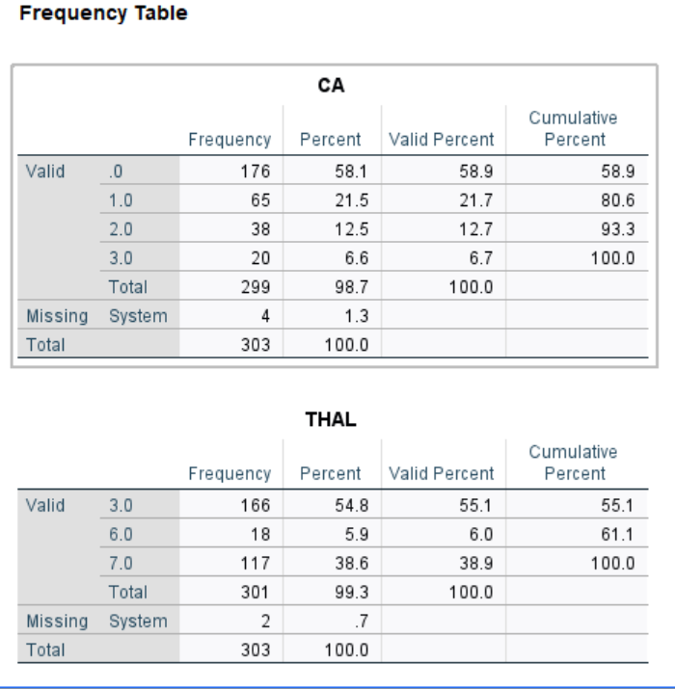
Missing value analysis
Missingness was limited to two predictors. No manual replacement was performed in SPSS.
CA
THAL
4
missing records
2
missing records
1.3% of the dataset (299 valid)
0.7% of the dataset (301 valid)
Model pipelines must handle these missing values explicitly and reproducibly.

Slide 8
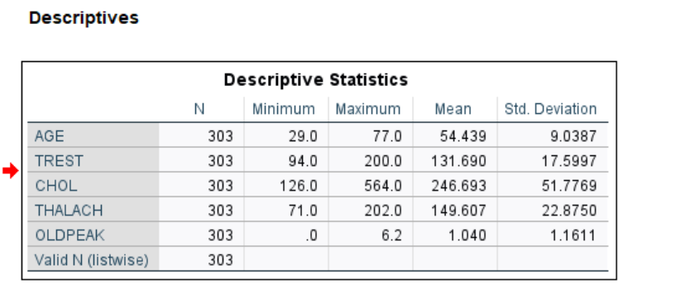
Descriptive statistics
Values taken from the SPSS Descriptive Statistics output (N = 303).
Variable | Minimum | Maximum | Mean | Std. Dev.
AGE | 29.0 | 77.0 | 54.439 | 9.0387
TREST | 94.0 | 200.0 | 131.690 | 17.5997
CHOL | 126.0 | 564.0 | 246.693 | 51.7769
THALACH | 71.0 | 202.0 | 149.607 | 22.8750
OLDPEAK | 0.0 | 6.2 | 1.040 | 1.1611
SPSS output: Analyze → Descriptive Statistics → Descriptives.
Mean age was 54.4 years. The heart_disease mean of 0.4587 means about 45.9% of records are in the positive class.

Slide 9
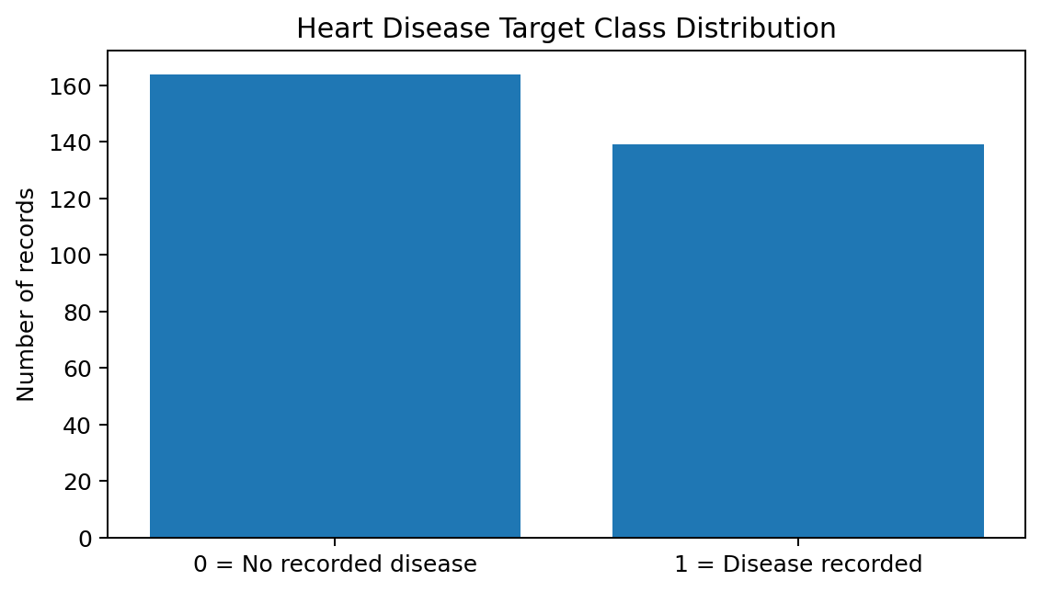
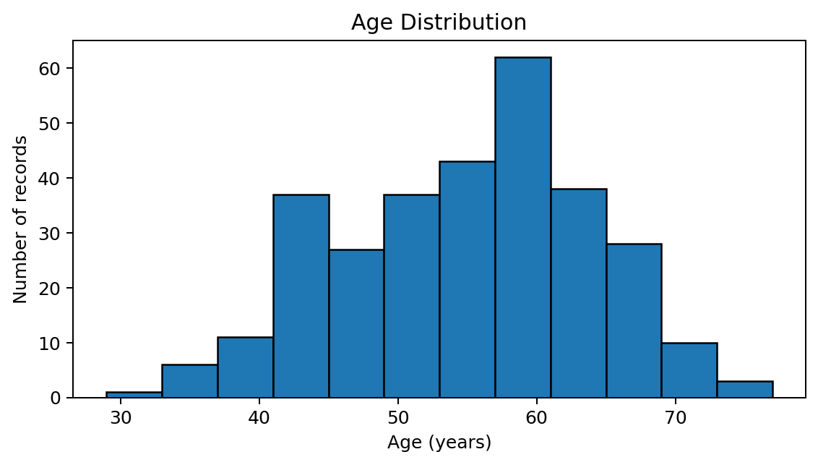
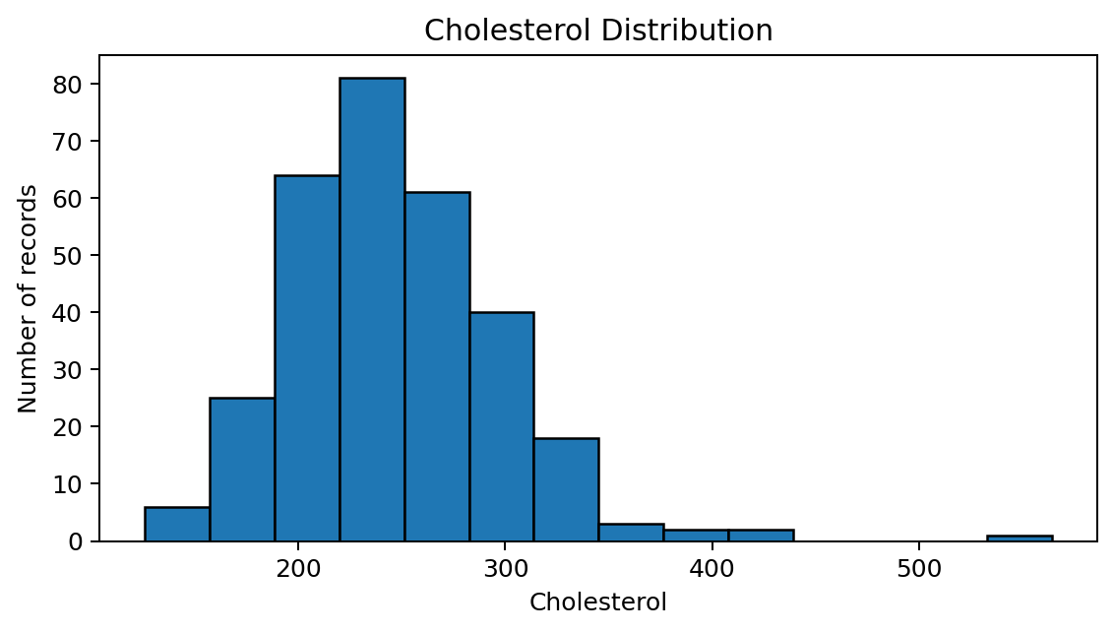
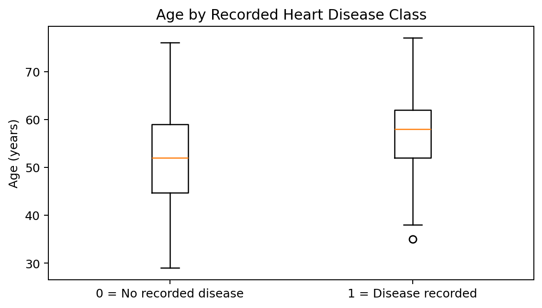
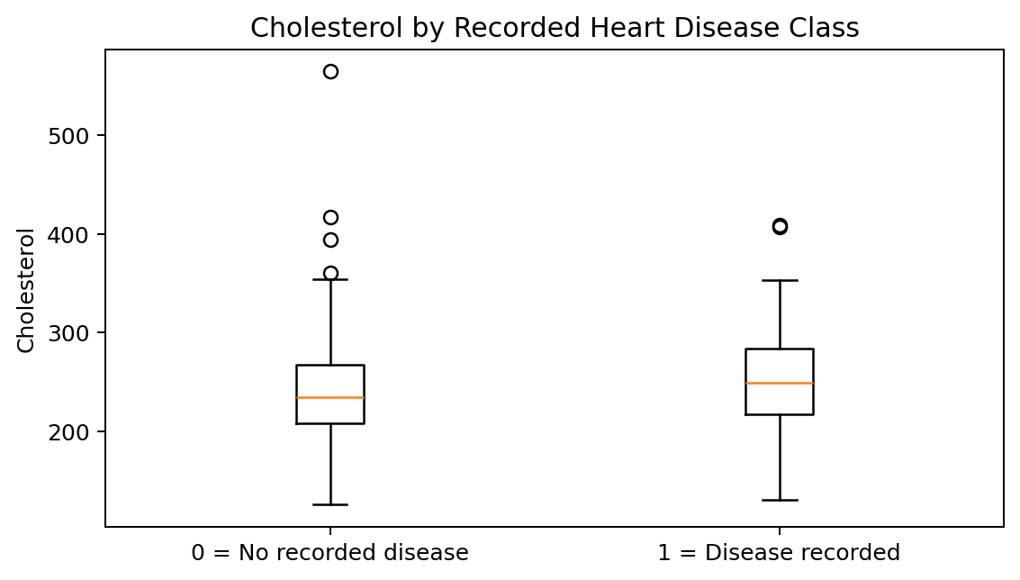
Exploratory data analysis
Descriptive views of the processed Cleveland data — not clinical findings.

Slide 10
Two classification algorithms
A
Logistic Regression
B
Decision Tree
A transparent linear classifier that estimates class probability. It offers a strong, interpretable baseline and works well when predictors relate approximately linearly to log-odds.
A rule-based classifier that splits records into branches using predictor thresholds. It is easy to visualise and captures nonlinear patterns, but its performance depends on tree depth, sample size and the specific train–test split.
Same predictors • same training / test split • compared on identical test records

Slide 11
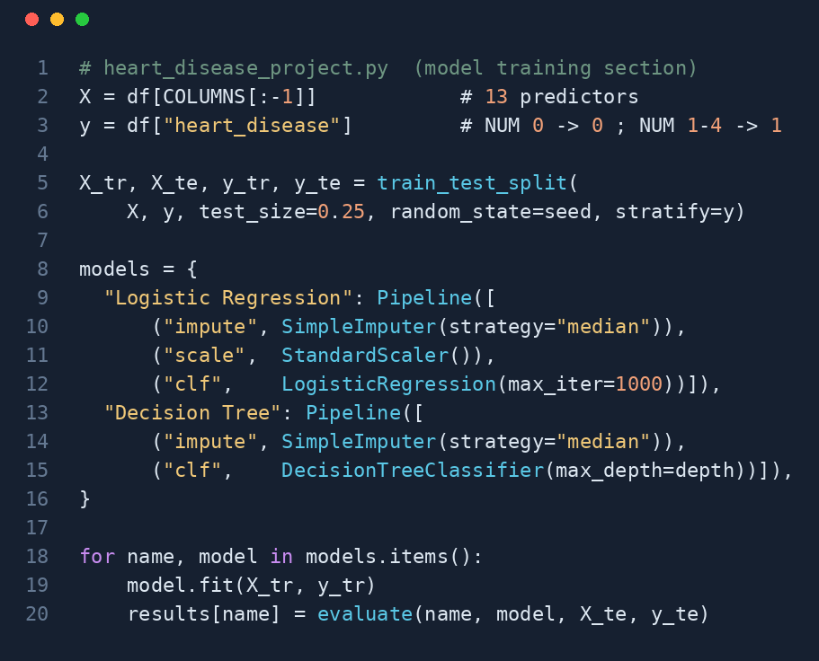
Model training and testing
A fixed split keeps evaluation separate from model fitting.
TRAINING • 227 records
TESTING • 76 records
303 records in total; 25% held out for testing
Models are fitted on the training portion only
Metrics are computed on the 76 unseen test records
Model-training section of heart_disease_project.py

Slide 12
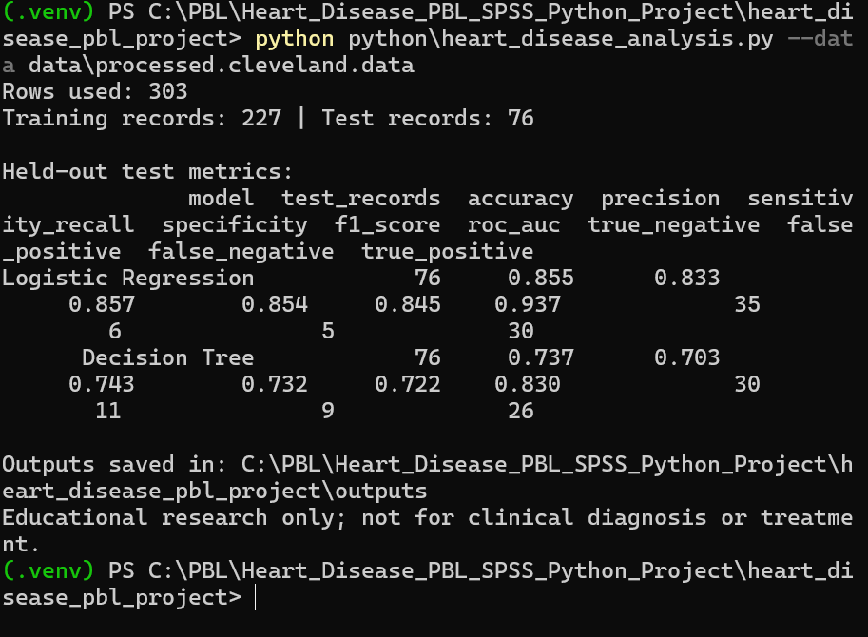
Evaluation metrics
No single metric tells the whole story—especially when missed positive cases matter.
Accuracy
Precision
Recall
Overall proportion classified correctly
How often predicted positives are correct
How many actual positives are found
Specificity
F1-score
ROC–AUC
How many actual negatives are found
Balance of precision and recall
Ranking quality across thresholds
Python console output: held-out test metrics for both models (76 test records).

Slide 13
Model performance comparison
Logistic Regression performed better on this particular test split.
Logistic Regression
Decision Tree
Pred 0
Pred 1
Pred 0
Pred 1
Actual 0
35
TN
6
FP
Actual 0
30
TN
11
FP
Actual 1
5
FN
30
TP
Actual 1
9
FN
26
TP
Confusion matrix
Confusion matrix
Interpret this result as split-specific evidence—not proof of universal superiority.

Slide 14
Python project: structure and how to run
Open the folder in VS Code and run the commands in the integrated terminal.
PROJECT FOLDER
TERMINAL COMMANDS (WINDOWS)
heart_disease_project/
├── heart_disease_project.py
├── dashboard.py
├── requirements.txt
├── README.md
├── data/
│ └── processed.cleveland.data
└── outputs/ (charts + CSV)
python -m venv venv
venv\Scripts\activate
pip install -r requirements.txt
python heart_disease_project.py
python -m streamlit run dashboard.py
Outputs: test_metrics.csv, missing_values.csv, descriptive_statistics.csv, target_frequency.csv, crosstabs, EDA charts (PNG).

Slide 15
Interactive dashboard (Streamlit)
dashboard.py presents the project results in four pages.
01
02
03
04
Overview
EDA
Model comparison
Try a prediction
Record counts, class split, missing values and descriptive statistics.
Target chart, histograms, boxplots by class and crosstabs.
Metrics table, ROC curves and confusion matrices; adjustable seed and tree depth.
Enter the 13 predictors and see a model-estimated probability (classroom demo).
python -m streamlit run dashboard.py
Opens at http://localhost:8501 • The prediction page is not medical advice.

Slide 16
Conclusion and future scope
✓
What we learned
→
What comes next
SPSS supported structured inspection and reporting. Python enabled reproducible training and evaluation. On this test split, Logistic Regression gave the stronger result (accuracy 85.5% vs 73.7%; ROC-AUC 0.937 vs 0.830). Limited sample size and split sensitivity restrict generalization.
Use larger and more diverse datasets, independent validation, robust missing-value pipelines, hyperparameter tuning, calibration analysis and additional model comparisons.
Educational project only — not a clinical diagnostic tool.

Slide 17
Thank You
Yash Kaklij • Siddhika Kankubji • Sakshi Patvi

