Slide 1
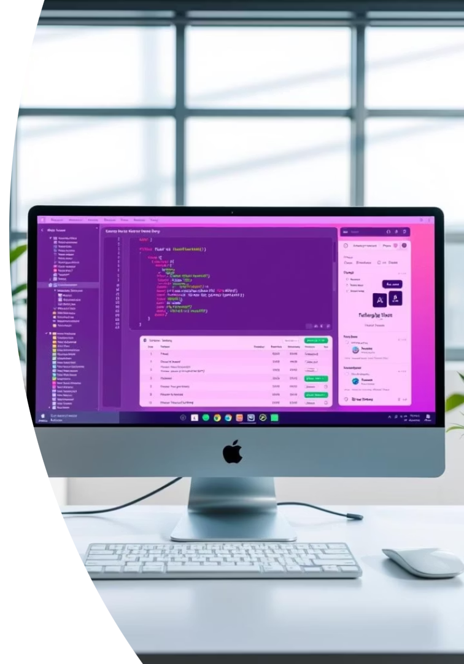
Ticket Booking System in Java: A Mini Project
This project demonstrates a Java-based ticket booking system. It highlights key programming skills and realistic application features.

Slide 2

Project Overview: Goals, Features, and Technologies
Core Features
Goals
Search events and tickets effectively
Enable efficient and user-friendly ticket booking experience.
Booking and cancellation options
Seat selection with payment integration
Technologies
Java programming language
JDBC and MySQL for database
Swing/JavaFX for user interface
Java mini project

Slide 3
Database Design: Entities and Relationships
Entities
Relationships
User accounts
Users linked to bookings
Events and venues
Events connected to multiple seats
Booking records
Bookings reserve specific seats
Java mini project

Slide 4


Core Functionality: Booking, Cancellation, and Search
Search Tickets
Book Seats
Cancel Bookings
Filter events by date, location, and type.
Choose seats with real-time availability updates.
Users can cancel and access refund options.
Java mini project

Slide 5
User Interface: Design and Implementation
Design
Implementation
Clean layout ensures quick navigation for users.
Built with Swing and JavaFX for responsive, attractive UI.
Java mini project

Slide 6
Code Structure and Design Patterns
MVC Pattern
DAO Pattern
Singletons
Separates UI, business logic, and data access layers.
Abstracts database operations for easier maintenance.
Manage key resources like database connections centrally.
Java mini project

Slide 7
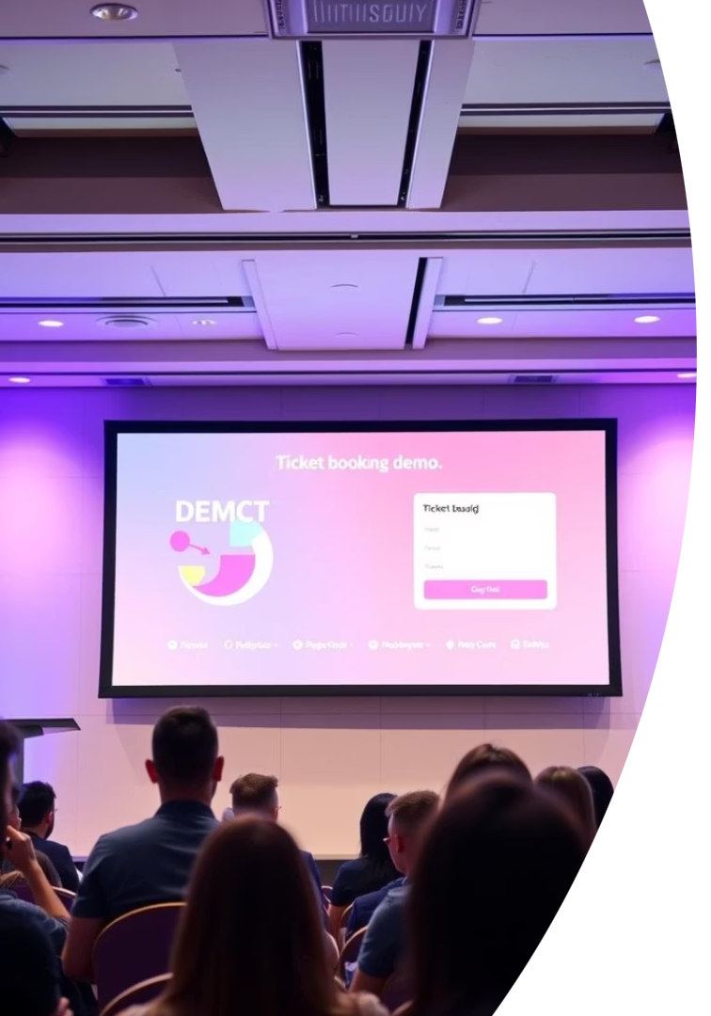
Demo and Future Enhancements
Demo Highlights
Live demo showcasing booking and cancellation features.
Enhancements
Integrate payment gateways
Add user profiles and history
Support for mobile applications
Java mini project

Slide 8
Conclusion
Summary
Next Steps
Project highlights core Java skills with practical value.
Expand features and continuously improve user experience.
Includes database integration, UI design, and clean code.
Team:
1. Sanchit Patil
2. Siddhi Patil
3. Ganesh Kamble
4. Diya Patel
Java mini project

Slide 9
Thank you !!
Java mini project

