Slide 1

SEVA MANDAL EDUCATION SOCIETY’S
SMT. KAMALABEN GAMBHIRCHAND SHAH
DEPARTMENT OF COMPUTER APPLICATIONS
UNDER
DR B.M.N COLLEGE OF HOME SCIENCE (AUTONOMOUS)
NAAC RE-ACCREDITED ‘A+’ GRADE WITH CGPA 3.69/4
UGC STATUS-COLLEGE WITH POTENTIAL FOR EXCELLENCE
338, R.A KIDWAI ROAD, MATUNGA, MUMBAI 400019.
2023-2024
LIVE PROJECT ON
“CAKE SHOP MANAGEMENT SYSTEM”
Aastha Kushwah | Siddhi Prabhu | Sneha Prabhu | Aayesha Shindagi

Slide 2
Cake Shop Management System
For
Better Be Butter

Slide 3
ORGANISATION PROFILE
Name: Better Be Butter
Location: 90 feet road, Kalyan
Contact: 7021677653
Contact Person: Neffriti Monteiro, Victor Monteiro
Type of Company: Cake Shop

Slide 4
CURRENT SYSTEM
Currently there is no software for managing order in cake shop. The daily order processing is carried out manually by the owner or staff. There are many problems in current Manual system: Shop Owner face many difficulties while analyzing the record of his business in day-to-day life. He has to do a lot of paper work for maintaining his information.

Slide 5
PROPOSED SYSTEM
Automated System Proposal:
Platform:
Frontend: C#.net
Backend: SQL
Characteristics:
User-Friendly:Fast data retrieval and efficient storage.
Report Generation:Easy report creation aiding decision-making.
Operator Control: Minimal errors; simple data storage and retrieval.
Paperless:Virtually no paper usage; immediate data insertion; secure database storage.

Slide 6
PROPOSED SYSTEM
Advantages:
Reduces manpower needs.
Enhances data accessibility.
Simplifies searches; consistent results.
Minimizes human errors with reduced paperwork.
User-friendly graphical interface for easy understanding.

Slide 7
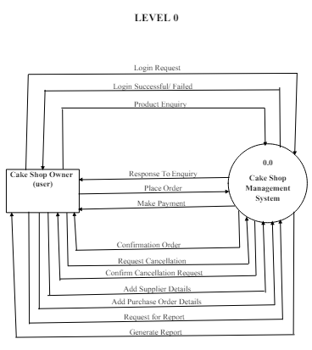

Slide 8
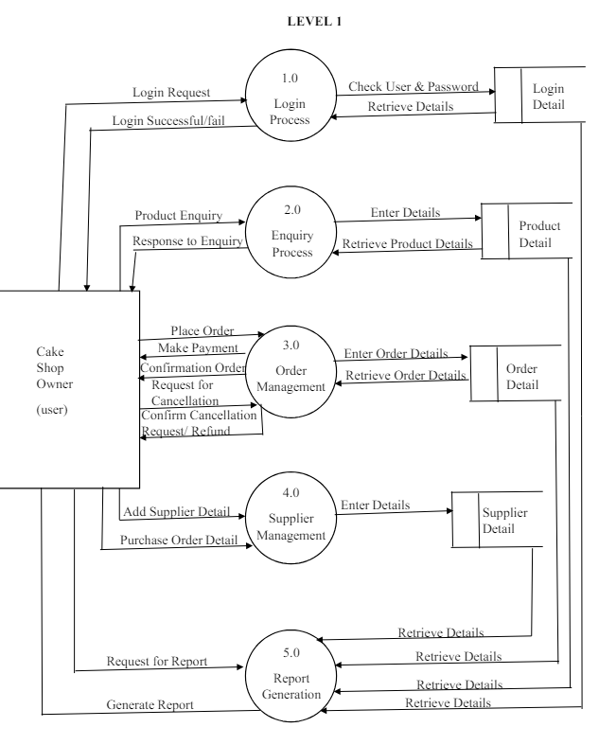

Slide 9
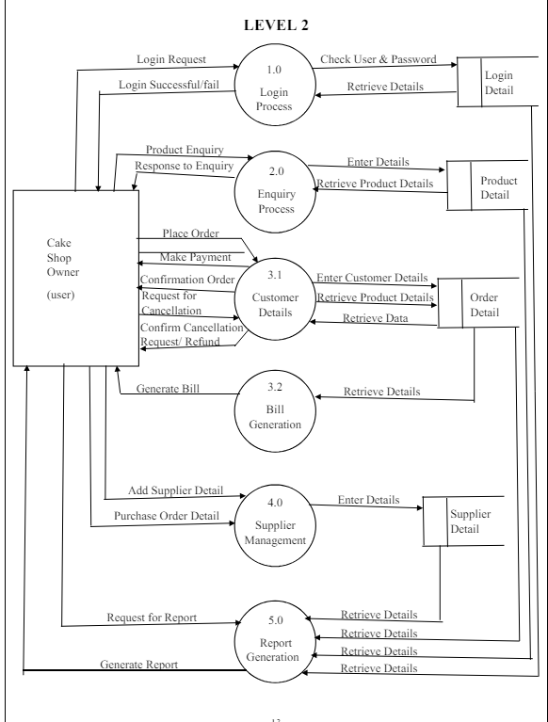

Slide 10
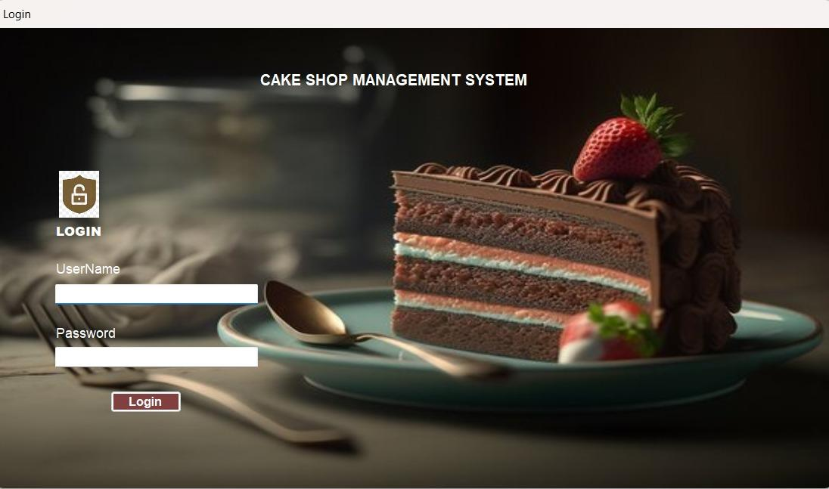

Slide 11
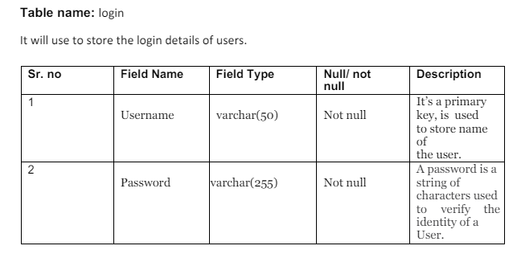

Slide 12
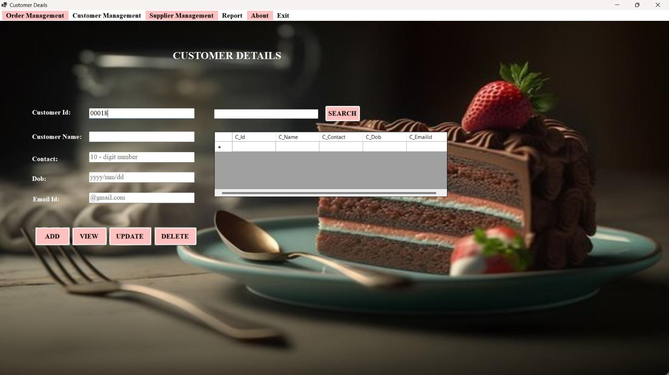

Slide 13
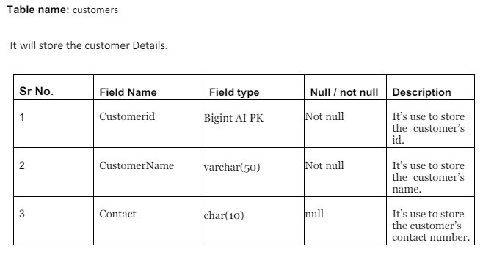
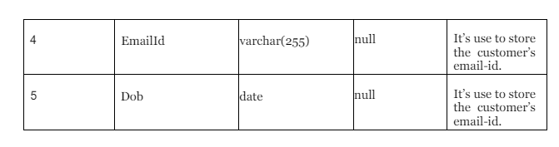

Slide 14
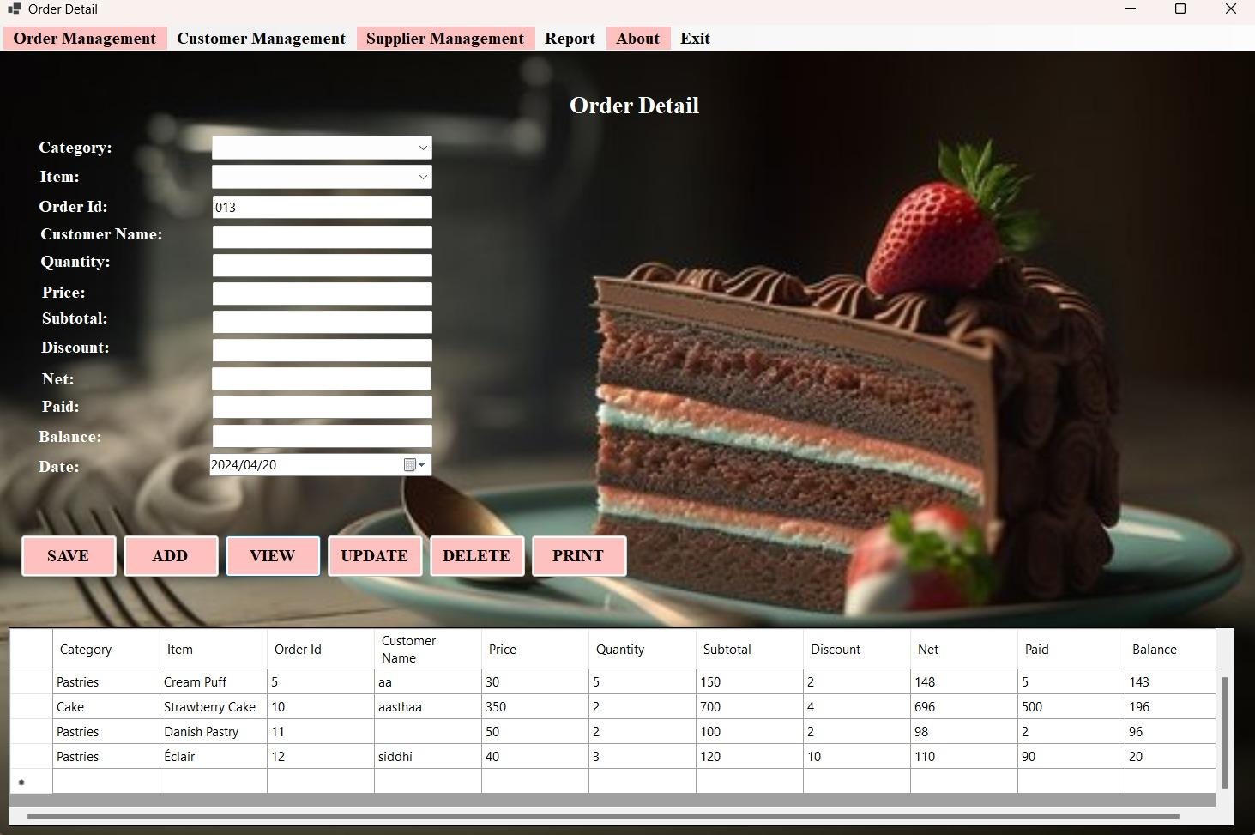

Slide 15
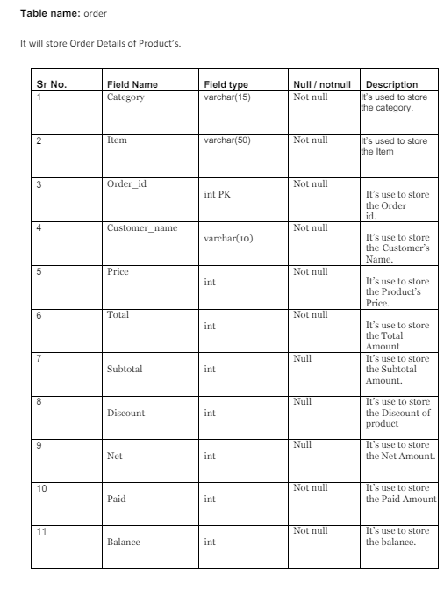


Slide 16
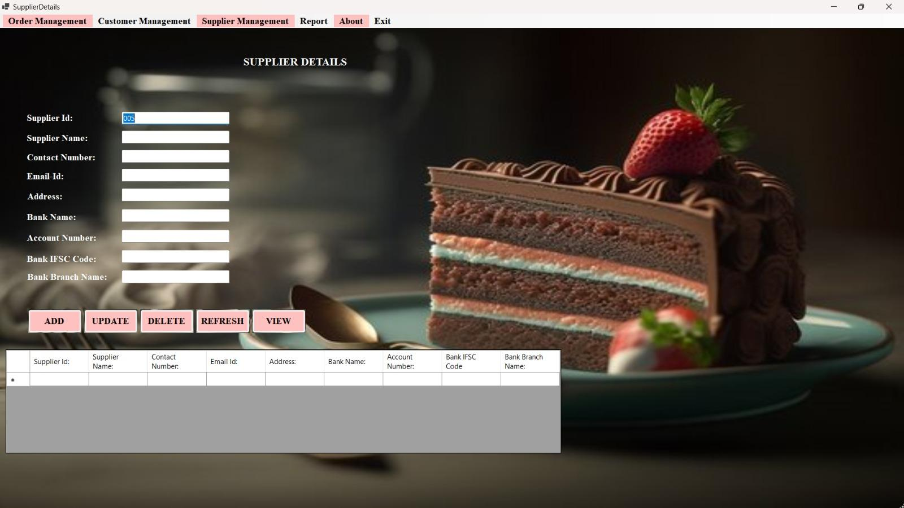

Slide 17
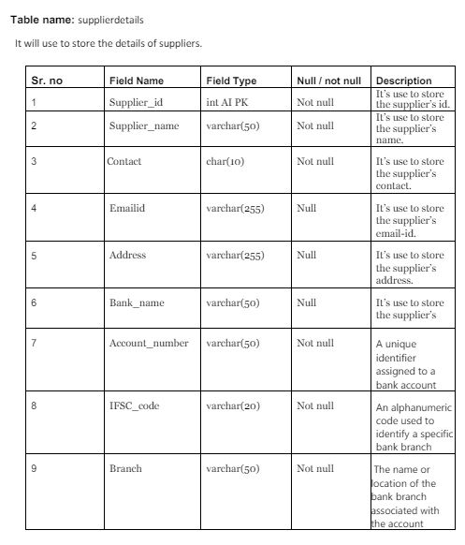

Slide 18
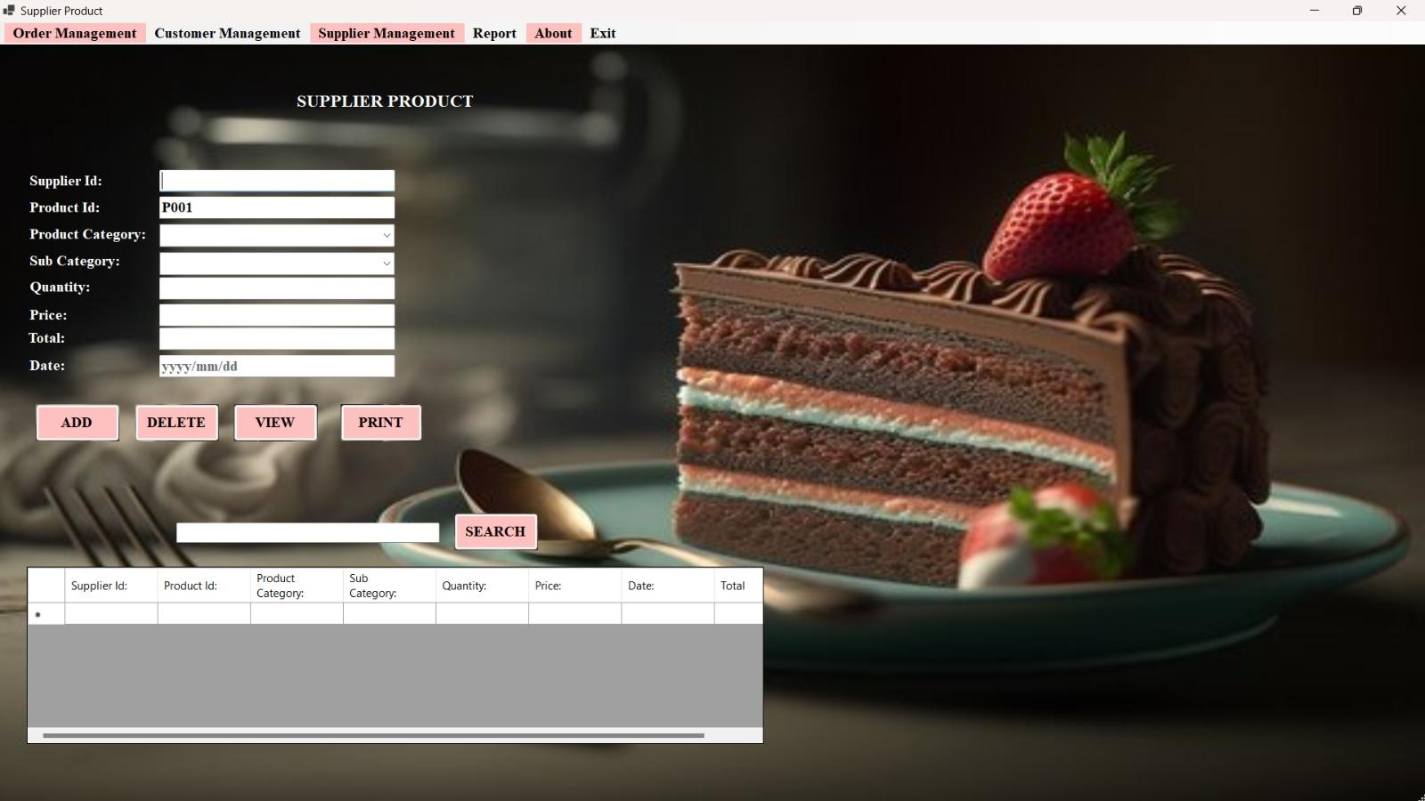

Slide 19
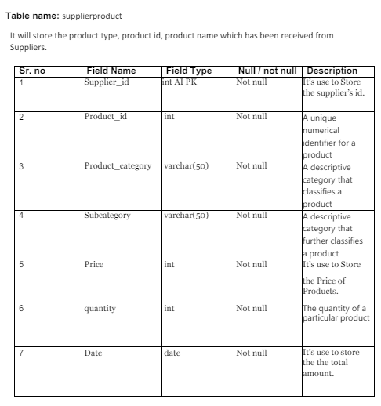

Slide 20
FUTURE ENHANCEMENT
We will add courses and workshops on cake baking.
In future if business grows, we will add more branches and more varieties of products in our application.
We will try to make this system online.

Slide 21
DRAWBACKS
The analysis of the current Manual system really has exposed some problems are follows:
The Current Manual System is time consuming.
There is no Data Security.
There is Data Redundancy Issue in current System.
Preparation of reports is not an easy work.
Maintaining information and retrieving information to our needs are limited.

Slide 22

THANKYOU

