Slide 1
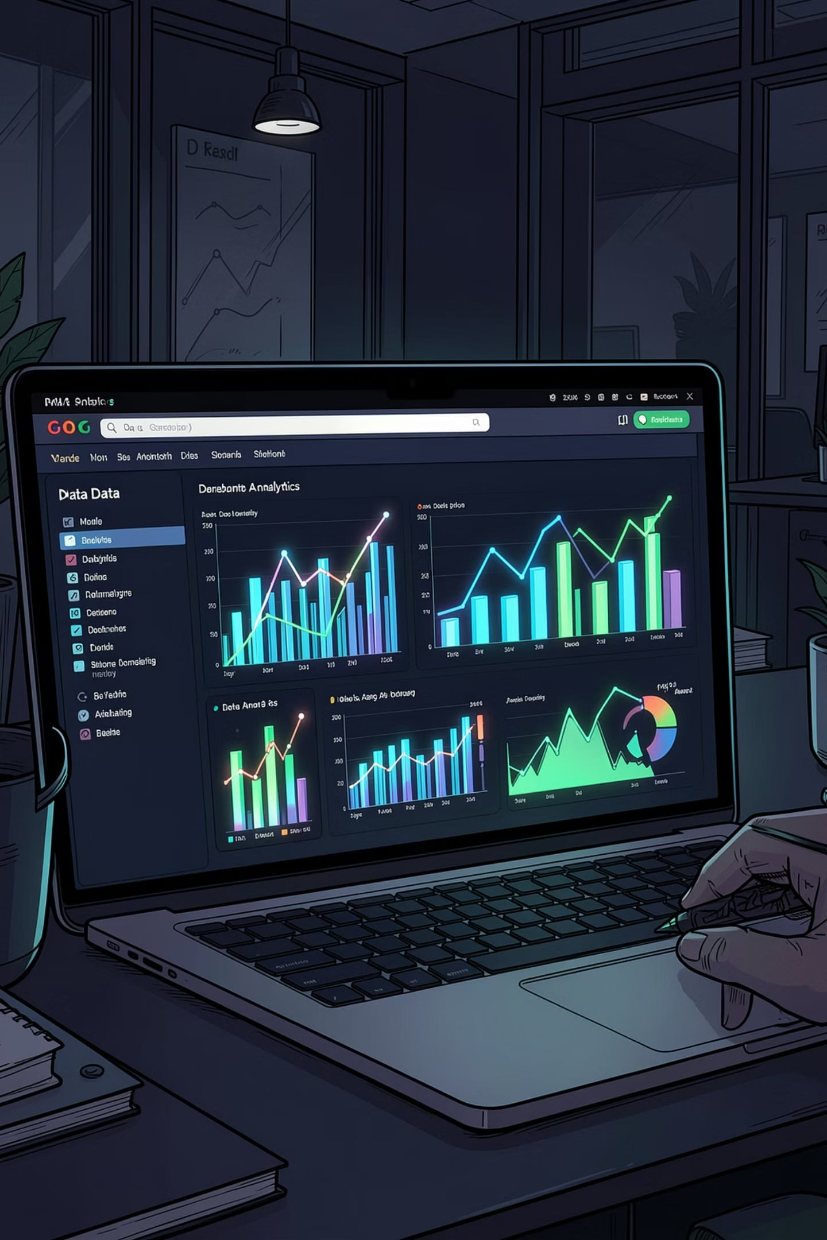
SuperStore Sales Dashboard
An interactive Power BI dashboard analyzing sales performance, customer purchasing trends, and regional insights — converting raw data into actionable business intelligence.

Slide 2
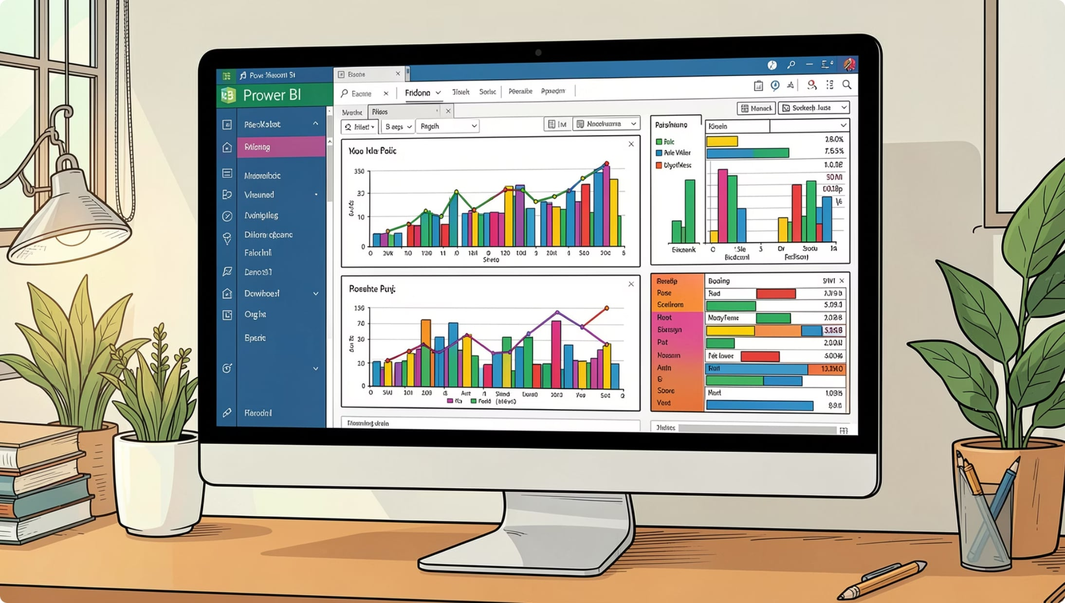

PROJECT OVERVIEW
What We Built
Developed an interactive SuperStore Sales Dashboard in Power BI to analyze sales performance and customer purchasing trends. Data was cleaned and transformed in Excel before creating visualizations.
Key Metrics
Interactive Slicers
Total customers, total sales, sales by age group, gender-wise distribution, order status by channel, monthly trends, and top 5 performing states.
Gender and Category slicers enable dynamic filtering for deeper analysis.

Slide 3
DATASET
Dataset at a Glance
9,995
20
Rows
Columns
Key features include: order_id, customer_id, shipping_state, shipping_country, gender, age, age_group, date, status, category, size, quantity, amount, and B2B flag.

Slide 4

DATA PREPARATION
Exploratory Data Analysis in Excel
Load Data
Feature Engineering
Import Excel file
Create age_group via nested IFs
Connect to Power BI
Preprocess
Find and replace to clean values
Import cleaned Excel file
Data was loaded from an Excel file, preprocessed using find-and-replace to remove inconsistent values, and enhanced with a new age_group column created via nested IF conditions before connecting to Power BI.

Slide 5

POWER BI
Building the Dashboard
DAX Measures Created
Visualizations Created
KPI cards for customers, sales, and categories
Column chart: sales by age group
Pie & donut charts: gender distribution and order status
Horizontal bar: top 5 state sales
Line chart: monthly orders vs. sales
Interactive slicers: Gender and Category
Total Sales
COUNT of Amount field
Total Customers
COUNT of Cust ID field
Total Categories
COUNT of Category field

Slide 6
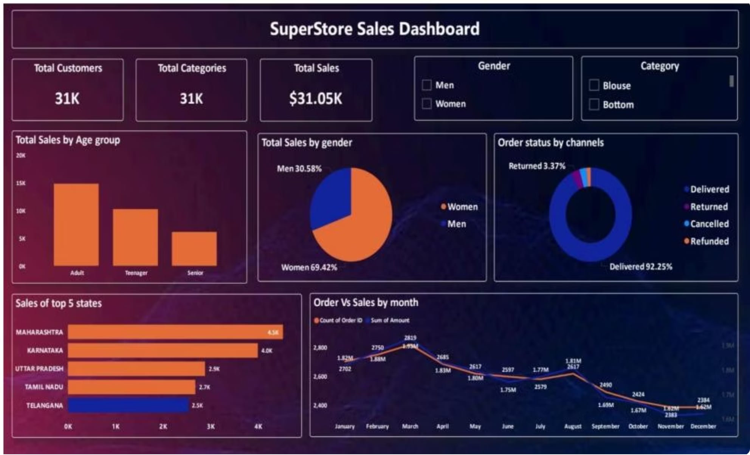
DASHBOARD
SuperStore Sales Dashboard
Total Customers
Total Categories
Total Sales
31K
31K
$31.05K

Slide 7
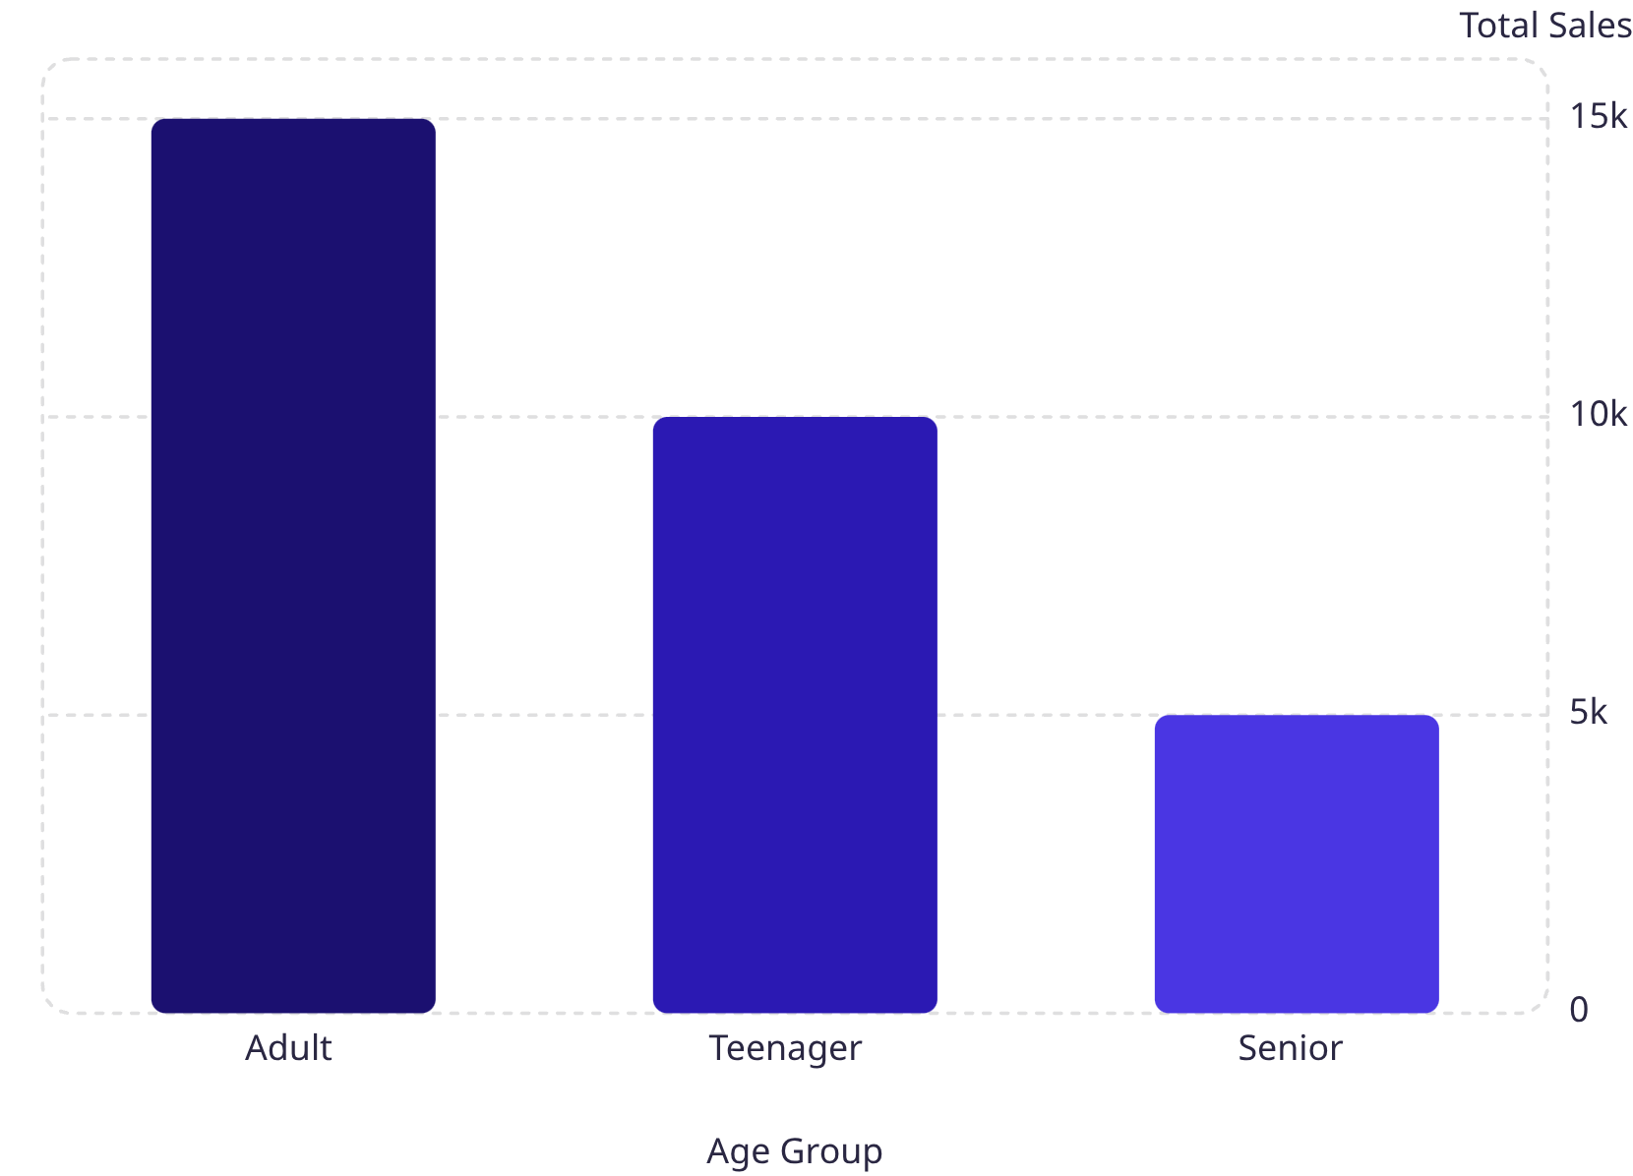
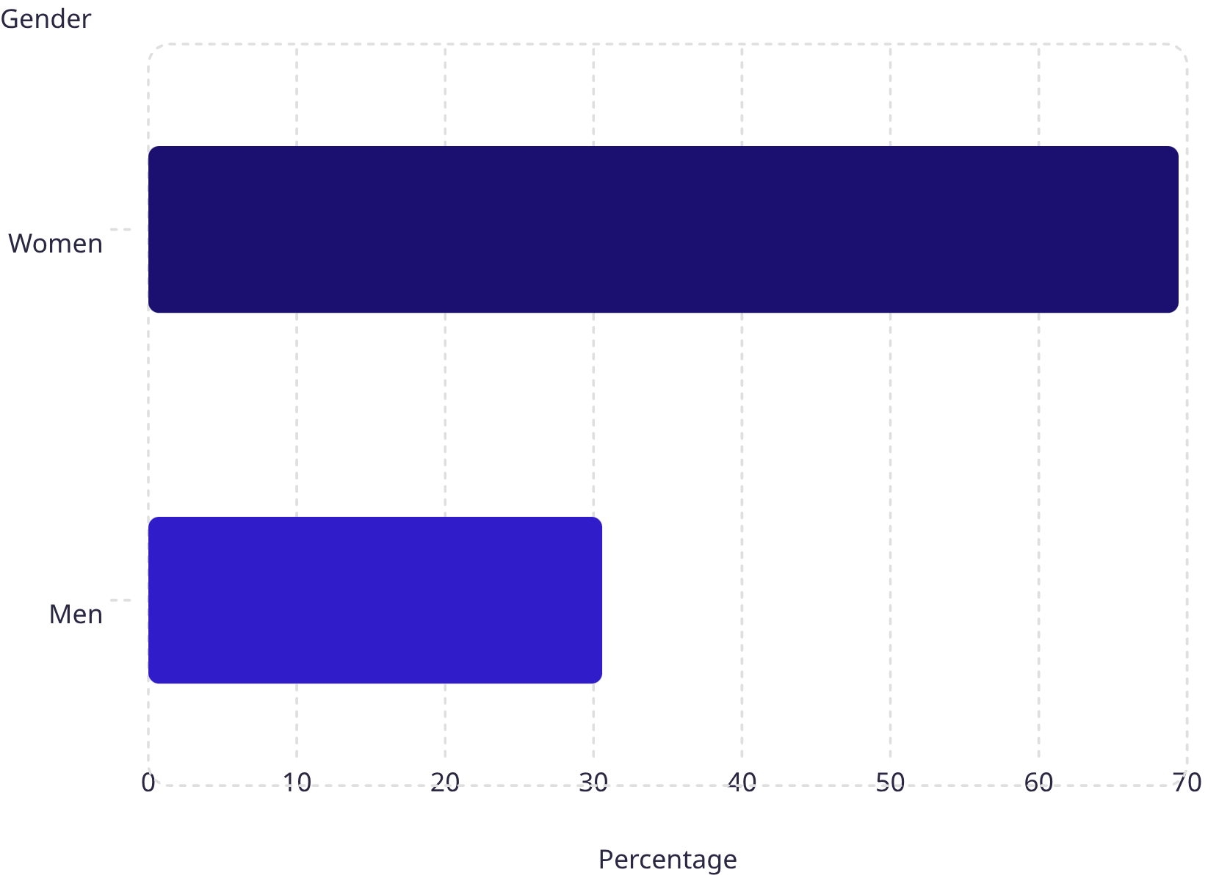
INSIGHTS
Sales by Age Group & Gender
Gender Distribution
Adults are the highest-spending age group (15K sales), while Women account for nearly 69.42% of total sales — a key demographic to prioritize in marketing campaigns.

Slide 8
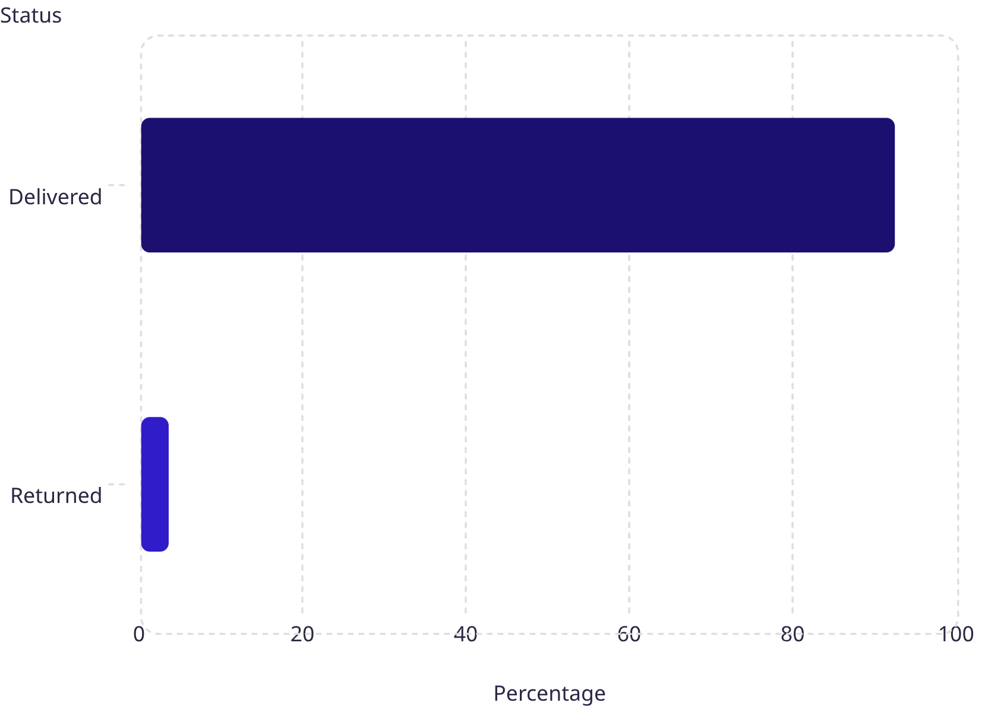
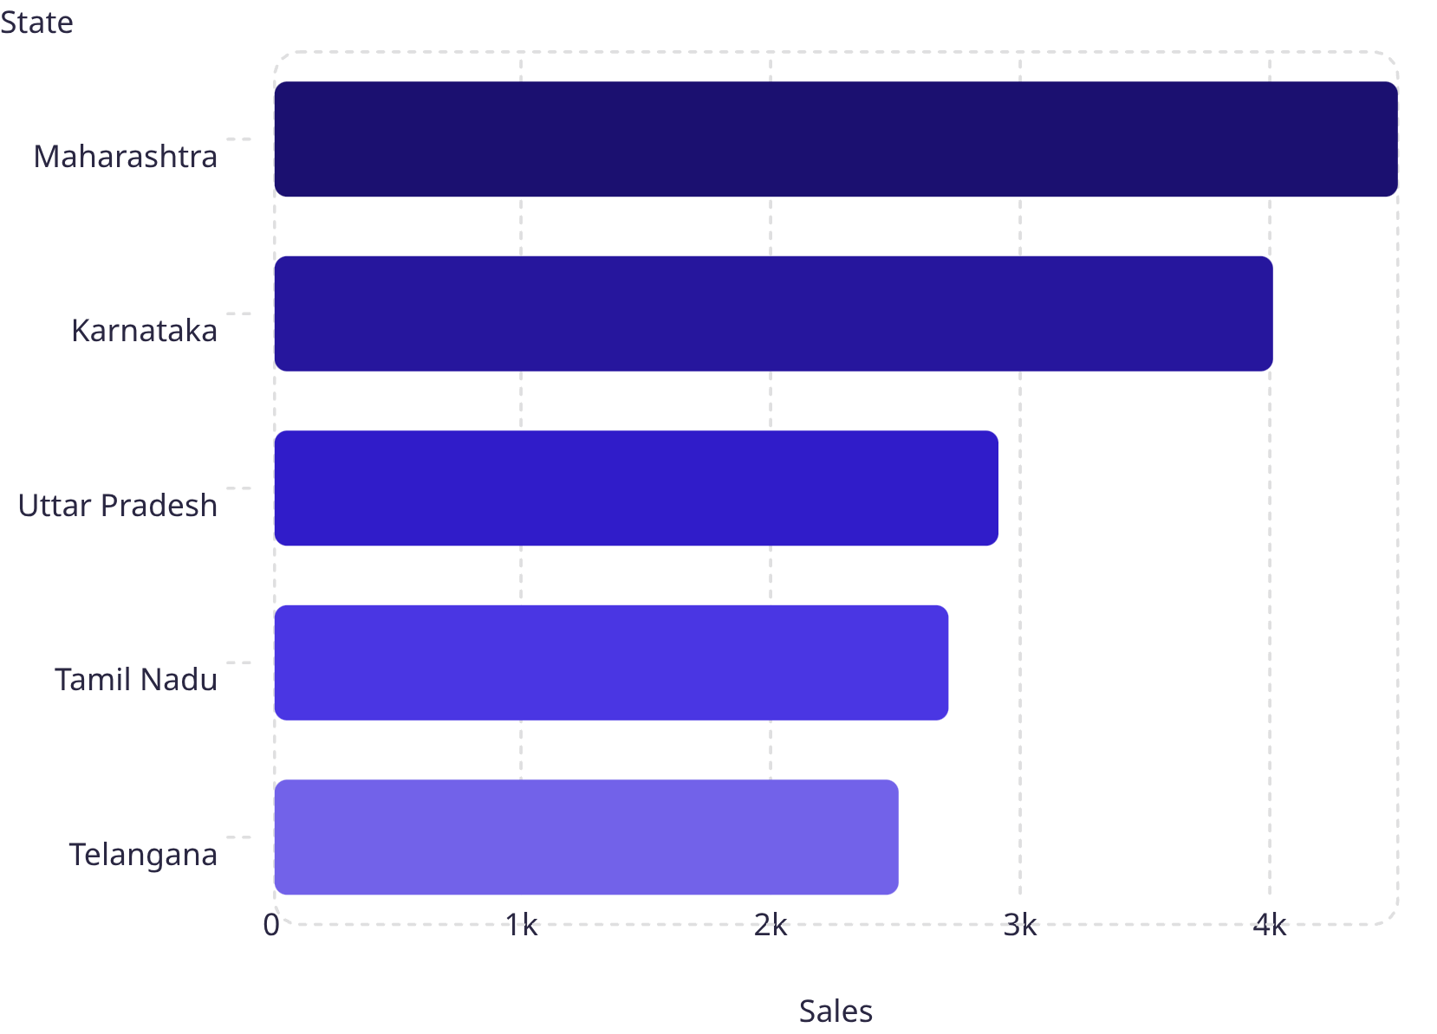
INSIGHTS
Order Status & Top 5 States
Order Status by Channel
Sales by Top 5 States
92.25% of orders are successfully delivered. Maharashtra leads in sales (4.5K), while Telangana has the lowest among top 5 states.

Slide 9
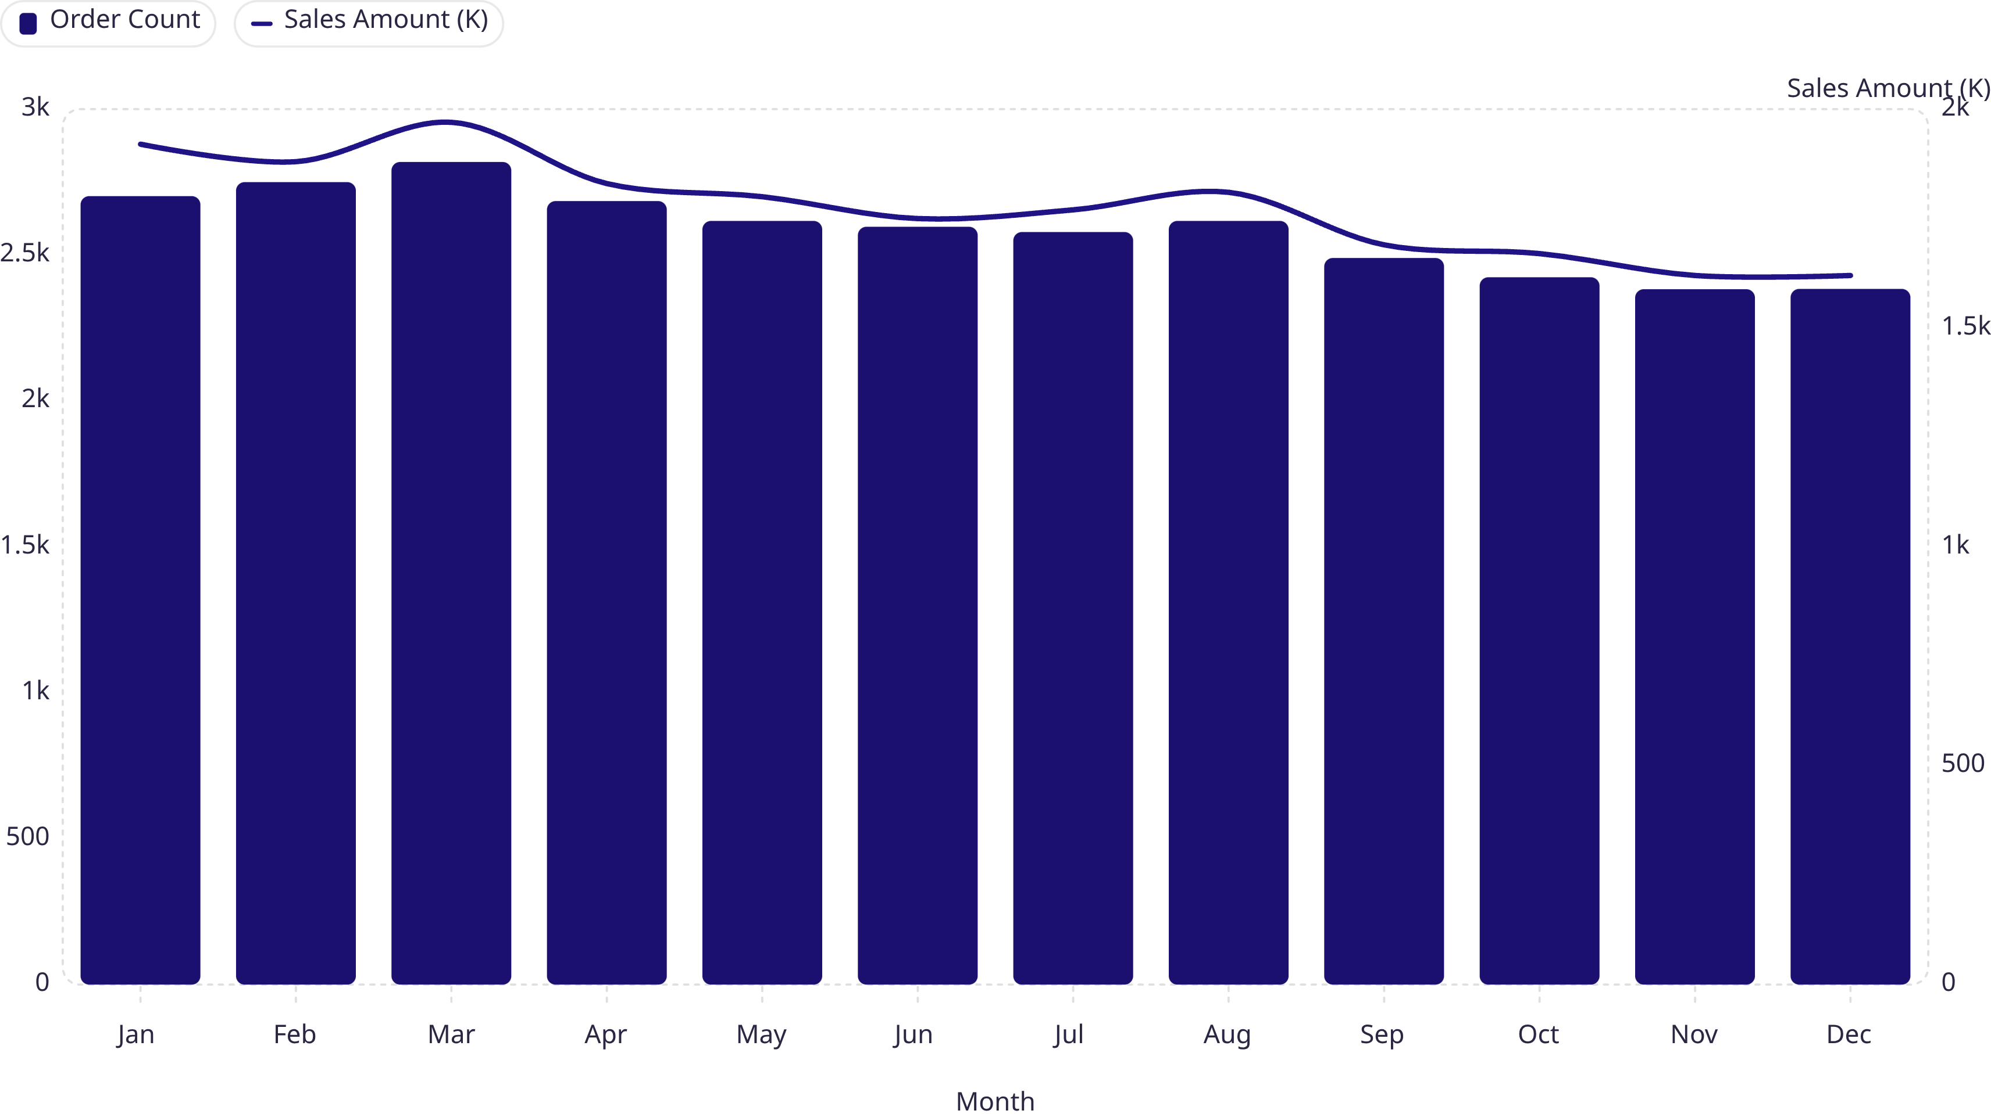
TRENDS
Monthly Orders vs. Sales
Orders and sales peaked in March (2,819 orders, $1.97M) and gradually declined toward year-end, with the lowest activity in November–December. This seasonal pattern supports targeted stock planning and promotional campaigns.

Slide 10




RECOMMENDATIONS
Actionable Insights
Target Age Groups
Leverage Seasonal Trends
Analyze which age groups contribute the most revenue and run personalized marketing campaigns — especially targeting Adults, the top-spending segment.
Increase stock and marketing efforts during high-sales months (Jan–Mar) and prepare promotional campaigns in advance for peak periods.
Improve Retention
Identify customers who haven't purchased recently and send personalized offers or discounts to encourage repeat purchases.

