Slide 1
RoutePulse – End-to-End Big-Data Pipeline on Hadoop & Spark
CSE 587 • Phase I + II • April 2025
Pratik Aher
Mrudula Deshmukh
Siddhi Nalawade

Slide 2
PROBLEM & GOALS
3 + million December-2024 yellow-cab trips ⇒ rich but messy
Stakeholder questions
“Which trips yield big tips?”
“Are there ghost/fraud rides?”
“How will riders pay (cash, card, wallet)?”
Goal :
Build scalable, repeatable pipeline → storage, EDA, ML

Slide 3
Project Phases at a Glance
Phase | Focus | Key Deliverables
I | Cluster setup, HDFS ingest, baseline EDA | Docker-based Hadoop/Spark, raw CSV in HDFS
II | Data engineering + 3 ML tasks | Cleansed Parquet, RF regression, DBSCAN, Logistic Reg.

Slide 4
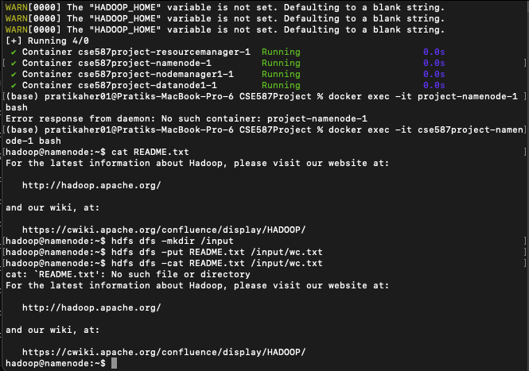
SYSTEM ARCHITECTURE
Docker-Compose pseudo-cluster
NameNode, SecondaryNN, DataNode
YARN ResourceManager + 2 NodeManagers
Spark 3.5.0 runs on YARN; replication = 1
Raw CSV → HDFS → Spark jobs → models back to HDFS

Slide 5
DATA PIPELINE FLOW
Local CSV ──► HDFS (/spd/input)
│
▼
Spark Cleansing & FE
│
▼
Cleaned Parquet (/spd/clean)
│
├─► SQL / EDA (plots)
└─► MLlib Models (/spd/models)

Slide 6
DATASET & CHALLENGES
3 519 975 trips | 19 columns | 245 MB zipped
Missing “\N” in passenger_count, Airport_fee, etc.
Negative / zero distances, fares, tips
Heavy right-skew (distance, fare, tip)

Slide 7
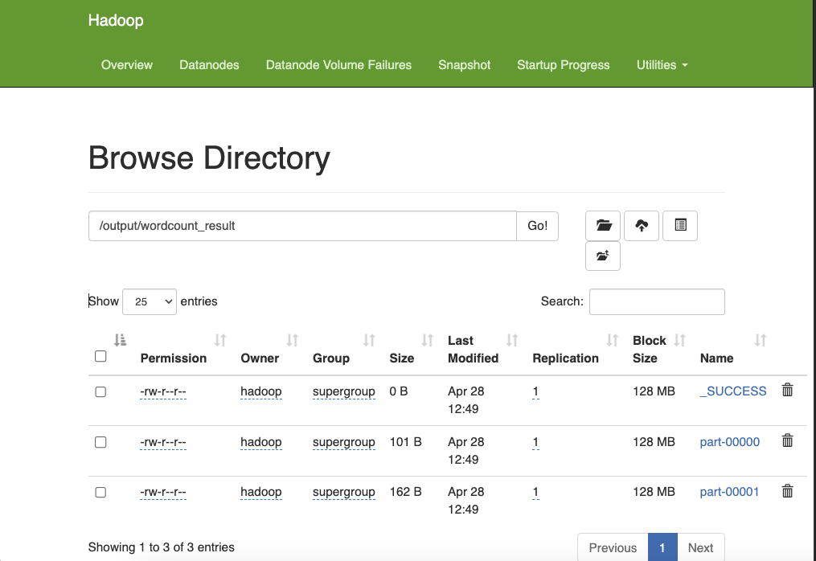
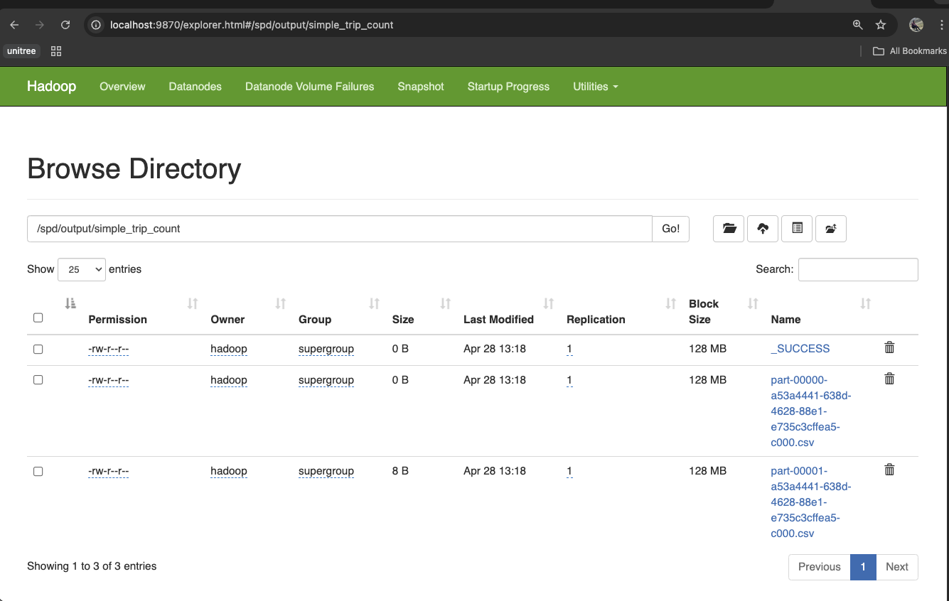
INGESTION PROOF

Slide 8
CLEANING & FEATURE ENGINEERING
Impute passenger_count = 1, cast numerics
Filter • distance > 0 • fare ≥ 0 • tip ≥ 0
Derived : pickup_hour, pickup_day, trip_duration, fare_per_mile
Saved cleaned_taxi_dec2024 (48 Parquet parts)

Slide 9
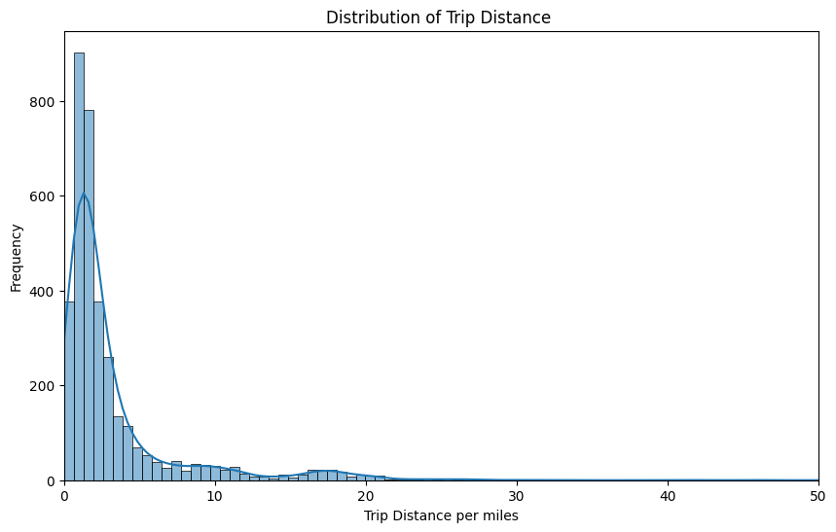
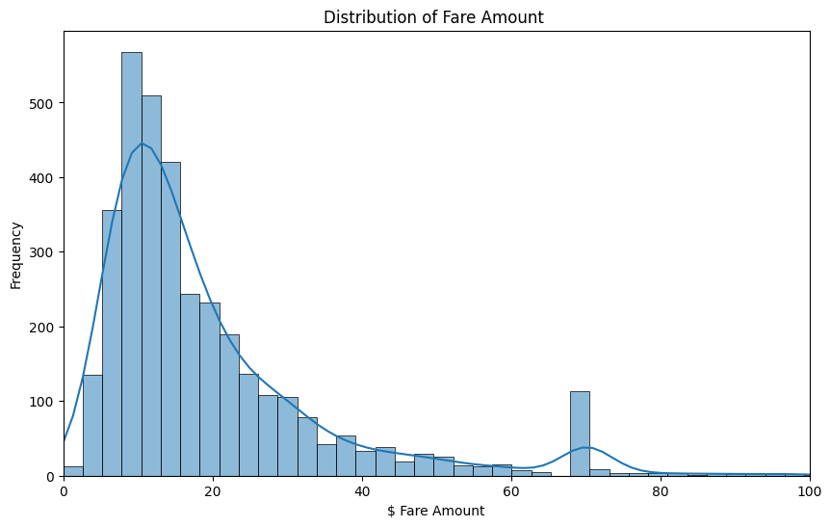
EDA HIGHLIGHTS
Trip Distance Distribution
Fare Amount Distribution

Slide 10
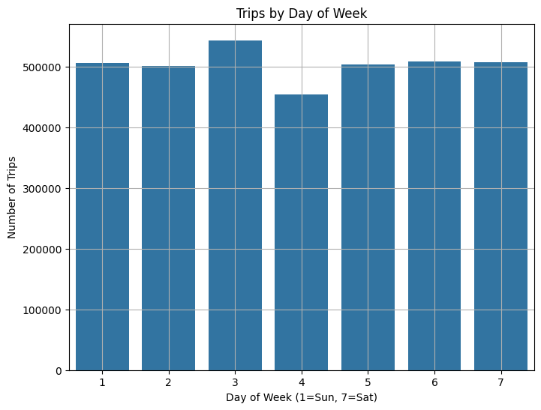
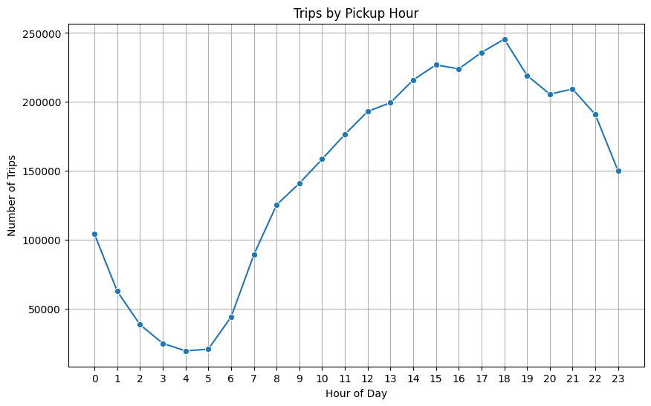
EDA HIGHLIGHTS
Trips by Hour of Day
Trips by weekday bar

Slide 11
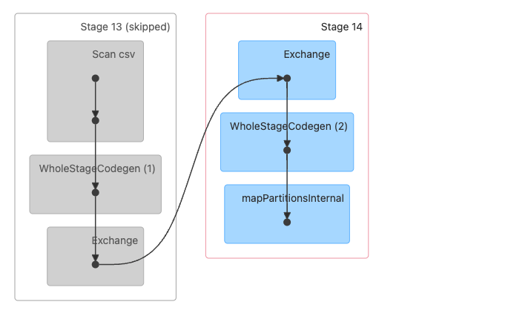
SPARK OPTIMISATION (AQE)
Adaptive Query Execution skipped Stage 23, merged shuffle → Stage 24
27 % less shuffle I/O, 1.8× faster aggregation

Slide 12
ML-1: TIP PREDICTION (Regression)
Random-Forest (100 trees, depth 8)
Features: distance, fare, hour, surcharges, etc.
RMSE = 2.10 $, MAE = 1.48 $
Top drivers: fare_amount, trip_distance, pickup_hour

Slide 13
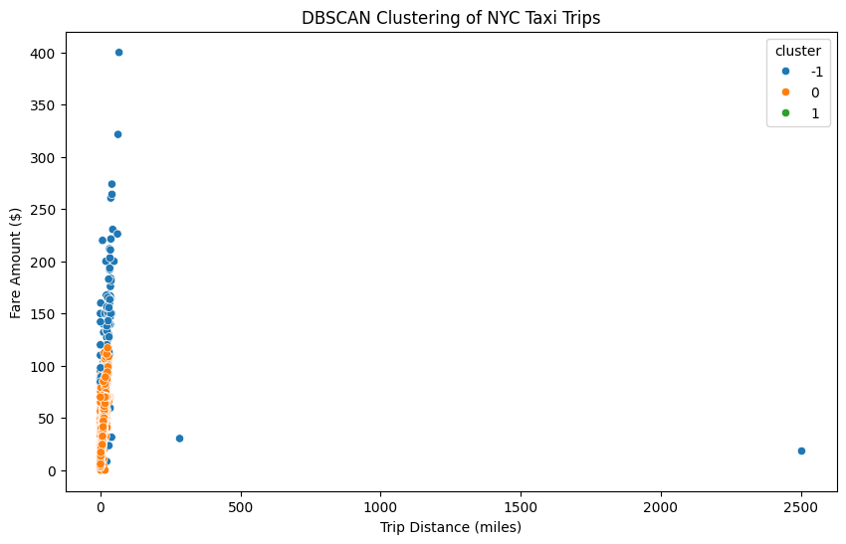
ML -2: Trip-Pattern Clustering (DBSCAN)
Clustering
distance vs fare
DBSCAN on scaled (distance, fare, tip)
6 clusters, noise=0.17 % (likely fraud)
Silhouette 0.41

Slide 14
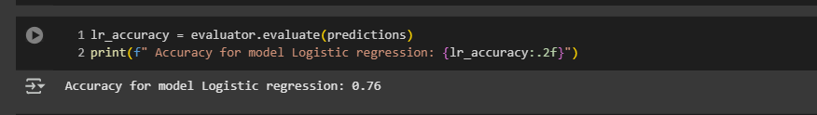
ML-3: Payment Classification
Logistic Regression (multinomial)
Accuracy 76.00%

Slide 15
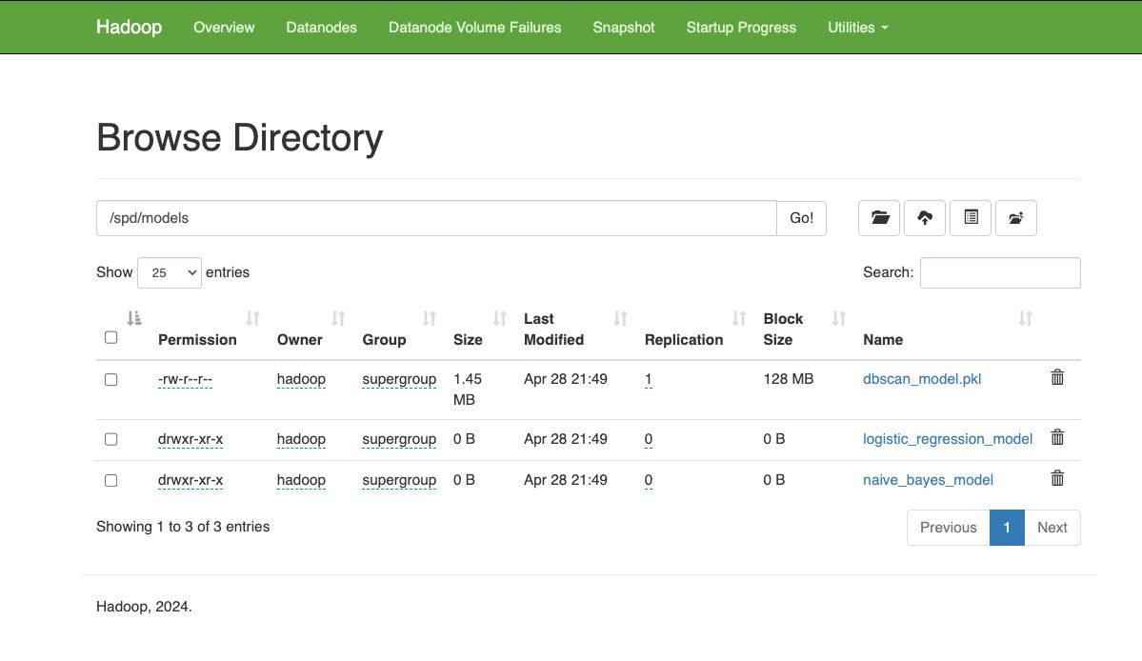
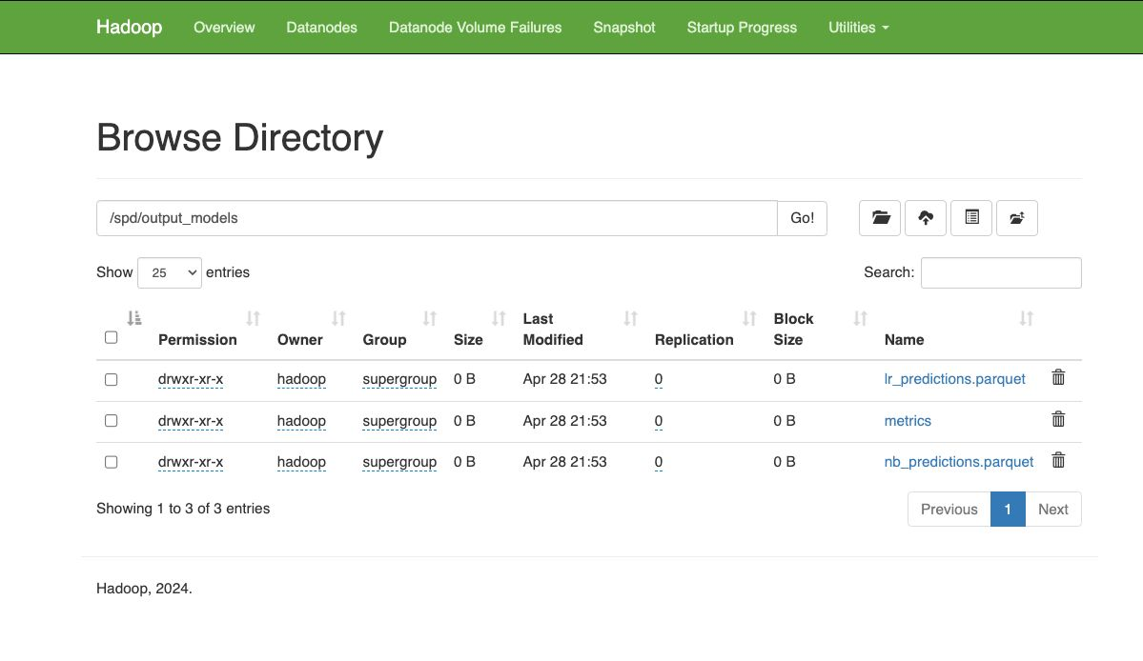
Trained Models & Predictions Persisted to HDFS

Slide 16
CONCLUSION
Built full Hadoop → Spark → ML pipeline
Met Phase-II targets:
RMSE < $2.50, Accuracy > 0.90
Ghost rides isolated
Runtime: end-to-end < 8 min

