Slide 1
EXECUTIVE SUMMARY
Paytm sees a shop’s bad week before the loan payment fails.
Sambhal helps instead of collecting.
RAVI’S MONDAY, AFTER 3 DAYS SHUT
HOW IT WORKS
Watch
→
Talk
→
Fix
Without Sambhal
→
Verify
₹3,400 · 57%
Two days below half of normal sales: flagged before a miss
Voice note in his language, only 8 am–7 pm
Only the lender’s pre-approved relief; code sets every rupee
Sales back, case closed, every step on record
With Sambhal
₹1,032 · 17%
Share of the day’s sales deducted. Without Sambhal: our model, as PhonePe documents.
22 → 5
0 / 73
4 / 4
1 in 6,000
merchants overdue, without vs with Sambhal (50 synthetic merchants, same days)
AI messages broke a rule (independent audit of the replay)
RBI no-contact occasions kept in code: bereavement, illness, family function, calamity
flagged cases kept from 90+ days overdue pays the AI cost of all 6,000*
WHY PAYTM
₹912 Cr a quarter in financial services revenue, +49%, led by merchant loans · first-loss guarantees up to ₹590 Cr
*About ₹10 of Sarvam calls a case (Ravi’s 5 voice notes and 3 replies cost about ₹6). A loan like Ravi’s (₹92,650 still owed) loses about ₹60,000 at 90+ days, where 30–35% is recovered. Sources: Paytm Q2 FY27 release (30–35%: p.15); Paytm filing, 26 Oct 2026, Annexure III (DLG). Demo figures are synthetic.
01
Notes:
Executive summary for readers of the deck. In the live 5-minute slot, use the 5-min deck instead.
1 in 6,000: about ₹10 of Sarvam calls per case (measured: Ravi’s case is about ₹6) against about ₹60,000 lost on a loan like Ravi’s that reaches 90+ days (65% of the ₹92,650 still owed, since 30–35% is recovered). AI running cost only, not staff or the licence. ₹912 Cr: Paytm financial services revenue, Q2 FY27, +49%. DLG: say “up to”, never “losses”.

Slide 2
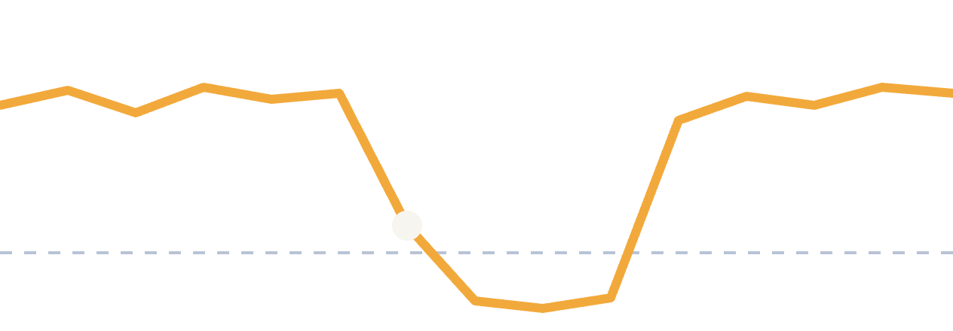
Sambhal
TRACK 2 · AI-POWERED FINANCIAL JOURNEYS
संभाल
Right-size the loan. Steady the merchant through bad weeks.
An AI teammate for Paytm merchant loans, before and during repayment
Siddh Mehta · Paytm Build for India AI Hackathon – Bengaluru · October 2026
Notes:
Cue: “Sambhal” means to steady, to take care of. One line: we help Paytm merchants take the right-sized loan and get through bad weeks without falling behind. The orange line is the whole story: takings dip below the installment, Sambhal notices at the white dot, and the merchant recovers.

Slide 3

One bad week can sink a good loan
THE PROBLEM
01
02
03
Sized on normal weeks
Shortfalls stack up
Outreach starts too late
Installments follow normal sales. A wedding, an illness or a flood can shut the shop and drop settlements to near zero.
Unpaid installments carry forward (in our model, as PhonePe documents). On reopening day they are swept from sales or stay overdue on the record.
Collections react to missed payments, not to the sales drop that predicted them. By then the talk is about arrears.
83–90%
30–35%
Timing decides the outcome. Help early, while it’s still easy to fix.
of early missed-payment cases resolved (Bucket 1)
recovered once a loan is 90+ days overdue
Source: Paytm Q2 FY27 release p.15.
03
Notes:
Cue: tell it as one merchant’s week. Installment is fixed on normal sales; the shop shuts for a few days; the unpaid installments are either swept from reopening day’s sales or stay overdue on his record (our model sweeps, as PhonePe documents); Sambhal prevents both. The numbers at the bottom are Paytm’s own: early cases mostly resolve, late ones mostly don’t. So the value is in acting early, not acting harder.

Slide 4


The rules change on 1 January 2027
WHY NOW
RBI’s final recovery directions
Paytm is already in position
RBI/2026-27/230 · issued 6 Aug 2026 · in force 1 Jan 2027
Paytm Q1 FY27 results · Pi launch, 2026
Lenders must document engagement with distressed borrowers before escalating, and explain the resolution options
Contact only between 8 am and 7 pm; calls recorded, and the borrower told
No calls or visits during bereavement, medical emergencies, calamities or marriage functions
Lenders pay borrowers for harm caused by rule-breaking recovery
Merchant loan distribution is one of Paytm’s four growth engines
Paytm acts as collection outsourcing partner on these loans
Paytm already lists better collections as a goal for its AI
Pi now offers AI agents to banks, lenders and insurers
Lending partners have ten weeks to build this. Sambhal’s audit log is that record.
Sources: RBI/2026-27/230, Responsible Business Conduct amendment directions, 6 Aug 2026; Paytm Q1 FY27 earnings release; Paytm Pi launch coverage, Sep 2026.
04
Notes:
Cue: two forces meet. Left, from 1 Jan 2027, RBI/2026-27/230 requires lenders to document engagement with distressed borrowers before escalating and to explain resolution options, plus strict contact rules. Sambhal's audit log is that record. (RBI doesn't require prediction: spotting trouble early is our choice.) Right, Paytm already sits in the middle: it distributes the loans, it is the collection partner, and it now sells AI agents to lenders through Pi. Sambhal is the product where these meet.

Slide 5
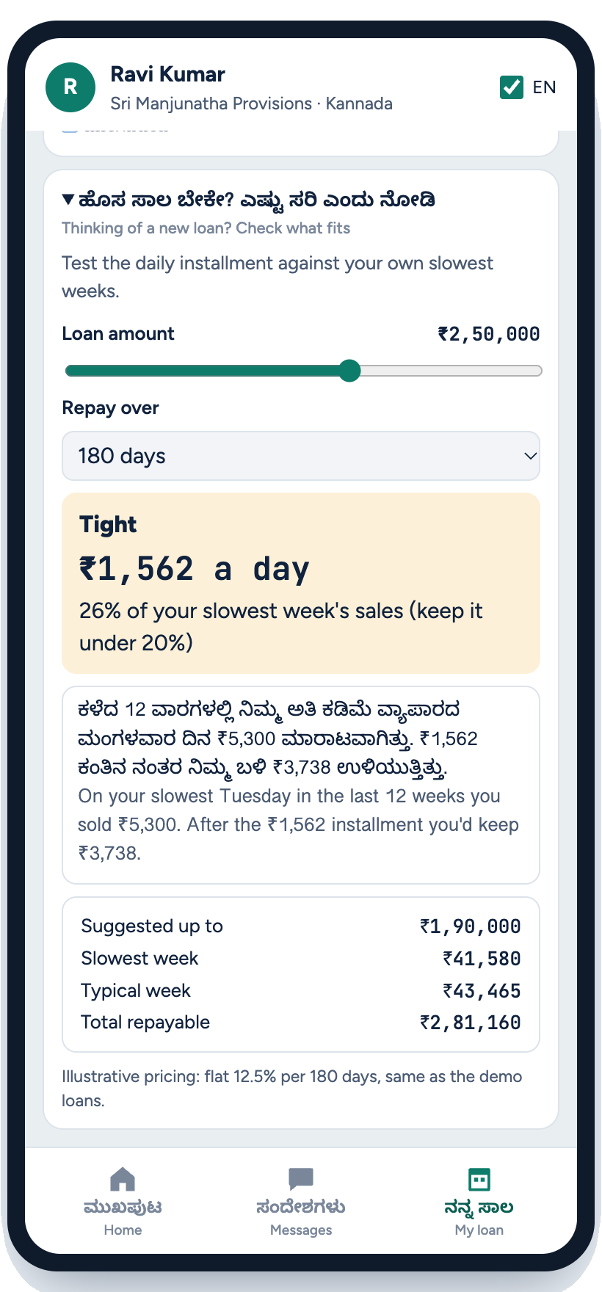



One teammate, two risky moments
THE SOLUTION
BEFORE THE LOAN
DURING THE LOAN
Right-size
Steady
Tests the daily installment against the merchant’s last 12 weeks of sales
1 · Detect
2 · Talk
Flags two days below half of normal, before a payment is missed; spots whole-area dips
Voice note or call in the merchant’s language, inside the RBI rules
Shows what the installment leaves on the merchant’s slowest days, in their language
3 · Fix
4 · Verify
Suggests a size that keeps bad weeks manageable; the lender decides
Offers only lender-approved options: a short pause, smaller catch-ups, part-payment
Watches sales recover, closes the case, then helps the merchant prepare
Sambhal never sets credit terms or invents offers. Lenders keep every decision.
Sambhal · Paytm Build for India AI Hackathon – Bengaluru
05
Notes:
Cue: two moments in one journey. Before the loan, right-size it using the merchant’s own sales. During the loan, the loop: detect, talk, fix, verify, and now prepare. Stress the bottom line: the AI talks, but it can only offer what the lender pre-approved. The phone is the right-sizer in the app (My loan, 'New loan? Check what fits'): ₹2.5 lakh over 180 days is Tight, ₹1,562 a day is 26% of Ravi's slowest week; it suggests up to ₹1.9 lakh. The lender decides.

Slide 6

A bad week, handled: Ravi’s kirana
HOW IT WORKS · DEMO STORY
Thu 9:05 pm
Fri 8:00 am
Fri 8:20 am
Fri 8:22 am
Tue 8:00 am
Detect
Talk
Understand
Fix
Verify
Second day below half (31%). Flagged before any miss; held till 8 am.
Kannada voice note, recording notice first: “Slow week? We can help.”
“Wedding at home, shop shut till Sunday.” No contact until Monday.
Lender allows a 3-day pause: ₹2,550 spread over 14 days. Ravi taps Accept.
Sales recover. Case closed, every step on record. Pay-ahead offered.
Monday’s deduction without Sambhal
With Sambhal
₹3,400
₹1,032
57% of the day’s sales in one sweep (our model, as PhonePe documents)
17%: the usual ₹850 plus ₹182 catch-up
Synthetic kirana, ₹850 a day, shut Fri–Sun. Without Sambhal the backlog is either swept from Monday’s sales or overdue on his record; Sambhal prevents both.
06
Notes:
Cue: walk left to right. The flag arrives Thursday 9 pm, before anything is missed, and the code holds the message until 8 am because RBI allows contact only 8 to 7. The first message is help, not a demand, and says it is recorded. The moment Ravi mentions a wedding, Sambhal goes quiet until Monday. The fix comes from the lender’s menu. Payoff: Monday’s deduction falls from ₹3,400 (57% of the day) to ₹1,032 (17%). Maths: 3 × ₹850 = ₹2,550; over 14 days = ₹182 a day.

Slide 7
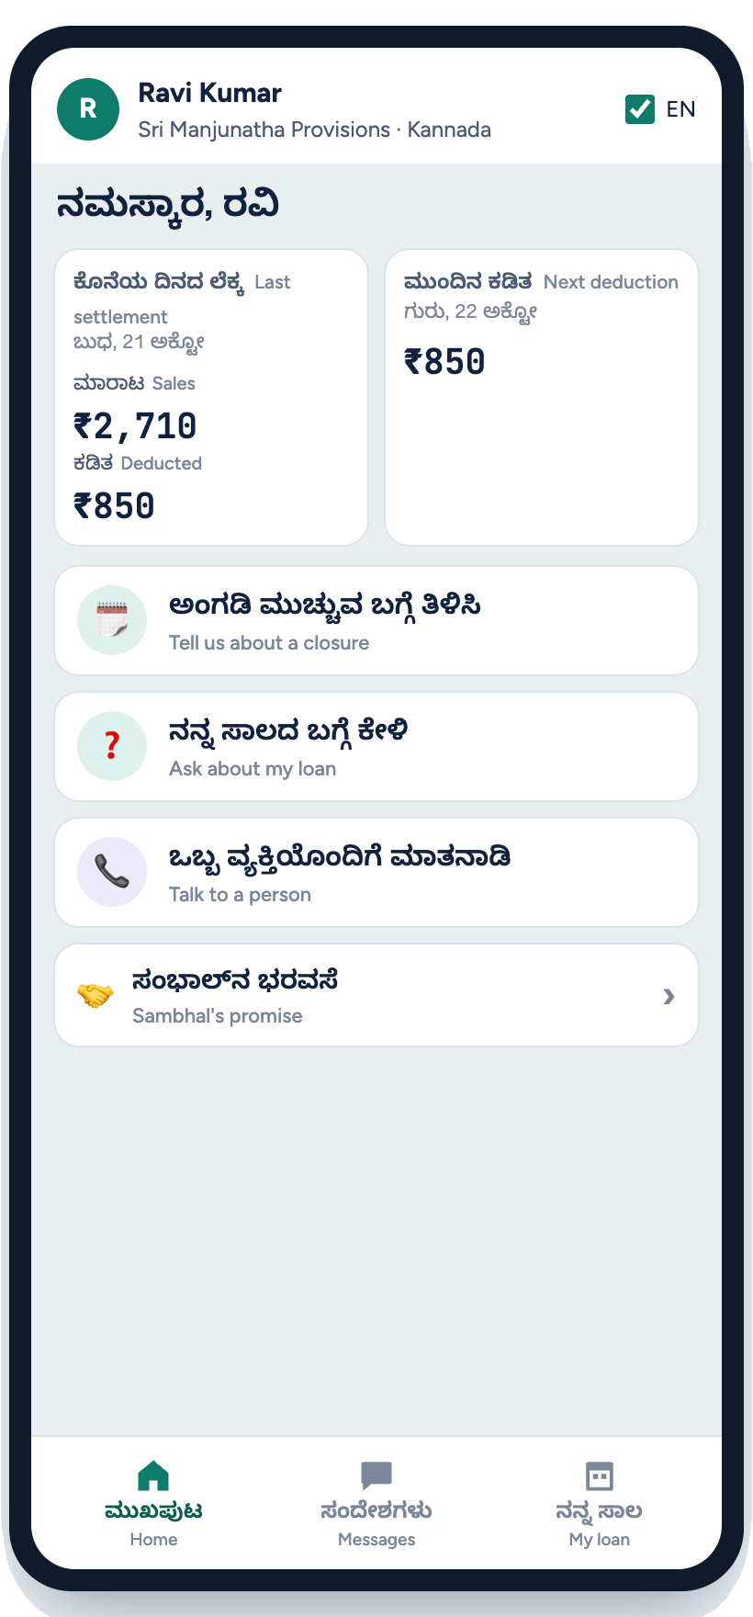
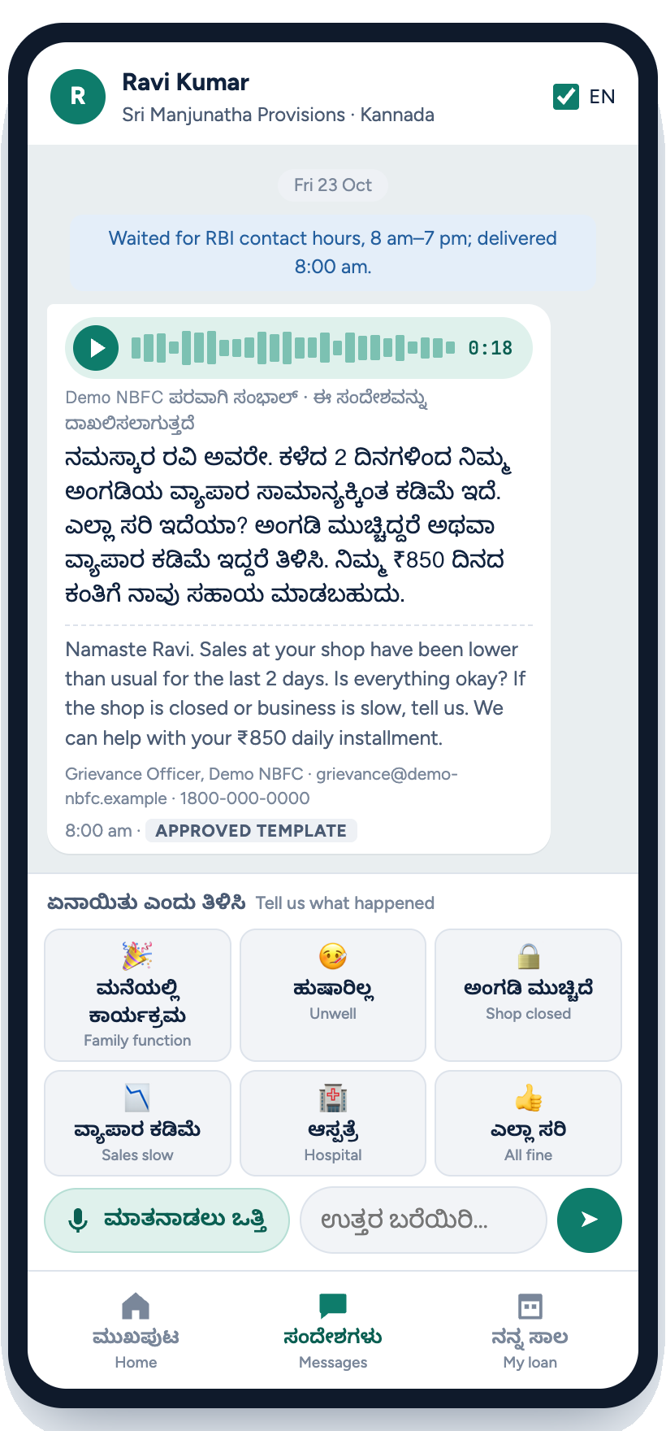
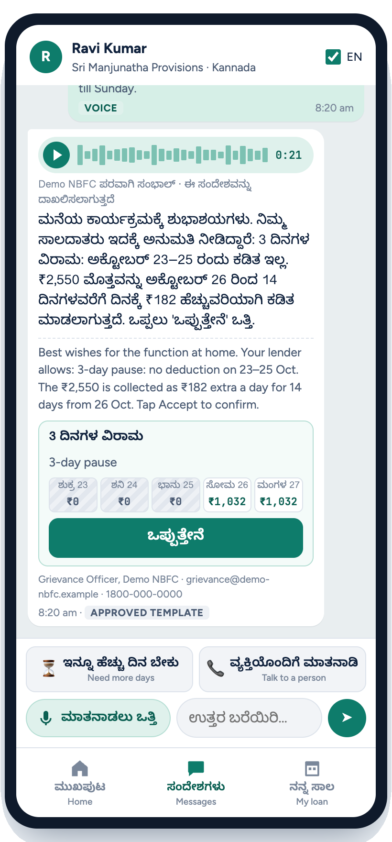
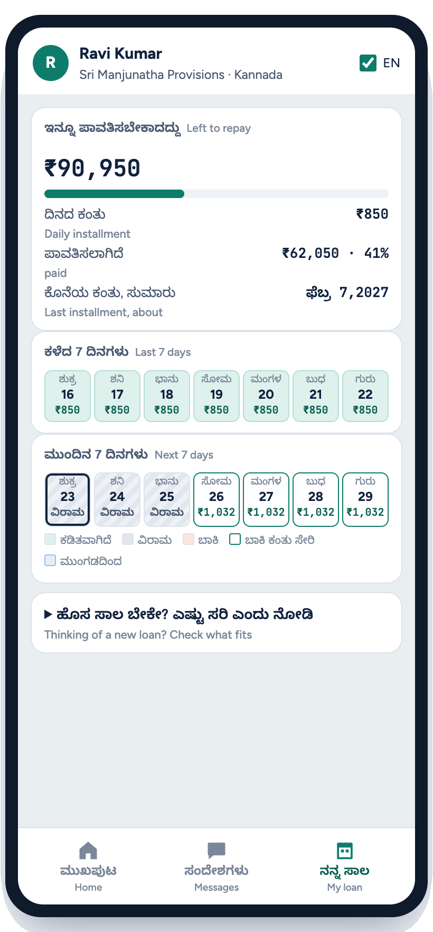
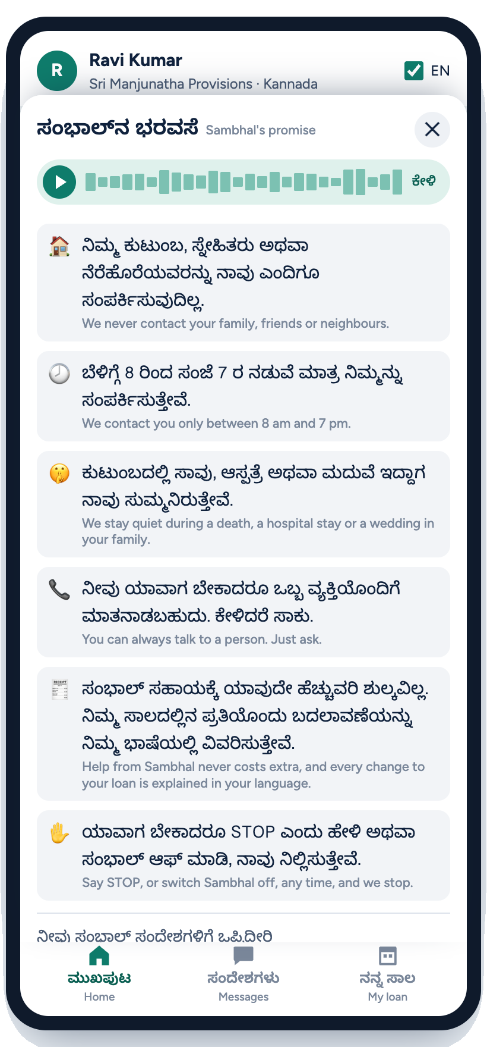

Built for a busy counter, in his language
THE MERCHANT’S APP · WORKING PROTOTYPE
Home: today’s numbers and three big buttons
A voice note in Kannada; reply by voice or one tap
Only the lender’s options, with a day-by-day preview
A calendar of paid, paused and catch-up days
Six promises, read aloud; switch off any time
Sambhal · Paytm Build for India AI Hackathon – Bengaluru
07
Notes:
Cue: this is the working prototype, not a mock-up. Kannada first, English underneath for judges. Point at the one-tap reasons and the big mic: built for someone at a busy counter. The offer shows exactly what each day will cost before he agrees. The promise screen turns our guardrails into commitments he can hear.

Slide 8
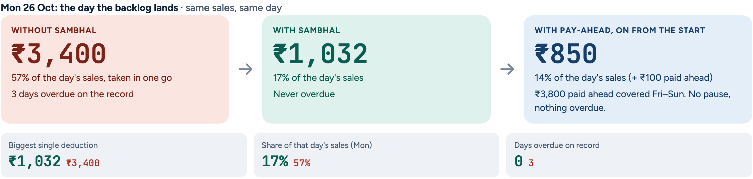
Ready for the next bad week
PREPARE
₹3,800
paid ahead by the wedding week, had Ravi switched on pay-ahead when his loan began
Good days: on days he sells ₹6,000 or more, ₹100 goes towards future installments (about 1.6% of a good day).
Bad days: the cushion pays first. Fri–Sun covered, nothing overdue, no lender decision needed.
His choice: off any time. Installments paid early to the lender, not a deposit or a wallet.
ACROSS THE SAME 50 MERCHANTS
If every flagged merchant had pay-ahead from the start: 1 merchant overdue for 1 day (22 without help, 5 with Sambhal’s pauses).
An upper bound: it assumes everyone opts in. The pilot measures real uptake.
Sambhal doesn’t just get a merchant through a bad week. It gets them ready for the next one.
Sambhal · Paytm Build for India AI Hackathon – Bengaluru
08
Notes:
Cue: the idea. Paytm sees the good days too. With pay-ahead, ₹100 on days Ravi sells ₹6,000 or more, he would have had ₹3,800 ahead by the wedding: Friday to Sunday covered, no pause, no lender decision. Be honest: it is the same money, paid earlier on days it hurts least; it is his choice and off any time. The 1-merchant figure assumes everyone opts in, so it is an upper bound we would measure in the pilot.

Slide 9
Built to say no
GUARDRAILS
When this happens | Sambhal does this | Because
A message falls due at 7:30 pm | Holds it until 8 am the next day | RBI: contact only 8 am–7 pm
The merchant mentions a death or illness | Stops contacting, hands the case to a person for hardship help | RBI: no contact in bereavement or emergencies
The merchant asks to waive the dues | Declines kindly, offers only approved options, routes the request | The lender’s policy, not the model, sets terms
Sales vanish with no reason given | Flags for human review and takes no action | Could be payments moved to another QR
Every message says it is recorded, and is logged. Before each release we replay 40 test situations; one rule break blocks it.
The AI does the talking. A fixed rulebook decides what it may say, and when.
09
Notes:
Cue: this is the slide that answers “isn’t this just a nicer collections bot?”. The model never decides timing or terms; a rules engine does. Walk one row, the bereavement one: Sambhal stops and hands over to a person. Then the proof: a fixed set of 40 scenarios runs on every build, and any rule violation blocks the release.

Slide 10
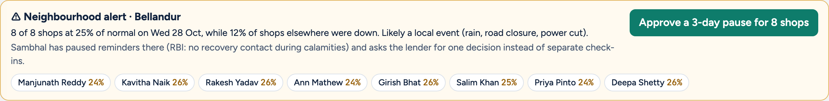
What only Paytm can see
BEYOND ONE MERCHANT
Neighbourhood alert
Tell us first
Trust, then check
Eight shops in Bellandur dip together while the rest of the city is normal. No reminders there (RBI: no contact in calamities); the lender approves one area pause in a click.
Shobha books her sister’s wedding closure in the app before it happens. The pause is set for those days: no dip alarm, no check-in.
Her shop reopens a day early. Sunday is collected as usual and her catch-up shrinks to the two days she was really shut.
Lender staff act inside the same rules: no calls at night or during a bereavement.
Sambhal · Paytm Build for India AI Hackathon – Bengaluru
10
Notes:
Cue: only Paytm sees thousands of shops side by side. When eight shops in Bellandur dip together, it is a local event, not eight problems: no reminders there, one decision for the lender. Shobha shows the merchant starting the conversation, and trust-then-check shows we don’t give relief blindly.

Slide 11
Same 50 merchants, same days
PROOF · SAME DATA, WITH AND WITHOUT
 | Without Sambhal | With Sambhal
Merchants who fell overdue | 22 | 5
Merchant-days overdue | 66 | 32
Merchants 3+ days overdue | 13 | 5
Biggest single deduction (median) | 2.0× | 1.2×
Rule breaks found by an independent audit | – | 0 of 73 messages
40/40
scenario checks pass, live
160
automated tests
0
rule breaks found
Lender what-if: pause up to 2 days instead of 3, and 5 merchants overdue become 13. Lenders tune the menu with evidence before it goes live.
Synthetic merchants, 21 Oct–10 Nov. The 5 still overdue are with a person by design (bereavement, ICU, review, grievance, not eligible). This shows how a pilot would be measured, not a real-world result.
Sambhal · Paytm Build for India AI Hackathon – Bengaluru
11
Notes:
Cue: same synthetic merchants, same days, only Sambhal differs. 22 fall overdue without, 5 with, and those 5 are with a person by design. An independent audit re-checks every message: zero rule breaks. Then the what-if: lenders can see the cost of a stricter menu before they ship it. Say clearly this is synthetic, and how the pilot would measure it.

Slide 12
How Sambhal is built
TECH STACK
INPUTS
THINK
GUARD
ACT AND PROVE
Daily settlements
Early-warning rule
Policy engine
Indic voice
Paytm merchant payments
Two days below half of normal, or anything overdue
Fixed rules the AI can’t override
Sarvam Saaras v4 and Bulbul v3: Kannada, Hindi, English
Loan ledger & options
Agent
Contact rules
Lender console
From the lending partner
Detect → talk → fix → verify → prepare
RBI hours, no-contact days, call limits
Cases, staff actions, alerts, audit trail
Neighbourhood signal
Many shops in one area dipping together
Language model
Eval harness
Sarvam-105b reads replies; keyword rules as a safety net
40 scenario checks, 160 tests; replay vs no Sambhal
Stack: Python · FastAPI · Sarvam AI (Saaras v4, Bulbul v3, Sarvam-105b) · plain JavaScript · pytest · runs offline
Sambhal · Paytm Build for India AI Hackathon – Bengaluru
12
Notes:
Cue: read it left to right. Settlements and a neighbourhood signal come in; a plain early-warning rule and an agent think; a deterministic guard layer sits between the model and the merchant; everything that goes out is logged and tested. Sarvam does the voice and reads replies; the rules decide days and amounts.

Slide 13
Why this is hard to copy
USP
1
A signal only Paytm has
2
Does what a risk score can’t
Daily settlements from 1.64 crore merchants on subscription (Q2 FY27) show trouble days before a payment is missed. A lender without them sees only the miss.
It works on top of the lender’s existing risk model: it holds the conversation, offers the fix and proves it worked.
3
Follows the rules by design
4
Proof, not promises
The 2026 RBI rules are written into the code, not left to the AI. Every message is timed and logged.
Results are compared with similar merchants who didn’t get Sambhal, and 40 test cases must pass before every release.
A score says who is at risk. Sambhal changes what happens next.
Merchant count: Paytm, Q2 FY27 (merchants on subscription).
13
Notes:
Cue: if a judge says “we already have risk scores”, this is the answer, card 2. We don’t compete with the score; we start where it stops. Card 1 is the moat: only Paytm sees daily takings. Card 3 is why a lender’s compliance team will like it. Card 4 is why a product team will trust it.

Slide 14



Better for merchants, lenders and Paytm
IMPACT & BENEFITS
Merchant
Lending partner
Paytm
No backlog swept or left overdue on reopening day: 17% of the day’s sales, not 57%, in our model
Terms and options explained by voice, in their own language
No calls at night, at a wedding or in grief
Steps in at Bucket 1, where 83–90% of cases resolve
Audit-ready for the 1 January 2027 rules
AI conversations handle early cases before tele-calling starts
Better collection performance in its role as collection partner
On-track merchants borrow again; repeat borrowers already get over half of disbursements
A ready Pi module to sell to other lenders
PILOT SCORECARD
Compared with merchants who don’t get Sambhal: how many fall behind · cost per case fixed · complaints · rule breaks (target: zero)
Bucket-1 resolution: Paytm Q2 FY27 release p.15. Repeat borrowers: Paytm Q1 FY27 earnings release. Demo figures are synthetic.
14
Notes:
Cue: one benefit per stakeholder, said in their language. Merchant: dignity and cash on reopening day. Lender: act while the account is still curable, and be audit-ready. Paytm: better collection performance and more repeat borrowers. Close with the scorecard: we will not claim a percentage improvement until a pilot measures it against a holdout group.

Slide 15
Lenders pay; merchants never do
BUSINESS MODEL
Paytm’s own lending partners
PATH TO SCALE
Bundled into Paytm’s role as collection partner. Paytm earns through better resolution on loans it already distributes.
Pilot: one city, one lending partner, a comparison group, eight weeks
Roll out across Paytm merchant loans
Offer through Pi to outside lenders, then extend to Postpaid and personal loans
Banks and NBFCs, via Pi
A licence per active loan per month, plus an outcome fee for each account that gets back on track.
Each case costs an AI conversation, not a field visit. We earn more only when merchants recover.
Paytm has approved up to ₹590 Cr of first-loss guarantees (DLG) for five lenders in FY27: loans that stay on track matter to Paytm directly.
Compliance pack
The record RBI/2026-27/230 asks for: how the lender engaged a distressed borrower and which options it explained, before escalating.
DLG approvals: Paytm filing, 26 Oct 2026, Annexure III.
15
Notes:
Cue: who pays and why. Why Paytm cares: it approved up to ₹590 Cr of first-loss guarantees (DLG) for five lenders in FY27 (say “up to”, never “losses”). Inside Paytm it improves a revenue line Paytm already has, as collection partner. Outside, it is a Pi module priced per active loan plus an outcome fee, so we only earn more when merchants recover. Pricing numbers come after a pilot, not before. The path: one city, one partner, a holdout group, eight weeks.

Slide 16


What you just saw is working
BUILT, TESTED, RUNNING
50 synthetic merchants, 5½ months of daily settlements: Ravi’s week and 49 others
TEAM
Kannada, Hindi and English by voice with Sarvam, tested live; runs offline too
Siddh Mehta
A merchant app: voice notes, one-tap reasons, tell us first, pay-ahead
ML Analyst, Airbus India, Bengaluru: reconciliation pipelines and NLP ticket clustering in production
A lender console: alerts, staff actions, what-if, audit log
Earlier: LangGraph agents at Fynd; document classification with Samsung PRISM
40 scenario checks and 160 tests, run live; 0 rule breaks in the replay
B.Tech CSE (Data Science), VIT Vellore
Sambhal: help before the backlog, and ready for the next one.
All merchant data in the prototype is synthetic. No real payments or messages are sent.
16
Notes:
Cue: everything on this list runs today, on a laptop, offline if needed. Then one line on why you can build it: you already run reconciliation and NLP pipelines in production. End on the tagline.

Slide 17
SARVAM AI · VOICE AND LANGUAGE
How we used Sarvam
Saaras v4 speech-to-text
LISTEN-BACK: SARVAM CHECKS SAMBHAL’S OWN VOICE
The merchant answers by voice in Kannada, Hindi or English; the language is detected automatically.
Every saved voice note is played back through Saaras. A line whose amount or ending isn’t heard as written is made again. Four faults found, four fixed:
WHAT WE HEARD
THE FIX
Bulbul v3 text-to-speech
₹850 spoken as “800” in Kannada (every amount ending in fifty)
→
Amounts given to the voice in Kannada words, with ರೂಪಾಯಿ
Every message is also a voice note in the merchant’s language (voice: priya).
Long Hindi lines cut off before the end
→
Spoken one sentence at a time
“सब ठीक है?” sounded like a statement
→
Hindi questions start with क्या
Sarvam-105b language model
Reads “wedding at home, shut till Sunday” as a reason. It never sets amounts or days: code does.
“23–25 Oct” heard as “23 and 25”: Saturday sounded deducted
→
Spoken “from 23 to 25” in all three languages
Tested live at the venue: voice out 1.4 s · speech-to-text 0.8 s · language model 1.0 s. No key? The story’s saved Sarvam audio still plays.
Sambhal · Paytm Build for India AI Hackathon – Bengaluru
17
Notes:
How we used Sarvam: Saaras v4 hears the merchant, Bulbul v3 speaks every message, Sarvam-105b reads free-form replies (never amounts or days). Saaras also listens back to our own voice notes: four faults found by listening tests (Wispr Flow, then Saaras), all fixed. Venue checks, 31 Oct: voice 1.4 s, speech-to-text 0.8 s, language model 1.0 s.

