Slide 1
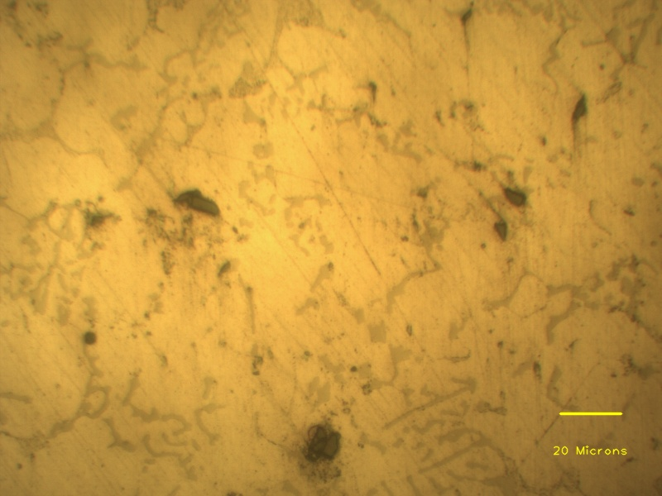
Individual SiC particles
Eutectic phases
Agglomerated SiC particles
Aluminium dendrite

