Slide 1
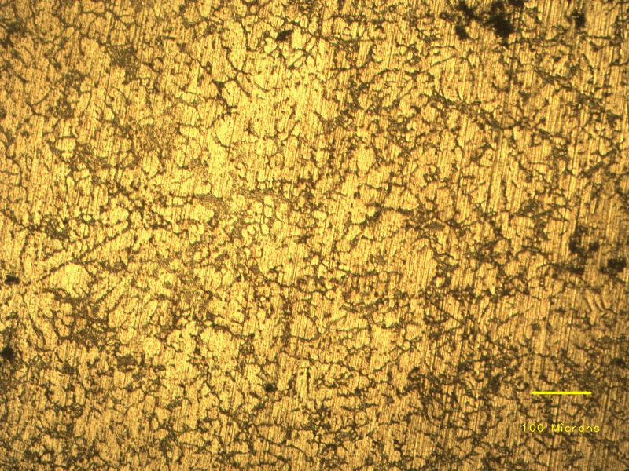
SiC particles
Fine grains
Eutectic phases
Aluminium dendrites
Grain boundaries

