Slide 1
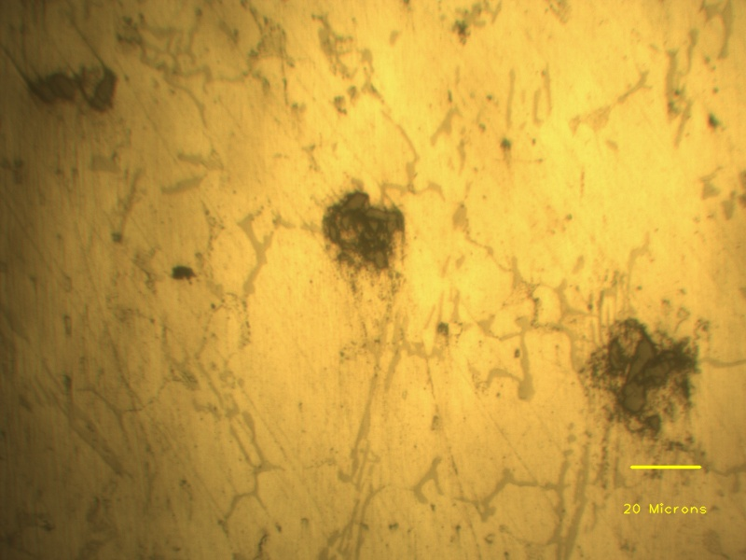
Agglomerated SiC particles
Aluminium dendrite
Eutectic phases

