Slide 1
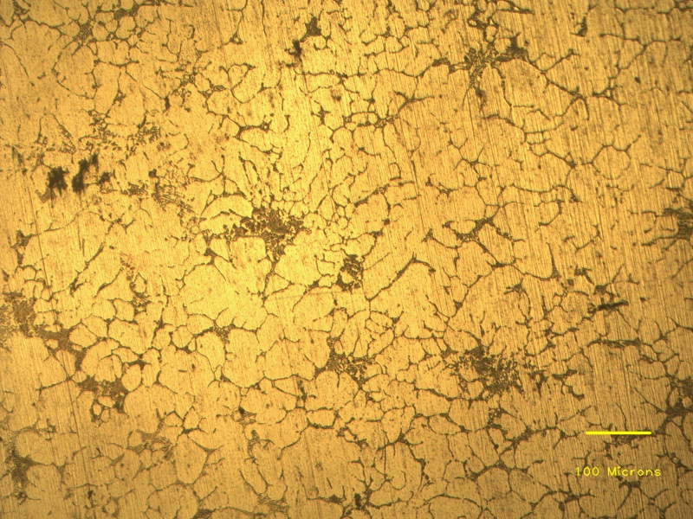
SiC particles
Eutectic phases
Aluminium dendrites
Coarse grains
Grain boundaries

