Slide 1
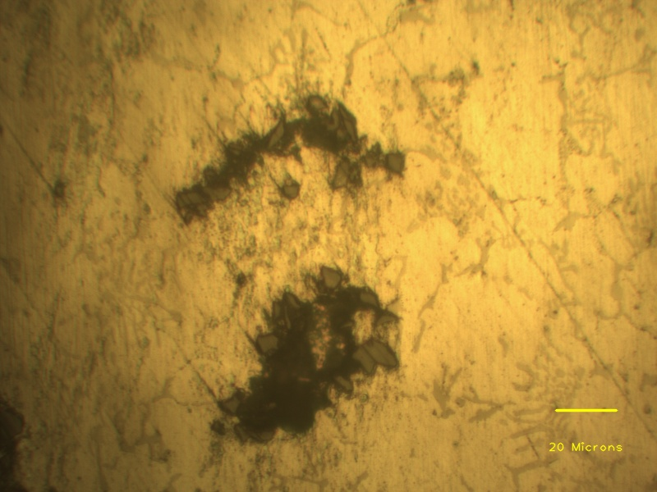
SiC particles
Eutectic phases
Porosity

