Slide 1
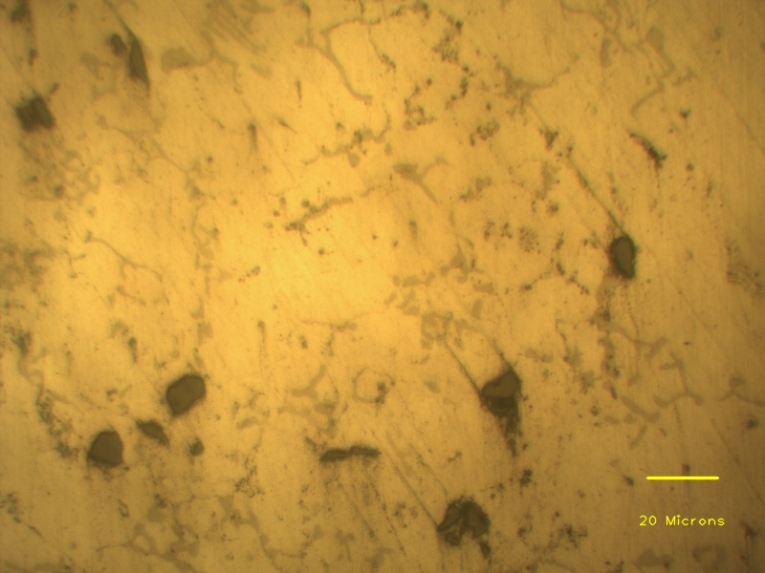
Eutectic phases
Aluminium dendrite
SiC particle clusters
Individual SiC particles

