Slide 1
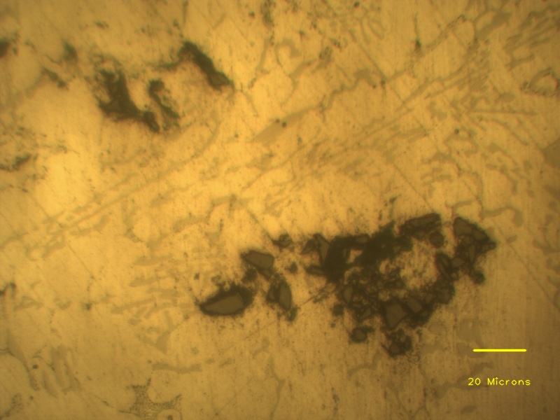
Agglomerated SiC particles
Individual SiC particle
Aluminium dendrite
Eutectic phases

