Slide 1
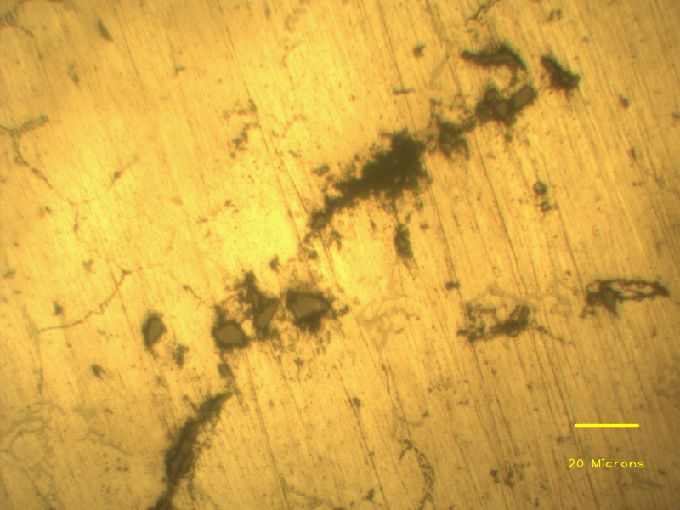
Eutectic phases
Porosity
SiC particle clusters
Aluminium dendrite
Individual SiC particles

