Slide 1
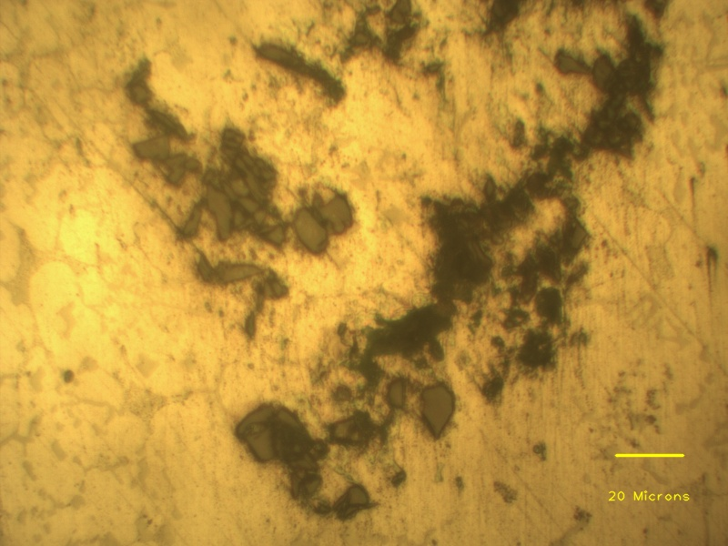
Agglomerated SiC particles
Porosity
Aluminium dendrite
Individual SiC particle

