Slide 1
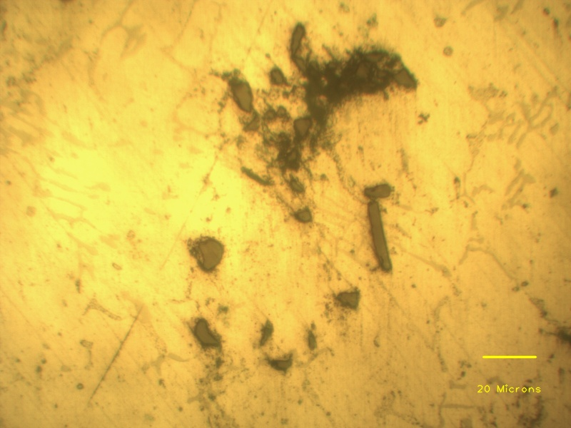
Porosity
SiC particle clusters
Aluminium dendrite
Eutectic phases
Individual SiC particles

