Slide 1
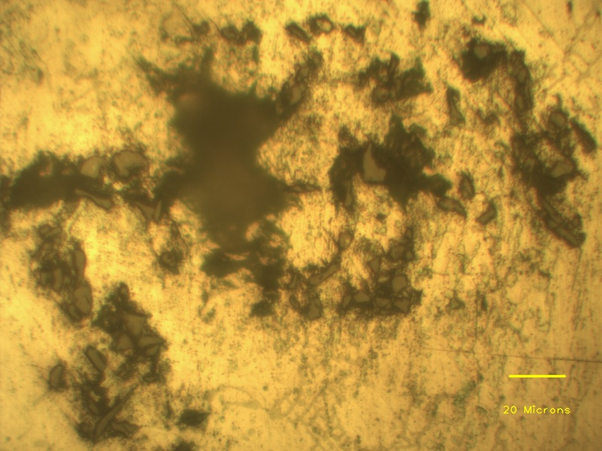
Aluminium dendrite
Individual SiC particle
Porosity
SiC particle clusters

