Slide 1
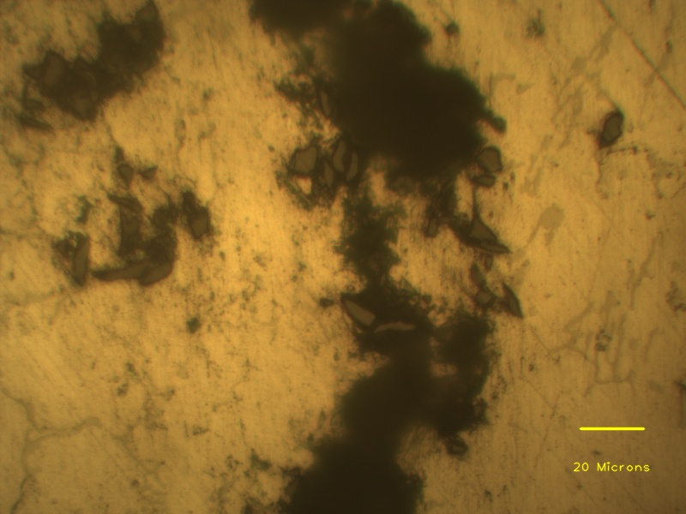
Porosity
SiC cluster

