Slide 1
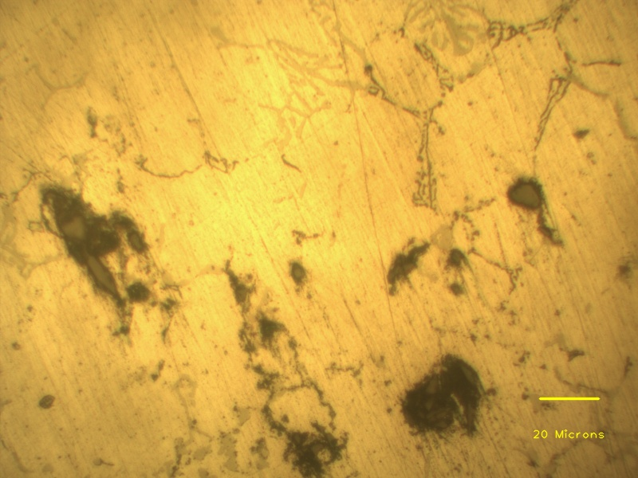
Al-Fe phases
Mg-Si phases
SiC particles
Porosity with SiC clusters

